Slide 1

Sonography of spleen
By
Faculty of MIATA

Slide 2


Slide 3
ANATOMY AND PHYSIOLOGY OF THE SPLEEN
The spleen, the largest structure of the reticuloendothelial system, is an intraperitoneal organ located within the left upper quadrant of the abdomen just below the diaphragm whose primary objective is to filter the peripheral blood (Table 6-1).
The spleen is also considered the largest lymphatic organ.
It begins to develop around the fifth week of gestation.
In the fetus, it is responsible for erythropoiesis

Slide 5
ANATOMY AND PHYSIOLOGY OF THE SPLEEN
In childhood, it plays an important role in the defense against infection, while in adults it produces lymphocytes and monocytes.
Although red blood cell production in the adult is primarily performed by the red bone marrow, the spleen’s hematopoietic function can return in cases of severe anemia.
This is referred to as extramedullary hematopoiesis

Slide 6
ANATOMY AND PHYSIOLOGY OF THE SPLEEN
The spleen is composed of specialized tissues called white pulp and red pulp.
The lymphatic function of the spleen is performed by the white pulp, which produces lymphocytes to aid in the immune response.
The redpulp performs the phagocytic function of the spleen.
Phagocytes engulf and destroy pathogens.

Slide 7
ANATOMY AND PHYSIOLOGY OF THE SPLEEN
The spleen also removes irregular cells from the bloodstream and retains them through a process called culling.
It can also clean red blood cells of unwanted material, a process called pitting.

Slide 8
Gross Anatomy
The spleen is the largest mass of reticuloendothelial tissue in the body.
It normally measures approximately 12–14 cm in length, 7 cm in width, and 3 cm in anteroposterior dimension.
It is located in the left upper quadrant, left hypochondriac region, inferior to the diaphragm, and posterolateral to the stomach.
The tail of the pancreas is medial to the splenic hilum. The left kidney is medial and posterior to the spleen; the stomach and left colic flexure are both medial to the spleen.

Slide 9
The spleen is an intraperitoneal organ except for the hilum area.
The capsule is fibroelastic and is composed of small fibrous bands that give the spleen its framework and permit it to expand in size.

Slide 10
The spleen is not essential to life, but it has important functions, especially during the fetal period.
It is the main component of the reticuloendothelial system and its functions include the breakdown of hemoglobin and the formation of bile pigment; formation of antibodies, production of lymphocytes and plasma cells; a reservoir for blood; and blood formation in the fetus (erythrocytes) or when there is severe anemia

Slide 11
The spleen is a homogeneous organ and is either slightly less echogenic or isoechoic to the normal liver.
The spleen is crescent shaped with a convex superior lateral border and concave medially. The inferior portion is tapered.

Slide 12
Vascular Anatomy of the Spleen
The splenic artery is a branch of the celiac trunk.
From the trunk, the splenic artery courses laterally toward the spleen.
It marks the superior border of the pancreatic body and tail.
This is why the splenic artery can be confused for the main pancreatic duct in some patients.
The splenic artery enters the spleen at the splenic hilum superior and anterior to the splenic vein.

Slide 13
The splenic vein exits the spleen and travels along the posterior border of the pancreatic tail and body.
It joins with the superior mesenteric vein posterior to the pancreatic neck to form the portal vein (Fig. 6-1).

Slide 14
The splenic artery, which is a branch of the celiac axis, courses along the anterior superior border of the pancreas and enters into the spleen at the splenic hilum.
The splenic artery divides into six branches once it enters into the spleen.
The splenic vein exits at the splenic hilum and courses transversely across along the posterior aspect of the pancreas and joins with the superior mesenteric vein to form the portal vein.

Slide 16
SONOGRAPHY OF THE SPLEEN
Most often, the spleen is best visualized with deep inspiration, with the patient lying on his or her right side.
The sonographic appearance of the normal spleen is frequently isoechoic to the liver, although it may be slightly less echogenic.
The adult spleen has a concave, pointed inferior margin and a convex superior border.

Slide 17
The size of the spleen in the adult varies with age and sex.
The spleen decreases in size with advancing age and may enlarge when pathology is present.
The splenic hilum, located along the medial surface of the spleen, is the location of the splenic vessels. Some persons may have an accessory spleen.
This small, round island of splenic tissue is located near the splenic hilum or possibly near the tail of the pancreas.
An accessory spleen will appear isoechoic to the spleen (Fig. 6-2).

Slide 18
Congenital Anomalies
The most common congenital anomaly is the accessory spleen.
Splenic tissue separate from the spleen is usually found near the splenic hilum or adjacent to the tail of the pancreas.
Accessory spleens are typically small and round and have the same echogenicity as the spleen.
They are difficult to demonstrate on ultrasound and must be differentiated from lymphadenopathy.
A wandering spleen is a spleen in an ectopic location usually found in the pelvis.
The patient usually presents with an abdominal or pelvic mass and intermittent pain.
Splenic torsion may occur and color Doppler is used to document the vascularity.
Asplenia is rare and often associated with congenital heart disease and other anomalies.
Aplasia is failure of the spleen to develop.

Slide 20
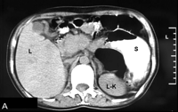
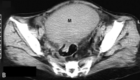
Wandering spleen

Slide 21
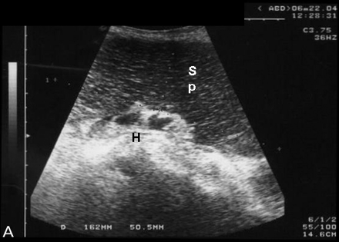
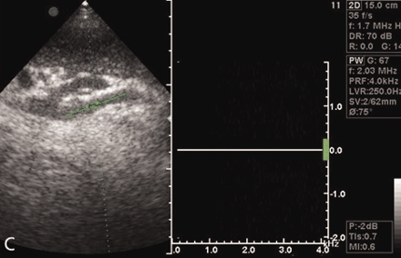
Splenic torsion

Slide 22
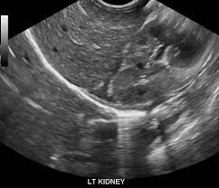
asplenia

Slide 23
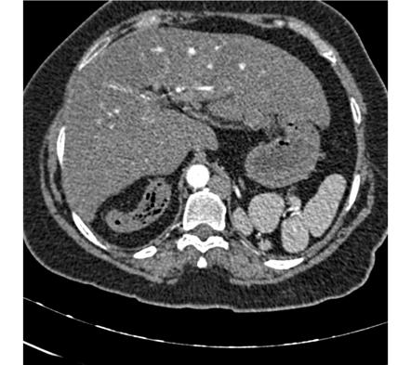
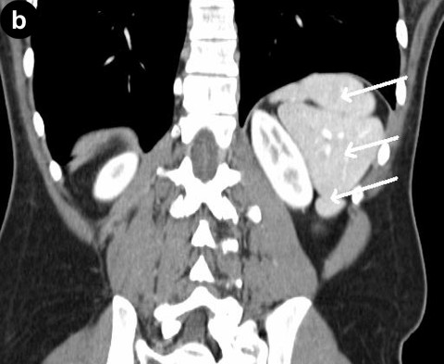
polysplenia

Slide 24
PATHOLOGY OF THE SPLEEN
Splenomegaly
The most common abnormality of the spleen is splenomegaly.
Enlargement of the spleen can be manually suspected on physical examination and subsequently confirmed using sonography.
Although the splenic size varies with age and sex, the spleen should never measure more than 12 cm in length and 5 cm in thickness.

Slide 25
The most common cause of splenomegaly is portal hypertension.
Other causes of splenomegaly include acquired immunodeficiency syndrome (AIDS), mononucleosis, leukemia, lymphoma, infection, a pediatric sickle cell anemia crisis, and trauma

Slide 26
When portal hypertension is suspected, the sonographer should evaluate the splenic hilum closely for the associated abdominal varices seen in this condition.
It is important to note that massive splenomegaly can lead to spontaneous splenic rupture.

Slide 28
Splenic Cysts
Most often, true splenic cysts will have thin walls, an anechoic center, and posterior enhancement.
However, cysts found in the spleen can appear complex, particularly those associated with trauma (see section “Splenic Trauma”).
Other complex appearance cysts could be displaced pancreatic pseudocysts, congenital cysts, hydatid cysts, or cystic metastasis.

Slide 30
Splenic Infarct
Tissue that has been deprived of oxygen will eventually die.
This is referred to as an infarct.
A splenic infarct may be caused by bacterial endocarditis, tumor embolization, vasculitis, and lymphoma.
It will appear as a hypoechoic, wedge-shaped mass within the spleen in the acute stage (Fig. 6-3).
In the chronic stage, splenic infarcts tend to appear more echogenic compared to adjacent normal splenic tissue.

Slide 33
Splenic Trauma
The spleen is often injured in cases of blunt trauma. Patients complain of left upper quadrant pain and will have decreased hematocrit with splenic trauma.
Fresh bleeds within the spleen can be difficult to identify with sonography, as they may appear isoechoic to the splenic tissue and can be located either subcapsular to or within the splenic parenchyma

Slide 34
As the hematoma undergoes lysis, the sonographic appearance may range from anechoic to echogenic or possibly complex (Fig. 6-4).
Occasionally, a laceration may be noted as an echogenic line within the spleen immediately following trauma.
In time, hemorrhagic cysts that result from trauma may have calcified walls

Slide 36
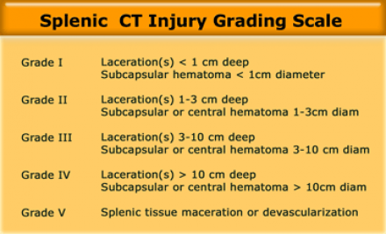

Slide 38
Splenic Hemangioma
The hemangioma is the most common benign tumor of the spleen.
A splenic hemangioma will most often appear as a well-defined, hyperechoic mass.
The patient with a hemangioma will be asymptomatic, although pain may occur with hemorrhage.

Slide 39
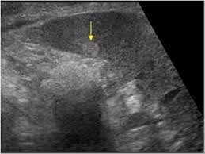

Slide 41
Granulomatous Disease in the Spleen
Occasionally, small echogenic foci may be seen throughout the spleen.
These small foci most often represent granulomas.
They can be individual or multiple and may produce an acoustic shadow.
Granulomas are often found in patients who have a history of histoplasmosis, tuberculosis, or sarcoidosis.

Slide 42
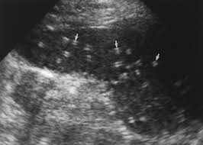

Slide 43
Malignant Diseases of the Spleen
Although exceedingly rare, the primary malignant tumor of the spleen is an angiosarcoma.
Angiosarcomas will appear sonographically as a complex or solid mass.
More often, lymphoma and leukemia rather than angiosarcoma will involve the spleen, with lymphoma being cited as the most common malignancy of the spleen.
Diffuse involvement of lymphoma or leukemia will often produce splenomegaly.
These malignant processes can also manifest as a focal disease and be recognized as a hypoechoic mass or masses within the spleen.

Slide 44
Lymphoma can be classified as Hodgkin lymphoma or non-Hodgkin lymphoma.
Both are malignant disorders affecting the lymphocytes, with subsequent immune system compromise.
The differentiation between these two types of cancers is performed microscopically.
The presence of Reed–Sternberg cells indicates Hodgkin lymphoma.
It can be treated and carries a high recovery rate

Slide 45
The other form of lymphoma, non- Hodgkin lymphoma, is not as easily managed but is more common.
Metastatic disease to the spleen is rare and occurs late in the disease process.
The most common primary locations are the breast, lung, skin (melanoma), and ovary.

Slide 46
PEDIATRIC PATHOLOGY OF THE SPLEEN
Trauma, infections, and cancer will affect the pediatric spleen much like they affect the adult spleen.
Epstein–Barr infection, which is associated with infectious mononucleosis, will typically result in splenomegaly in children.
Also, children suffering from sickle cell disease often have an enlarged spleen.
Sickle cell disease is found more frequently in African-American children and Hispanic children of Caribbean descent in the United States

Slide 50
Thank you

