Slide 1
Big Data for Marketing Campaigns in Banking
Instructor: Dr. David Belanger
BIA-678-D
Team D1

Slide 2

Team D1 - Info

Slide 3
Introduction
One of the most common uses of data science and machine learning is the analysis of marketing data from companies.
In general, marketing data sets can be used for one of two corporate objectives:
1. Estimating each customer's marketing campaign performance and describing the variables that influence those results. Finding out how to make marketing campaigns more effective using this information is helpful.
2. Identifying client segments using information on customers who have signed up for term deposits. This makes it easier to determine a customer's profile and create more focused marketing campaigns for those who are more inclined to buy the goods.

Slide 4



Technology Used
Apache Spark
Spark SQL
Apache Spark MLLib
Databricks Notebook

Slide 5
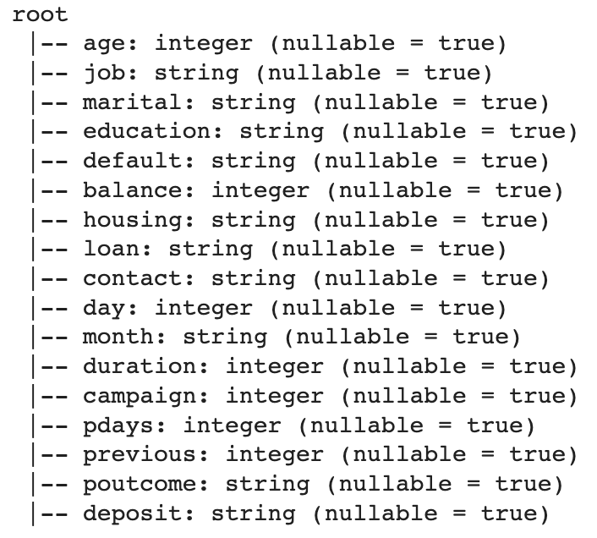
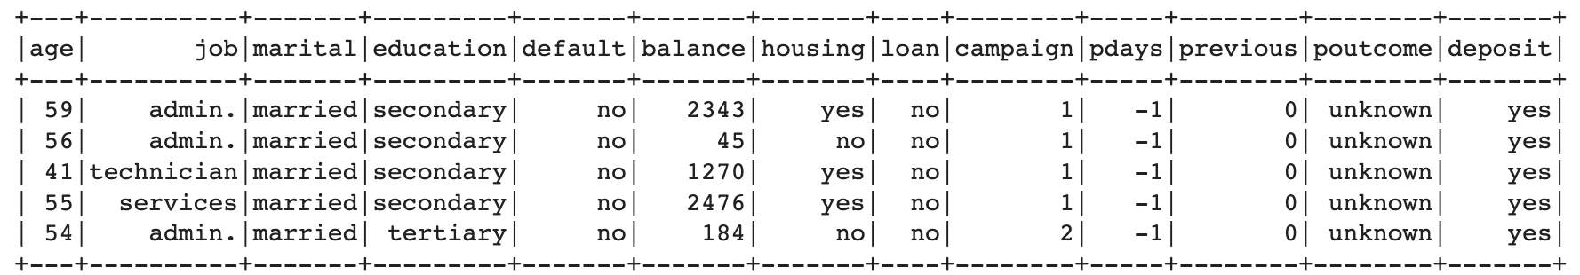
Data
This dataset contains information from banking marketing campaigns that can be utilized to enhance marketing efforts and increase the no. of people who sign up for term deposits.
Table shows the selected features from the dataset

Slide 6
Approach
Preparing the Data for Processing
Basics flow of data in Apache Spark, loading data, and working with data
Exploratory Data Analysis
Define the Machine Learning Pipeline
Train a Machine Learning Model
Testing a Machine Learning Model
Evaluating a Machine Learning Model (i.e. Examine the Predicted and Actual Values)

Slide 7
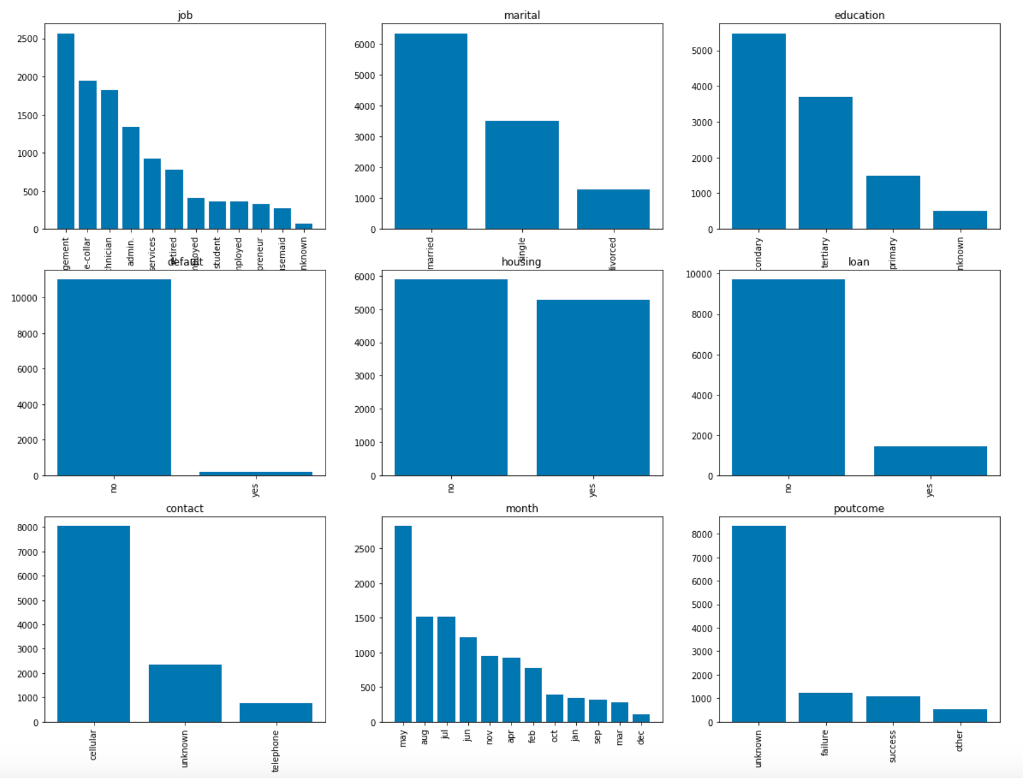
Exploratory Data Analysis
Categorial Columns

Slide 8
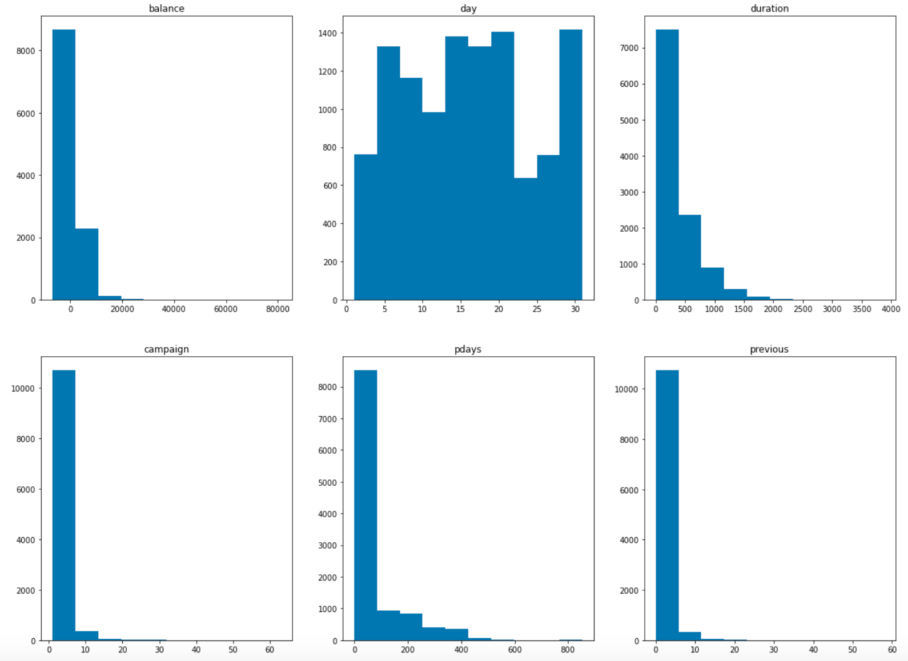
Exploratory Data Analysis (To be continued)
Numerical Columns

Slide 9
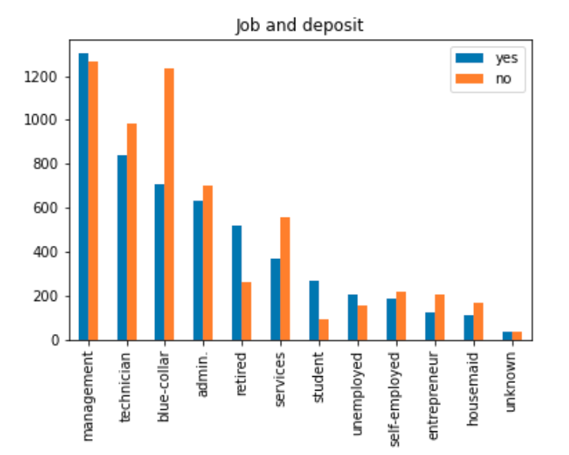
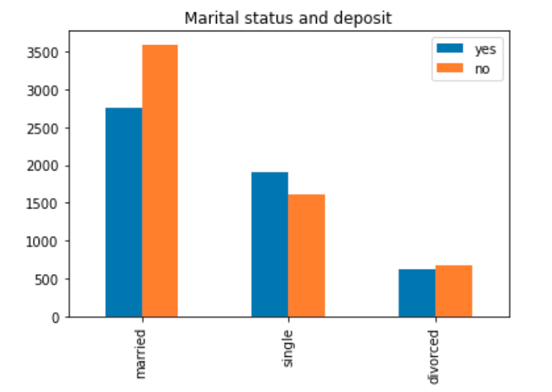
Exploratory Data Analysis (deposit column vs categorical columns)

Slide 10
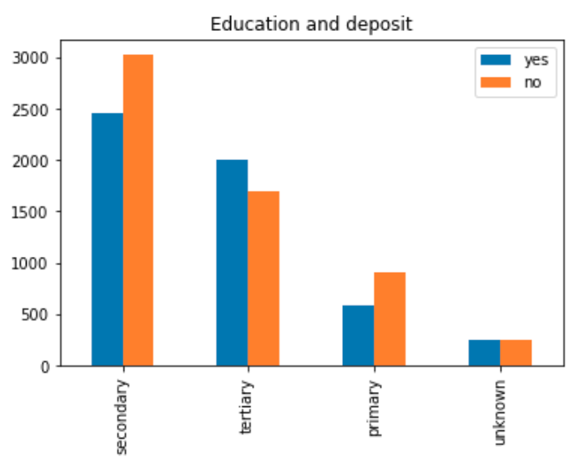
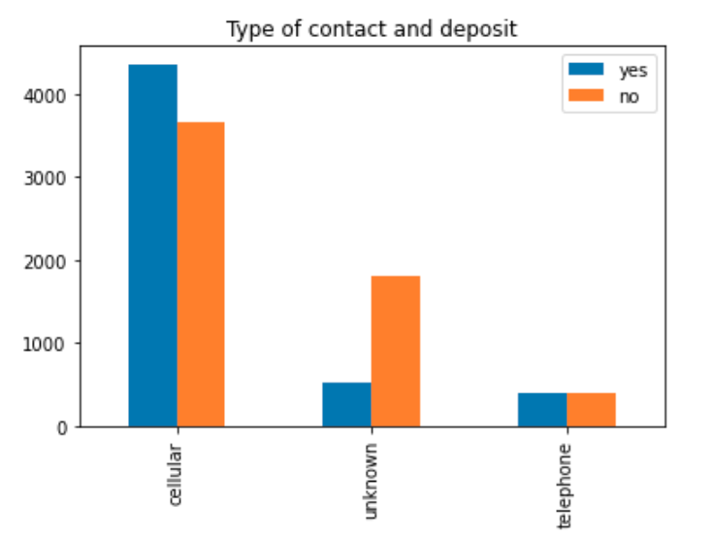
Exploratory Data Analysis (deposit column vs categorical columns)

Slide 11
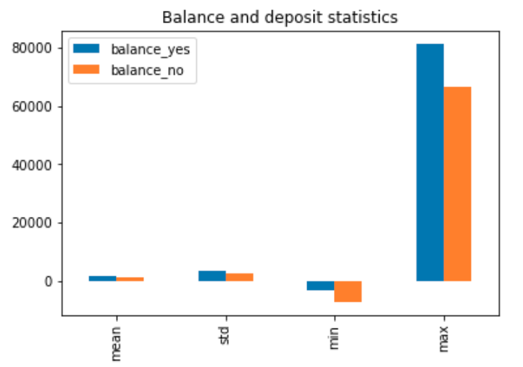
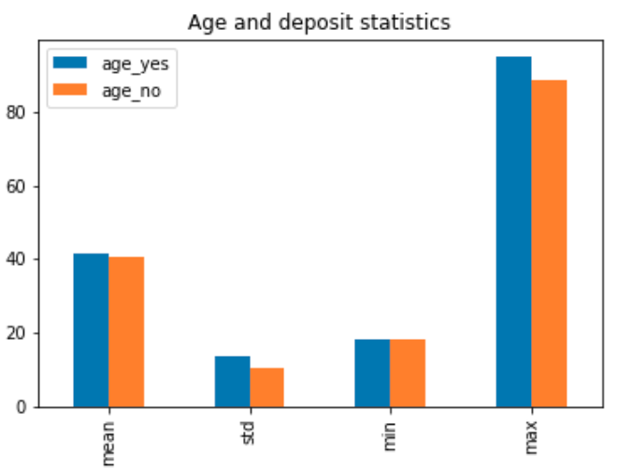
Exploratory Data Analysis (deposit column vs categorical columns)

Slide 12
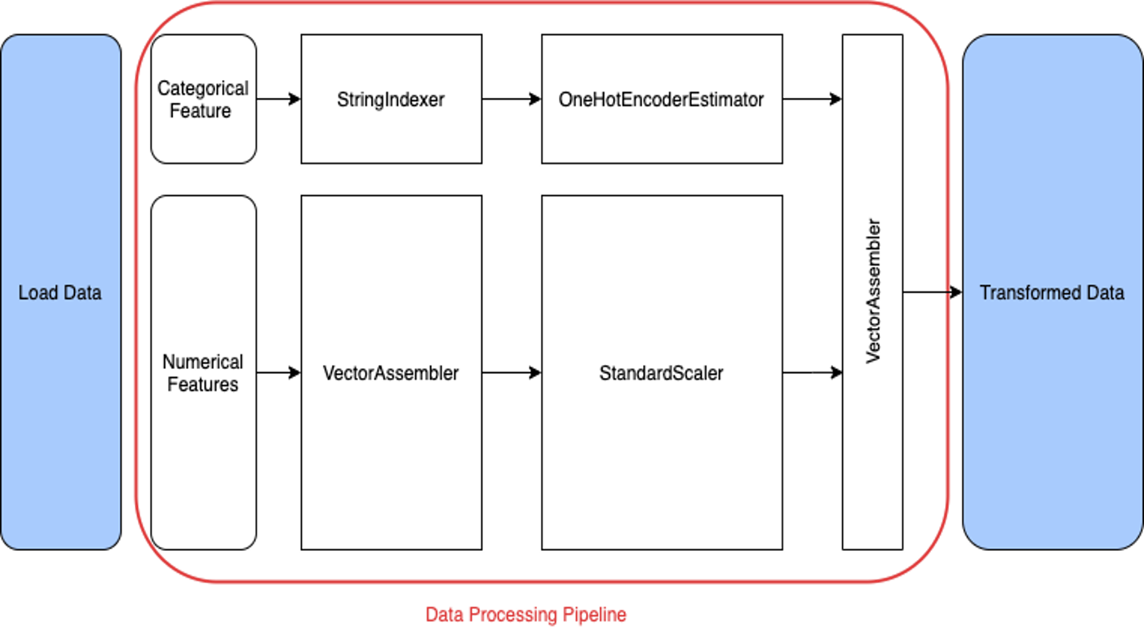
Data Processing – Pyspark Pipeline

Slide 13
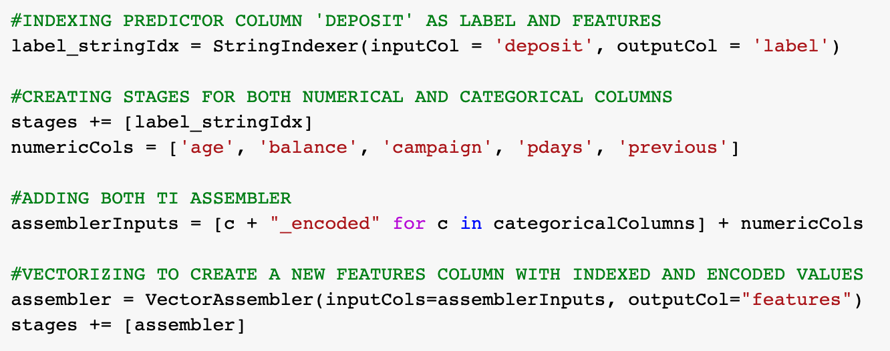
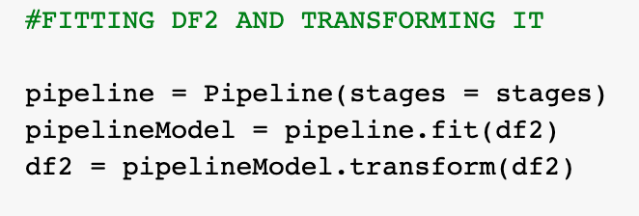
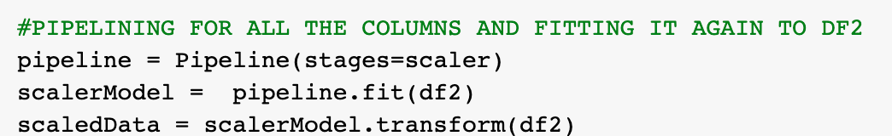
Pipeline
A pipeline consists of a series of transformer and estimator stages that typically prepare a DataFrame for modeling and then train a predictive model.
Vectorizing to create a new features column with indexed and encoded values
Fitting and transforming
Selecting only the encoded columns to Normalize

Slide 14
Vector Assembler
A transformer called VectorAssembler() creates a single vector column from a supplied list of columns.
In order to train ML models like logistic regression and decision trees, it is important for integrating raw features and features produced by various feature converters into a single feature vector.
All integer types, boolean types, and vector types are all acceptable input column types for VectorAssembler.
The input column values in each row will be concatenated into a vector in the prescribed order.

Slide 15
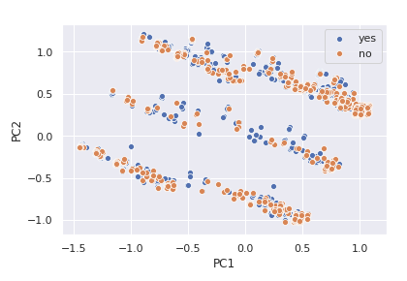
Model
Now we will use the cleaned dataset to predict the outcome of campaign with the help of Machine Learning classification models.
These are:
Supervised
K-means clustering 2. PCA
With k= 2,3...8 Used to find the dimension with the largest
variance out of overall variance
accuracy: 66.11

Slide 16
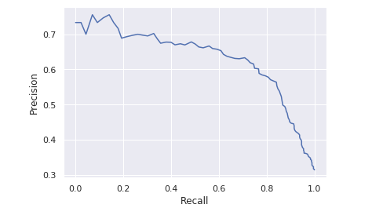
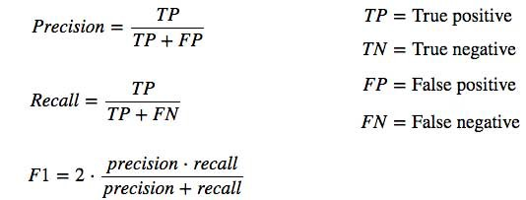
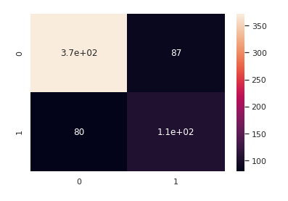
Model
Supervised
Logistic Regression Model
accuracy=74.1486

Slide 17
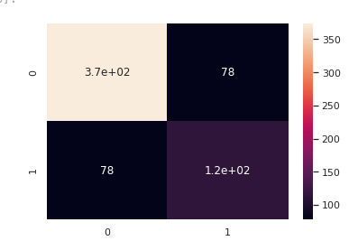
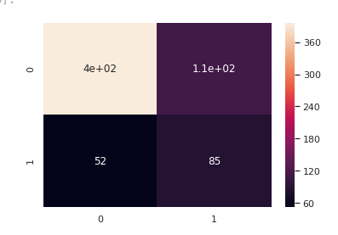
Model
Supervised
2. Decision Tree Model 3. Naïve Bayes Model
accuracy= 75.8514 accuracy: 74.4582
Tuning of model parameters and automated tuning via MLlib Cross validator can be used to push the target metrics of the model while keeping in mind that the model does not overfit the training data.
Notes:
Sklearn is always a gold standard when it comes to building traditional models and visualizations nut when the data is of the orders of few GBs then the performance lag really starts to reflect. This is where a few MLlib models come on top.

Slide 18
Conclusion
Recommendations to be used to conduct future marketing campaigns:
The outcome of the campaign is significantly influenced by the customer's account balance
Future correspondence should target those clients since people with high account balances are more likely to sign up for term deposits
Campaign results are also impacted by the customer's age. The focus of future marketing campaigns should be on consumers between the ages of 30 and 50

Slide 19
Thank you!

