Slide 1

Final Project Presentation MIS 633-WS
Team:
Priya Gohil
Mit Dani
Rachel Sherry
Ritika Dave

Slide 2
Introduction
Using the dataset that revolves around Ebay electronics sales data we aim to solve the problems that are persisting in the system.
How the business works:
Customer orders a product in the electronics category
Order completed or returned based on criteria
Analysis performed using tools
Notes:
Overview of Forever Collectibles:
Forever collectibles also known as Team Beans owned and operated by Michael Lewis, started their operation in 1999 with few hard working young people.
Today FC is one of the most innovative companies in the sports collectible industry with products for NFL, NHL, MLB, NBA, NCAA colleges and universities.
In 2011, FC made a major acquisition of Home win in UK and established FC UK.
Currently they manufacture and distribute their products in US, UK and Canada.
They manufacture majority of their products in Asia, mainly in China and Vietnam.
Even though it is a successful business with international presence, the company faces lots of challenges from different areas of their business cycle, such as pre-production, product development, sales and marketing and customer service.

Slide 3
1. Industry & business function
eBay Inc. is an American multinational e-commerce corporation based in San Jose, California, that facilitates consumer-to-consumer and business-to-consumer sales through its website.
Datasets dealing with electronics sales data for the company “eBay”
Functions dealing with purchasing and returning a product
Visualizing order processing/flow

Slide 4
2. The business problems you intend to solve via your work.
Integrating BI tool into the company's dataset
Incorporating data visualizing using power BI/Tableau
Detecting and analyzing suspicious activities
Increasing efficiency for data around order and returns
Improved decision making
Analysis that matches business processes
Data consistency, NOSQL analysis, OLAP tools, Visualizations

Slide 5
3. Dataset Description
Dataset is found on Kaggle.
Link: https://www.kaggle.com/datasets/sinjoysaha/sales-analysis-dataset
The following are the four disparate datasets:
Customer - The table consists of Customer ID, Customer Name, City, State, Postal Code, Country, Region
Product – It consists of Product ID, Product Name, Category, Sub-Category, Segment, Sales, Quantity, Profit
Order – It consists of Order ID, Order Date, Ship Date, Discount
Returns - Return ID

Slide 6
4. Business Process
Technology Track
Technical
Architecture
Design
Product
Selection &
Installation
Business
Requirements
Definition
Data Track
Dimensional
Modeling
Physical
Design
Data Staging
Design &
Development
Deployment
Maintenance
& Growth
Project
Planning
Application Track
End-User
Application
Specification
End-User
Application
Development
Project Management

Slide 7
5. Opportunity Matrix
Business Proces | Finance | Operations | Human Resources | Customer Service | Strategic Management | Logistics
Online Sales Transaction (BP1) | X | X | X | X | X | X
Vendor Sales Transaction (BP2) | X |  |  |  |  | X
Order processing (BP3) |  | X
Delivery processing(BP4) | X |  |  | X |  | X
Return Policy (BP5) | X |  |  | X |  | X

Slide 8
6. Prioritization Grid
High
Business Process/Event​
Online sales transaction (BP1)​
Vendor sales transaction (BP2)
Order Processing (BP3)
Delivery processing (BP4)​
Returns policy (BP5)​
BP3
BP2
BP1
BP4
Potential
Business Impact
BP5
Low
High
Feasibility

Slide 9
7. High level bus matrix
Business events/Dimensions | Date | Material | Location | Owner | Product | Service policy | Account status | Order | Customer
Online sales transaction | X | X |  |  | X | X | X | X | X
Order processing | X |  | X | X | X | X | X | X | X
Delivery process | X |  | X | X |  | X | X | X | X
Return policy | X |  | X |  |  | X | X | X | X

Slide 10
8. Detailed Bus Matrix
e-commerce business process | fact tables | granularity | fact | Date | Product | Location | Owner | Service policy | Account status
online sales transaction | sales transaction | Per line item | purchase date key purchase amount key purchase unit price key transaction number | x | x |  | x | x | x
 | click stream | Per click | referral key session key time key event key page key | x | x |  |  | x | x
 | Vendor information | Per vendor item | vender number key vendor product amount key | x | x | x | x | x
order processing | warehouse picking | Per warehouse receipt | ship date key requested date key product key vendor key | x | x |  | x | x
 | billing and invoicing | Per order | date key order number quantity key product key … | x | x |  | x |  | x
delivery process | shipping notice | Per line item | shipping date key shipping cost key tracking number delivery company key | x | x | x | x | x | x
 | delivery operation | Per line item | tracking number shipping date delivery cost key | x | x | x |  | x | x
return policy | store return process | Per line item | store number key item number key return date key | x | x | x |  | x | x
 | mail return process | Per line item | tracking number return date key | x | x |  | x | x | x

Slide 11
9. Logical Fact Table Diagram
Date and Time
Shipment
Facilities Location
Vendor
Sale transaction item
Fact Table
Grain:
Item on online sale transaction
Customer profile
Product
Partner
Employee
Inventory
promotion
Material
Service policy
Owner
Transaction
Payment

Slide 12
9. Fact Table – Sales Transaction
Sales_Transaction Fact table​ ​
Promotion_group_id (FK)​ Promotion_id (FK)​ Inventory_id (FK)​ Product_id (FK)​ Transaction_id (FK)​ Date and Time_id (FK)​ Shipment_id (FK)​ Customer_ID(FK)​ Payment_id (FK)​ ​ Item_quantity​ Item_total_sales​
- Dimension Keys
- Foreign Keys
Dimensions are the foundation of the fact table and is where the data for the fact table is collected.
The grain of a fact table represents the most atomic level by which the facts may be defined.

Slide 13
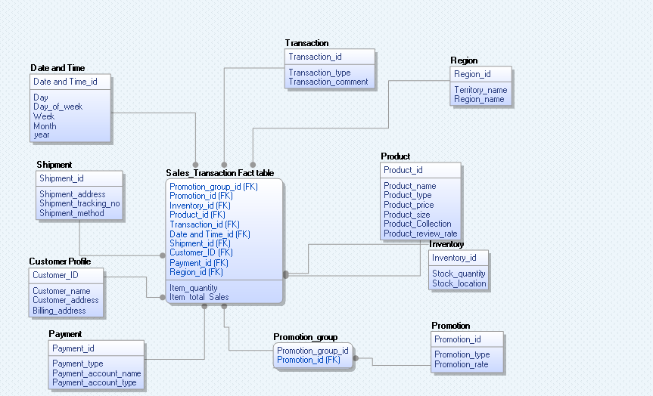
10. Star Schema of Sale transaction

Slide 14
11. Dimension Attribute Detail Descriptions - Product dimension
Attribute Name | Description | Cardinality | Slowly changing dimension policy | Sample Values
Product_ID | ID that uniquely identifies each product within ebay's online system | 10,437,500(est) | Not Updatable | 59785110, 54102887, 64001424
Product_Name | Name of the product | 75,843 | Not Updatable | Dell laptop, HP, Apple mac book
Product_type | Type of the product | 13 | Type 2 | Camera, Laptop, Mobile, Accessories
Product_price | The number that identify the price of the product | - | Type 1 | $750
Product_Size | The category of the size of products | 26 | Not Updatable | 10d, 7d
Production_Collection | The full descriptive name of the collection | 18 | Type 2 | Dell Inspiron
Product_review_rate | The number which shows review rate of the customer | 5 | Not updatable | 2.5, 4, 5

Slide 15
11. Dimension Attribute Detail Descriptions-Customer Profile Dimension
Attribute Name | Description | Cardinality | Slowly Changing Dimension Policy | Sample Values
Customer_ID | ID that uniquely identifies the customer's purchase history | 10,000(est) | Not Updatable | CG1250, C15460
Customer_Name | Provides full descriptive name of the customer | 10,000(est) | Type 1 | Joe, David
Customer_Address | Provides full descriptive address of the customer | 10,000(est) | Type 1 | Los Angeles, Seattle
Billing_Address | Provides billing address of the customer | 10,000(est) | Type 1 | Los Angeles, Seattle

Slide 16
11. Dimension Attribute Detail Descriptions- Shipment Dimension
Attribute Name | Description | Cardinality | Slowly Changing dimension policy | Sample Values
Shipment_ID | Id that uniquely identifies shipment status | 9995 | Not updatable | CA-2016-15126
Shipment_Address | Provides the address name | 9995 | Type 1 | Florida, California
Shipment_tracking_no | Provides the tracking number | 9995 | Not updatable | 152540,175043
Shipment_payment_no | Provides the payment number | 9995 | Not updatable | P598046, P789524

Slide 17
12. Dimension Table Detailed Diagram- Product Dimension
Product_Type
Product_Collection
Product_review_rate
5
13
18
Product_Name
Product_Price
Product_Size
26
75,843
Slowly Changing Dimension
•Product_type
•Product_price
•Product_Collection
Product_ID
10,437,500

Slide 18
13. Conformed Dimensions
Standardized conformed dimensions are the goal for any well-architected data warehouse.
In our case E-commerce has the following Conformed Dimensions
Date and Time Dimension
Product Dimension
Customer Dimension

Slide 19



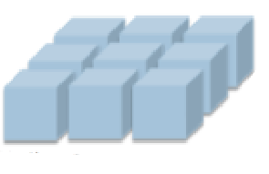
14. MDDB CUBE
Laptop
Laptop
Camera
Camera
East
Phones
Central
Phones
West
Q1
Q2
Q3
Q2
Q3
Central
Laptop
Roll up
PRODUCTS
Dice
Camera
East
Phones
West
REGION
East
Q3
Central
Q1
Q2
East
West
Q3
Phones
West
Q2
Central
Central
Q1
Q2
Q3
Q1
Laptop
Camera
Phones
Slicing
Pivot

Slide 20
15. Aggregate Tables
Sales Transaction | Product |  |  |  | Region |  |  |  | Time
 | Category_1 |  | Category_2 |  | Worldwide |  |  |  | Year1 |  |  |  | Year2
 | Product 1 | Product 2 | Product 1 | Product 2 | Country 1 |  | Country 2 |  | Q1 |  | Q2 |  | Q1 | Q2
 |  |  |  |  | Region 1 | Region 2 | Region 1 | Region 2 | M1 |  | M2 |  | M1 | M1
 |  |  |  |  |  |  |  |  | D1 | D2 | D1 | D2 | D1 | D1
Unit cost
List price
Quantity
Sales price
Net profit
Net revenue
Aggregate Fact table with atomic facts

Slide 21
16. User Roles and Delivery
User Role | Task Analysis | Delivery
Executives/Managers | Interested in summaries and not detailed reports | Portal, Reports, Overview through Dashboards
Analysts | Ad hoc reports, BI dashboards, Drill down and Drill across capabilities | Portal, OLAP, MOLAP
Operational workers | Access to data, create reports | Operational reports for BI tool visualization
Knowledge workers | Access to day-to-day data with drill down capabilities | Portal

Slide 22
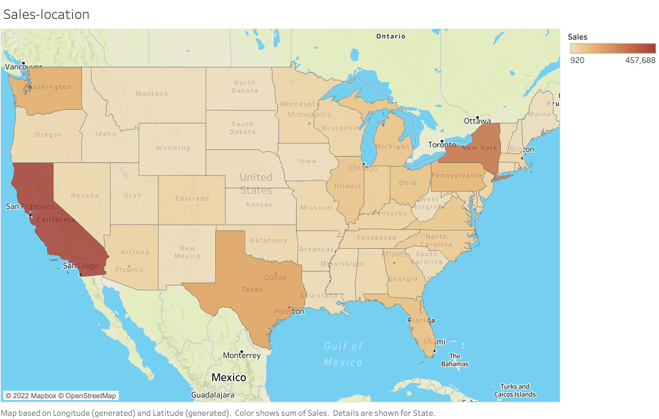
17. Data Visualization

Slide 23
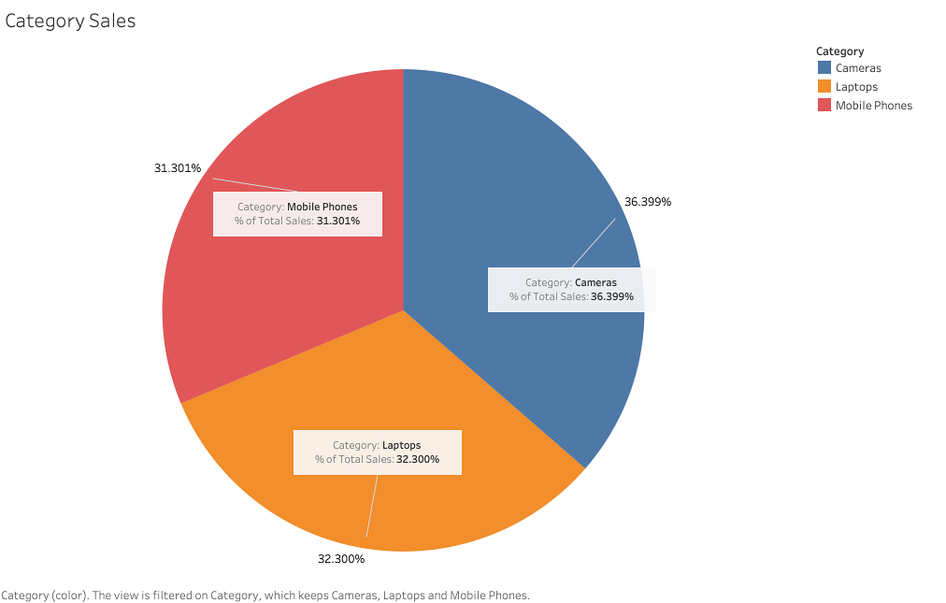
17. Data Visualization

Slide 24
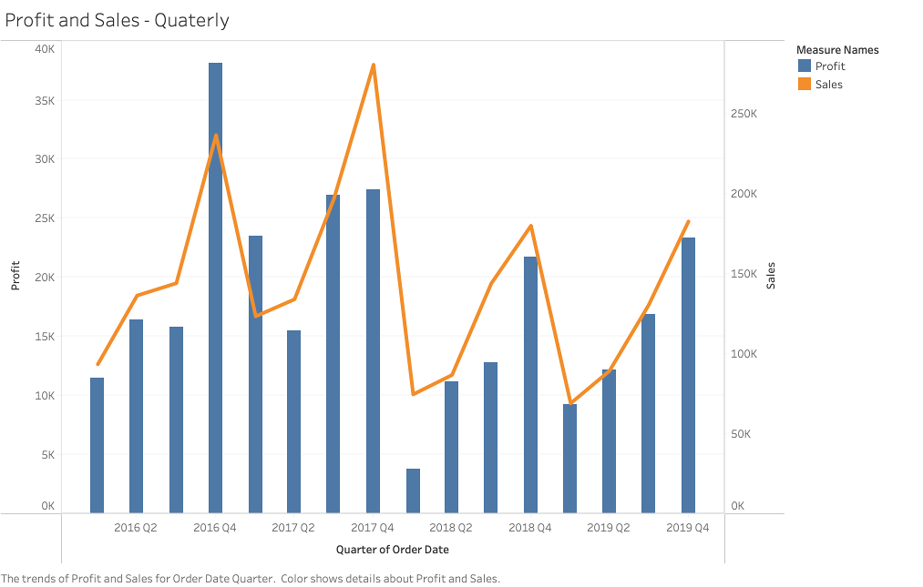
17. Data Visualization

Slide 25
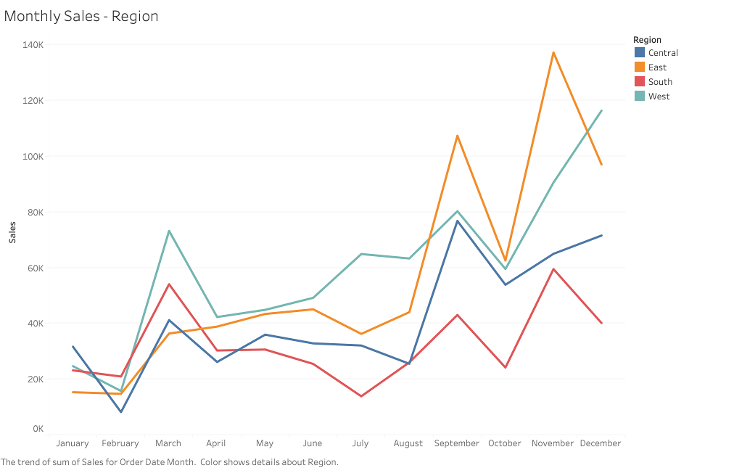
17. Data Visualization

Slide 26
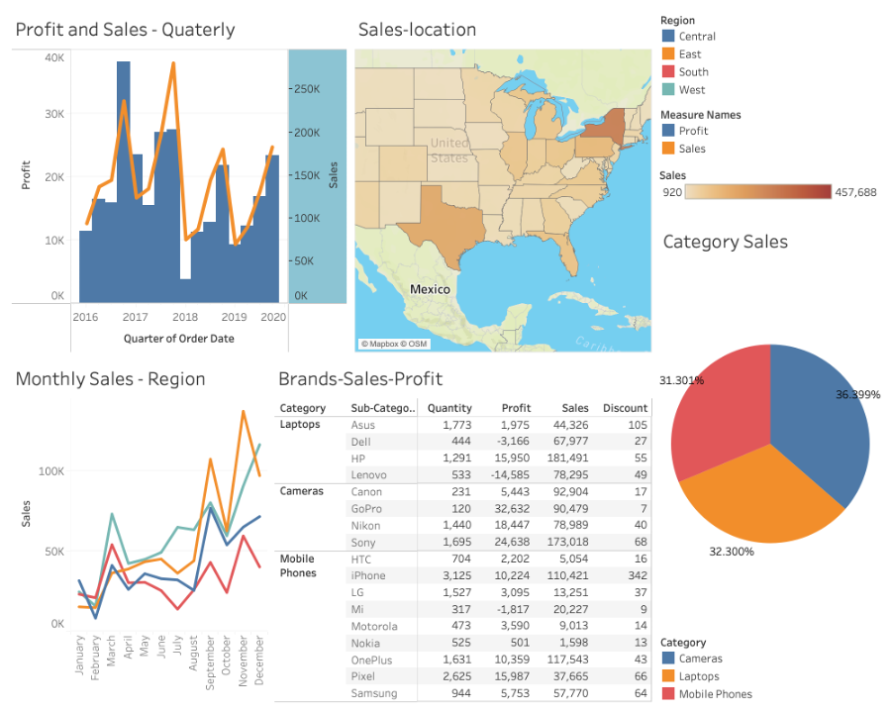
18. Dashboard

Slide 27
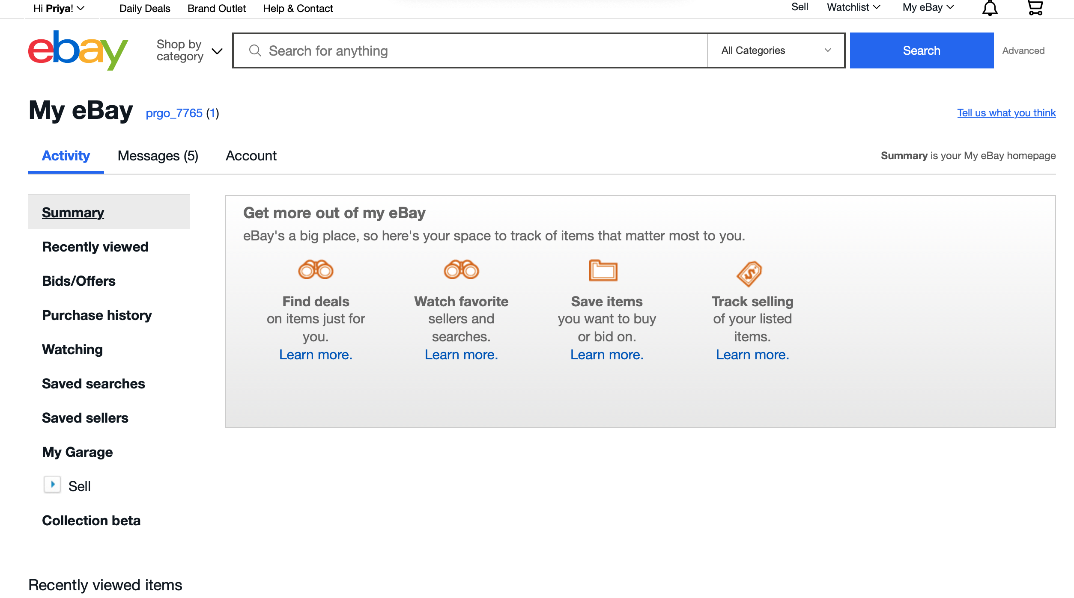
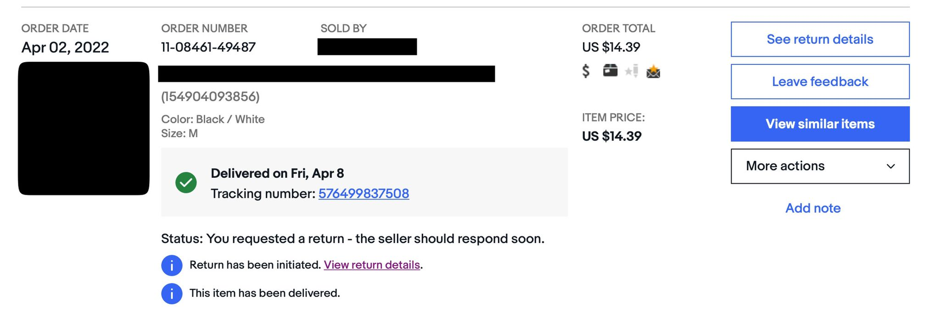
19. BI Portal landscape-Customer
User interface while placing an order on Ebay.

Slide 28
20. Conclusion
Can forecast the future requirements by integrating BI tool into the company's dataset, incorporating data visualizing using Tableau
Can identify suspicious activities by detecting outliers in the plot
Metrics like Sales, Profits based on categories using BI tools helps in decision making in the overall process
Implementation in Data consistency, OLAP tools, Visualizations helps in overall welfare of the business process and decision making

Slide 29
Final Project Presentation
MIS 633-WS Business Intelligence & Data Integration Spring 2022

