Slide 1

NYC Taxi Weekly Performance Analysis
Analyzing four years of NYC taxi trip data to identify demand patterns and operational insights.

Slide 2
Project Overview
1
2
Track key KPIs such as Trips, Fare per Trip, and Distance per Trip
Identify week-level demand patterns
3
4
Measure Week-over-Week (WoW) performance changes
Understand peak demand by time and location

Slide 3

Dataset Summary
Years of data: 2017–2020
~26 Million trip records
Additional Calendar and Location reference tables

Slide 4
Data Preparation & Transformation
01
02
Python (Jupyter Notebook)
Combined yearly CSV files
Cleaned invalid timestamps and trip durations
Filtered standard street-hail trips
Corrected fare-distance inconsistencies
Standardized column names
MySQL
Created structured database
Built Calendar and Location dimension tables
Created optimized SQL views for Power BI
Extracted pickup hour for time-based analysis

Slide 5
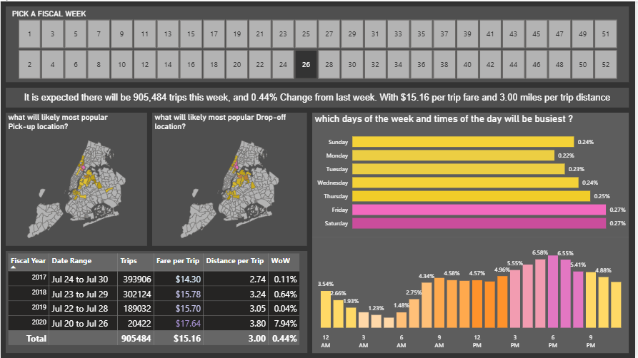
Dashboard Overview

Slide 6
Key Insights
Clear weekly seasonality in trip demand.
Evening hours show peak taxi usage.
Fare per trip remains relatively stable across
years.
2020 shows visible variation compared to
previous years.

Slide 7

Business Impact
Enables short-term demand monitoring
Supports better taxi allocation planning
Identifies peak time slots for resource optimization
Helps track revenue efficiency through Fare per Trip
Detects abnormal Week-over-Week changes quickly

