Slide 1
Sales and Order Fulfillment Analysis

Slide 2

Objective
To analyze sales and order data to understand customer buying patterns and fulfillment performance, and to build a machine learning model that predicts whether an order will be shipped or not.

Slide 3

Data Source
Sales Data Sample – Contains customer orders, product details, shipment status, pricing, and region info.
Download Dataset:
Click here

Slide 4


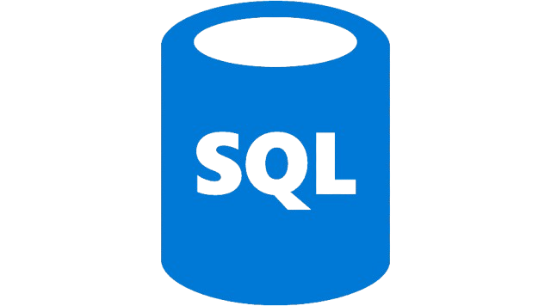
Tools & Technologies Used
Excel → Initial data cleaning & formatting
MySQL → Data storage
Python → Model building using pandas, scikit-learn
Power BI → Interactive dashboard and visual insights

Slide 5


Key Visuals
1.Total Sales: 1.49M
Shows the overall revenue generated from all orders.
2.Total Orders: 298
Represents the total number of unique customer orders recorded.
3. Average Order Value (AOV): 541.23
Indicates how much revenue is generated per order on average.

Slide 6

Insights
Sales Trend: Sales peak during November and December.
Top Product Category: Classic Cars are the highest-selling product line.
High-Performing Regions:USA and Madrid lead in total sales across country and city views.

Slide 7
Summary
This analysis provides a clear view of sales trends, order fulfillment status, and customer purchasing behavior.
By identifying top-performing products and regions, and highlighting delayed or unshipped orders, stakeholders can:
Optimize inventory and logistics planning
Improve order processing efficiency
Focus on high-value customer segments
The predictive model adds further value by flagging orders at risk of not being shipped, enabling proactive decision-making.

