Slide 1
SYSTEM DESIGN • C++ CONCURRENCY • HIGH-PERFORMANCE DATA PIPELINES
Multi-Source Log
Normalization & Analytics Engine
Architecture, core data structures and algorithms
INGEST
NORMALIZE
DEDUP
PERSIST
Based on the supplied project design document and architecture diagram

Slide 2
ENGINE-TO-SUBJECT MAPPING
Engines and the core subjects behind them
01 Receiver Engine
02 Parser / Normalization Engine
• Computer Networks — TCP sockets and byte streams
• Data Structures — sliding byte buffer (std::vector<char>)
• Algorithms — newline scanning and byte-stream framing
• Data Structures — strings and LogEntry struct
• Algorithms — format detection, parsing and schema normalization, MurmurHash3 fingerprint generation
• Operating Systems — worker threads and producer-consumer flow
03 Sharded Deduplication Engine
04 Disk Writer Engine
• Data Structures — hash set (std::unordered_set)
• Algorithms — hashing, modulo partitioning and duplicate lookup
• Operating System — mutexes, lock striping
• Operating Systems — file handling and disk I/O
• Algorithms / Patterns — sequential persistence and buffered writes
• Data Structures — bounded queue of normalized LogEntry objects
16

Slide 3
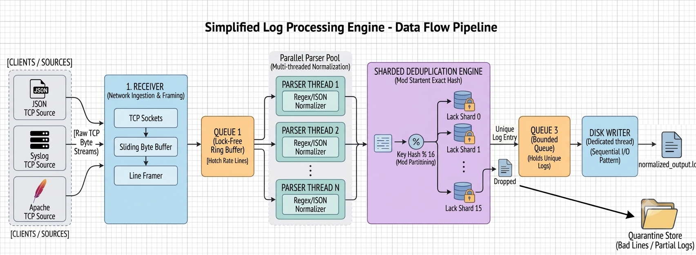
END-TO-END PIPELINE
Architecture overview
Sources → TCP receiver & framing → bounded Queue 1 → parallel parsers → sharded exact deduplication → bounded Queue 3 → single sequential disk writer
Bounded queues propagate backpressure upstream; malformed or incomplete records are routed to quarantine.
02

Slide 4
CORE STRUCTURES
Data structures overview
01 Sliding linear byte buffer
02 Lock-free bounded ring queue
Per-connection scratchpad for TCP fragments
Pipeline location: Receiver
Fixed-capacity handoff between pipeline stages
Pipeline location: Queue 1 & Queue 3
03 Unified LogEntry schema
04 Lock-striped sharded hash set
Canonical normalized record + 64-bit fingerprint
Pipeline location: Parser → Dedup → Writer
Exact in-memory fingerprint store split into shards
Pipeline location: Dedup engine
Design themes: bounded memory • cache-friendly representation • concurrency with localized contention • exact duplicate detection
03

Slide 5
DATA STRUCTURE 01 • STD::VECTOR<CHAR>
Sliding linear byte buffer
Stage 1 • Receiver
How it works
Why this design
Each TCP connection owns a growable byte buffer. Bytes from recv() are appended; complete newline-terminated records are extracted. Any trailing partial record is moved back to the start for the next read.
TCP is a byte stream, not a message stream. A contiguous buffer makes delimiter scanning straightforward and handles large records without a small fixed-size limit.
Alternatives considered
Fixed char[2048]: risks truncation or overflow for large payloads.
Circular byte ring: wrap-around delimiter scanning adds pointer complexity.
04

Slide 6
DATA STRUCTURE 02 • LOCKFREEBOUNDEDQUEUE<T>
Lock-free bounded circular ring buffer
Queue 1 & Queue 3
How it works
Why this design
A fixed-capacity circular array coordinates producers and consumers with atomic head/tail sequence markers and acquire/release memory ordering. It is used for raw strings at Queue 1 and normalized LogEntry objects at Queue 3.
Capacity is bounded, so memory use cannot grow without limit. Atomic coordination reduces mutex and kernel context-switch overhead on the hot handoff path.
Alternatives considered
Unbounded std::queue + lock: memory can grow until OOM under sustained overload.
Mutex + condition variable: higher context-switch and lock arbitration cost at very high rates.
05

Slide 7
DATA STRUCTURE 03 • STRUCT LOGENTRY
Unified LogEntry schema
Parser → Dedup → Writer
How it works
Why this design
The parser converts JSON, Syslog, Apache and key-value records into one canonical structure. It carries a standardized timestamp, level, source, message and precomputed fingerprint through downstream stages.
A fixed, purpose-built representation avoids repeated parsing and the heap-allocation overhead of generic key-value maps. It gives deduplication and persistence a stable contract.
Alternatives considered
Generic std::map<string,string>: node allocations and poor cache locality.
Raw text only: downstream stages would repeatedly parse the same content.
06

Slide 8
DATA STRUCTURE 04 • SHARDEDDEDUP
Lock-striped sharded hash set
Stage 3 • Deduplication
How it works
Why this design
Fingerprints are stored in an array of shards (typically 16). Each shard owns a mutex and an unordered_set. A record locks only its selected shard while checking or inserting its fingerprint.
Independent shards allow parser threads to perform lookups and inserts concurrently, reducing contention compared with one global mutex while retaining exact set membership checks.
Alternatives considered
One global hash set + one lock: serializes all workers.
Bloom filter: false positives can incorrectly discard unique logs.
Remote cache: network round trips are much slower than local RAM.
07

Slide 9
PROCESSING & CONCURRENCY TECHNIQUES
Algorithms overview
01 Byte-stream framing
02 Format detection & normalization
03 MurmurHash3 (64-bit)
Raw TCP bytes → complete newline-delimited records
JSON / Syslog / Apache / key-value → LogEntry
Canonical identity fields → compact fingerprint
04 Modulo sharding & deduplication
05 Single-writer sequential persistence
06 Cascading backpressure
Fingerprint → shard → exact membership decision
Unique records → buffered append-only output
Bounded queues → receiver pause → TCP zero window
Together these algorithms convert fragmented, heterogeneous streams into normalized, unique, sequentially persisted records.
08

Slide 10
ALGORITHM 01 • RECEIVER::PROCESS_BYTES()
Byte-stream framing algorithm
Stage 1 • Ingestion
PROCESS
Purpose / outcome
1
Append each recv() chunk to the connection's sliding buffer.
Reconstructs logical log records from arbitrary TCP packet boundaries before parsing begins.
2
Scan linearly for newline delimiters (\n).
3
Emit each complete line to Queue 1.
Failure handling / trade-off
A mid-frame disconnect sends the fragment to quarantine.log with reason incomplete_frame_connection_reset.
4
Move the trailing incomplete fragment to buffer index 0.
5
On disconnect, quarantine any leftover partial frame.
append(bytes)
for each '\\n' found:
enqueue(line)
compact(remaining_bytes)
09

Slide 11
ALGORITHM 02 • PARSERPOOL::WORKER_LOOP()
Format detection & schema normalization
Stage 2 • Parallel parsing
PROCESS
Purpose / outcome
1
Pop a raw line from Queue 1.
Converts heterogeneous source formats into one canonical LogEntry representation using a parser worker pool.
2
Identify its format using signatures and parsing heuristics.
3
Extract timestamp, level, host and message fields.
Failure handling / trade-off
Unknown or malformed records bypass downstream queues and are appended to quarantine.log with reason unknown_format.
4
Convert timestamp to ISO-8601 UTC and build LogEntry.
5
Send unrecognized or corrupt input to quarantine.
JSON → {timestamp, level, host, msg}
Syslog → PRI / timestamp / facility
Apache → client / time / request
Key-value → key=value fields
10

Slide 12
ALGORITHM 03 • LOGENTRY::COMPUTE_HASH()
Fast fingerprinting: MurmurHash3 (64-bit)
Stage 2 → Stage 3 boundary
PROCESS
Purpose / outcome
1
Concatenate canonical identity fields: timestamp + host_source + message.
Creates a compact key for fast identity checks while avoiding storage and comparison of full log strings.
2
Run the 64-bit non-cryptographic MurmurHash3 mixing function.
3
Store the resulting uint64_t in LogEntry::fingerprint.
Failure handling / trade-off
The hash is for identity lookup, not cryptographic integrity or tamper resistance. The design document does not describe a secondary full-record collision check.
4
Pass the fingerprint to the deduplication engine.
identity = timestamp + host_source + message
fingerprint = MurmurHash3_64(identity)
entry.fingerprint = fingerprint
11

Slide 13
ALGORITHM 04 • SHARDEDDEDUP::IS_DUPLICATE()
Modulo sharding & exact deduplication
Stage 3 • Deduplication
PROCESS
Purpose / outcome
1
Compute shard_index = fingerprint % NUM_SHARDS.
Distributes concurrent membership operations across independent locks while retaining exact hash-set membership semantics.
2
Lock only the selected shard's mutex.
3
Search that shard's fingerprint set.
Failure handling / trade-off
A duplicate is dropped and counted; a unique entry advances to Queue 3. The typical configuration uses 16 shards.
4
If found: unlock, increment duplicates_dropped and discard.
5
If absent: insert, unlock and enqueue the unique LogEntry.
shard = fingerprint % NUM_SHARDS
lock(shards[shard])
if contains(fingerprint):
duplicates_dropped++
else:
insert(fingerprint)
enqueue_unique(entry)
12

Slide 14
ALGORITHM 05 • DISKWRITER
Single-writer sequential persistence
Stage 4 • Persistence
PROCESS
Purpose / outcome
1
A dedicated writer thread consumes Queue 3.
Keeps disk writes ordered and sequential, avoiding multiple threads competing over file pointers and write coordination.
2
Format each normalized LogEntry for output.
3
Append records sequentially to normalized_output.log.
Failure handling / trade-off
A slow writer causes Queue 3 to fill; bounded capacity then propagates backpressure upstream rather than allowing unbounded memory growth.
4
Use buffered bulk writes to improve disk throughput.
while (queue3.pop(entry)):
format(entry)
output_buffer.append(entry)
flush_buffer_when_ready()
13

Slide 15
ALGORITHM 06 • REVERSE PRESSURE PROPAGATION
Cascading flow control & TCP backpressure
System-wide concurrency pattern
PROCESS
Purpose / outcome
1
Disk writer slows; Queue 3 reaches capacity.
Uses bounded queues and TCP flow control to limit memory growth and apply pressure all the way back to senders.
2
Deduplication blocks when pushing a unique record.
3
Parser workers slow; Queue 1 eventually reaches capacity.
Failure handling / trade-off
The intended behavior is blocking/backpressure, not dropping records from a full internal queue. Quarantine and duplicate accounting remain explicit terminal paths.
4
Receiver blocks on Queue 1 push and stops calling recv().
5
Kernel receive buffer fills; TCP advertises a zero window.
Disk slow → Queue 3 full
→ Dedup blocks → Parsers stall
→ Queue 1 full → Receiver pauses
→ SO_RCVBUF fills → TCP window = 0
6
Remote clients pause outbound transmission.
14

Slide 16
CORRECTNESS CHECKPOINT
System invariant & record accounting
Every ingested line must be accounted for by exactly one terminal outcome.
NORMALIZED OUTPUT
DUPLICATES DROPPED
QUARANTINE
Clean, unique records
Redundant fingerprints
Malformed / incomplete records
CONSERVATION EQUATION
Total Lines Received = Lines Written to Output + Duplicates Dropped + Quarantined Lines
The document defines lossless ingestion as zero unhandled memory drops or internal process discards, supported by bounded queues and TCP zero-window signaling.
15

