Slide 1

GPU Dataset Processing using CUDA
Execution time, speedup and memory-transfer overhead: sequential CPU vs. parallel CUDA on an NVIDIA GPU
USN | Name
01FE24BCI104 | B Bhagya
01FE24BCI110 | Priya N K
01FE24BCI117 | Ananya Bhat
01FE24BCI121 | Soumya S

Slide 2



Experiment Overview
Theme
Parallel Mode
Main Task
GPU Dataset Processing
CUDA on an NVIDIA GPU
Element-wise operation: Output[i] = Input[i] × 2
What we measured
Processing time on 5 dataset sizes, 5 iterations each
CPU time vs. CUDA kernel time vs. total CUDA time (incl. PCIe transfers)
Speedup and result verification for every run

Slide 3

Dataset Plan
Dataset Run | Number of Elements | Approx. Float Data Size
Dataset 1 | 1,000,000 (1M) | ~4 MB
Dataset 2 | 5,000,000 (5M) | ~20 MB
Dataset 3 | 10,000,000 (10M) | ~40 MB
Dataset 4 | 20,000,000 (20M) | ~80 MB
Dataset 5 | 50,000,000 (50M) | ~200 MB
Generated in code
Single-precision floats
h_input[i] = (float)(i % 1000)
No external dataset required

Slide 4
Method & Environment
1
Generate data on host
2
Run CPU loop (baseline)
3
Copy Host → Device
4
Launch CUDA kernel
5
Copy back & verify
System requirements
Speedup definitions
NVIDIA CUDA-capable GPU + driver
CUDA Toolkit (nvcc), compiled with -O2
Windows 10/11 or Linux / WSL
Python 3.8+: matplotlib, numpy, pandas
Total (end-to-end)
CPU Time ÷ Total CUDA Time
includes PCIe transfers
Kernel (compute-only)
CPU Time ÷ CUDA Kernel Time
isolates GPU compute

Slide 5
Average Results (5 Iterations)
Dataset Size | Avg CPU (ms) | Avg Kernel (ms) | Avg Total CUDA (ms) | Speedup (Total) | Speedup (Kernel) | Verified
1,000,000 | 0.97 | 0.473 | 2.22 | 0.43x | 2.04x | PASSED
5,000,000 | 4.72 | 0.592 | 8.32 | 0.57x | 7.97x | PASSED
10,000,000 | 8.45 | 0.698 | 16.27 | 0.52x | 12.11x | PASSED
20,000,000 | 17.43 | 0.930 | 30.65 | 0.57x | 18.74x | PASSED
50,000,000 | 46.18 | 1.594 | 80.05 | 0.58x | 28.97x | PASSED
All 25 runs (5 sizes × 5 iterations) produced correct output. Kernel speedup grows with size, while total speedup stays below 1x.

Slide 6
Kernel Speedup Across Iterations
Dataset Size | Run 1 | Run 2 | Run 3 | Run 4 | Run 5 | Average
1,000,000 | 1.89x | 2.11x | 1.64x | 2.00x | 2.51x | 2.04x
5,000,000 | 9.15x | 6.66x | 7.67x | 10.62x | 6.85x | 7.97x
10,000,000 | 13.23x | 15.67x | 13.37x | 11.53x | 8.74x | 12.11x
20,000,000 | 18.70x | 18.90x | 18.46x | 19.69x | 17.99x | 18.74x
50,000,000 | 27.73x | 29.45x | 29.31x | 32.53x | 26.14x | 28.97x
Larger datasets give more stable results (50M: 26.1x to 32.5x). Small sizes vary more because fixed launch costs and timer noise matter more.

Slide 7
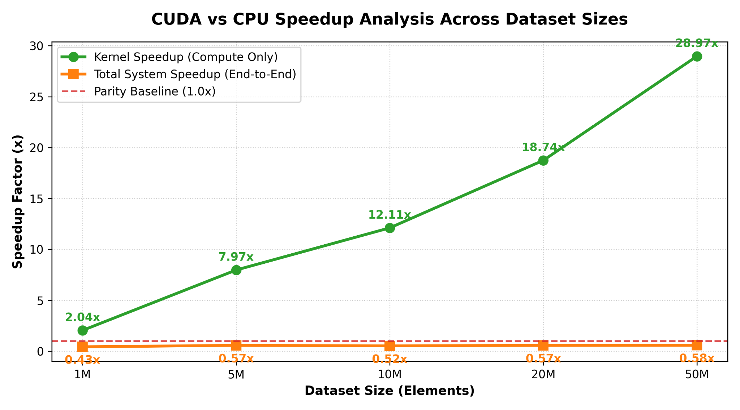
Kernel Speedup Scales with Data Size
28.97x
kernel speedup at 50M elements
up from 2.04x at 1M elements

Slide 8
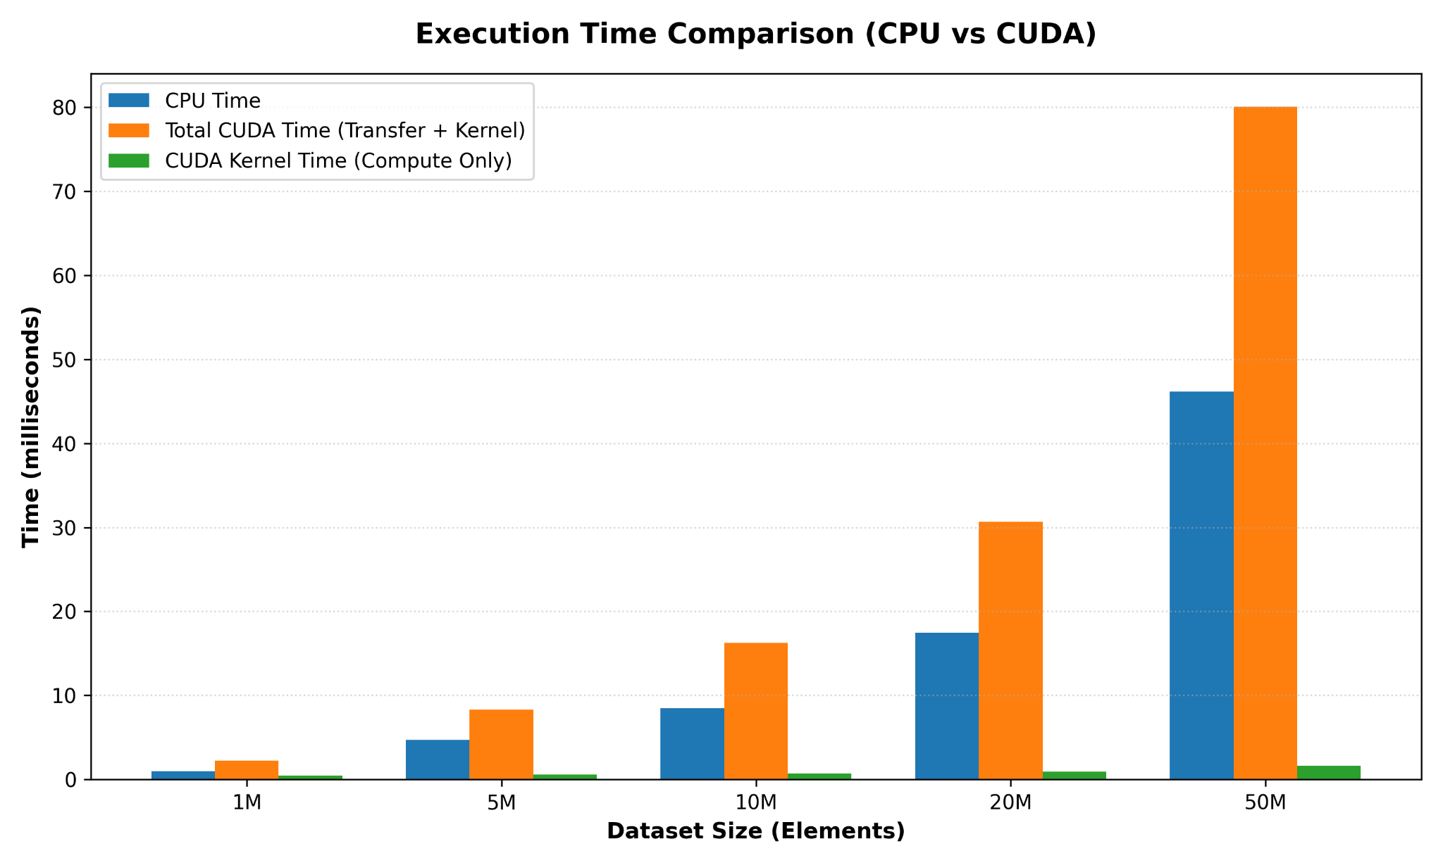
Execution Time: CPU vs. CUDA
The kernel alone is far faster than the CPU, but copying data over PCIe pushes total CUDA time above CPU time.

Slide 9
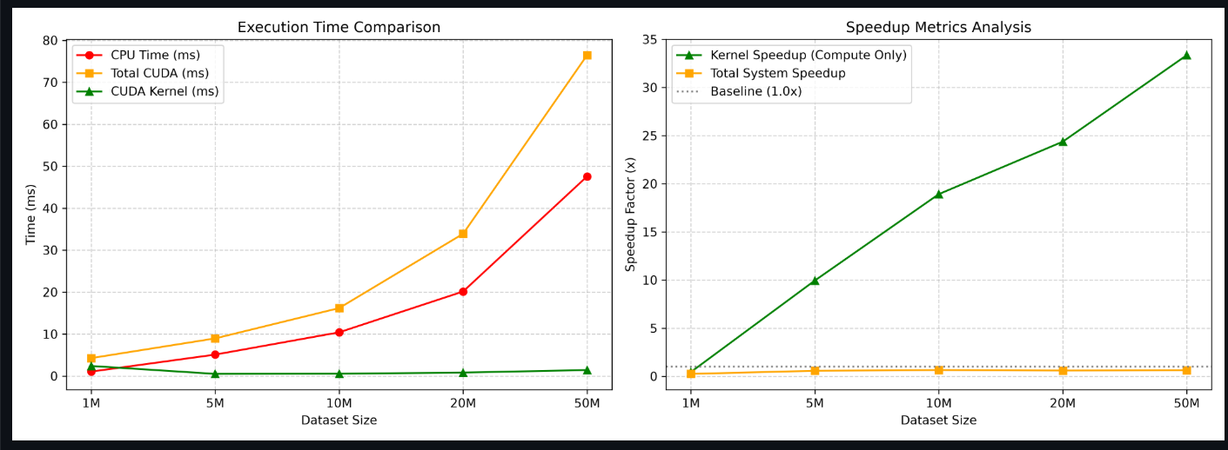
Performance Analysis

Slide 10


Why Total CUDA Time Exceeds CPU Time
98%
PCIe transfer overhead
cudaMemcpy moves data Host → Device → Host across the PCIe bus, with high fixed latency.
of total CUDA time at 50M elements is data transfer and overhead
Driver & context setup
Only 1 FLOP per element
cudaMalloc, CUDA context initialization and kernel launches add fixed time.

Slide 11

Why Compare Kernel Time vs. CPU Time?
Raw parallel capability
Shows the true compute potential of thousands of GPU threads, without bus-transfer noise.
Architecture potential
Shows how massively parallel hardware handles element-wise work once data is in high-bandwidth VRAM.
Optimization guidance
Reveals whether an application is limited by compute density or by PCIe bandwidth.

Slide 12
Conclusion
28.97x
2.04x → 28.97x
kernel speedup at 50M elements
kernel speedup, 1M to 50M elements
~98%
< 1x
of CUDA time is transfer at 50M
end-to-end speedup (0.43x to 0.58x)

Slide 13
Thank you

