Slide 1


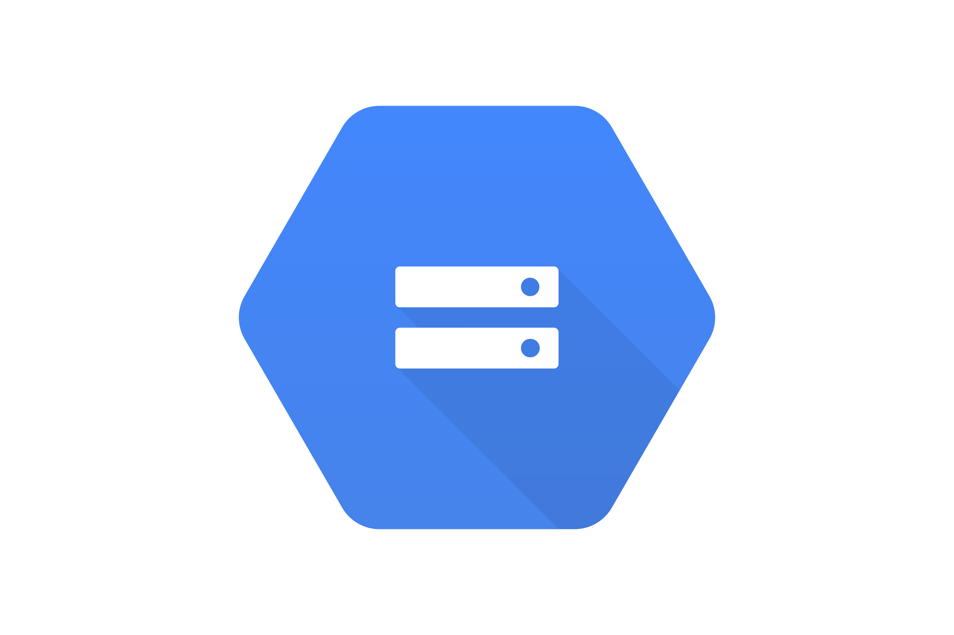




Data Tier
Processing Tier
Presentation Tier
Reading data from BQ for
visualization
Sending processed data to BQ
Cloud Storage
Cloud Function
Input files
Processing Input files, applying
data validations
This environment can be reproduced using Terraform.

