Slide 1
Phenology Study
Jean Lafitte National Historical Park and Preserve

Slide 2
Overview
The Project – Pratheeba Nalligounder Palanisami
The Data – Priyanka Choudhary
The Results – Mike Rouw
Prepared for UNO ISQA 8086 Special Topics – Data to Decisions, Fall 2019
https://github.com/priya0318/PartsPerMillion/tree/master/FinalSubmission

Slide 3
The Project
Pratheeba Nalligounder Palanisami

Slide 4
Background
Jean Lafitte National Historical Park and Preserve
Located in the State of Louisiana just southwest of New Orleans
The largest part of the park is the Barataria Preserve, covering 26,000 acres of the Mississippi River delta
Named after Jean Lafitte, an infamous character who lived in and dominated the region in the early 1800s
First established as a state park in 1966, later designated as a national park in 1978
Life in the Barataria Preserve
Home to three different ecosystems including hardwood forest, swamp and marshlands
Over 400 different species of plants are found in the preserve
Birds are also plentiful, with over 200 species making their homes in and around the area
Mammals may include armadillos, squirrels, rabbits, minx, coyote, and white-tail deer
Tree frogs, green anoles, and water snakes are plentiful, as are American alligators
Fish, crabs and other aquatic life are also found on the preserve, as are numerous varieties of insects

Slide 5
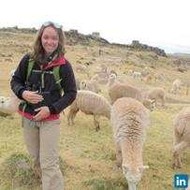
Audience Profile
Dr. Elizabeth (Liz) Marchio
Currently working as Citizen Science Coordinator at Jean Lafitte National Historical Park
PhD in the Department of Recreation, Park, and Tourism Science with a specialty in Environmental Sociology
Park Employees
Employed by the US National Park Service and funded largely by the US Department of the Interior
May include tour guides, information providers, maintenance personnel, historians, and others
Volunteers
Dr. Marchio currently uses citizen volunteers to gather phenology data from the preserve
These are often repeat visitors hiking through the parks different trails on an ad-hoc basis

Slide 6
Phenology
Definition
Phenology is the study of periodic plant and animal life cycle events and ….
how these are influenced by seasonal and interannual variations in climate, as well as habitat factors
Phenophase Event
An observable stage in the annual life cycle of a plant or animal that can be defined by a start and end point
Examples include the period over which newly emerging leaves are visible, or the period over which open flowers are present on a plant
Measurable elements for a phenophase event include start day, end day, and duration
Specific phenophase events can then be described over time and/or across different locations
Scientists are now beginning to study inter-relationships of phenophase events between species

Slide 7
Research Questions
What is the time of year when the phenological event begins for the different species grouped by categories?
What is the length of time observed for the phenological event for the species grouped by categories?
Is there a time or duration change of the phenological event for any species during the three years of observations?
Is there a difference in the time or duration for the species found in multiple regions of the phenological events?

Slide 8
The Data
Priyanka Choudhary

Slide 9
Data Overview
Collected by volunteers with some training while hiking trails
Collected from four separate trails within the park
Data provided from late summer 2017 through mid summer 2019
Over two dozen different species of plants and birds
Over two dozen different phenophase events measured
Data is primary (collected for phenology study) and observed (viewed and recorded without influence)
Dataset provided for the project
Metadata information was provided giving solid definitions for each column
Observation data was well organized with single rows showing specific observation information
Given dataset was NOT the original observations, but rather statistical values for single and multiple observations of the same event on the same species at the same location during the same year
Project used the provided means for the study, as most had only one or two observations

Slide 10
Data Structure
Last NO Day
First NO Day
First YES Day
Last YES Day
← Time →
Days to Last NO
Days to First NO
Positive Duration
Total Duration
*note: all values were means of single or dual observations

Slide 11
Data Cleaning
Pass Number One
Problem – some data was incomplete, showing only a First YES Day or a Last YES Day, but not both
Solution – if either YES was missing, it was set to the other YES, giving a positive duration of ONE day with ZERO days to the nearest NO
Pass Number Two
Problem – filtering and selecting only rows and columns needed for the analysis
Solution – rows were included if the data was complete, and columns were selected for those needed in the analysis
Pass Number Three
Problem – only some of the data was provided, and other dates and durations needed to be calculated
Solution – columns were added for Last NO Day, First NO Day, Positive Duration and Total Duration
Pass Number Four
Problem – some of the data observations contained impossible values, such as negative durations
Solution – rows were analyzed for temporal correctness, and those that failed were discarded

Slide 12
Data Enrichment
Many rows did not contain complete information – e.g. missing a YES value
Result from cleaning, both YES dates are set to the same date, giving positive duration of one day
Raises possible issues with the quality of the data collection process
Added new research question based the missing YES values
What is the extent of this missing YES value in the data?
Added a new column to the data to show ranges of positive duration for plotting
Developed a new table showing means on four selected phenophases
Calculated means for First YES Day, Total Duration, and Positive Duration, all by location
Used the years 2017/2018 for fall phenophases, and the years 2018/2019 for the spring phenophases

Slide 13
The Results
Mike Rouw

Slide 14
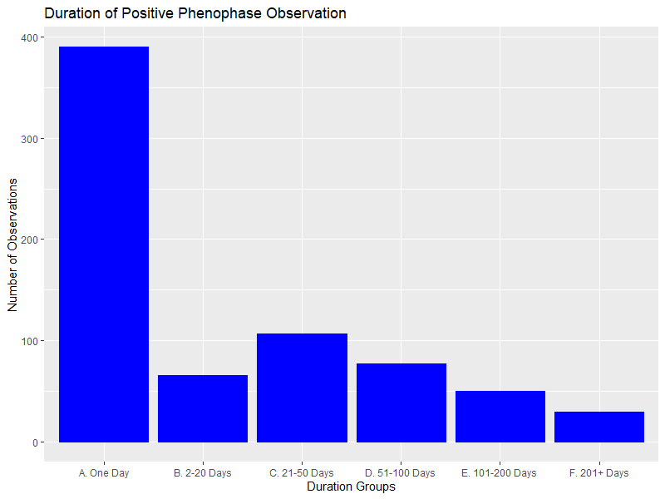
Frequency by Positive Duration

Slide 15
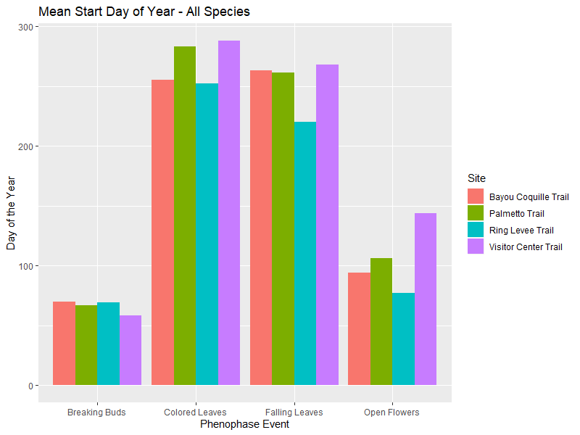
Mean Start Day by Phenophase

Slide 16
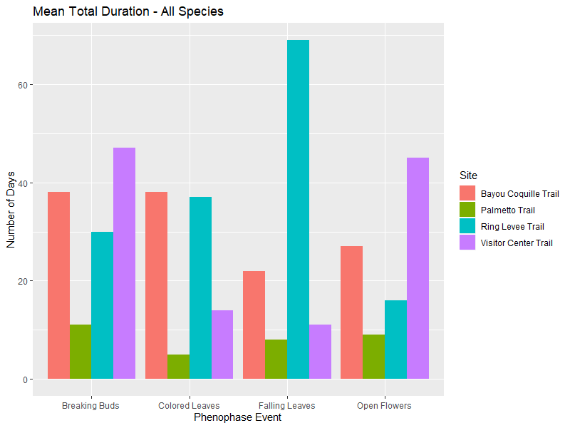
Mean Total Duration by Phenophase

Slide 17
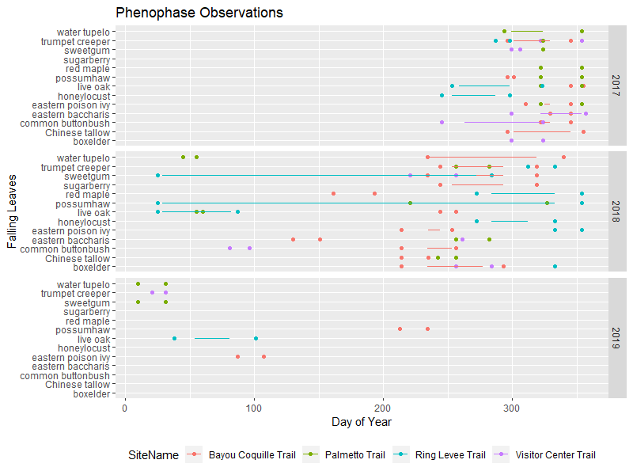
Phenophase Timing by Species

Slide 18
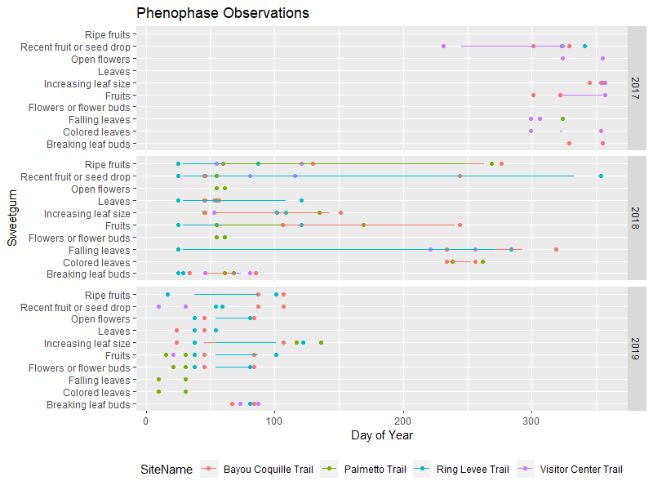
Species Timing by Phenophase

Slide 19
Conclusions
Limited data over time makes year-to-year comparisons difficult
Possible data collection issues make reliable conclusions hard to reach
Though we did not have time, integrating weather data may be interesting
Timing plots are available for all species and four selected phenophases

Slide 20
Thank You
Jean Lafitte National Historical Park and Preserve

