Slide 1
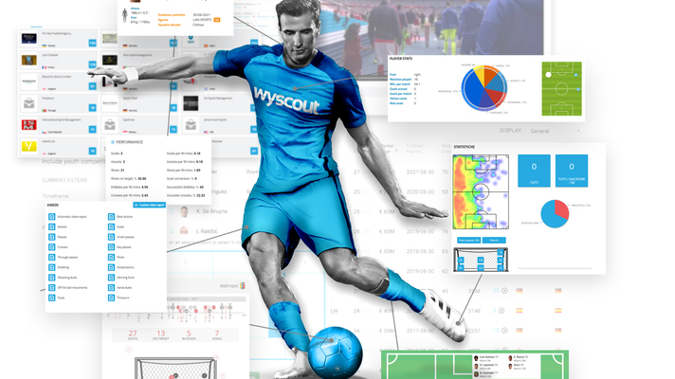
“Key Factors to Success: Exploring Insights from Football Analytics"

Slide 2

Business Objectives
Performance Analysis
Team Comparison
Player Profile and Market Value
Referee Analysis
Attendance and Stadium Analysis
Event Analysis
Substitution Patterns
Competition Analysis
Player Attributes and Demographics
Contract Management

Slide 3
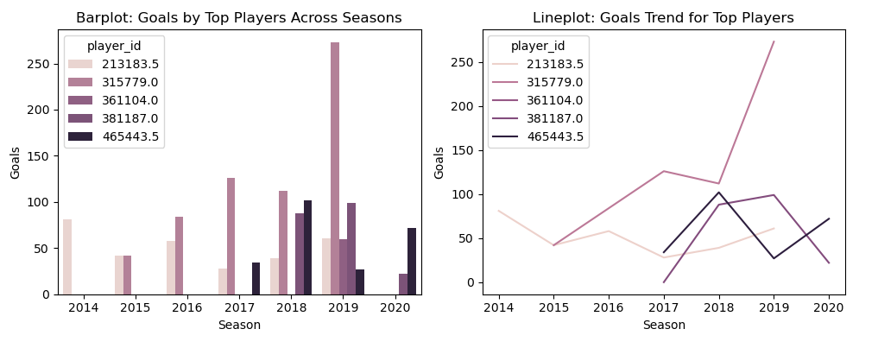
Performance Analysis
Key Interpretation :
Consistently High-Performing Players is – player id 315779 (Christian Pulisic).
The Goals were highly increased from 2018, shows a sudden increase in performance
Analysis of Correlation between Features to influence team performance :
Correlation Between Goals and Minutes Played is 0.19 a weak positive relationship. Players who play more minutes might score slightly more goals.
Goals and Total Team Goals has correlation (0.03) indicates almost no relationship. This could indicate that individual goals scored may not strongly influence the total team goals.

Slide 4
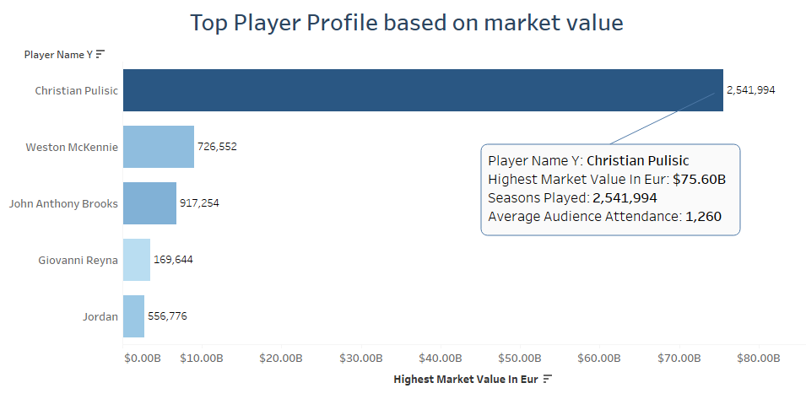
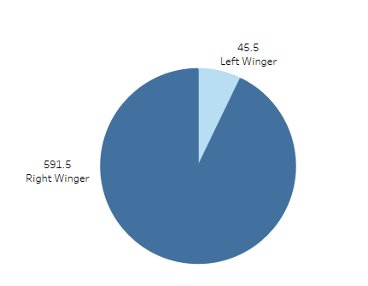

Player Profile and market value
Key Interpretations:
Player ‘Christian Pulisic’ have played the maximum season and holds the Highest market value.
The Audience will be more likely to be attending the match in which the player will be playing.
The most often playing position of the player is : Right Winger

Slide 5
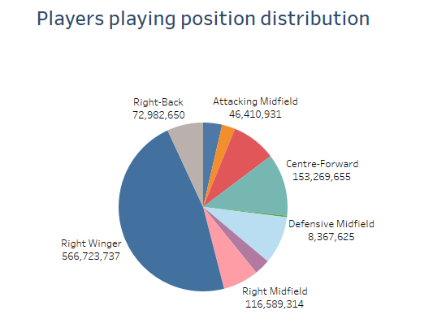
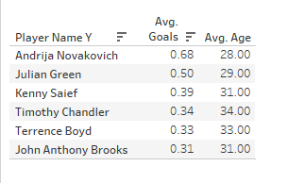
Player Profile and market value continued..
Key Interpretation:
The Maximum players plays from ‘Right Winger’ Position.
Top players making maximum goals in Age from 28 to 34.
Players who play longer tend to have higher probabilities of scoring goals. This could indicate that allowing key players more time on the field can positively impact team performance. A potential recommendation could be to prioritize extended playtime for high-performing players.
The probability that a player scores a goal, given they played for more than 75 minutes in a match is 52%

Slide 6
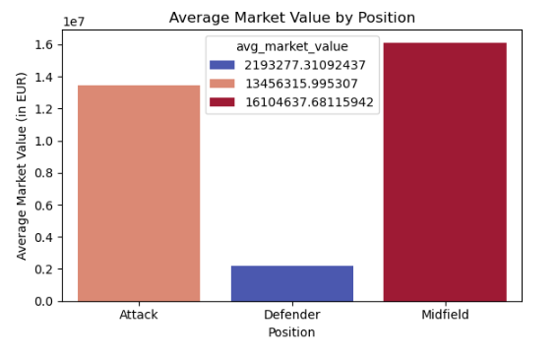
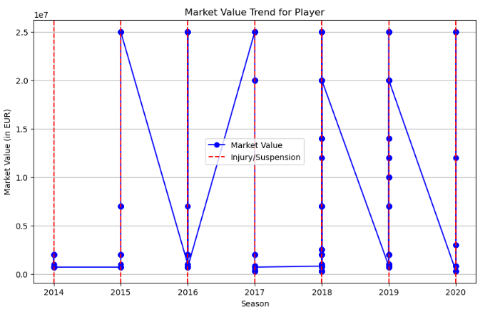
Player Profile and market value continued..
Observation and Interpretations :
Younger players (ages 22–26) have higher market values, especially attackers and midfielders. Market value declines after 28 for all positions. Midfield position have highest market values but not significant deference from Attack position market value. Defenders generally have significantly lower market values compared to Midfield and Attack position. Age negatively impacts market value, with older players (>30) valued less due to limited career years.
Injuries or suspensions significantly impacted the player's market value, causing noticeable declines during affected seasons. Peaks indicate periods of high performance or recovery.
Player market value is not directly influenced by high goal score or high attendance of player.

Slide 7
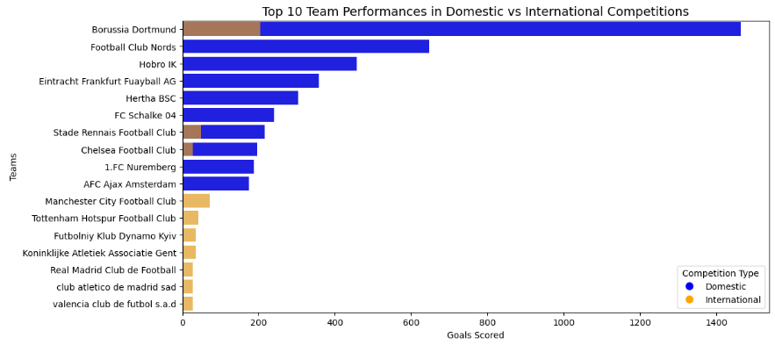
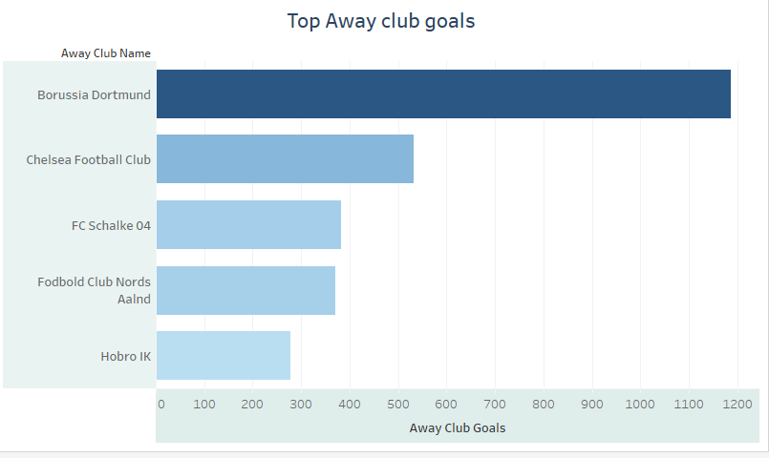
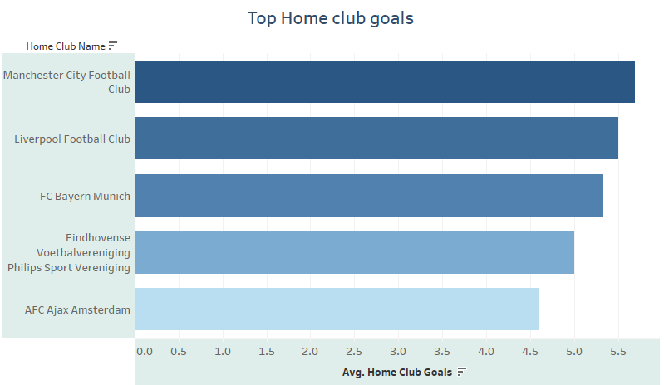
Team Comparison
Key Interpretation :
Team : Borussia Dortmund is performing well in both domestic and international competitions.
Domestic competitions generally have higher total goals scored compared to international competitions, but international competitions see more variance in team performance.
The maximum average gold scored in Away club is : 1,188 and maximum average gold scored in Home club is : 5962

Slide 8
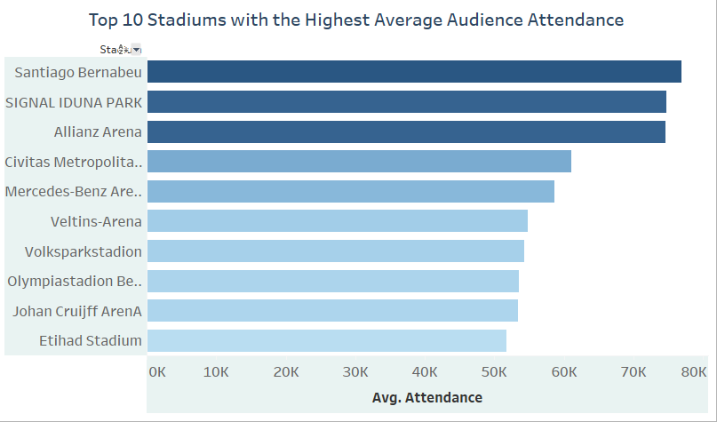
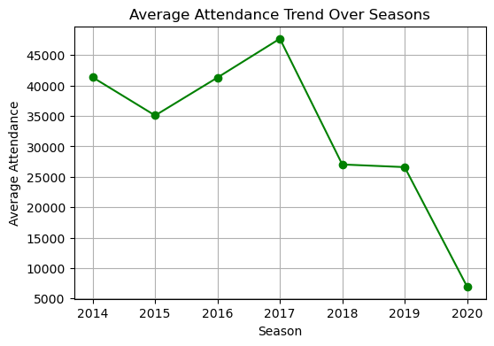
Attendance and stadium Analysis
Key Interpretations :
Stadiums with the Highest Average Audience Attendance :
Santiago Bernabeu, Signal Iduna Park and Allianz Arena are the top Stadium having highest attendance.
These are the highest revenue generating stadiums, Marketing and promotions can be increased.
Attendance Trends Over the Seasons
The Fan attendance was maximum in Year 2017 and its in decreasing trend, the attendance is fully dipped in 2020.

Slide 9
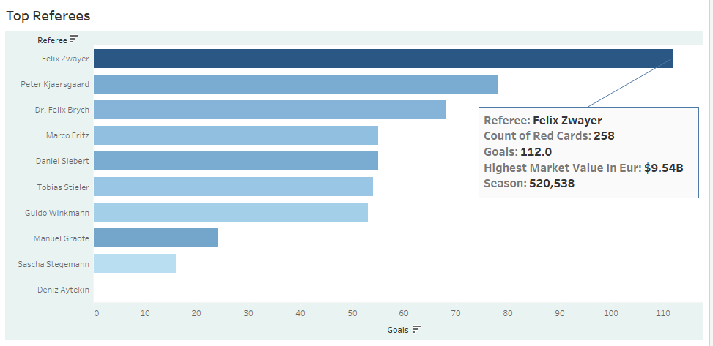
Referee Analysis
Key Interpretation :
Referee – Felix Zwayer has been attended the maximum seasons of Matches; He has been the most Experienced Referee so the can be considered as top Referee Trainer.
Total Goals made in his matches : 112 and the most of highest market value players played in the matches were the referee was Felix Zwayer .
There is high chances of the Referee to be the famous and can be high contributor in generations of Revenues.

Slide 10
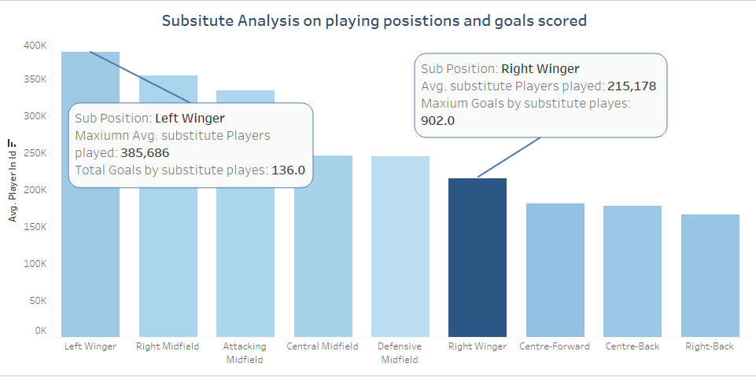
Substitution Analysis
Key Interpretation :
The maximum average Substitution players played in Left Winger position, which is the most played position.
The maximum average Goals made by Substitution players in Right Winger position.

Slide 11
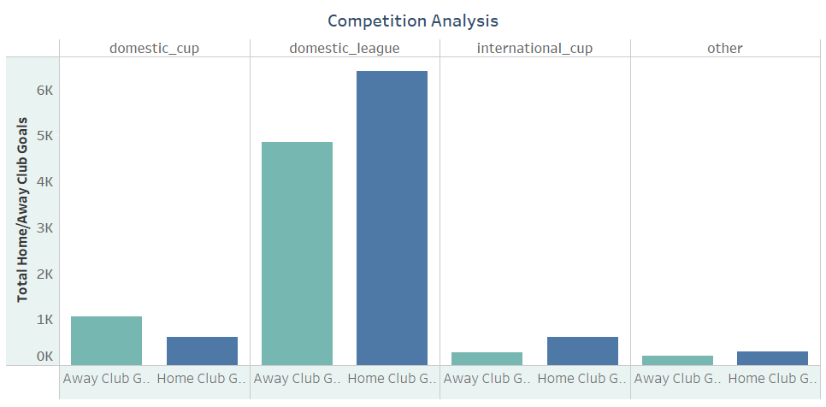
Competition Analysis
Key Observations:
The most often played matches were domestic league, and both the games Home club and away club were played in the domestic leagues.
The International cups were lesser held and lesser goals scored for home and away clubs.
It is observed that the maximum Goals were scored in Home clubs indicating higher player performance in home clubs.
Keynote :
As per t-Hypothesis test: There is a significant difference in the average number of goals scored in domestic and international competitions.

Slide 12
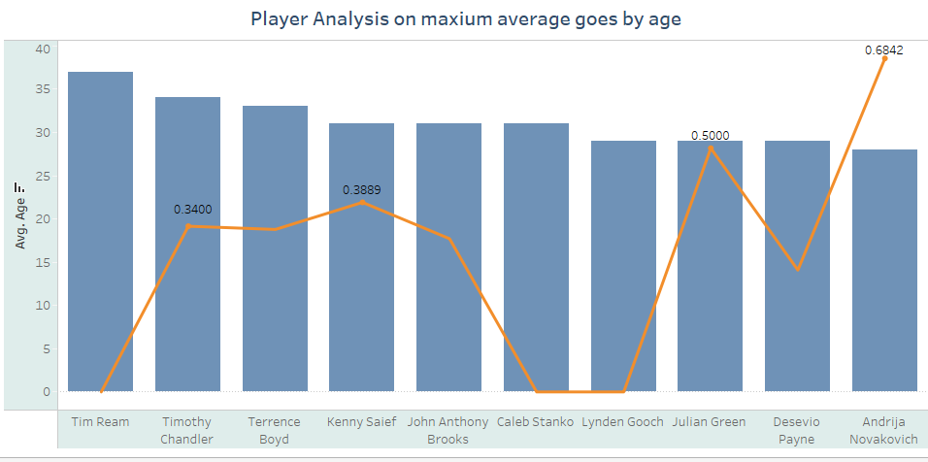
Player Attributes and Demographics
Key Interpretation :
Maximum Goals where score by player withing age range 28-35
Andrija Novakovich has scored maximum goal lies in above age range.
Goal is negatively influenced by age above age 35.

Slide 13
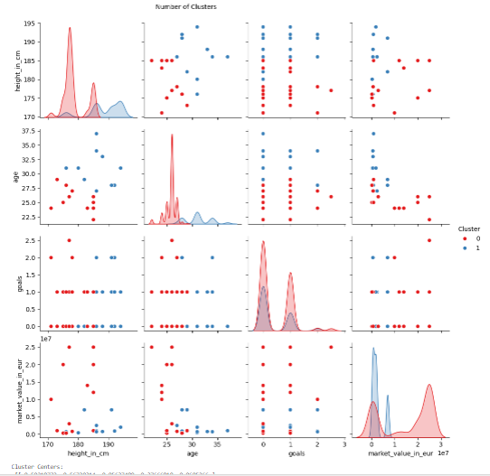
Player Attributes and Demographics continued..
Key Interpretation :
Based on Players are divided into 2 cluster 0 and 1
2864 Player relies to Cluster 0
1335 Player relies to Cluster 1
Cluster 0 (Higher Value Players): These players are above average in goals, minutes played, and market value. They represent "star players" and should be prioritized for retention, development, and marketing.
Cluster 1 (Older, Taller Players): These players are older with lower market value and fewer goals. They bring experience and tactical knowledge, serving in supporting or leadership roles.
Retention Strategy: Focus on Cluster 0 for marketing and retention due to their higher performance and market value. For Cluster 1, nurture leadership and use them strategically in lower-pressure games.
Training and Development: Invest in Cluster 1 to enhance market value and performance through specialized training or role adjustment.
Conclusion: The clustering shows two distinct player groups: high-value performers and experienced, lower-value players. Further refinement can improve clustering for better decision-making in retention, development, and marketing.

Slide 14
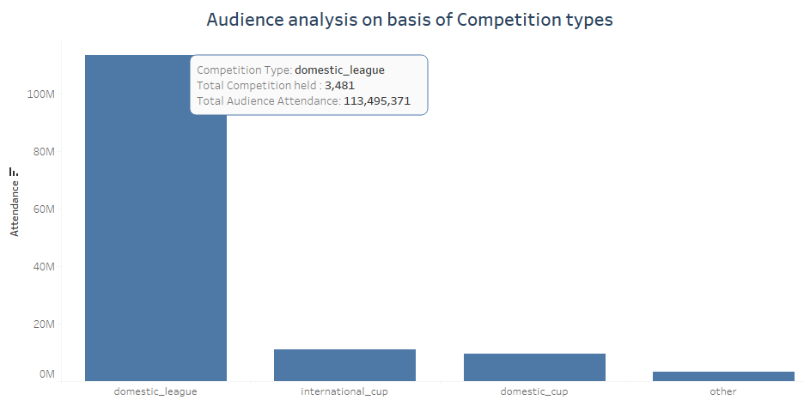
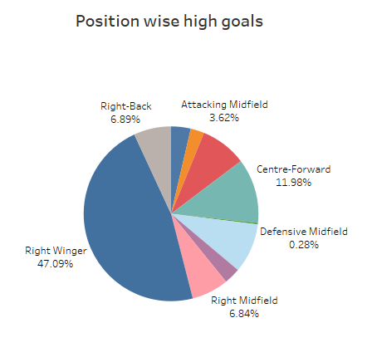
Event Analysis
Key Interpretation :
The Maximum competition were organized in form of “domestic_leagues”
The Positions Right Winger turns out to be higher Goals scorer positions.

Slide 15
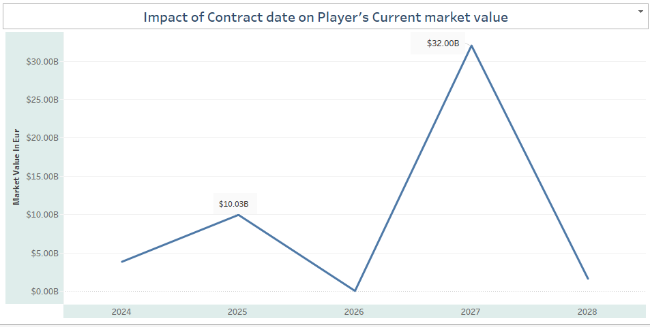
Contract Management
Key Interpretation :
The player likely to have higher current market value with longer contract expiration year.

Slide 16
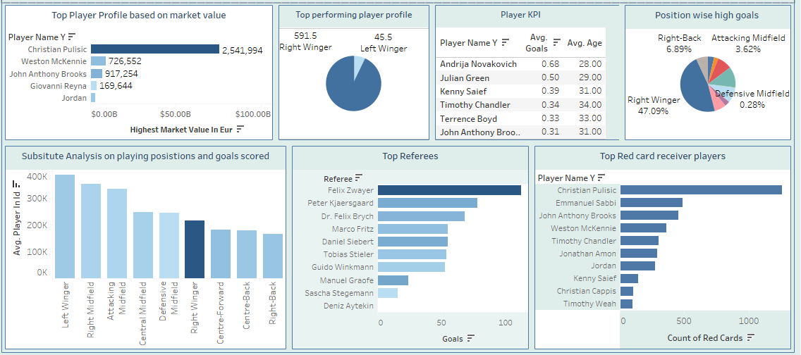
Football Performance & Improvement Dashboard

Slide 17
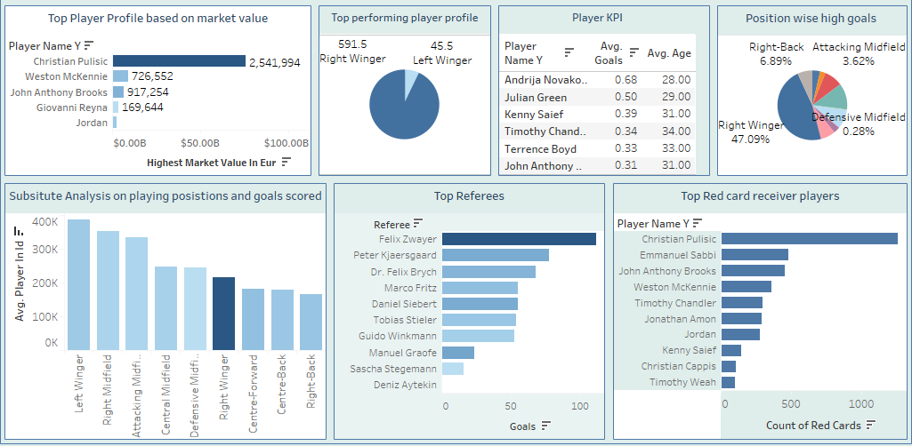
Football Business & Revenue Optimization Dashboard

Slide 18
Interpretation : Football Performance & Improvement
Top Player Performance:
Christian Pulisic (Player ID 315779) is a consistent high performer and valuable team asset.
Goals Trend:
Sudden rise in goals since 2018, indicating improved strategies or development.
Key Correlations:
Goals vs. Minutes Played (0.19): Weak positive link—more playtime may slightly boost scoring.
Individual Goals vs. Total Team Goals (0.03): Minimal impact, suggesting team effort is key.
Market Value & Contract Expiry: Longer contracts are linked to higher player market value.
Team Performance:
Borussia Dortmund excels in both domestic and international matches.
Domestic Competitions: More matches and higher goals compared to international cups.
Club Performance:
Home Clubs scored higher (5,962 avg. goals) than Away Clubs (1,188 avg. goals), reflecting stronger home performance.
Referee Impact:
Felix Zwayer, the most experienced referee, officiated matches with 112 total goals and top-value players, making him a key contributor to match quality and revenues.
Substitution Insights:
Most substitutions occurred in Left Winger, while Right Winger substitutes scored the most goals.
Match Insights:
Domestic Leagues dominate with higher goals for home and away clubs.
Right Winger position scored the highest goals, emphasizing its strategic importance.
Focus on leveraging key players, enhancing home and positional performance, and extending contracts for long-term value.

Slide 19
Interpretation : Football Business & Revenue Optimization
Top Player Insight:
Christian Pulisic: Most seasons played, highest market value, and primarily plays as Right Winger. Matches involving him likely attract higher attendance.
Player Performance Trends:
Right Winger is the most common and impactful playing position.
Maximum goals are scored by players aged 28–34, with Andrija Novakovich leading in this range.
Players aged >35 show a decline in goals scored.
Market Value Dynamics:
Younger players (22–26) have the highest market value, especially attackers and midfielders.
Midfielders hold slightly higher market values than attackers, while defenders are valued significantly lower.
Market value declines with age, injuries, or suspensions but improves with longer contract years.
Clustering Insights:
Cluster 0 (2,864 players): Star players with above-average goals, minutes, and market value—key focus for retention and marketing.
Cluster 1 (1,335 players): Older, experienced players with lower market value—suitable for leadership roles and tactical games.
Recommendations:
Extend playtime for high-performing players to boost goals.
Retain and market Cluster 0 while training and adjusting roles for Cluster 1 to enhance performance.
Focus on leveraging star players, managing market value dynamics, and optimizing player retention for business growth and audience engagement.

Slide 20
Thank you
Priya Mishra
Data Analytics
Enrollment No. : EN12025082423_

