Slide 1
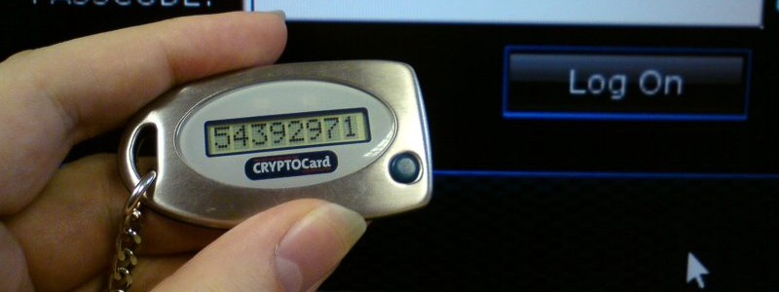
Python_Capstone_Project OTP Verification System
By HARI PRIYA GUDE

Slide 2
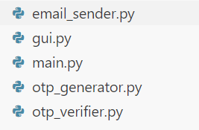


Python Files/modules created :
Problem Statement: OTP Verification System
Objective: Develop an OTP (One-Time Password) verification system in Python. The system should:
Generate a 6-digit OTP.
Send the OTP to the user's email address.
Prompt the user to enter the OTP for validation.
Grant access if the entered OTP matches the generated OTP; otherwise, deny access.
Benefits:
Enhanced security: OTP adds an extra layer of security to user authentication.
User-friendly: Simple and intuitive interface for OTP verification.
Flexible: Can be integrated into various applications for secure access.
Tools and languages used:
Vs code
Python
This Photo by Unknown Author is licensed under CC BY-SA

Slide 3

Key components
OTP Generation: A function to randomly generate a 6-digit OTP.
Email Sending: Simulate sending the OTP to the user's email address.
OTP Verification: Compare the entered OTP with the generated OTP for validation.
User Interaction: Provide a user-friendly interface for entering the OTP.
Error Handling: Handle incorrect OTP entries and provide appropriate feedback to the user.

Slide 4
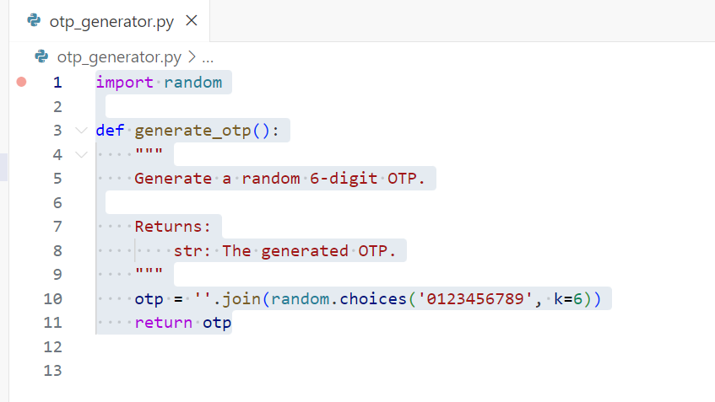
Module:1 otp_generator.py
Importing the random Module:
The random module is imported to utilize its functions for generating random values.
Defining the generate_otp Function:
A function named generate_otp is defined to generate a random 6-digit OTP.
The function does not take any arguments.
Generating the OTP:
Inside the function, the random.choices() function is used to generate a sequence of 6 digits.
The choices are made from the characters '0123456789', representing digits from 0 to 9.
The k parameter specifies the number of elements to choose, which is set to 6 for a 6-digit OTP.
Converting to String Format:
The generated list of digits is joined together using the str.join() method.
This results in a single string representing the 6-digit OTP.
Returning the OTP:
The generated OTP string is returned as the output of the function.

Slide 5
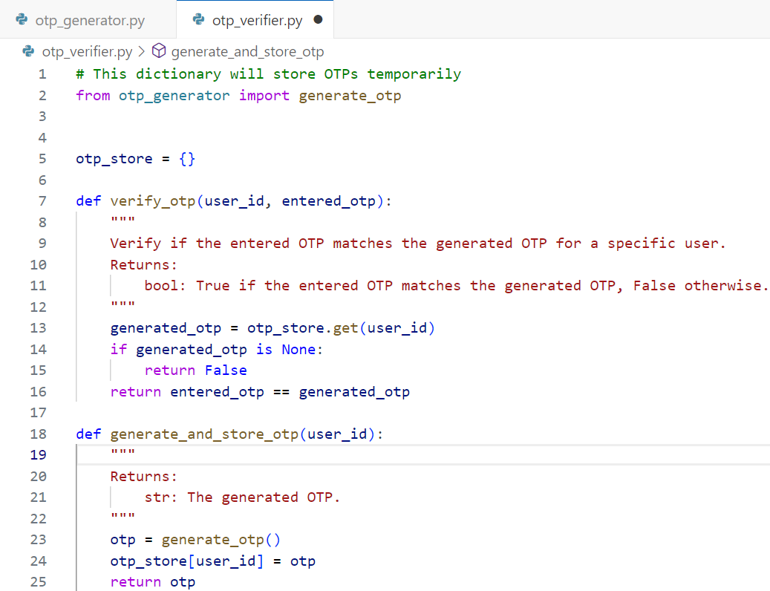
Module 2: otp_verifier.py
Importing generate_otp Function:
The generate_otp function from the otp_generator module is imported to generate OTPs.
Defining otp_store Dictionary:
A dictionary named otp_store is initialized to store OTPs temporarily. It will be used to associate OTPs with user IDs.
Defining verify_otp Function:
The verify_otp function verifies if the entered OTP matches the generated OTP for a specific user.
It takes two parameters: user_id and entered_otp.
If the user ID is not found in otp_store, it returns False, indicating that the OTP verification failed.
Otherwise, it compares the entered OTP with the generated OTP stored in otp_store.
Returns True if the entered OTP matches the stored OTP, otherwise False.
Defining generate_and_store_otp Function:
The generate_and_store_otp function generates a new OTP and stores it for the specified user ID.
It takes one parameter: user_id.
Inside the function, it calls the generate_otp function to generate a new OTP.
The generated OTP is then stored in the otp_store dictionary with the corresponding user ID as the key.
Finally, the generated OTP is returned as output.

Slide 6
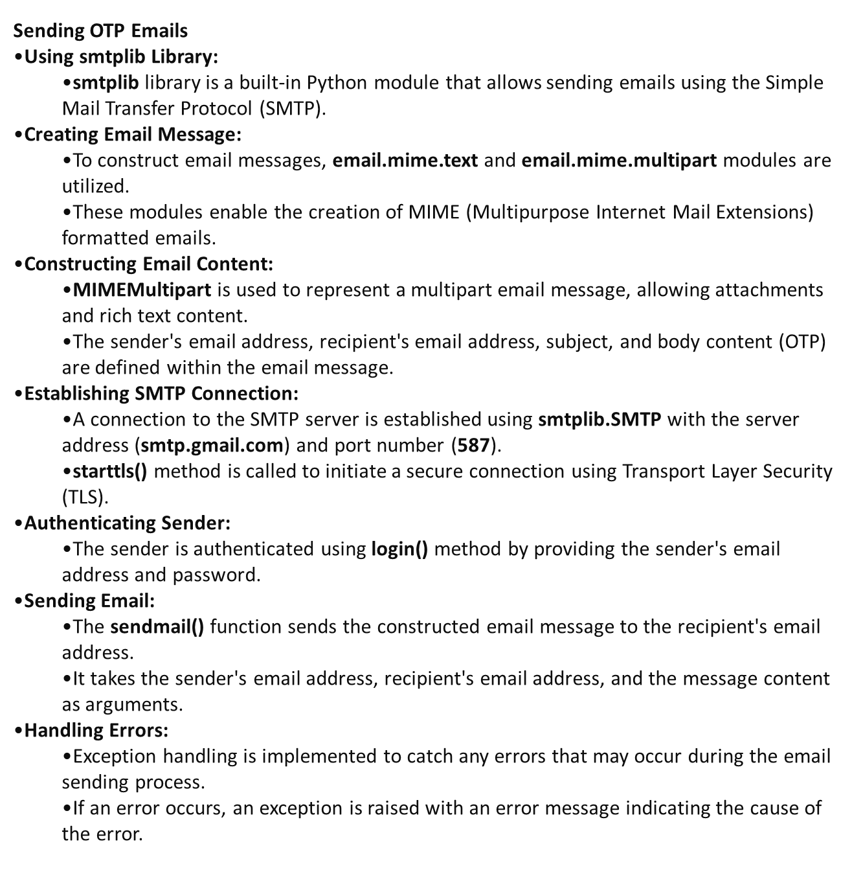
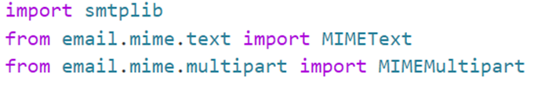
Module 3 : email_sender.py
OBJECTIVE

Slide 7
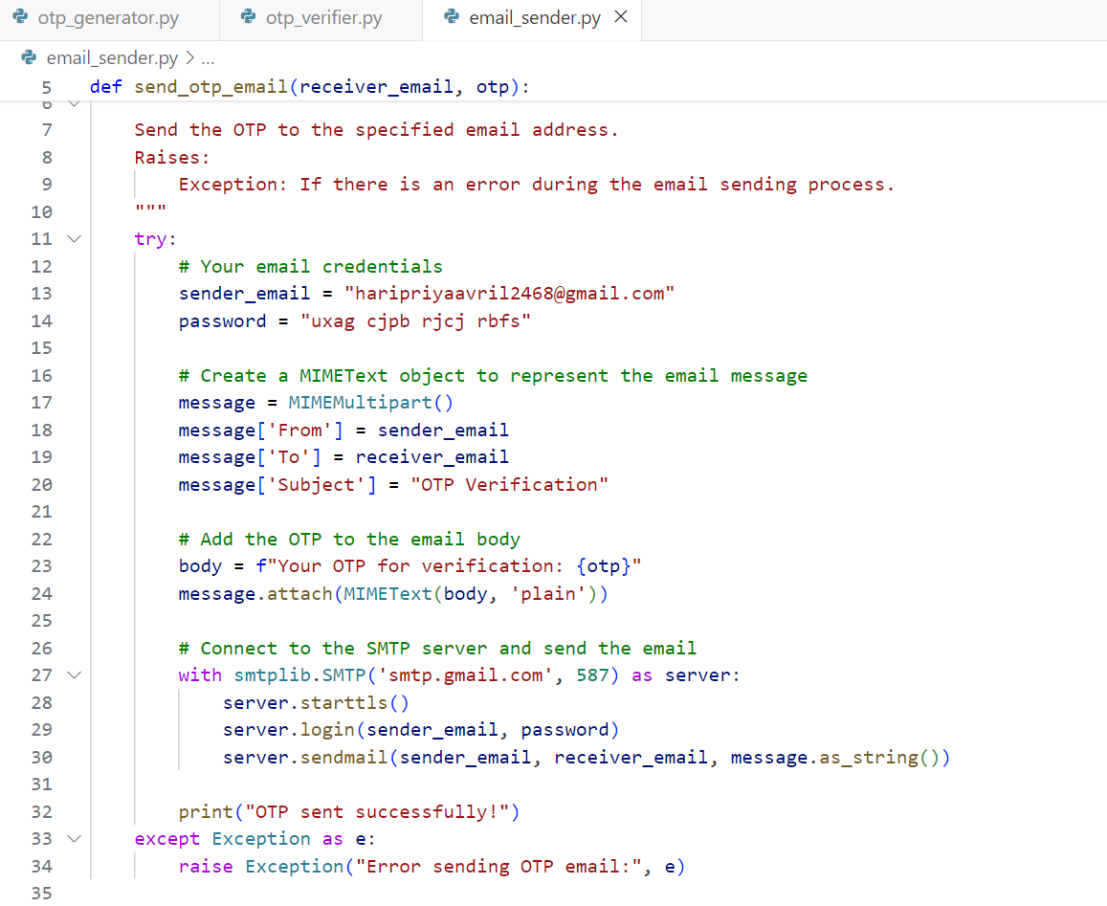
Module 3: email_sender.py Part-2
Function Definition:
def send_otp_email(receiver_email, otp): declares the function send_otp_email with two parameters: receiver_email (the email address where the OTP will be sent) and otp (the OTP to be sent).
Sending Email:
Inside the function, an email message is constructed using the MIMEMultipart class from the email.mime.multipart module. This allows for creating multipart emails with different content types.
The sender's email address, which is hard-coded as "haripriyaavril2468@gmail.com", and the subject, which is set as "OTP Verification", are added to the email message.
The OTP is embedded into the email body using string formatting (f"Your OTP for verification: {otp}"), and the body is attached to the email message using the MIMEText class.
SMTP Connection:
The code establishes a connection with the Gmail SMTP server (smtp.gmail.com) on port 587 using the smtplib.SMTP class.
It then initiates TLS (Transport Layer Security) encryption using the starttls() method to secure the connection.
Next, it logs in to the SMTP server using the sender's email address and password obtained from the code (ensure that you handle sensitive information securely).
Finally, it sends the constructed email message to the specified recipient email address using the sendmail() method of the SMTP server.
Error Handling:
The code includes a try-except block to catch any exceptions that may occur during the email sending process.
If an exception occurs, it raises a new Exception with the message "Error sending OTP email:" followed by the actual error message.
Output:
If the OTP email is sent successfully without any exceptions, it prints "OTP sent successfully!" to the console

Slide 8
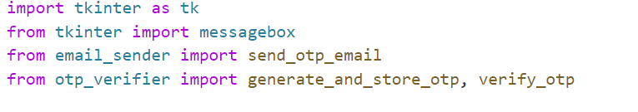
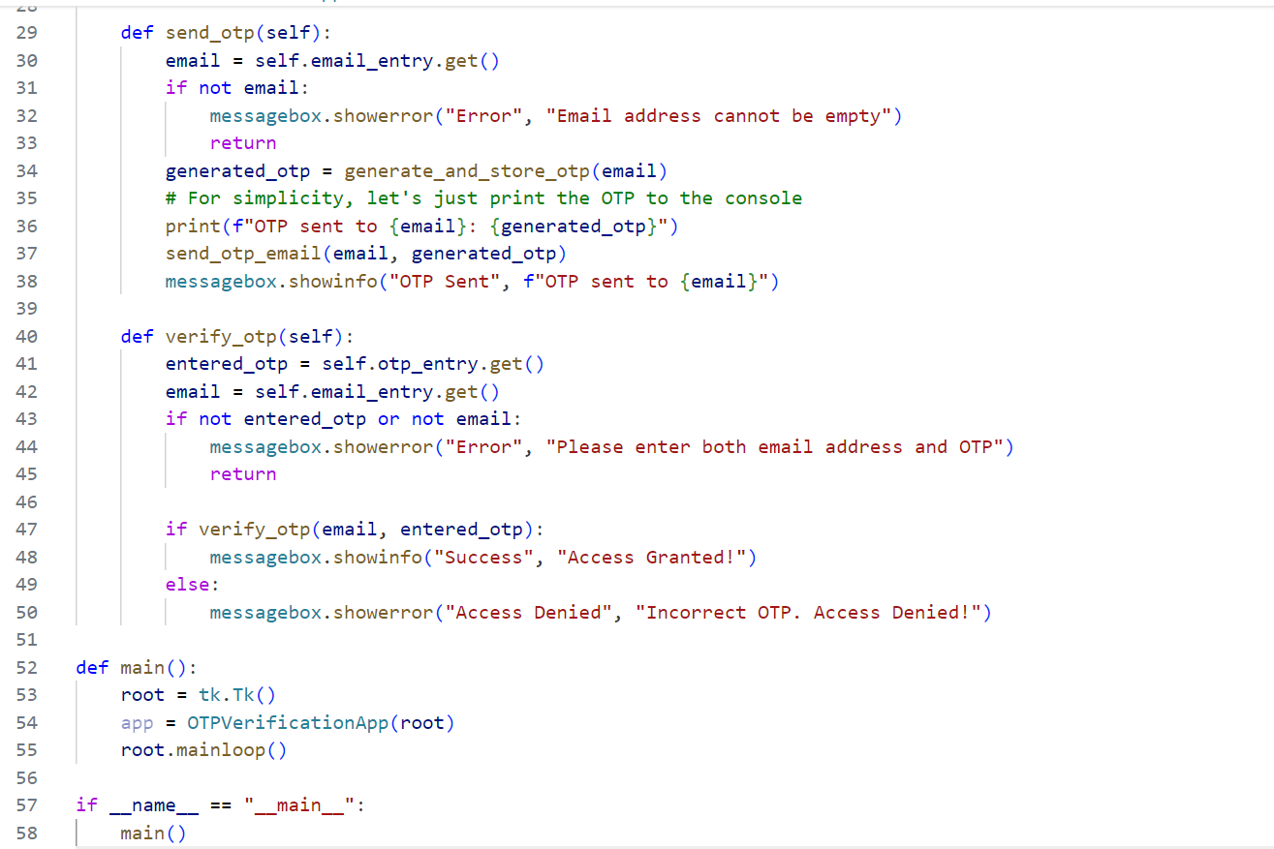

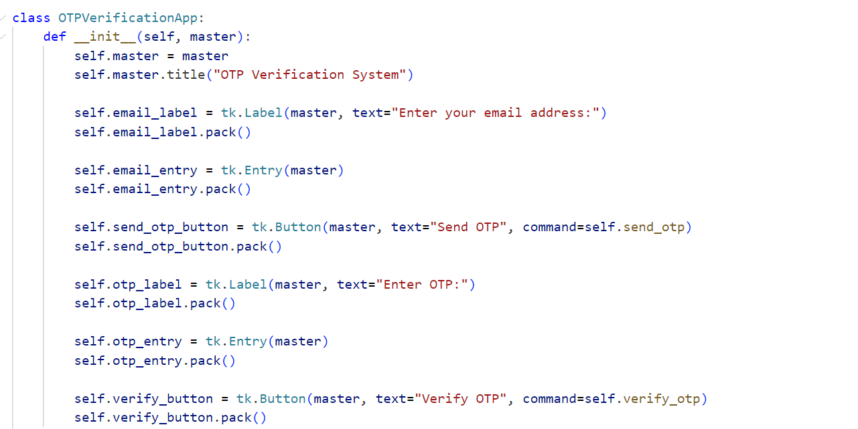
Module 4: gui.py

Slide 9
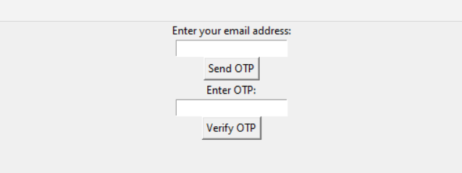
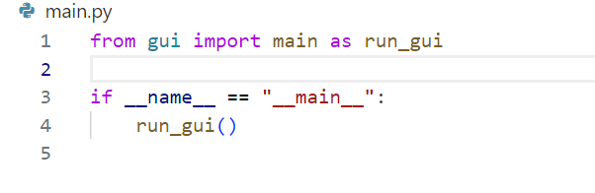
Module 5:main.py (main)
When I run the main.py file we get a graphical user interface :
Asking → email_address and OTP
With buttons →Send OTP and verify OTP

Slide 10
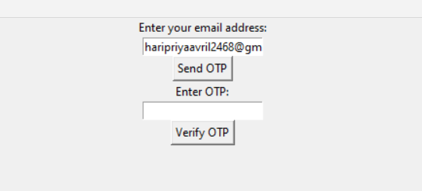
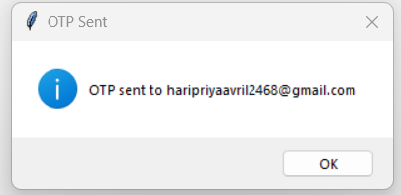
After I entered my email and hit send otp button
It will display a notification : that it has sent the otp to the respective email address

Slide 11


Got The OTP to my email address
And entered the otp in the GUI and hit verify OTP

Slide 12
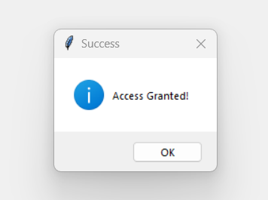
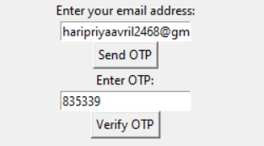
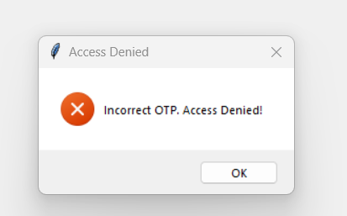
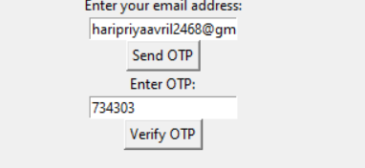
Access Granted!!!!!!!: when the generated otp=entered otp
Access Denied when
We pass a otp that is not equal to the generated otp

Slide 13
Conclusion of the project:
The OTP Verification System project successfully addresses the need for secure user authentication through one-time passwords.
By generating random 6-digit OTPs and sending them via email, the system ensures a secure and reliable method for user verification.
The integration of email functionality using the SMTP protocol enables seamless communication between the system and users.
Error handling mechanisms are implemented to handle exceptions during the email sending process, ensuring robustness and reliability.
Through this project, we have demonstrated the implementation of a fundamental security feature that can be integrated into various applications to enhance security

Slide 14

This Photo by Unknown Author is licensed under CC BY-SA
Ask me further queries if required!!!!!!!

