Slide 1

Project Title :Laptop Price Prediction for SmartTech Co.
Name: Hari Priya Gude
Date: June 1st , 2024
This Photo by Unknown Author is licensed under CC BY-ND

Slide 2
Project Overview:
SmartTech Co. has partnered with our data science team to develop a robust machine learning model that predicts laptop prices accurately. As the market for laptops continues to expand with a myriad of brands and specifications, having a precise pricing model becomes crucial for both consumers and manufacturers.
Client's Objectives:
Accurate Pricing: Develop a model that can accurately predict laptop prices based on various features, helping our clients stay competitive in the market.
Market Positioning: Understand how different features contribute to pricing, enabling SmartTech Co. to strategically position its laptops in the market.
Brand Influence: Assess the impact of brand reputation on pricing, providing insights into brand perception and market demand.

Slide 3
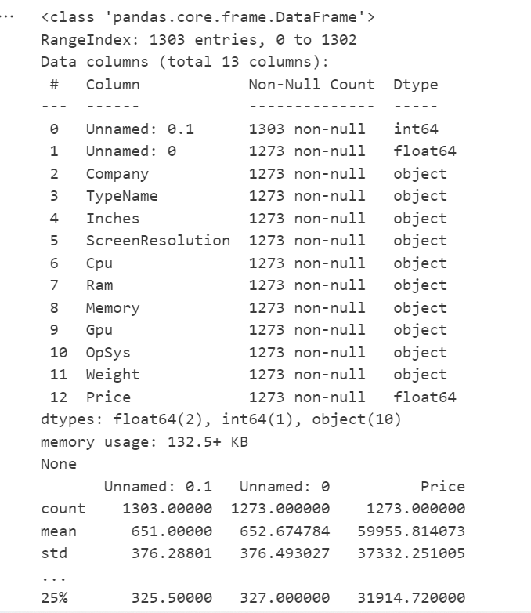
Data Exploration and Understanding:Initial Observations
Data Structure:
The dataset contains 1303 entries with 13 columns.
Columns include identifiers, company, type, specifications (like screen resolution, CPU, RAM, memory, GPU, OS, weight), and the target variable Price.
Missing Values:
Some columns have missing values (Unnamed: 0, Company, TypeName, Inches, ScreenResolution, Cpu, Ram, Memory, Gpu, OpSys, Weight, Price).
Data Types:
Most columns are of object type, indicating categorical data or mixed data types (e.g., Inches, Weight).
The Price column is a float, which is appropriate for our target variable.
Basic Statistics:
The Price column ranges from approximately 9270.72 to 324954.72, with a mean of 59955.81 and a standard deviation of 37332.25.

Slide 4
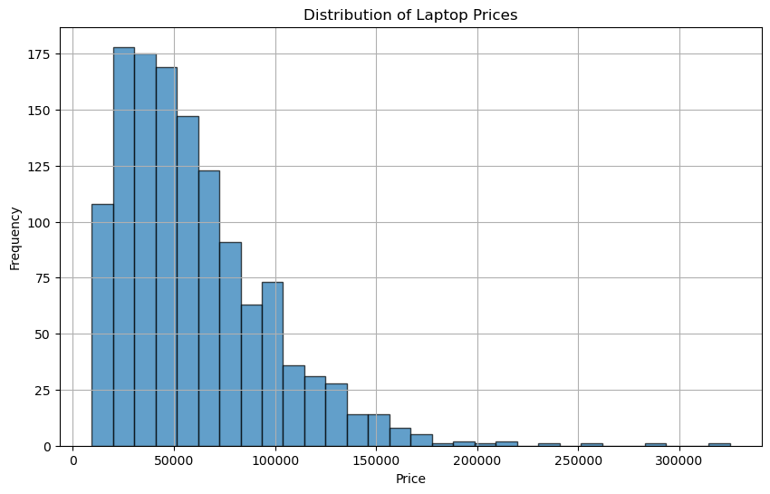
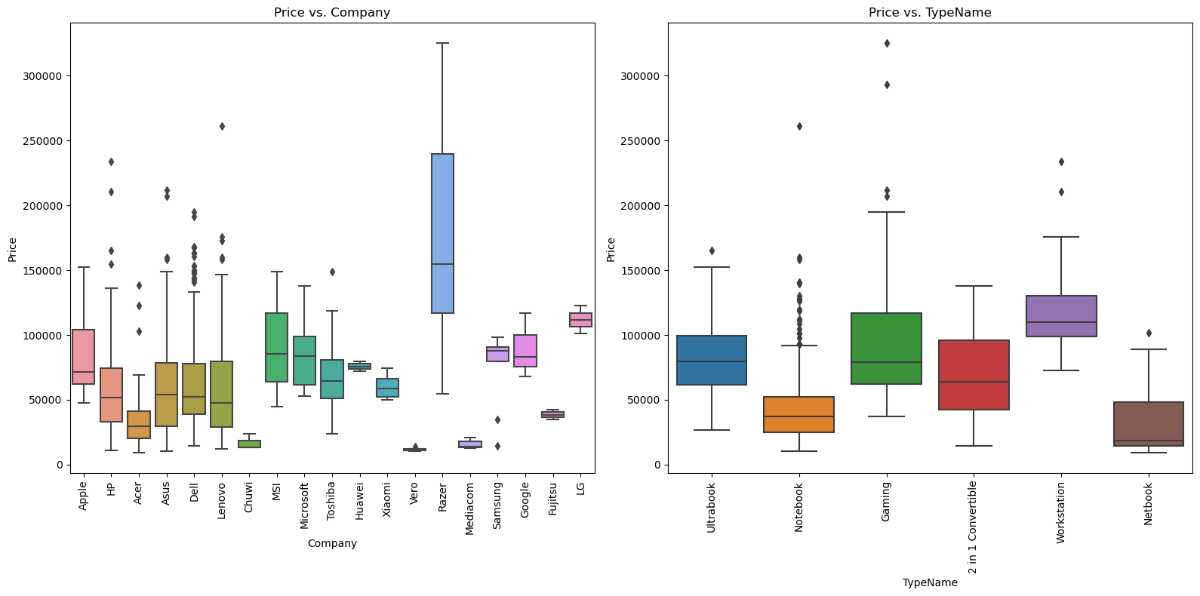
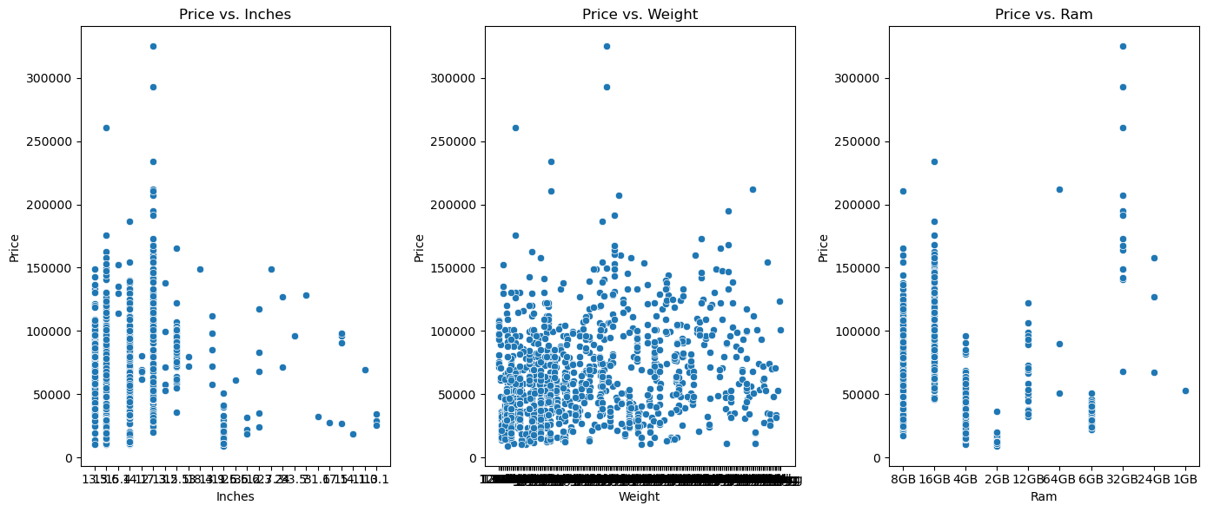
Visualization of data :EDA

Slide 5
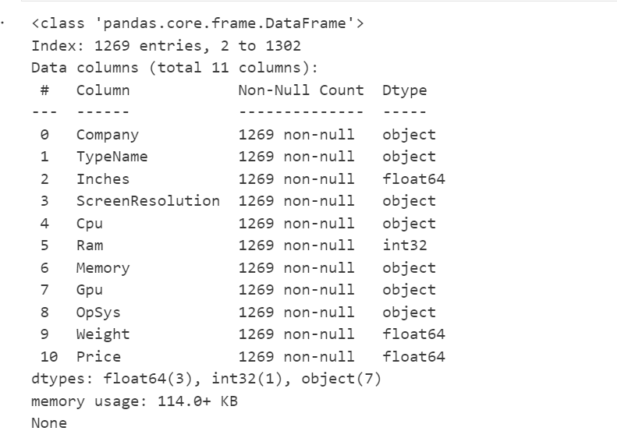
Data Preprocessing:
Step1: Handled missing values
Step2 : Remove rows with non-numeric values in 'Inches' and 'Weight’
Step3:Drop rows with any remaining missing values
Step4:Convert columns to appropriate data types
Step5:Drop unwanted columns
Step6:Drop the first two rows using drop function
Step 7: Verify the updated dataframe

Slide 6
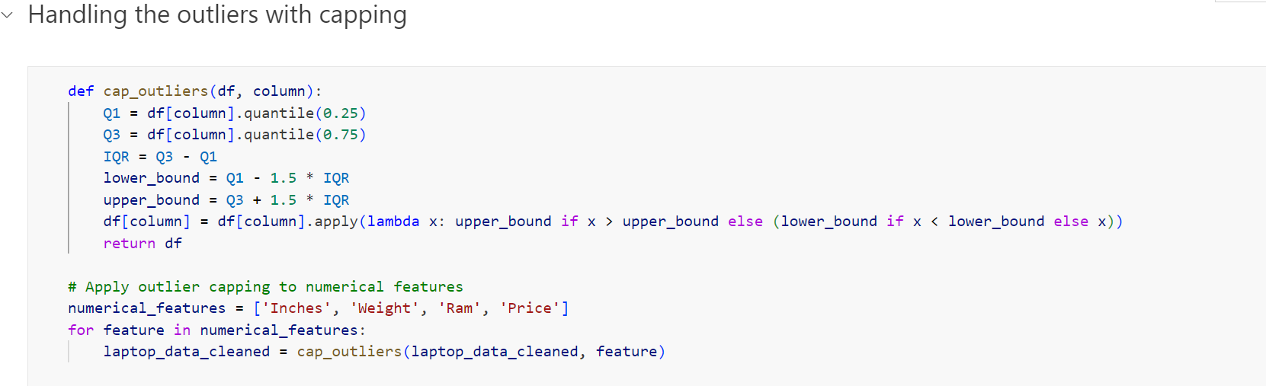
Handling the outliers with capping
The Interquartile Range (IQR) is a measure of statistical dispersion, which is the spread of the data values. It is defined as the difference between the 75th percentile (Q3) and the 25th percentile (Q1) of the data. The IQR is used to measure variability and to identify potential outliers in the data set.

Slide 7
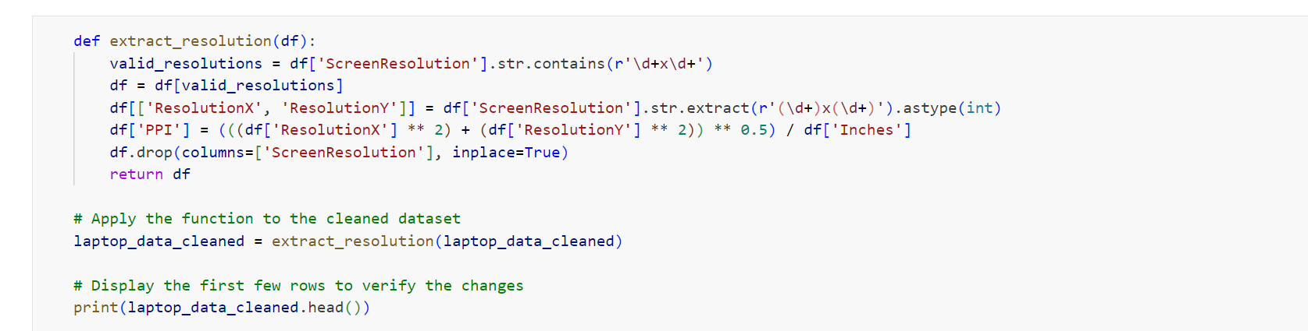
Feature Engineering
Extract ResolutionX and ResolutionY:
The code extracts the horizontal (ResolutionX) and vertical (ResolutionY) resolutions from the ScreenResolution column.
These values are converted to integers to be used in numerical calculations.
Calculate PPI:
Using the extracted ResolutionX, ResolutionY, and the Inches column, it calculates the PPI for each laptop.

Slide 8
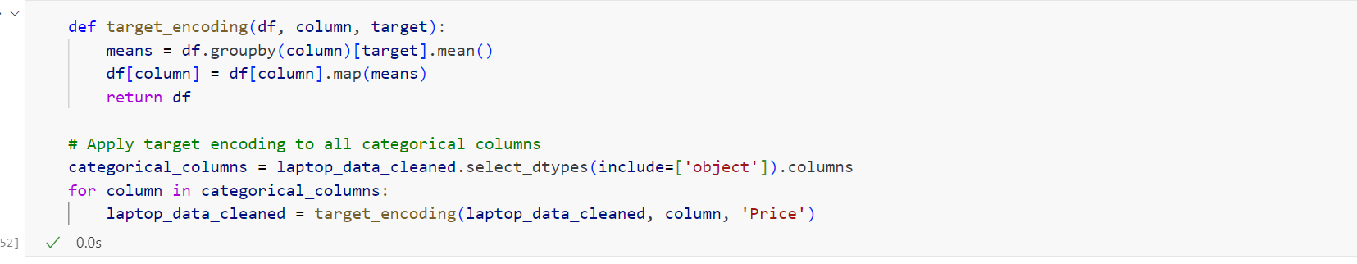
Handling encoding that has too many columns
Target encoding, also known as mean encoding or likelihood encoding, is a technique used to encode categorical variables with the mean of the target variable. It replaces each category in a categorical feature with the mean of the target variable for that category. This can be particularly useful in several scenarios:
High Cardinality Features:
When a categorical feature has a large number of unique values (high cardinality), using one-hot encoding can result in a very high-dimensional feature space. This can lead to computational inefficiency and overfitting. Target encoding helps in reducing the dimensionality of such features while preserving useful information.
Example: Encoding zip codes in a housing price prediction model

Slide 9
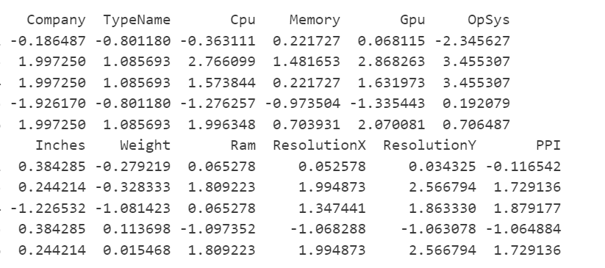
Feature Scaling
Improving Model Accuracy:
By creating more informative features, you can help the model capture complex patterns in the data, leading to better performance.
Example: Creating interaction features (e.g., product of two features) to capture the combined effect of two variables on the target variable.

Slide 10
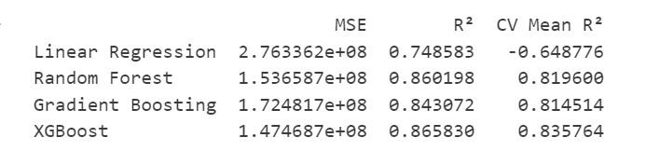
Model Training and Evaluation
The function fits the pipeline on the training data and makes predictions on the test data.
It calculates the mean squared error (MSE), R² score, and cross-validation mean R² score for the model.
Split the Data:
The dataset is split into training and testing sets using an 80-20 split (train_test_split function).
Define Models to Evaluate:
A dictionary of models is created, including Linear Regression, Random Forest, Gradient Boosting, and XGBoost.
Evaluate Each Model:
For each model in the dictionary, the evaluate_model function is called to train and evaluate the model.
The results (MSE, R², and cross-validation mean R²) are stored in the results dictionary.
Define Features and Target Columns:
It separates the features (input variables) and the target (output variable) from the cleaned dataset (laptop_data_cleaned).
features contains all columns except Price.
target contains the Price column.
Define Numerical and Categorical Features:
It specifies which features are numerical and which are categorical.
Numerical features: Inches, Ram, Weight, ResolutionX, ResolutionY, PPI.
Categorical features: Company, TypeName, Cpu, Memory, Gpu, OpSys.
Define Preprocessing Steps:
For Numerical Data: A pipeline with a standard scaler is created to scale numerical features.
For Categorical Data: A pipeline with one-hot encoding is created to encode categorical features.
Combine Preprocessing Steps:
A ColumnTransformer is used to apply the respective preprocessing steps to numerical and categorical features.
Define a Function to Evaluate Models:
The evaluate_model function takes a model and training/testing data as input.
It creates a pipeline with preprocessing steps and the model.

Slide 11
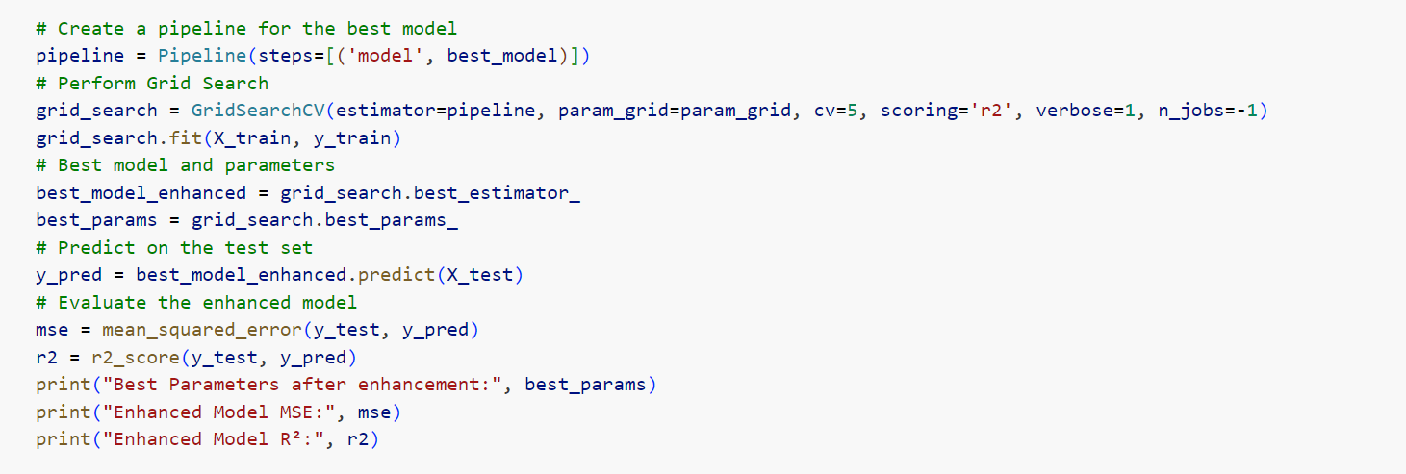
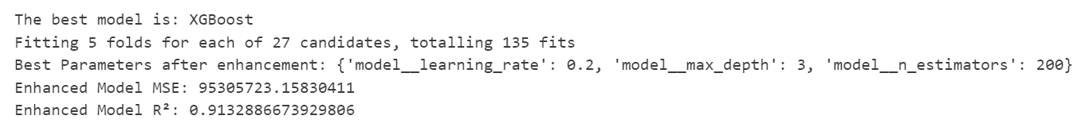
Best Model: The name of the model with the highest R² score.
Best Parameters: The optimal hyperparameters for the selected model.
Enhanced Model Performance:
MSE: Mean Squared Error of the enhanced model on the test set.
R²: R² score of the enhanced model on the test set.

Slide 12
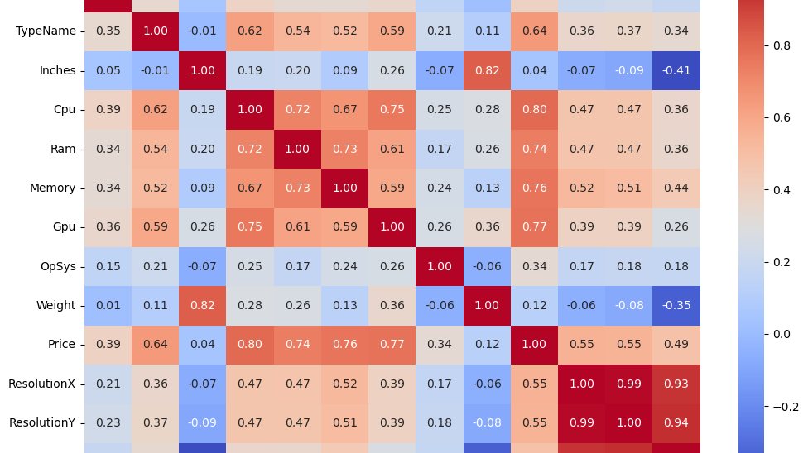
Key Indicators (Factors that Affect the Model) here are the key indicators that significantly affect the price of the laptop:
Gpu (Graphics Processing Unit)
Correlation with Price: 0.77
Impact: The type and performance of the GPU have a strong positive correlation with the price of laptops. High-performance GPUs are generally found in more expensive gaming and professional laptops.
Memory (Storage)
Correlation with Price: 0.76
Impact: The capacity and type of storage (e.g., SSD vs. HDD) strongly influence the price. Laptops with larger and faster storage options are more expensive.
Cpu (Central Processing Unit)
Correlation with Price: 0.74
Impact: The processor's brand and performance level significantly impact the price. High-end processors are commonly found in premium-priced laptops.
Ram (Random Access Memory)
Correlation with Price: 0.74
Impact: The amount of RAM affects the laptop's ability to handle multiple tasks simultaneously. More RAM is associated with higher prices.
ResolutionX (Horizontal Screen Resolution)
Correlation with Price: 0.55
Impact: Higher horizontal screen resolution contributes to a better display quality, thus increasing the price.
ResolutionY (Vertical Screen Resolution)
Correlation with Price: 0.55
Impact: Similar to ResolutionX, higher vertical resolution enhances display quality and increases the price.
PPI (Pixels Per Inch)
Correlation with Price: 0.49
Impact: PPI measures the pixel density of the screen. Higher PPI means a sharper display, which is typically found in more expensive laptops.
Additional Insights:
Weight
Correlation with Price: -0.06
Impact: Weight has a slightly negative correlation with price, suggesting that lighter laptops might be more expensive due to the use of premium materials and compact design.
Inches (Screen Size)
Correlation with Price: 0.04
Impact: Screen size has a minimal positive correlation with price. Both budget and high-end models can have varying screen sizes.
Company
Correlation with Price: 0.39
Impact: The brand or manufacturer of the laptop has a moderate positive correlation with price, indicating that brand reputation can influence pricing.
TypeName
Correlation with Price: 0.64
Impact: The type or category of the laptop (e.g., Ultrabook, Gaming, Notebook) shows a strong positive correlation with price, reflecting the market segment and intended use.
OpSys (Operating System)
Correlation with Price: 0.34
Impact: The operating system has a moderate correlation with price, with some systems (e.g., macOS) being associated with higher prices.

Slide 13
Recommendations
Focus on High-Impact Features:
GPU, CPU, RAM, and Memory: These components have the highest correlation with laptop prices. Invest in upgrading these features in high-end models to justify premium pricing.
Resolution and PPI: High-resolution displays and higher PPI are also significant price drivers. Consider incorporating high-resolution screens in premium models to attract consumers looking for superior display quality.
Brand Positioning:
Leverage Brand Influence: For well-known brands that command higher prices, emphasize the brand's reputation and quality in marketing strategies.
Highlight Unique Selling Points for Lesser-Known Brands: Promote superior specifications at competitive prices to attract cost-conscious consumers. Emphasize features like better performance per dollar spent.
Market Segmentation:
Segment the Market: Use the price distribution data to segment the market into different price ranges (e.g., budget, mid-range, premium). Tailor marketing strategies and product offerings to each segment.
Targeted Marketing: For budget segments, highlight cost-effectiveness and essential features. For premium segments, focus on high-performance components and superior build quality.
Feature Enhancement:
Enhance High-Impact Features: Based on the pairplot analysis, invest in features that drive price, such as increasing RAM, improving display resolution, and incorporating high-performance CPUs and GPUs.
Innovative Features: Consider adding innovative features that can justify a higher price point, such as advanced cooling systems for gaming laptops or high-resolution touchscreens for ultrabooks.
Dynamic Pricing Adjustments:
Implement Dynamic Pricing Models: Use the trained machine learning model to adjust prices in real-time based on changes in feature configurations and market demand. This approach helps in optimizing pricing strategies dynamically.
Market Demand Analysis: Continuously monitor market trends and adjust prices to stay competitive. Use data analytics to predict demand fluctuations and set prices accordingly.
Consumer Education:
Educate Consumers on High-Impact Features: Provide information on the benefits of high-impact features (e.g., higher PPI, more RAM) to drive demand for higher-end models. Use blog posts, videos, and detailed product descriptions to highlight these features.
Transparency in Specifications: Ensure that product listings clearly state the specifications and benefits, helping consumers make informed decisions.
Brand Differentiation:
Differentiate Based on Unique Features: Create differentiation by offering unique features or combinations of features that competitors do not provide. This could be in the form of exclusive software, better warranties, or unique hardware configurations.
Customer Feedback Loop: Regularly gather and analyze customer feedback to understand their preferences and pain points. Use this information to refine products and features continuously.

Slide 14

Implementation
Short-Term (0-3 months):
Conduct market research to identify consumer preferences in different segments.
Implement basic dynamic pricing models for real-time adjustments.
Educate the marketing team on emphasizing high-impact features in promotions.
Medium-Term (3-6 months):
Launch new models with enhanced high-impact features.
Roll out segmented marketing campaigns targeting budget, mid-range, and premium consumers.
Start consumer education initiatives through online and offline channels.
Long-Term (6-12 months):
Continuously refine the dynamic pricing model based on real-time data and market trends.
Expand the product line with more differentiated features.
Conduct regular consumer surveys to keep track of changing preferences and update strategies accordingly.
By focusing on these strategic areas, SmartTech Co. can optimize their pricing strategy, enhance their market positioning, and drive demand across different consumer segments.

