Slide 1
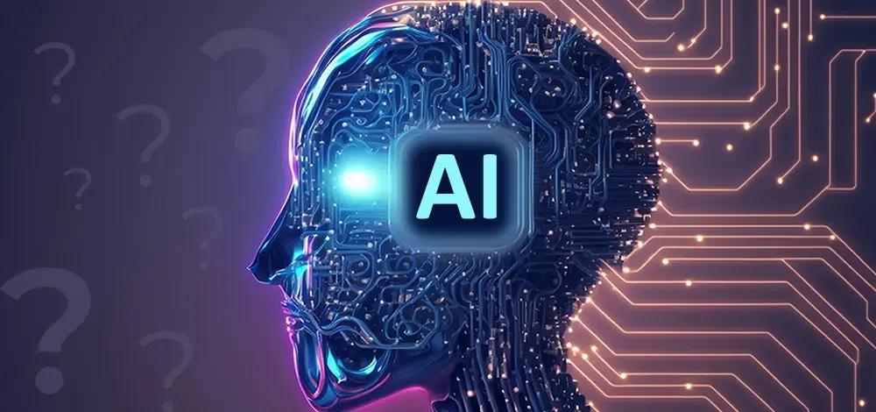

Slide 2
GROUP - 3
Group members
1.Loshini R
2.Mariyammal S
3.Nithya R
4.Pavithra R
5.Priyadharshini V
6.Shakthi M

Slide 3
INTRODUCTION
Artificial Intelligence (AI) refers to the simulation of human intelligence in machines that are programmed to think and act like humans. It involves the development of algorithms and computer programs that can perform tasks that typically require human intelligence such as visual perception, speech recognition, decision-making, and language translation. AI has the potential to revolutionize many industries and has a wide range of applications, from virtual personal assistants to self-driving cars.

Slide 4
DEFINITION
What is Artificial intelligence?
Artificial intelligence is the ability of machines to perform certain tasks, which need the intelligence showcased by humans and animals. This definition is often ascribed to Marvin Minsky and John McCarthy from the 1950s, who were also known as the fathers of the field.
Artificial intelligence allows machines to understand and achieve specific goals. AI includes machine learning via deep learning. The former refers to machines automatically learning from existing data without being assisted by human beings. Deep learning allows the machine to absorb huge amounts of unstructured data such as text, images, and audio.
Any AI system must be able to have some of the following characteristics: Observation, analytical ability, problem solving, learning, etc.

Slide 5
OBJECTIVES OF AI
Develop the problem solving ability
Incorporate knowledge representation
Facilitate planning.
Allow continuous learning
Encourage Social Intelligence
Promote creativity
Achieve General Intelligence
Promote synergy between humans and AI .

Slide 6
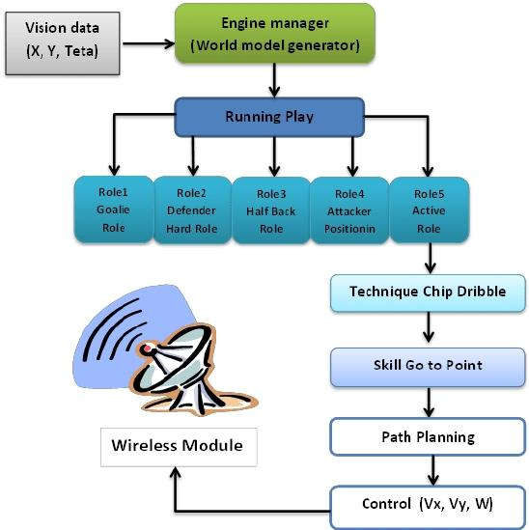
BLOCK DIAGRAM OF AI

Slide 7
USES OF AI
Artificial intelligence (AI) is becoming increasingly important in our daily lives. AI can automate routine and time-consuming tasks, allowing us to focus on more important activities. In addition, AI algorithms can analyze vast amounts of data to personalize products, services and experiences. Moreover, AI is driving innovation in various industries, such as finance, retail and education.
Here are seven artificial intelligence examples in everyday life.
1. Personal Assistants 7. Smart home devices
2. Social media
3. Customer service
4.Healthcare
. 5.E-commerce
6.Autonomous vehicles

Slide 8
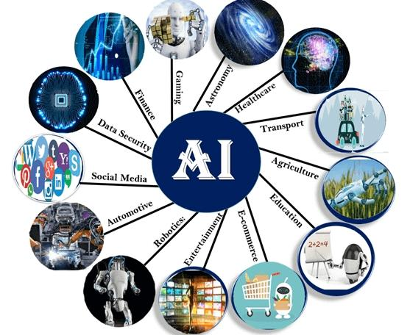
APPLICATIONS

Slide 9
FUTURE TRENDS
AI can deliver significant business impact, but companies can maximize its value by taking an end-to-end approach. Weaving together strategy, process redesign, and human and technical capabilities, we create the fabric of an AI-driven organization, enabling the outcomes that drive businesses forward.

Slide 10
CONCLUSION
Artificial intelligence has the potential to revolutionize virtually every area of life and business. This can be done by eliminating mundane or dangerous tasks from humans, allowing us to spend more time doing what we enjoy and are good at. AI-powered automation can help companies save on labor costs while increasing efficiency in production processes. Through improved analytics based off of the data acquired via machine learning algorithms, businesses will gain deeper insights into their operations, driving innovation and product development further than ever before. However, caution must be taken when implementing these technologies as there may be unforeseen consequences – both intended and unintended – that could have far-reaching effects if acted upon carelessly. With thoughtful planning and responsible oversight in place though, it is clear that artificial intelligence provides many opportunities for a bright future full of possibilities waiting to be explored.

Slide 11


