Slide 1
MERGE

Slide 2
OUR TEAM MEMBERS
TEAM MEMBER1
TEAM MEMBER3
NITIN MITTAL
TEAM MEMBER2
TEAM MEMBER4
TEAM MEMBER5
PRIYA
TOSHIMA SHARMA
ALKA VATS
NIKHIL VARGHESE

Slide 3
Outline
What MERGE is?
Make a Repository
How we clone?
How we ADD and check STATUS.
COMMITTING the files to remote repository
BRANCHES
MERGE
MERGE CONFLICT
REFERENCES
THANKS of vote.

Slide 4
What is merge?
git-merge - Join two or more development histories together.
In Git, the merging is a procedure to connect the forked history. It joins two or more development history together. The git merge command facilitates you to take the data created by git branch and integrate them into a single branch. Git merge will associate a series of commits into one unified history. Generally, git merge is used to combine two branches.

Slide 5
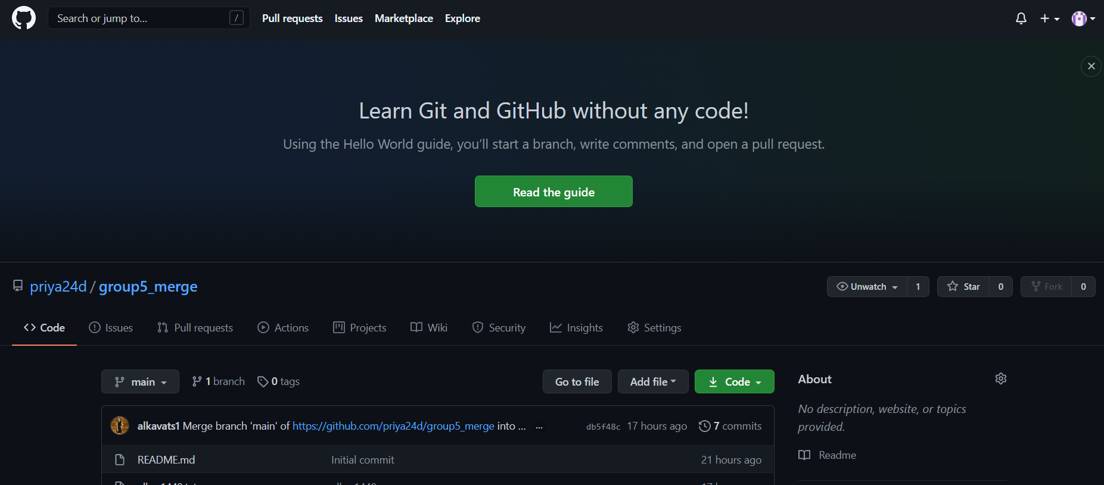
First we made a repository “group5_merge”
As by opening the GitHub account and gone for new repository.

Slide 6
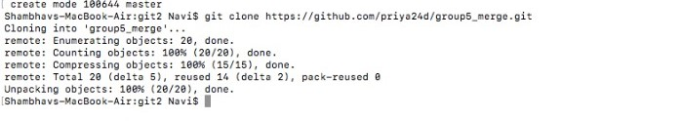
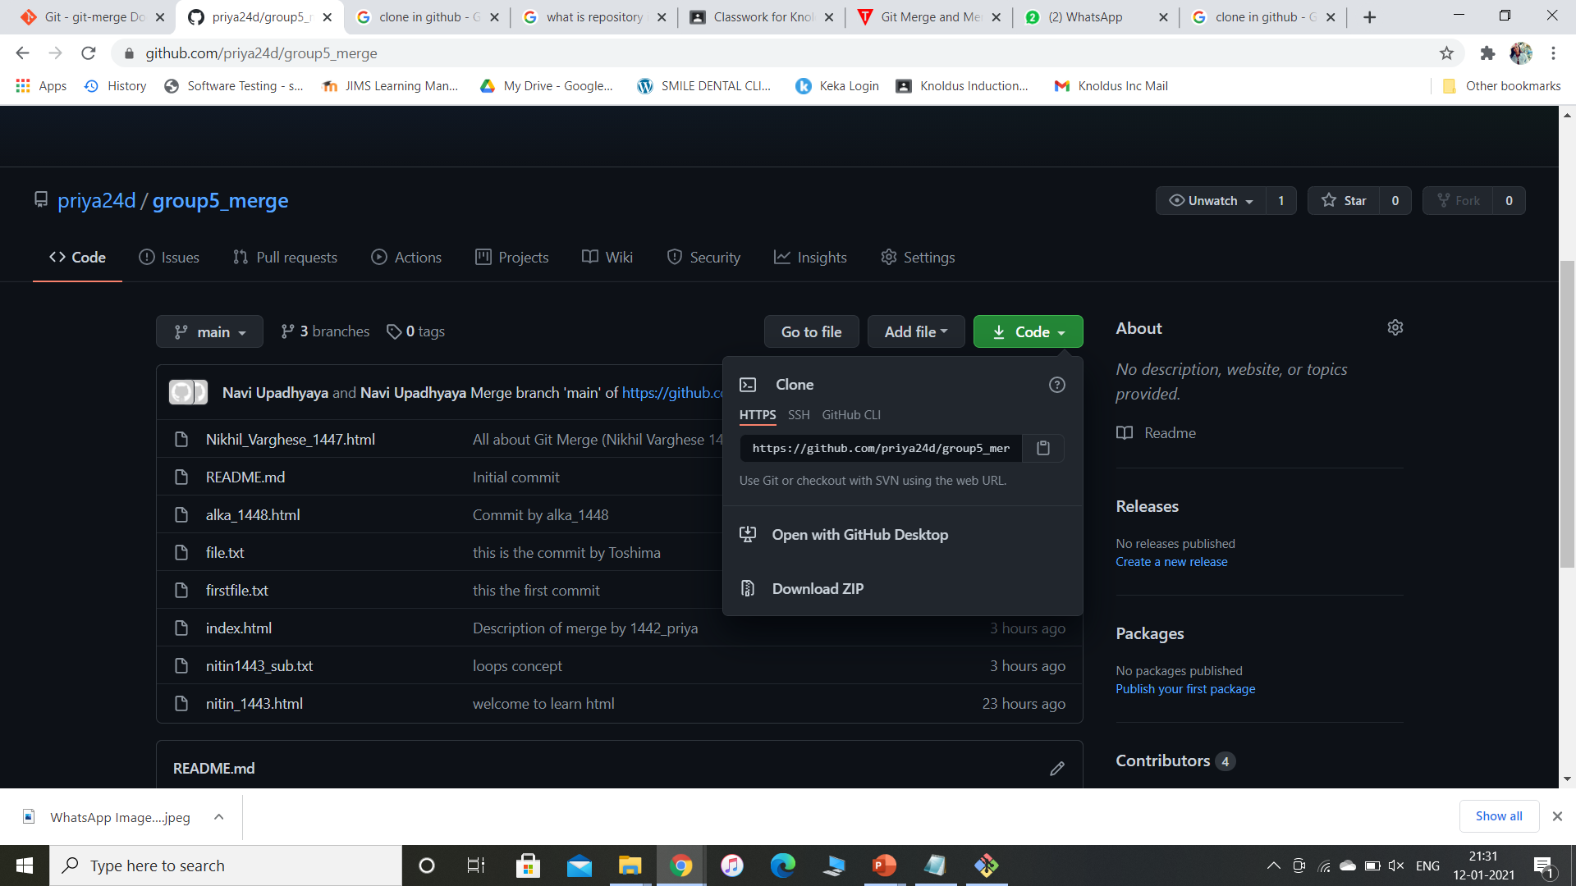
How we clone a repository?
Remote to Local Repository
git clone <repository url>
In Git, cloning is the act of making a copy of any target repository. The target repository can be remote or local. You can clone your repository from the remote repository to create a local copy on your system. Also, you can sync between the two locations.

Slide 7
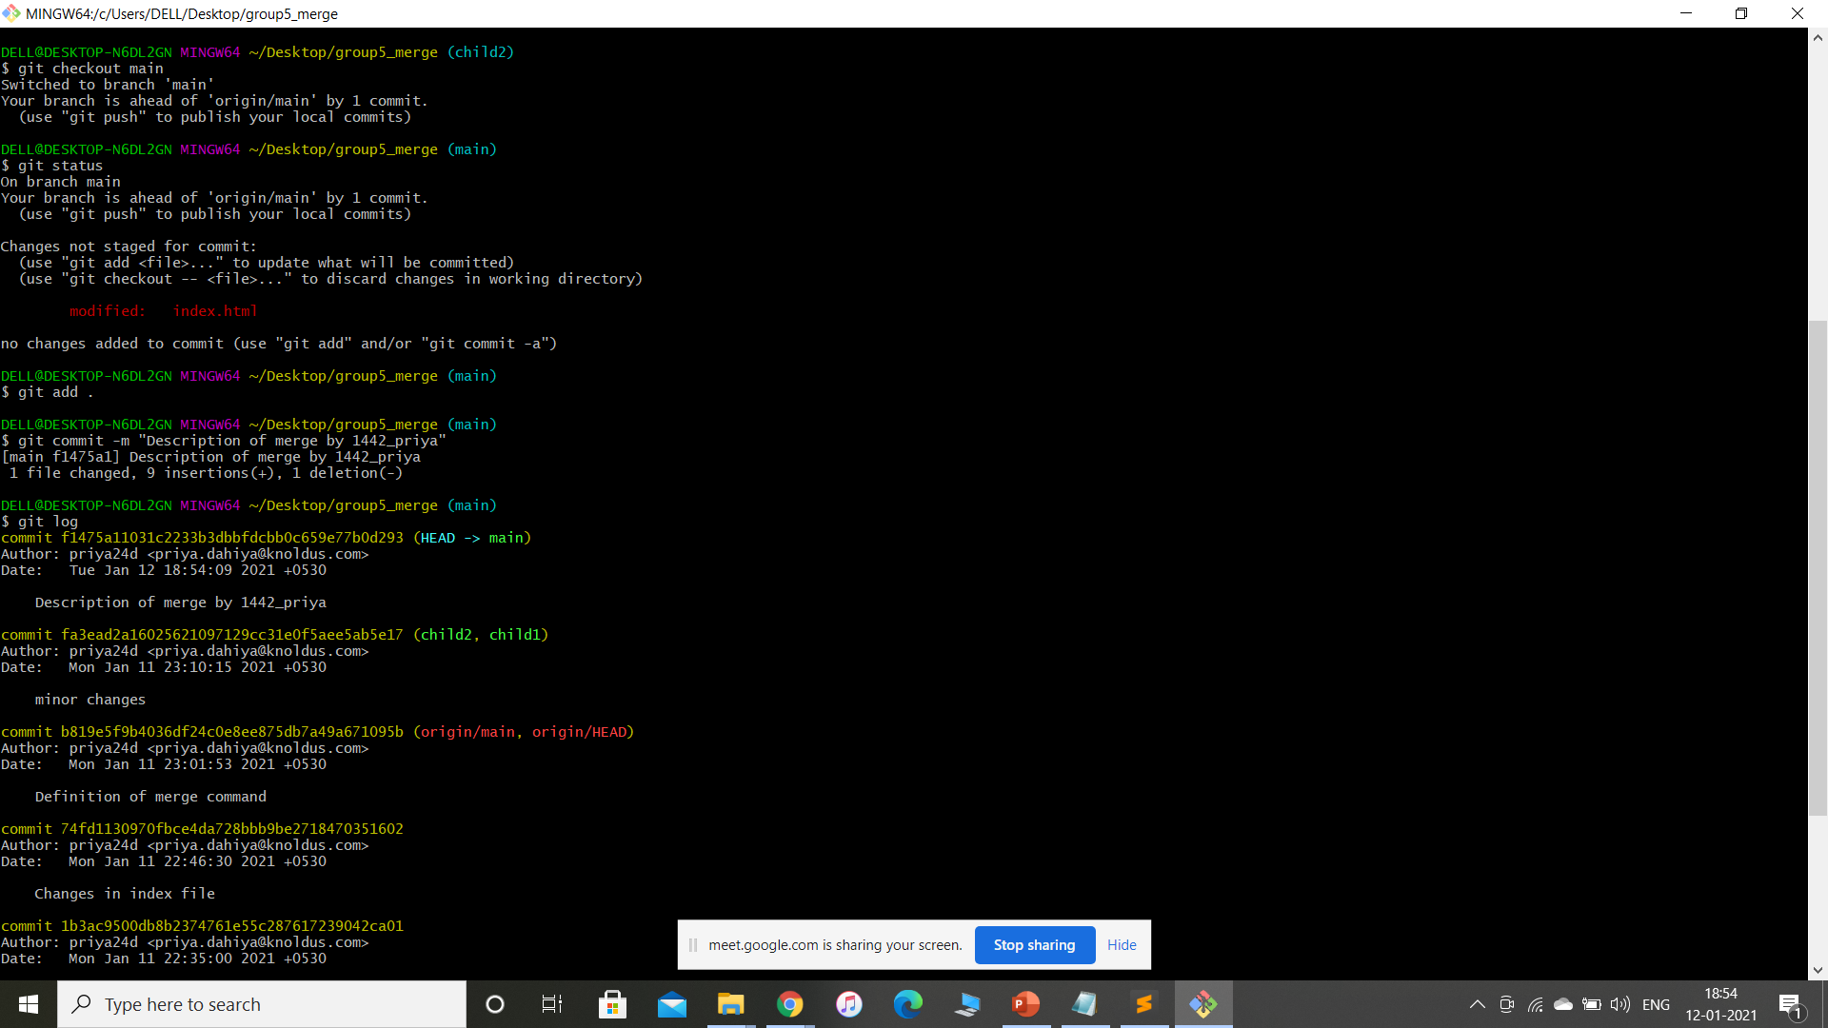
Adding files and checking status
git add.- used to add file contents to the staging area. It updates the current content of working tree to the staging area.
Adding specific file git add <filename>
Adding all files git add .
git status- used to display the state of repository and staging area.
Here in this image, index.html file is unstaged file or untracked.

Slide 8
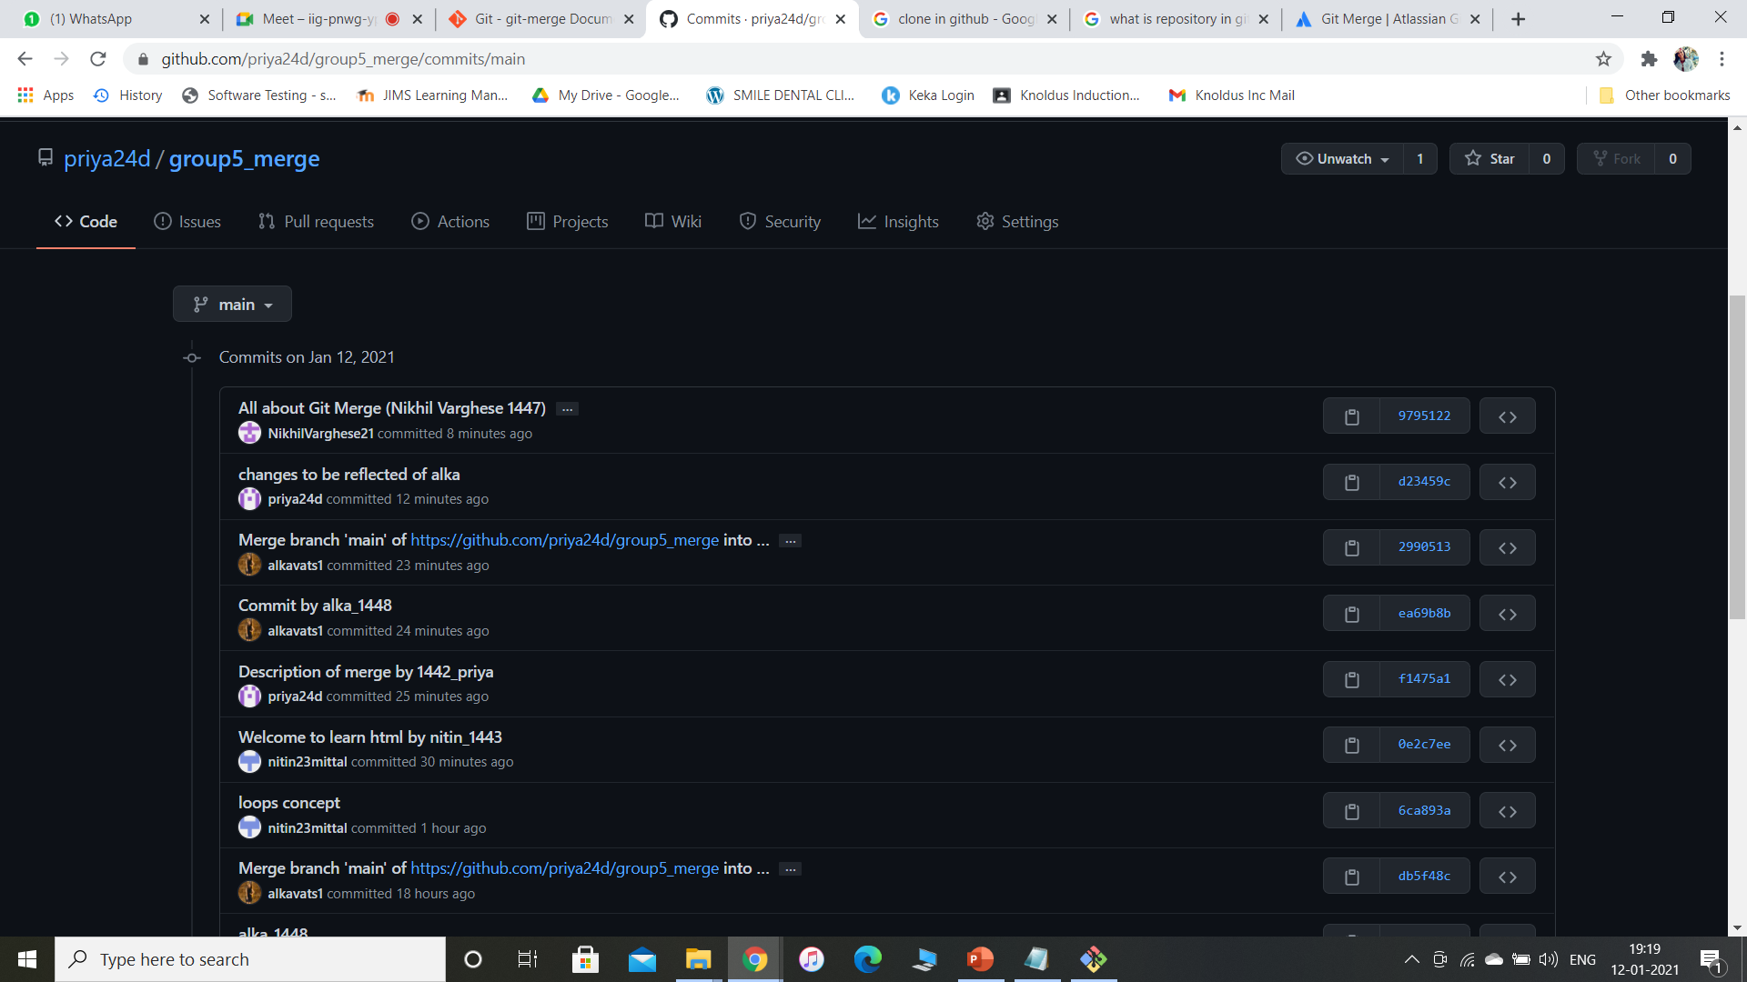
Commit (next command after the git add)
git commit –m “message”
Used to Record the changes in the repository.
Every commit contains the index data and the commit message.
Used to fetch updates from the staging area to the repository.

Slide 9
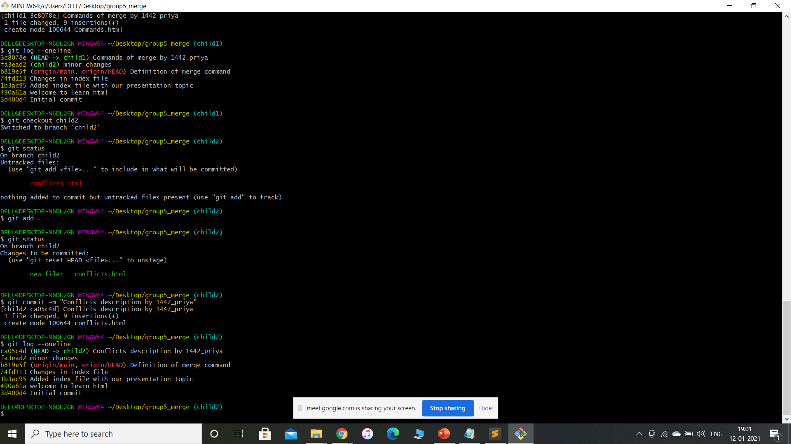
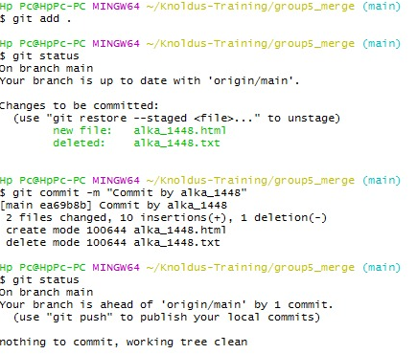
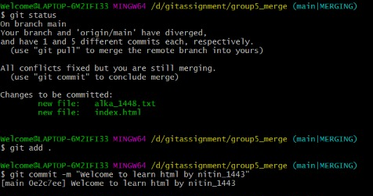
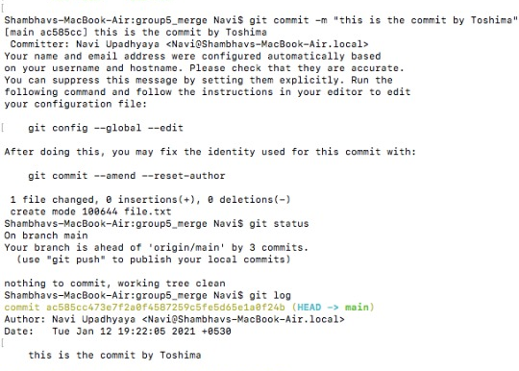
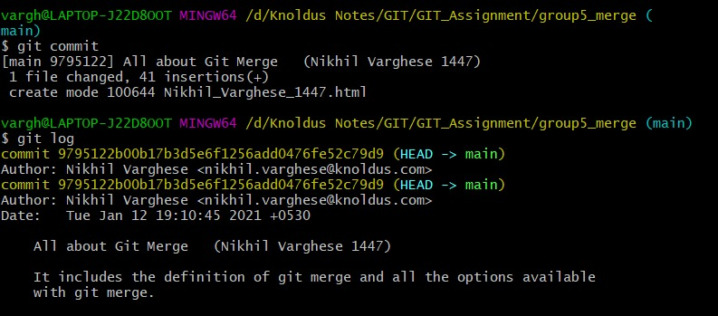
Commits by team members

Slide 10
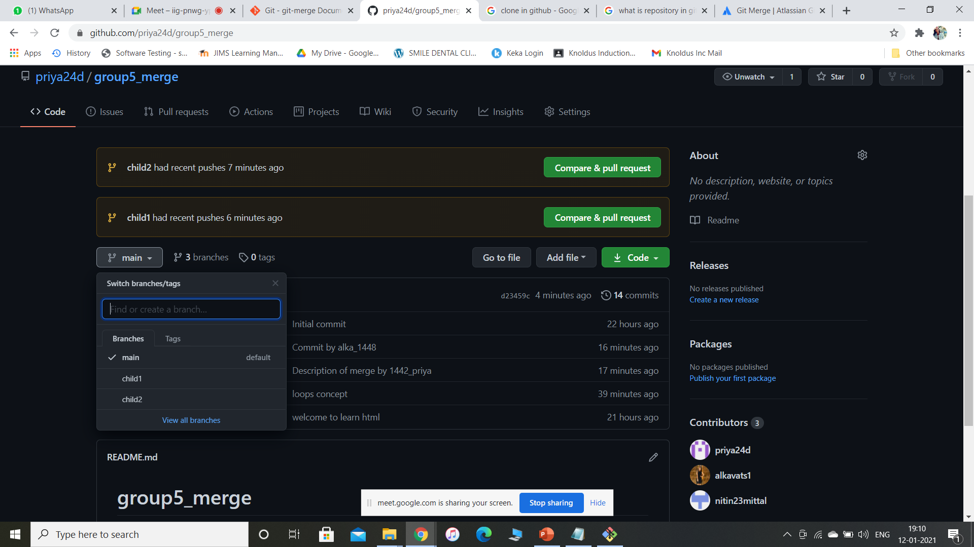
BRANCHES
git branch <branchname>
A Branch is a version of the repository that diverges from the main working project.
A git project can have more than one branch.
Here we have 3 branches main i.e. main branch of our repository another two branches are child1 and child2.
Creating Branch: - git branch <branchname>
List Branch: - git branch –list or git branch
Delete Branch:- git branch –d <branchname>
Switch Branch: - git checkout <branchname>

Slide 11
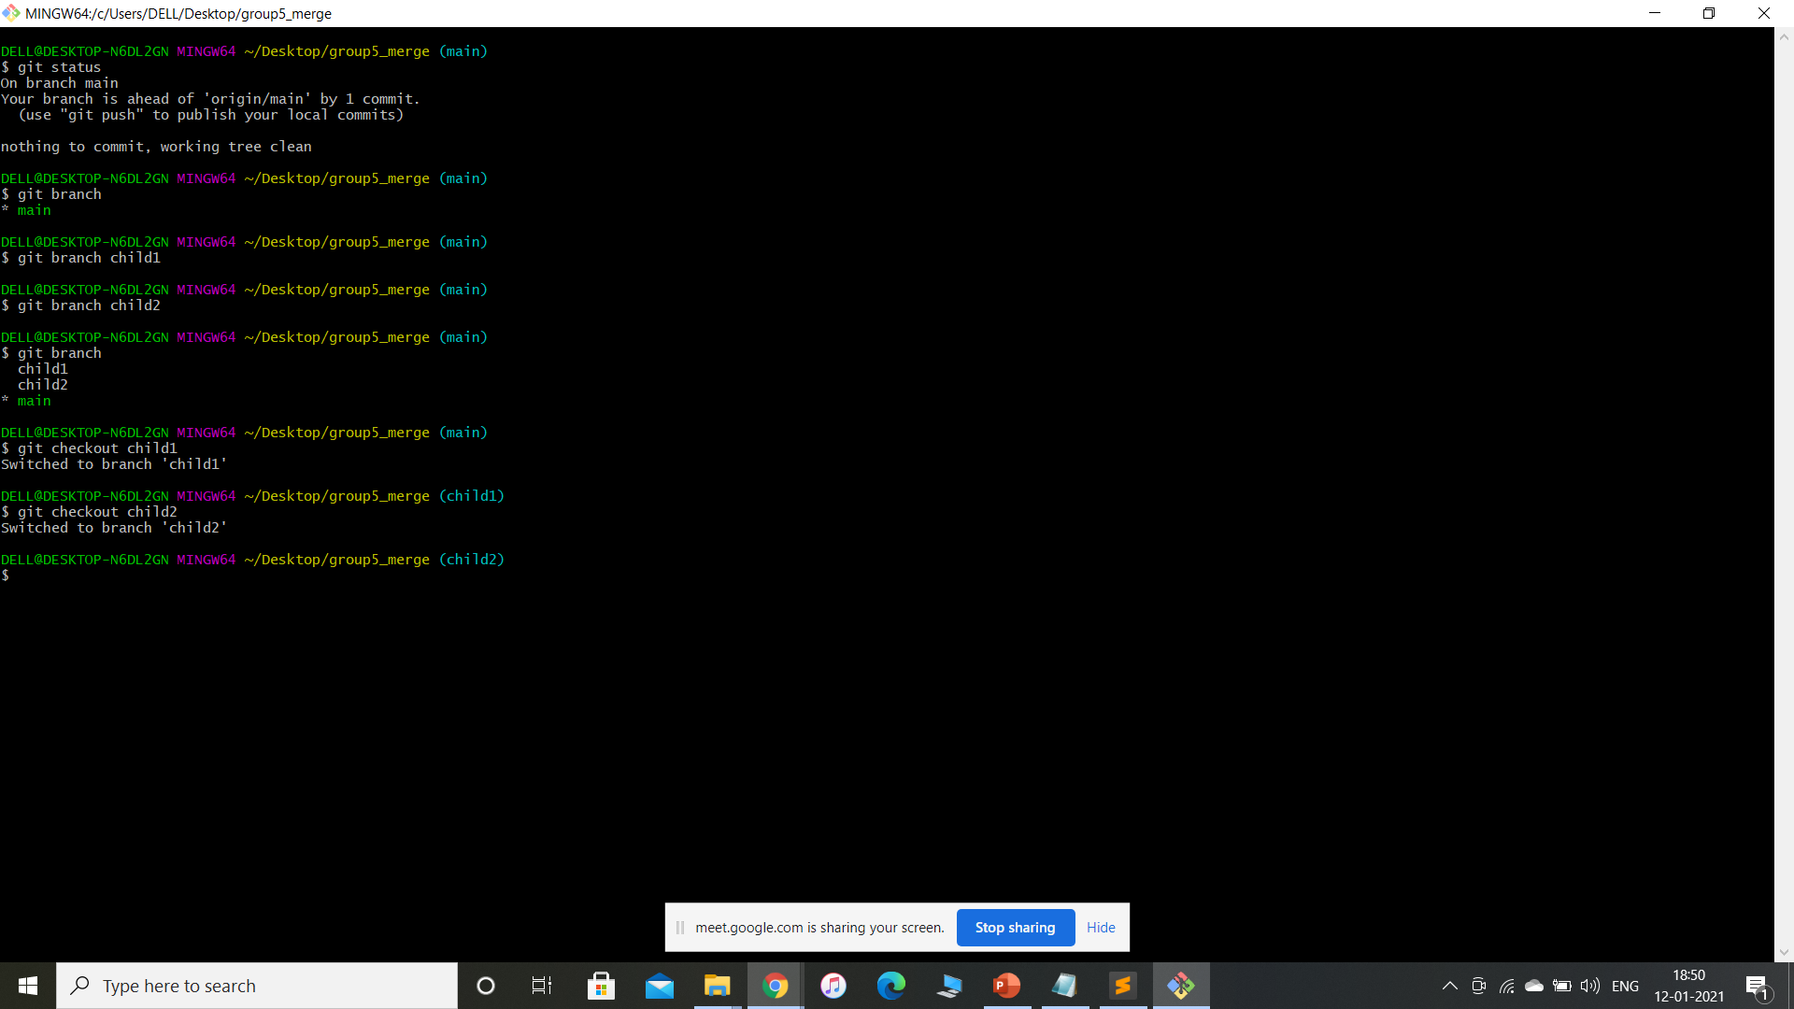
Creating, moving, listing branches

Slide 12
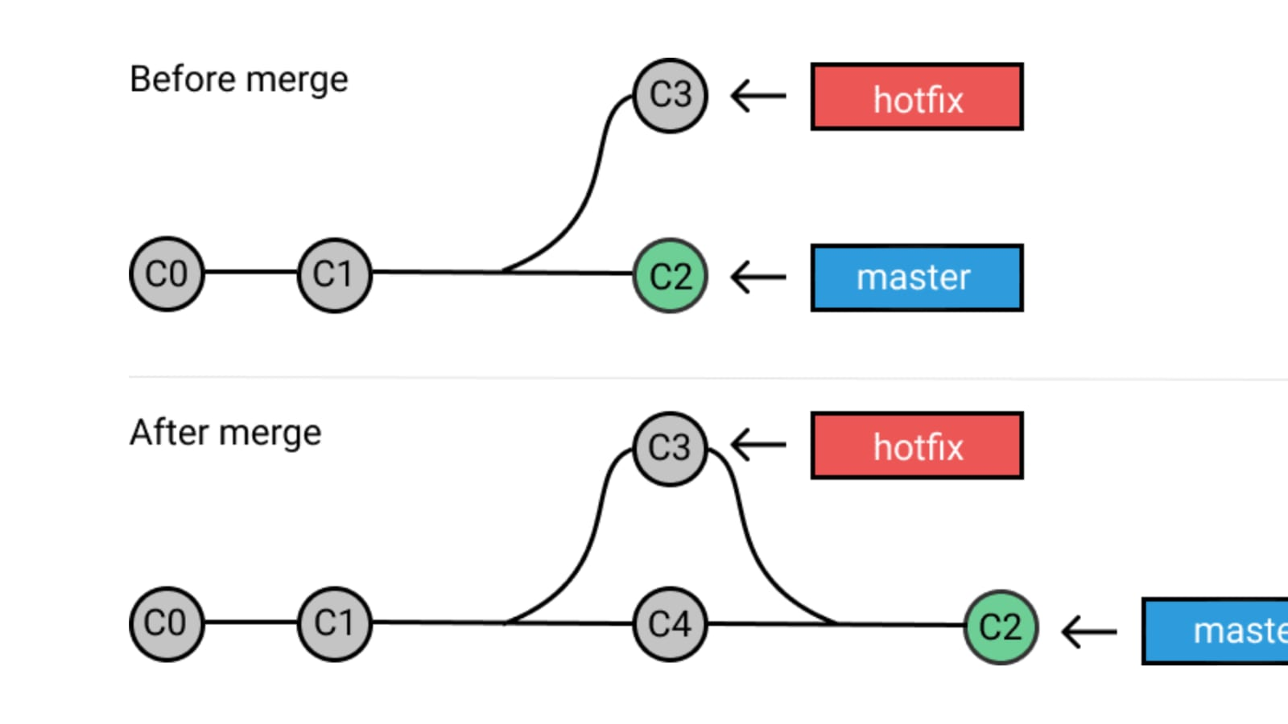
MERGE
git merge <branchname>
In Git, the merging is a procedure to connect the forked history. It joins two or more development history together.
Here, we merge child1 and child2 branches to the main branch.

Slide 13
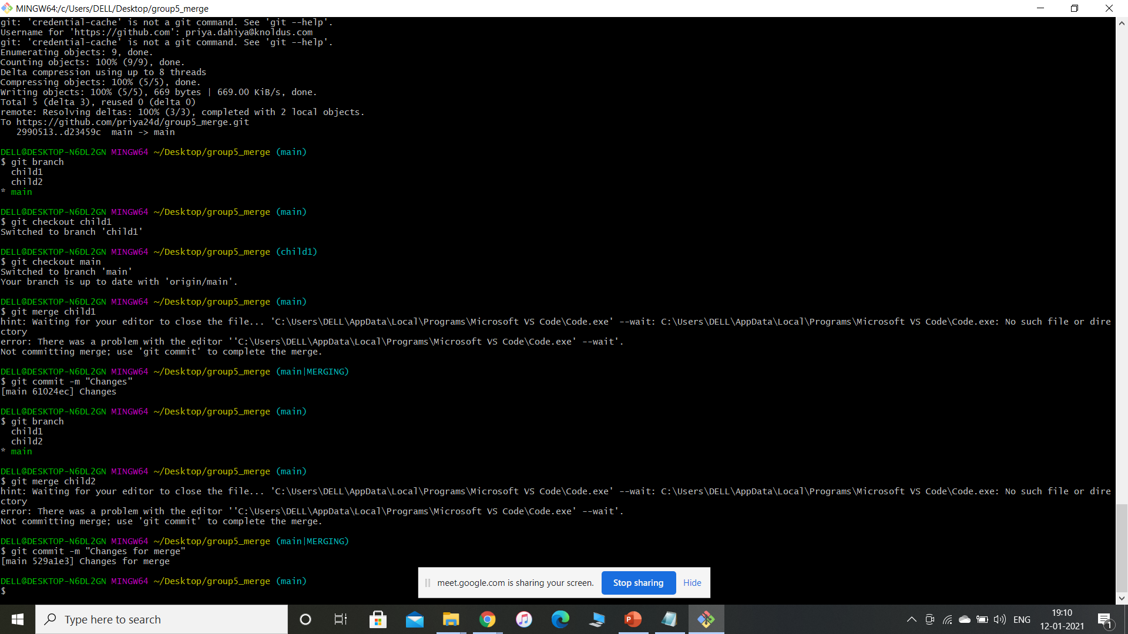
Steps to merge
In Git,
To merge commits into the main branch,
git log – to discover its commit id.
Then, switch over to the main branch
git checkout main
Then, git merge child1
It will merge child1 branch with the main branch. As specified in the image by us.

Slide 14
Different commands of merge
git merge –abort : It will abort the merge process and try to reconstruct the pre-merge stage.
git merge –commit : Perform the merge and commit the result.
git merge –quit : Forget about the current merge in progress.
git merge –continue : After a git merge stops due to conflicts you can conclude the merge by running continue.
git merge <commit> : Commits usually other branch heads, to merge into our branch.

Slide 15
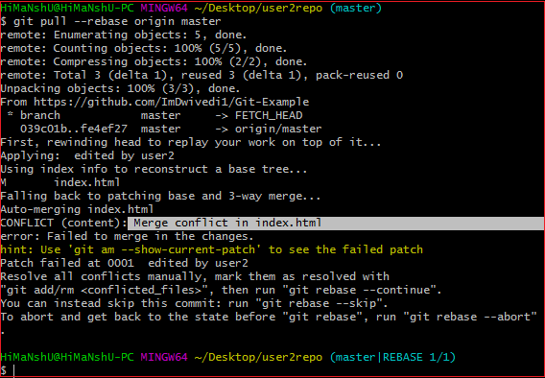
MERGE CONFLICTS
Here is how merge conflicts look like
In Git, when 2 branches are trying to merge, and both are edited at the same time and in the same file. Such a situation is called merge conflict.

Slide 16
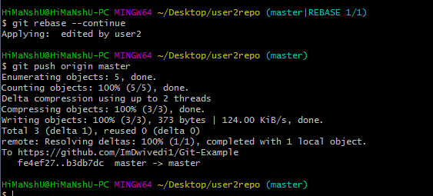
HOW TO RESOLVE CONFLICTS
To see that which is the first edited text of the merge conflict in your file, search the file attached with conflict marker <<<<<<<. You can see the changes from the HEAD or base branch after the line <<<<<<< HEAD in your text editor. Next, you can see the divider like =======. It divides your changes from the changes in the other branch, followed by >>>>>>> BRANCH-NAME.

Slide 17

THANK YOU!

