Slide 1

E- Commerce site

Slide 2
Submitted by:
MRINAL SINGH 2017UGCS010R
NEHA PATEL 2017UGCS011R
SRISHTI SUVERNA BARAIK 2017UGCS021R
ANJALI DUBEY 2017UGCS010R
SUPRIYA RANI 2017UGCS056R

Slide 3
INTRODUCTION
The proposed software product is the E-Commerce site(ECS).The system, a web application will be used to cater day-to-day grocery needs.
It is intended to act as a virtual supermarket, providing hassle free shopping experience to its customers, door step delivery of the products
The selected items may be collected in a shopping cart . At checkout time , more information will be needed to complete the transaction.
Usually, the customer will be asked to fill or select a billing address / a shipping address, a shipping option, and payment information such as credit card number. An e-mail notification is sent to the customer as soon as the order is placed.

Slide 4
USER CHARACTERSTICS

Slide 5
ADMINISTRATOR
Maintaining all the databases associated with the site like customer information ,product and stock management , order shipment, delivery, payment collection etc.

Slide 6
Customers/Visitors
Functionalities of the customers/visitor includes:
Browsing through the site, choosing products and placing them in virtual shopping cart.
To proceed with purchase, the customer is promoted to login and visitors are promoted to create an account .
Also, the customer can modify personal proﬁle information stated by application.
The customer can also view the status of any previous orders and cancel any order that has not been shipped yet.

Slide 7
Logical database
Proﬁle: Database of all the users accessing the system that includes their information like email id, password, phone number and other details
Order: It is the database of all the order the site or the administrator has
Shopping Cart: Contains the products that the customer is planning to purchase. Entities can be added to or removed from the cart.
Warehouse : Database of all the warehouses.
Invoices: It contains the information regarding billing.
Transaction : Payment information of all the customers.
Product Database: The database will contain information regarding product availabilty, stock etc.
Catalogue: It is the brochure containing the all the products the system has to oﬀer its customer.

Slide 8
FUNCTIONAL REQUIREMENTS
Functional Requirement
Registration
Cart
Login
Payment Collection
Receive Order
Shipping Items

Slide 9
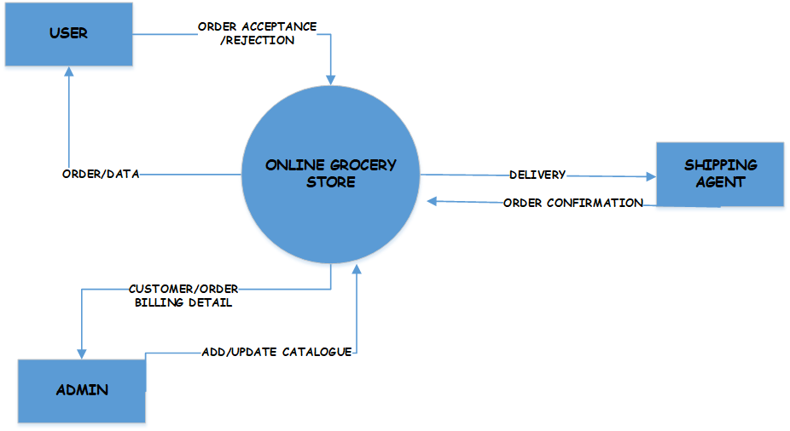
Context DIAGRAM

Slide 10
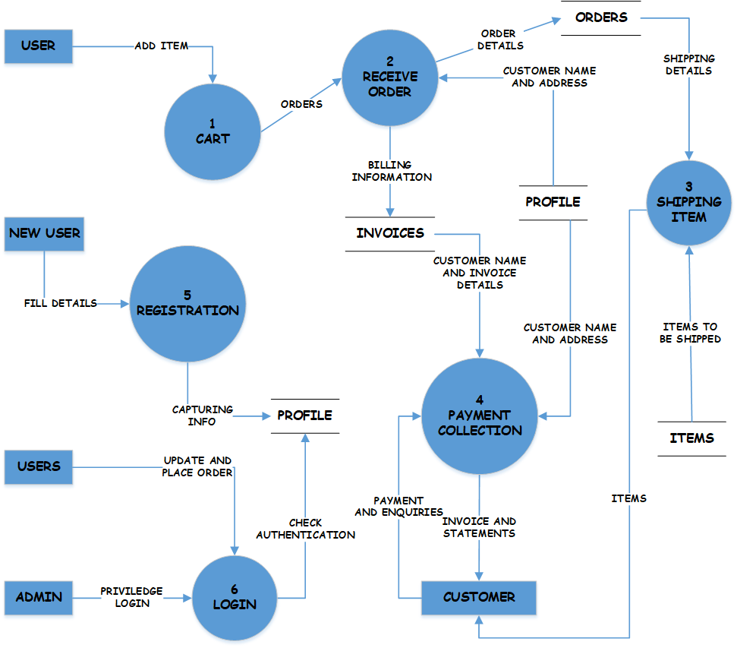
DFD LEVEL 1

Slide 11
DFD LEVEL 2

Slide 12
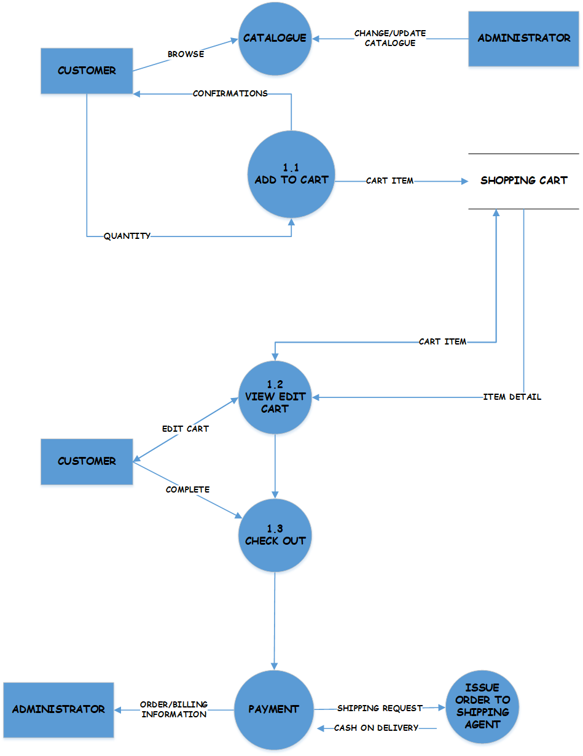
CART

Slide 13
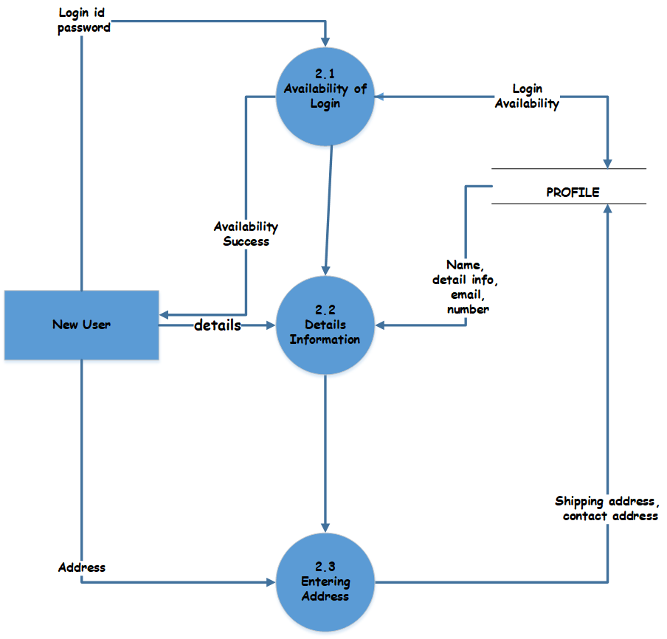
REGISTRATION

Slide 14
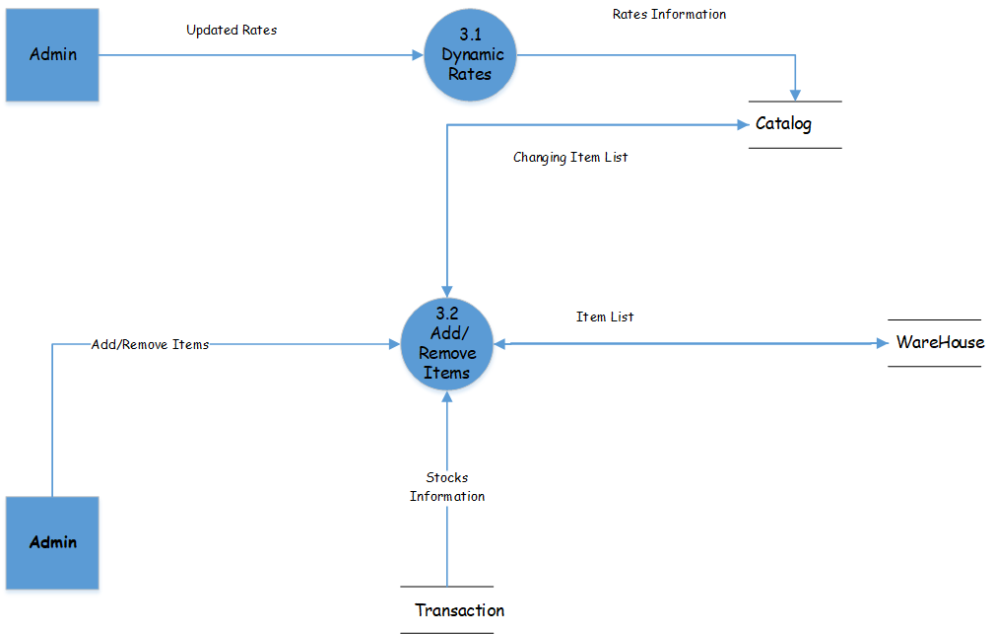
MAINTENANCE

Slide 15
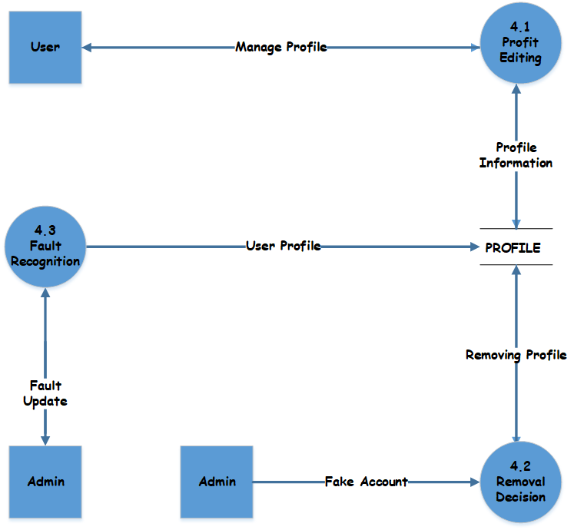
Profile handling

Slide 16
PHYSICAL transaction

Slide 17
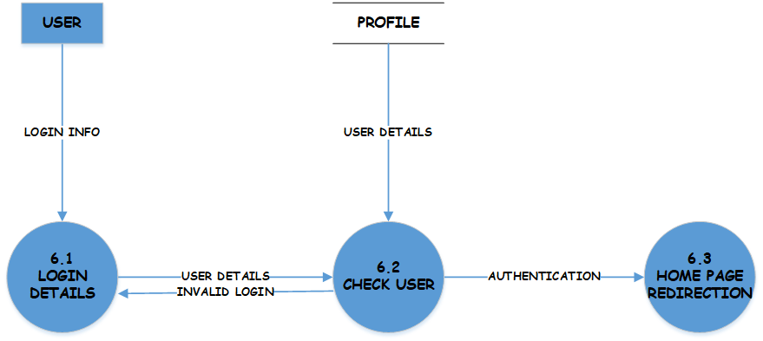
login

Slide 18
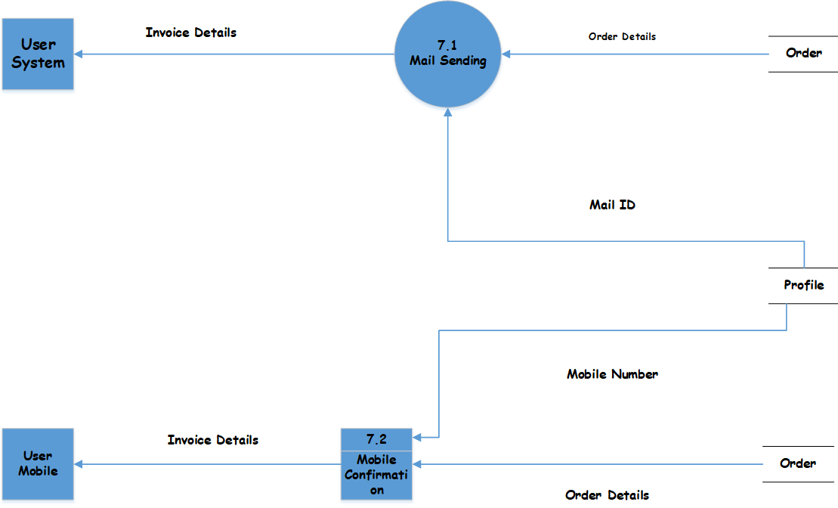
INTIMATION

Slide 19
DATA DICTIONARY
1. Item: String
2. Quantity: Integer
3. Price: integer
4. Customer- ID: Integer
5. Customer-Name: String
6. House No. : String
7. Street No : String
8. City: String
9. Pin: Integer

Slide 20
10. Date: year+ month +day
11. Year: Integer
12. Month: Integer
13. Day: Integer
14. Order : Customer-ID + items+ quantity + order No.
15. Order no. : Integer /*unique order no generated by the program*/
16. Bill : Item+ quantity + price +total amount+ customer address+ order no.
17. Customer address : Name+ house no. + street no. + city + pin
18. Total amount : Integer

Slide 21
STRUCTURE CHART

Slide 22
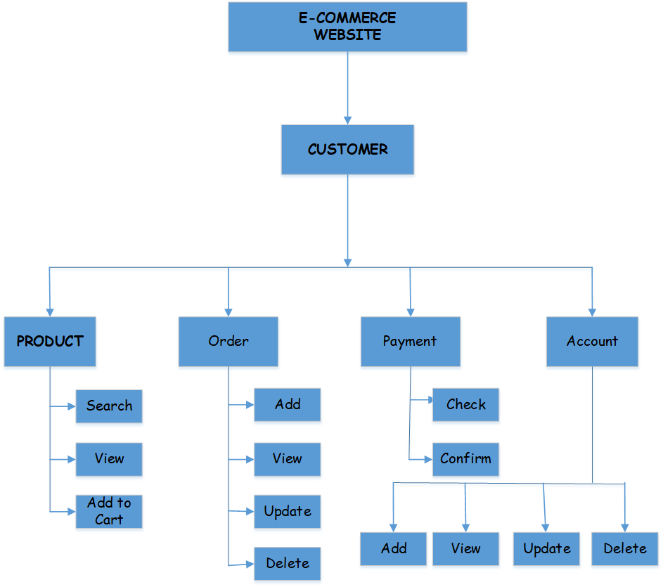
Customer related activities

Slide 23
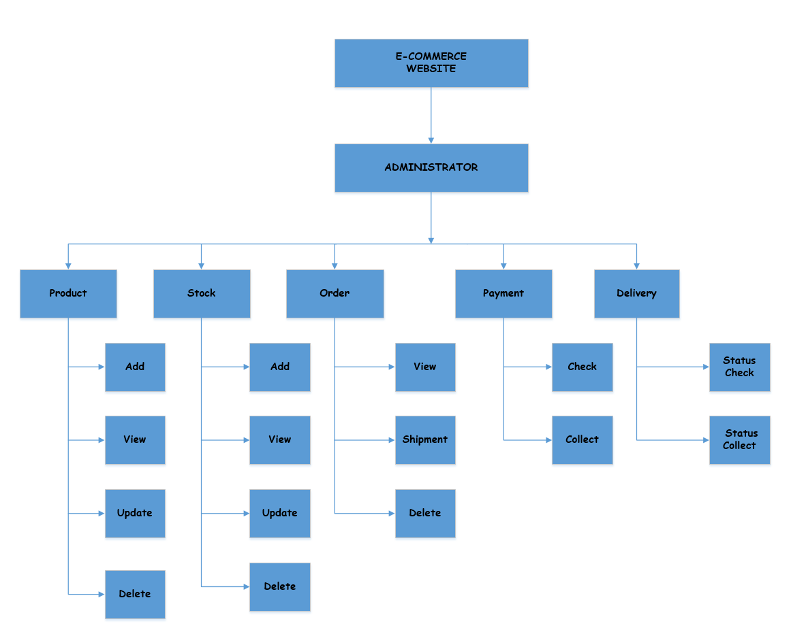
Administration related activities

Slide 24
CONCLUSION
The design of this software is very simple, user-friendly and interactive too, which makes it more efficient.
Agile model to be used for development of the software.

Slide 25
Table : E-commerce site
Serial No. | Role | Responsibility
1. | Administrator | Maintenance of database of customers and product
2. | Customer | Buy products from online book website
3. | Visitors | Surfs through the e-commerce site

Slide 26
Thank you

