Slide 1

INDIAN INSTITUTE OF INFORMATION TECHNOLOGY,RANCHI
FINAL YEAR MINOR PROJECT
ON
“FACIAL EXPRESSION RECOGNITION SYSTEM USING CONVOLUTION NEURAL NETWORK”
Under the supervision of
Dr. Kumari Pritee
(Assistant Professor, CSE, IIIT Ranchi)
SUBMITTED BY:
MRINAL SINGH (2017UGCS010R)
SUPRIYA RANI (2017UGCS056R)
SHOURYA PRATAP BHADAURIYA (2017UGCS062R)

Slide 2
CONTENTS
Introduction
Importance and Need
Objective and Scope
Working Principle and Methodology
Datasets
Software and Hardware Requirements
Conclusion
References

Slide 3
INTRODUCTION
A facial expression is the visible manifestation of the affective state, cognitive activity, intention, personality and psychopathology of a person and plays a communicative role in interpersonal relations.
Facial expression, as the most expensive and direct way to communicate emotion in humans, draws a lot of attraction. However, although facial expression can be easily recognized by human beings, reliable facial expression recognition by machine is still a great challenge.

Slide 4
Contd…
Automatic recognition of facial expressions can be an important component of natural human-machine interfaces. It needs to perform:
detection and location of faces in a cluttered scene
facial feature extraction
facial expression classification.

Slide 5
IMPORTANCE AND NEED
Facial expressions convey non-verbal cues, which play an important role in interpersonal relations.
Automatic recognition of facial expressions can be an important component of natural human-machine interfaces;
It may also be used in behavioural science and in clinical practice.

Slide 6
OBJECTIVES AND SCOPE
Our aim is to propose an approach that can achieve the desired goal of face expression identification effectively.
Facial expression recognition system will be implemented using Convolution Neural Network (CNN) to classify images of human faces into discrete expression categories and compare the result of different datasets.
CNN model of the project is based on LeNet Architecture.

Slide 7
WORKING PRINCIPLE AND METHODOLOGY

Slide 8
TRAINING PHASE
STEPS:
The training step takes as input an image with a face.
Normalization is applied to the image.
Normalized images are used to train the Convolutional Network.
The output of the training step is a set of weights that achieve the best result with the training data
Time consuming Process

Slide 9
Training Phase
Raw Image
Normalization
CNN Train
CNN weights
Fig. 1

Slide 10
TESTING PHASE
During test, the system receives a grayscale image of a face from test dataset, and outputs the predicted expression by using the final network weights learned during training.
Output is to be a single number that represents one of the seven basic expressions.

Slide 11
Testing Phase
CNN Weights
Raw Image
Normalization
CNN
Facial Expression
Fig. 2

Slide 12
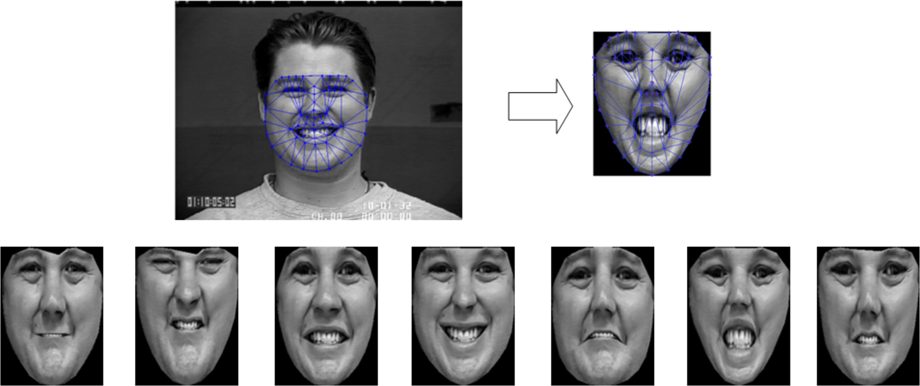
Normalization
Fig. 3

Slide 13
Convolutional Neural Network (CNN)
In machine learning, a convolutional neural network (CNN, or ConvNet) is a type of feedforward artificial neural network in which the connectivity pattern between its neurons is inspired by the organization of the animal visual cortex.
A typical architecture of a convolutional neural network contains an input layer, some convolutional layers, some fully-connected layers, and an output layer. Here, CNN is to be designed with some modification on LeNet Architecture.

Slide 14
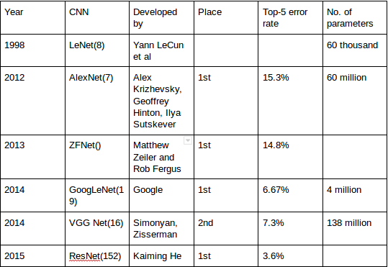
Classic Architectures:
Fig.4

Slide 15
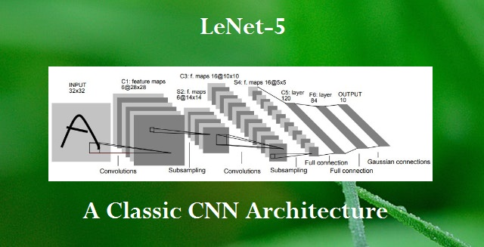
LeNet Architecture
LeNet is one of the very first convolutional neural networks which helped propel the field of Deep Learning.
It has 6 layers without considering input and
output.
Fig. 5

Slide 16
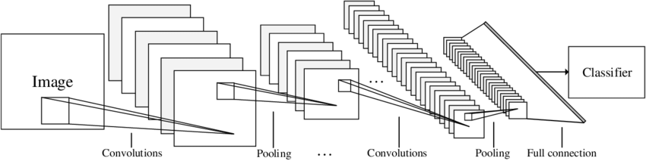
Example: LeNet Architecture (Broad View)
Fig. 6

Slide 17
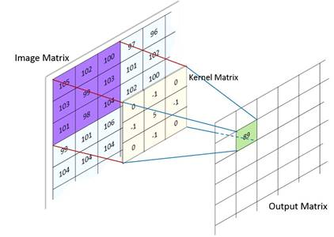
Step 1. Convolution
Fig. 7

Slide 18
Image Padding
Fig. 8

Slide 19
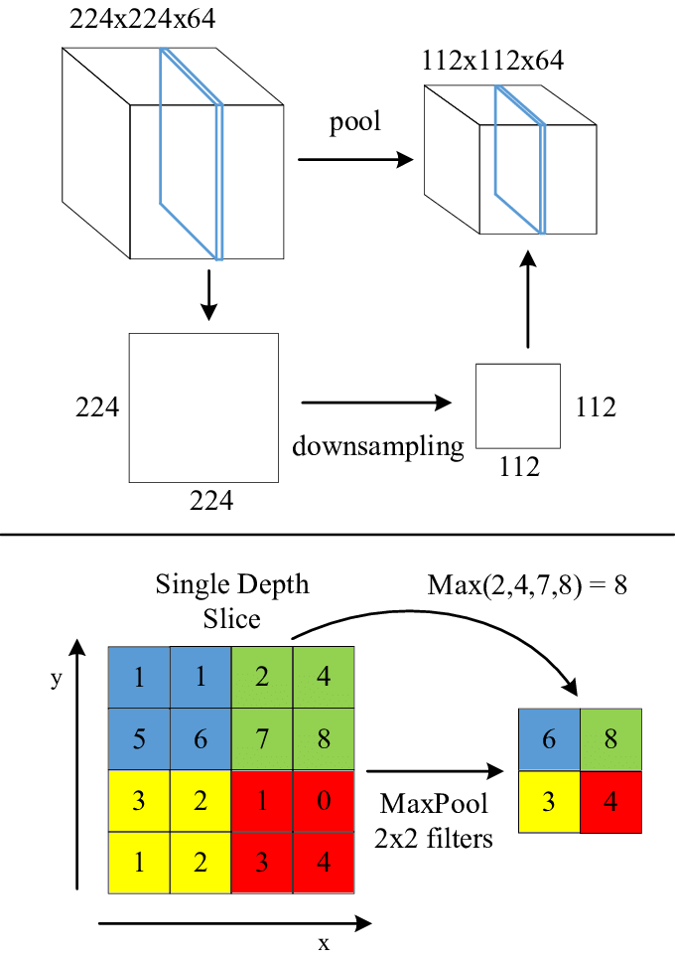
Step 2. Max Pooling
Fig. 9

Slide 20
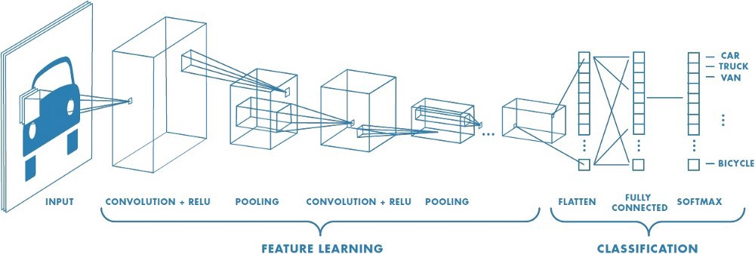
Fully Connected and Output Predictions
Fig. 10

Slide 21
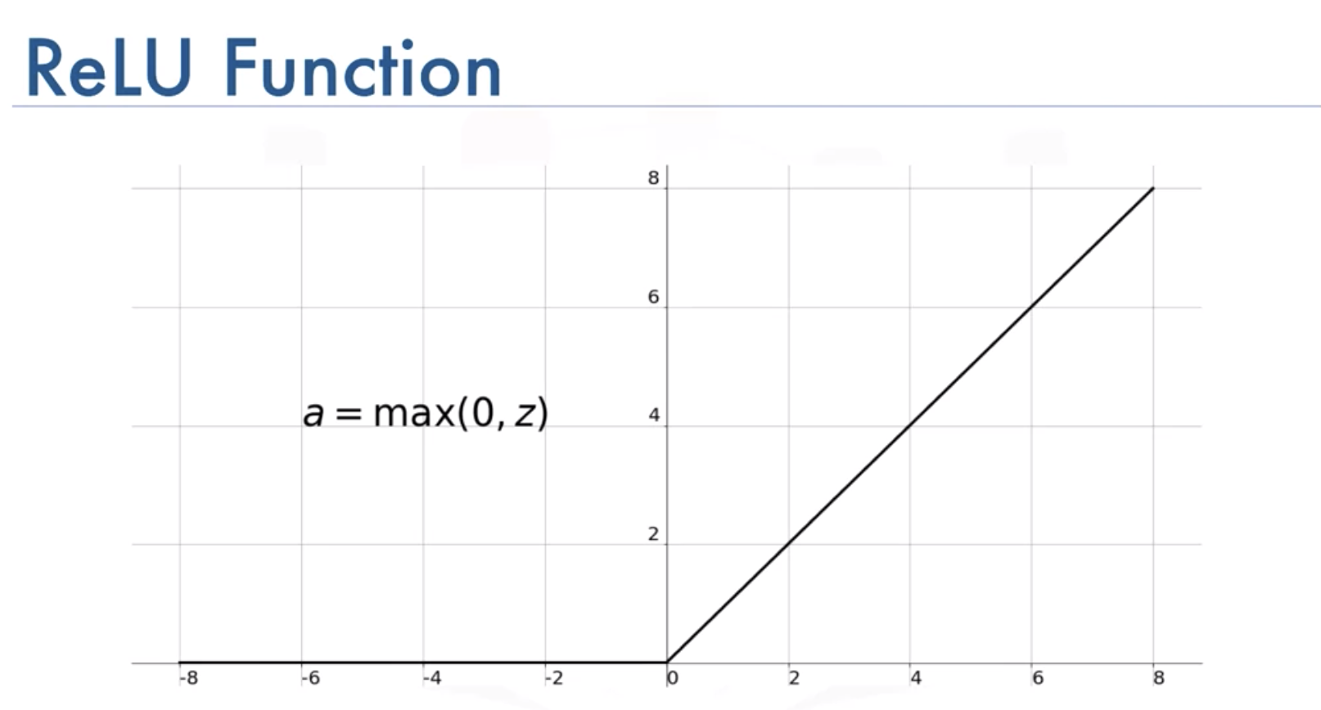
Relu Activation Function
Fig. 11

Slide 22
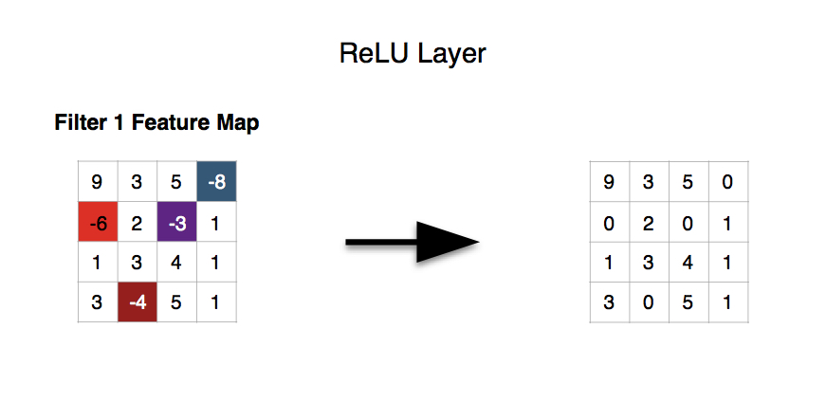
Fig. 12

Slide 23
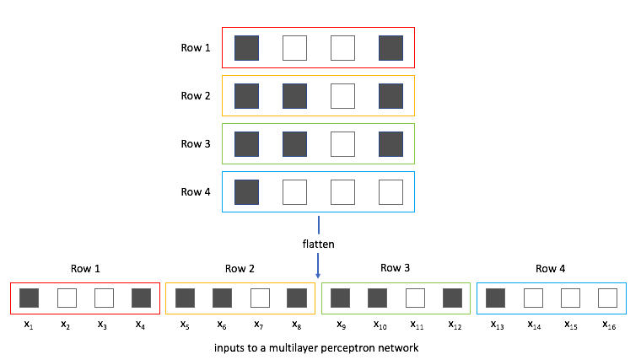
Flattening of Image
Fig. 13

Slide 24
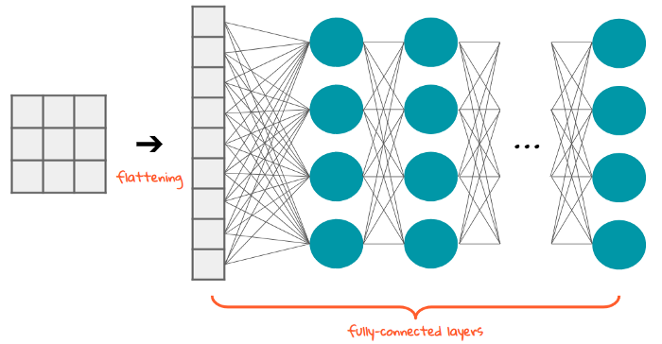
Connected Layers
Fig. 14

Slide 25
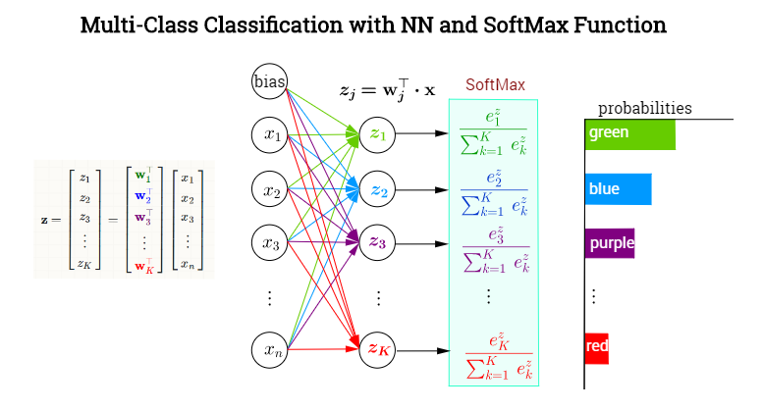
Softmax and Probability connection
Fig. 15

Slide 26
Insights to datasets
This dataset was prepared by Pierre-Luc Carrier and Aaron
Courville. The dataset is collected from Kaggle website.
The data consists of 48x48 pixel grayscale images of faces.
The training set consists of 28,821 examples and validation set consist of 7,066 examples.
The faces have been automatically registered so that the face is more or less centered and occupies about the same amount of space in each image.
The task is to categorize each face based on the emotion shown in the facial expression in to one of seven categories (0=Angry, 1=Disgust, 2=Fear, 3=Happy, 4=Sad, 5=Surprise, 6=Neutral).

Slide 27
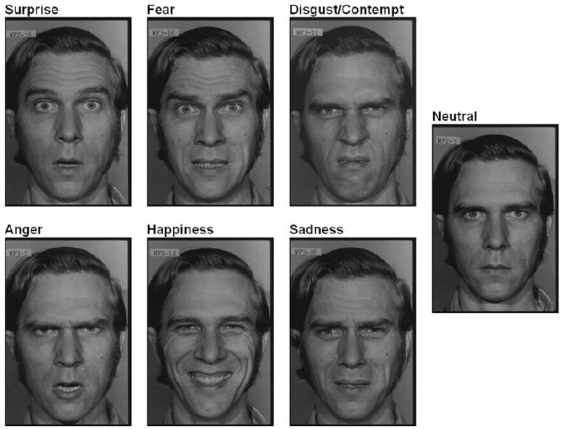
Fig. 16

Slide 28
SOFTWARE AND HARDWARE REQUIREMENTS
Software Requirements:-
1. Opencv 2.0
2. Python 3.0
Hardware Requirements:-
1. Web camera

Slide 29
CONCLUSION
In this project, we have used LeNet architecture based on convolution neural network to recognize human facial expressions i.e. happy, sad, surprise, fear, anger, disgust, and neutral from grayscale pictures.
After using different optimizing techniques and proper training, our model will able to predict the outcome from the datasets.

Slide 30
REFERENCES
Shan, C., Gong, S., & McOwan, P. W. (2005, September). Robust facial expression recognition using local binary patterns. In Image Processing, 2005. ICIP 2005. IEEE International Conference on (Vol. 2, pp. II-370). IEEE.
Chibelushi, C. C., & Bourel, F. (2003). Facial expression recognition: A brief tutorial overview. CVonline: On-Line Compendium of Computer Vision, 9.
"Convolutional Neural Networks (LeNet) – DeepLearning 0.1 documentation". DeepLearning 0.1. LISA Lab. Retrieved 31 August 2013.

Slide 31
THANK YOU!

