Slide 1
What is Apache Airflow 3.0?
Released: April 22, 2025 - First major release in 5 years (since Airflow 2.0 in 2020)
What it is: A complete architectural overhaul of Apache Airflow with service-oriented design.
Why it matters: Addresses pain points from 2.x, enables event-driven workflows, improves security, and expands to ML/AI use cases.

Slide 2
Core Architecture Changes:
Airflow 2.x Architecture
Airflow 3.0 Architecture
• Monolithic design
• Direct database access
• Tight coupling
• Limited isolation
• Service-oriented design
• Task Execution API
• API-based access
• Strong task isolation
Key Components:
API Server: Central access point for metadata, replaces direct database access
Task Execution Interface: Enables remote task execution with improved isolation
Edge Executor: Supports distributed task execution in edge and cloud environments

Slide 3
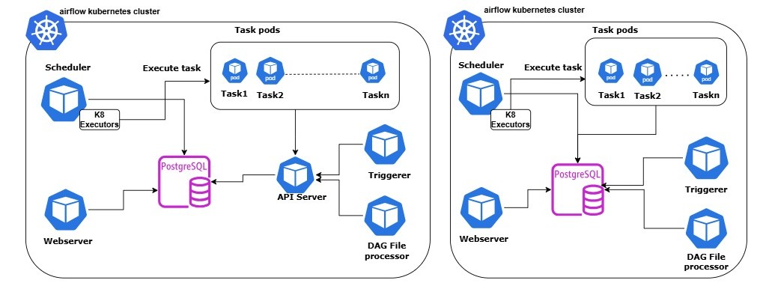
Architecture comparison:
Airflow 3.0.x
Airflow 2.0.x

Slide 4
Task SDK: The Foundation of Airflow 3.0
What is the Task SDK?
A lightweight runtime environment providing a stable, forward-compatible interface for DAG authoring and task execution, completely decoupled from Airflow internals.
Key Features:
Benefits:
• New airflow.sdk namespace
• Python-native DAG interfaces
• Isolated subprocess execution
• API-based resource access
• Version-agnostic compatibility
• Enhanced security & isolation
• Future multi-language support
• Cleaner, more maintainable DAGs
• Remote execution capabilities
• Reduced upgrade complexity

Slide 5
Task SDK: New Import Pattern
Airflow 2.x (Old Way)
Airflow 3.0 (New Way)
from airflow import DAG
from airflow.decorators import task
from airflow.operators.python import
PythonOperator
# Direct database access
# allowed (security risk)
from airflow.sdk import DAG, task
# Stable public interface
# No direct DB access
# API-based resource access
# Forward-compatible

Slide 6
Major New Features in Airflow 3.0
DAG Versioning
Asset-Driven Scheduling
Track DAG changes over time, immutable execution snapshots
Event-driven workflows with @asset decorator (renamed from Datasets)
Scheduler Backfills
Modern React UI
UI/API-triggered backfills managed by scheduler, not CLI
Complete UI rebuild with FastAPI backend, dark mode support
Edge Executor
Enhanced Security
Distributed task execution for edge and cloud environments
Task isolation, no direct database access from tasks

Slide 7
DAG Versioning:
Most requested feature from the Airflow community
The Problem in Airflow 2.x:
• DAGs updated mid-run executed different versions
• No tracking of which code version ran
• UI showed latest version even for old runs
• Impossible to debug historical issues
The Solution in Airflow 3.0:
• Each DAG run tied to immutable snapshot
• Complete version history in UI
• Task structure, code, and logs preserved per version
• Essential for compliance and auditing

Slide 8
Modern React UI with FastAPI
Old UI (Flask)
New UI (React + FastAPI)
• Dated interface
• Slow page loads
• Limited interactivity
• Flask AppBuilder dependency
• No dark mode
• Modern, intuitive interface
• Fast, responsive
• Enhanced grid/graph views
• FAB moved to provider
• Native dark mode
UI Improvements:
Better navigation • Enhanced asset panel • Backfill management from UI • Improved filtering and search • Faster task introspection • Version-aware views

Slide 9
Assets & Event-Driven Scheduling
(formerly known as Datasets)
What Changed:
• Datasets renamed to Assets for better alignment with data ecosystem terminology
• New @asset decorator for cleaner, asset-centric DAG definitions
• Asset Watchers: React to external events (webhooks, message queues, file uploads)
• Full REST API for external system integration
Use Cases:
• Trigger DAGs when data arrives (not just on schedule)
• Chain DAGs across teams when assets are updated
• Integrate with Amazon SQS, Kafka, and other message systems
• Enable truly event-driven workflows

Slide 10
Scheduler-Managed Backfills:
Airflow 2.x
Airflow 3.0
• CLI-only backfills
• Separate processes
• Session timeouts
• Hard to monitor
• Fragile for large jobs
• UI & API support, Scheduler-managed
• No timeouts
• Real-time monitoring
• Reliable at scale
Benefits:
• Start backfills with one click from UI
• Monitor progress in real-time
• Pause, cancel, or modify running backfills
• Essential for ML retraining and historical data processing

Slide 11
Breaking Changes & Migration
Removed Features:
What Changed:
• SubDAGs (use TaskGroups)
• SLAs (use Deadline Alerts)
• XCom/DAG pickling
• Sequential Executor
• Direct DB access from tasks
• Old context variables
• CLI split: airflow + airflowctl
• Imports: airflow.sdk namespace
• logical_date = run_after
• Python 3.9-3.13 supported
• REST API v2 (FastAPI)
• SQLAlchemy 2.0 support
Migration Requirements:
Upgrade to Airflow 2.7+ first
Run ruff checker for DAG compatibility
Update imports to airflow.sdk
Replace direct DB access with API calls
Test thoroughly in dev environment

Slide 12
Additional Improvements
Performance & Reliability:
ML/AI Enhancements:
• Faster scheduler
• Improved dependency tracking
• Better database connectivity
• Reduced memory leaks
• Enhanced error handling
• Non-interval DAGs
• Parallel inference runs
• Model experimentation support
• Hyperparameter tuning
• GenAI workflow optimization
Developer Experience:
Enterprise Features:
• Simplified DAG authoring
• Better debugging tools
• Enhanced logging
• TaskFlow API improvements
• Enhanced RBAC
• Audit logging
• Compliance improvements
• Multi-tenancy support

Slide 13
Modern Technology Stack
Python 3.9 - 3.13 Support
SQLAlchemy 2.0 Compatibility
PostgreSQL psycopg3 Driver Support
Airflow 3.0 embraces the latest Python ecosystem improvements for better performance, security, and developer experience.

Slide 14
Apache Airflow 3.0
The Future of Workflow Orchestration
Key Takeaways:
✓ Service-oriented architecture with Task SDK
✓ Enhanced security through task isolation
✓ Modern React UI with improved UX
✓ DAG versioning for better governance
✓ Event-driven scheduling with Assets
✓ Production-ready for ML/AI workflows

