Slide 1
Appointment Management System Industrial Training Project Report
Mr. Yash Somnath Gorde & Ms. Priya Shivaji Gunjal
Sahakar Maharshi Bhausaheb Santuji Thorat College of Arts,
Science & Commerce, Sangamner
Academic Year 2024-2025

Slide 2
Overview
Project Title: Appointment Management System
Submitted By: Yash Somnath Gorde & Priya Shivaji Gunjal
Guided By: Prof. Mande P.B.
Institution: Sahakar Maharshi Bhausaheb Santuji Thorat College
Internship: Maxgen Technologies Pvt. Ltd. (Nov 2024 – Mar 2025)
Technologies: Java (Spring Boot), Python (Django), React.js, MongoDB,MySQL, PostgreSQL

Slide 3
Introduction
A microservices-based web application to streamline healthcare appointment
scheduling
Key Features:
Appointment booking, rescheduling, and cancellation
Real-time doctor availability tracking
Automated notifications (Email/SMS)
Role-based access (Admin, Doctor, Patient)
Objective: Enhance eﬀiciency, reduce manual work, and improve patient experience

Slide 4
Existing System & Need
Existing System Limitations:
Manual/phone-based bookings prone to errors
Paper-based records, diﬀicult to manage
Limited scalability and integration
Ineﬀicient scheduling leading to missed appointments
Need for the System:
Centralized platform for appointment management
Real-time availability and digital records
Scalable, secure, and user-friendly solution

Slide 5
Scope of Work
Appointment Scheduling: Patients book, reschedule, or cancel
appointments
Doctor Management: Manage schedules and patient details
Hospital Administration: Monitor activities and generate reports
Notifications: Automated email/SMS alerts
Data Management: Structured (MySQL, PostgreSQL) and unstructured
(MongoDB) data
Security: Role-based access, encryption
Scalability: Microservices architecture for high traﬀic

Slide 6
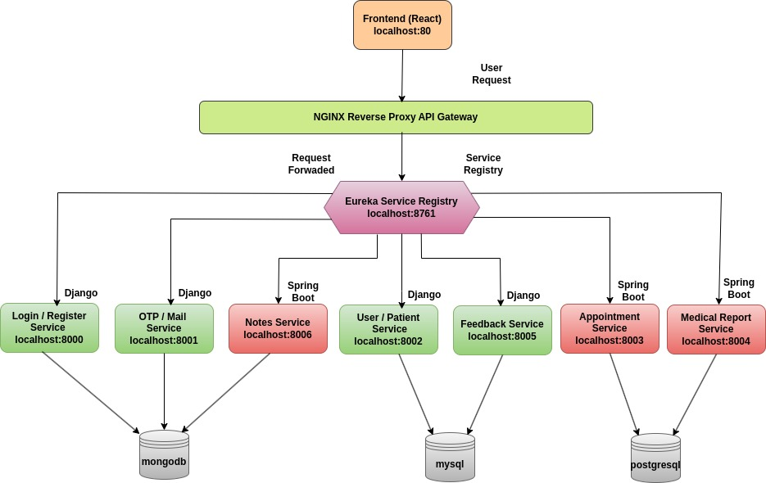
System Architecture

Slide 7
Operating Environment
Hardware Requirements:
Server: Intel Xeon/AMD Ryzen 7, 8GB RAM, 1TB SSD
Client: Intel i5/AMD Ryzen 5, 4GB RAM, 256GB SSD
Software Requirements:
Server: Ubuntu 22.04/Windows Server 2019, Spring Boot, Django, NGINX
Databases: MongoDB, MySQL, PostgreSQL
Client: Windows 10/11, macOS, Linux, Chrome/Firefox/Edge

Slide 8
Feasibility Study
Technical: Open-source tools (React.js, Django, Spring Boot); team expertise available
Economic: Cost-effective with open-source tech and cloud hosting
Operational: User-friendly interface, role-based access
Legal: Complies with data privacy laws, secure authentication
Schedule: Agile development ensures timely delivery

Slide 9
System Objectives
Secure scheduling & management
Efficient doctor/patient handling
Scalable & customizable architecture

Slide 10
User Requirements
Admin:
Manage doctors, patients, appointments, and reports
Role and permission management
Doctor:
View appointments, update availability
Add medical notes/prescriptions
Patient:
Register, book/cancel appointments
Receive notifications, view history

Slide 11
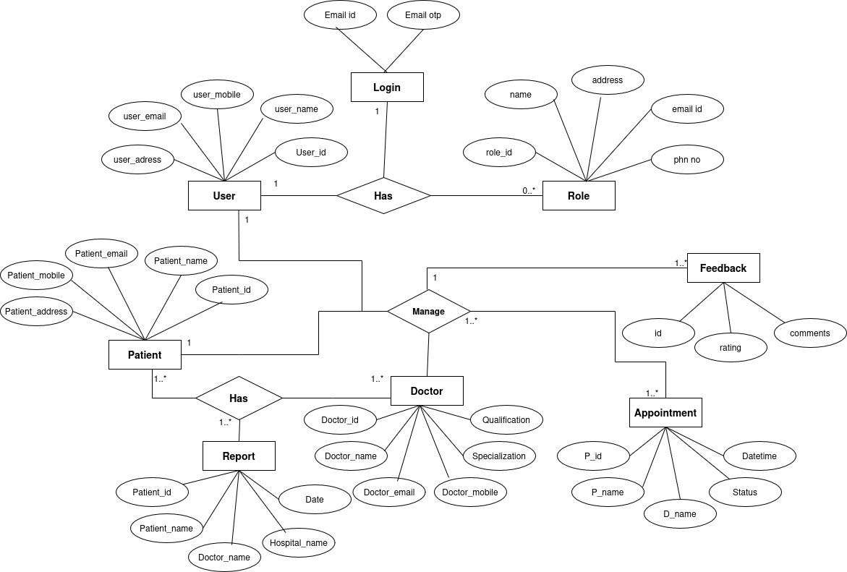
ER Diagram

Slide 12
UML Diagrams
Class Diagram
Object Diagram
Use case Diagram
Sequence Diagram
Activity Diagram
Collaboration Diagram
Component Diagram
Deployment Diagram

Slide 13
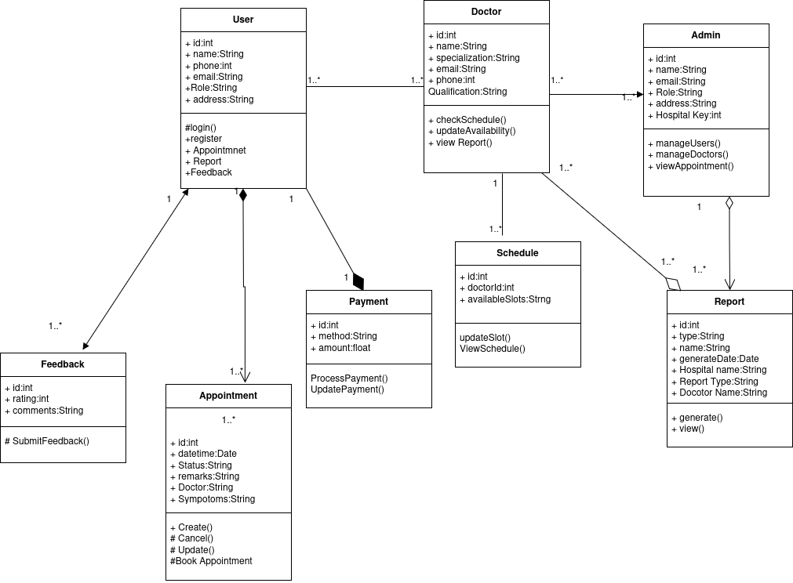
Class Diagram

Slide 14
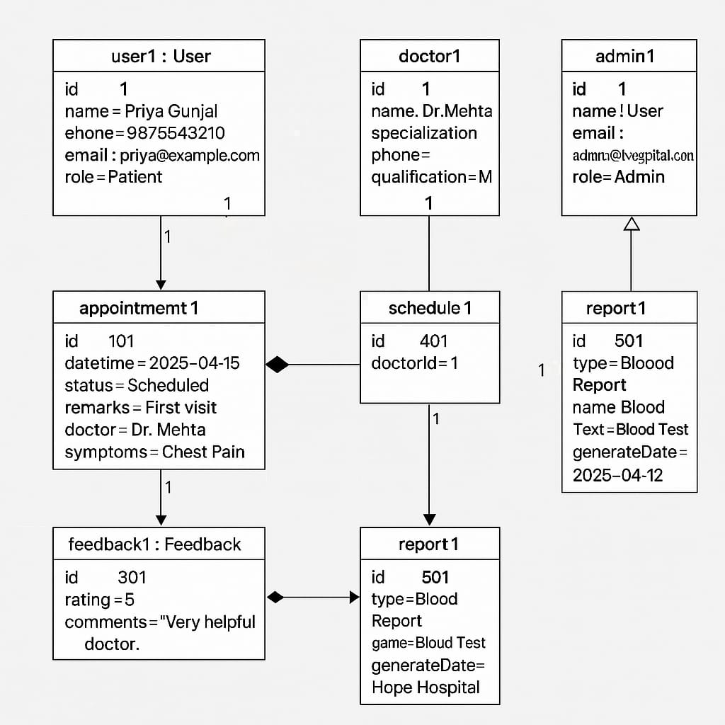
Object Diagram

Slide 15
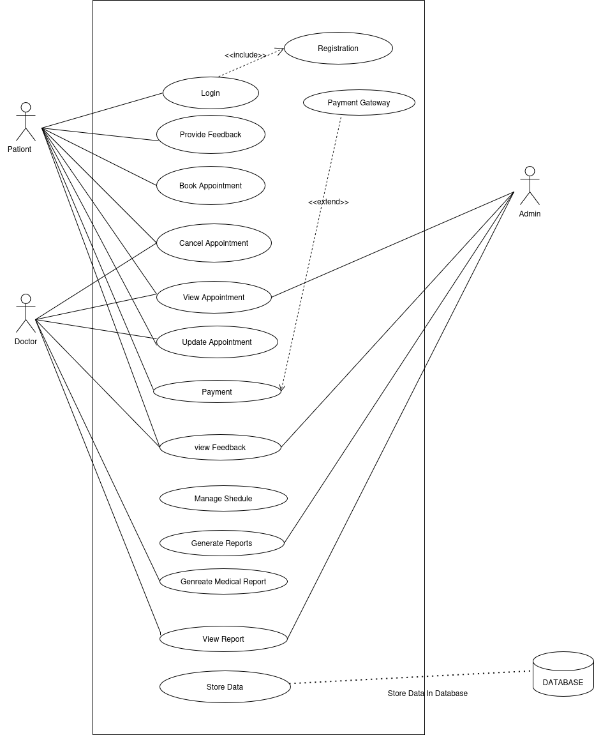
UseCase Diagram

Slide 16
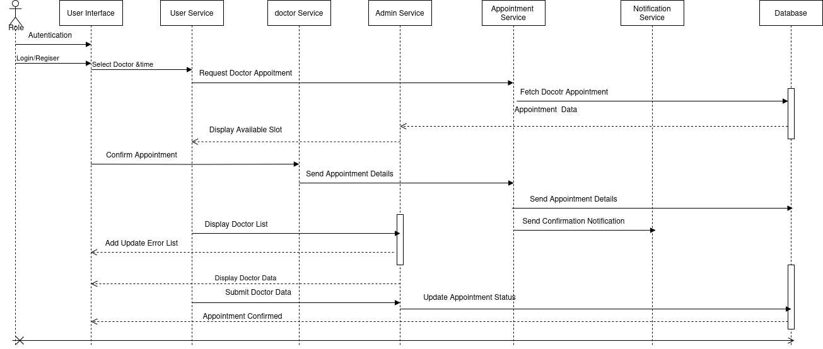
Sequence Diagram

Slide 17
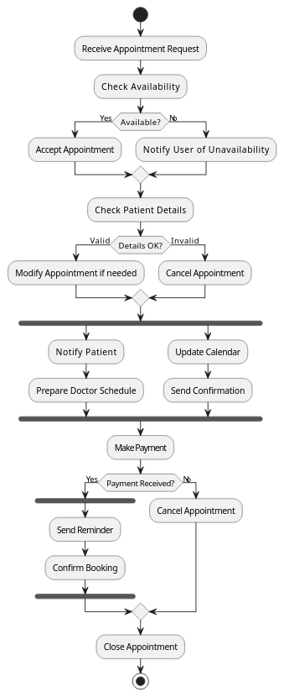
Activity Diagram

Slide 18
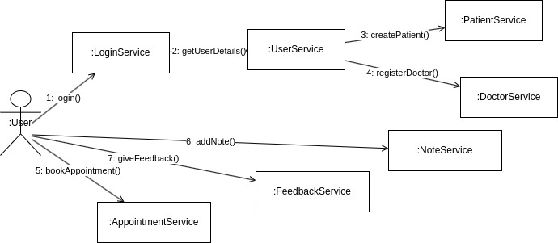
Collaboration Diagram

Slide 19
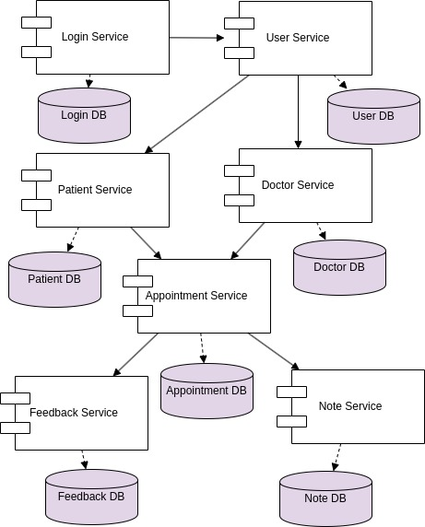
Component Diagram

Slide 20
Deployment Diagram

Slide 21
Data Dictionaries
Doctor_Details
Column | Type | Null | Default | Description
id | bigint | Not Null | - | Primary Key
name | varchar(255) | Not Null | - | Doctors Name
specialization | varchar(255) | Not Null | - | Area of experties
contact | varchar(255) | Not Null | - | Phone number
email | varchar(255) | Not Null | - | Email address
address | longtext | Not Null | - | Residential address
qualifications | longtext | Not Null | - | Education background
experience | int | Not Null | - | Year of experience
doctor_number | varchar(20) | Not Null | - | Registration number
emergency_contact | varchar(15) | Not Null | - | Emergency contact number
aadhar_number | varchar(12) | Not Null | - | Aadhar number
image | longtext | Null | - | Profile Image
aadhar_image | longtext | Null | - | Addhar Image
reg_id | varchar(255) | Not Null | - | Registration Id
hos_id | varchar(255) | Null | - | Hospital Id

Slide 22
Data Dictionary
Patient_details
Columne Name | Type | Null | Default | Description
id | bigint | Not Null | - | Uniq Id
patient_id | varchar(24) | Not Null | - | Custom Id
name | varchar(100) | Null | - | Full name
email | varchar(254) | Null |  | Email address
phone | varchar(15) | Null | - | Phone number
dob | date | Null | - | Date of birth
gender | Varchar(10) | Null | - | gender
addredd_line1 | varchar(255) | Null | - | address
city | varchar(100) | Null | - | city
state | varchar(100) | Null | - | state
zip_code | varchar(20) | Null | - | Zip code
created_at | datetime | Not Null | - | Tiime stamp
updated_at | datetime | Not Null | - | Time stamp
profile_image | longtext | Null | - | image

Slide 23
Data Dictionary
Feedback
Column name | Data Type | Null | Default | Description
id | bigint | Not Null | - | Primary key
feedback_type | varchar(20) | Not Null | - | Type of feedback
rating | int | Not NUll | - | Rating give by user
feedback_text | longtext | Null | - | Option feedback
created_at | datetime | Not Null | - | timestamp
user_id | longtext | Null | - | Foreign key

Slide 24
Data Dictionary
Appointment
Column Name | Data Type | Null | Default | Description
id | bigint | Not Null | - | Primary Key
appointment_date | date | Not Null | - | Date of appointment
appointment_time | datetime | Not Null | - | Time of appointment
communication_mode | varchar(20) | Not Null | - | Mode of communication
doctor_id | varchar(255) | Not Null | - | Doctor foreign key
is_complete | boolean | Not Null | - | indicator
status | varchar(50) | Null | - | Status of appointment
symptoms | varchar(500) | Null | - | symptoms
user_id | varchar(255) | Not Null | - | User id foregin key
user_name | varchar(100) | Not Null | - | Name of user

Slide 25
Data Dictionary
Report
Column Name | Data Type | Null | Default | Description
id | bigint | Not Null | - | Primary key
date_uploaded | varchar(255) | Not Null | - | Date of report uplode
description | varchar(255) | Null | - | descprition
doctor_name | varchar(255) | Null | - | Doctor name
hospital_name | varchar(255) | Null | - | Name of hospital
report_file | text | Not Null | - | image
report_name | varchar(255) | Not Null | - | Report namet
report_type | varchar(255) | Not Null | - | Type of report
uploaded_by | varchar(255) | Not Null | - | Id of uploder
uploader_name | varchar(255) | Not Null | - | Name of the uploder
user_id | varchar(255) | Not Null | - | Id or user

Slide 26
Data Dictionary
user_otp
Field Name | Data Type | Null | Description
_id | ObjectId | Not Null | Unique identifier
user_email | string | Not Null | User email
user_name | string | Not Null | User name
otp | integer | Not Null | Generated otp
created_at | DateTime | Not Null | Create time
mail_type | String | Not Null | Mail type
Field Name | Date Type | Null | Description
_id | ObjectId | Not Null | Uniq Id
patientId | string | Not Null | Foregin key
doctorId | string | Not Null | Foregin key
patientName | string | Not Null | Patient Name
date | datetime | Not Null | Created time
noteContent | string | Not Null | Note by the doctor
Notes

Slide 27
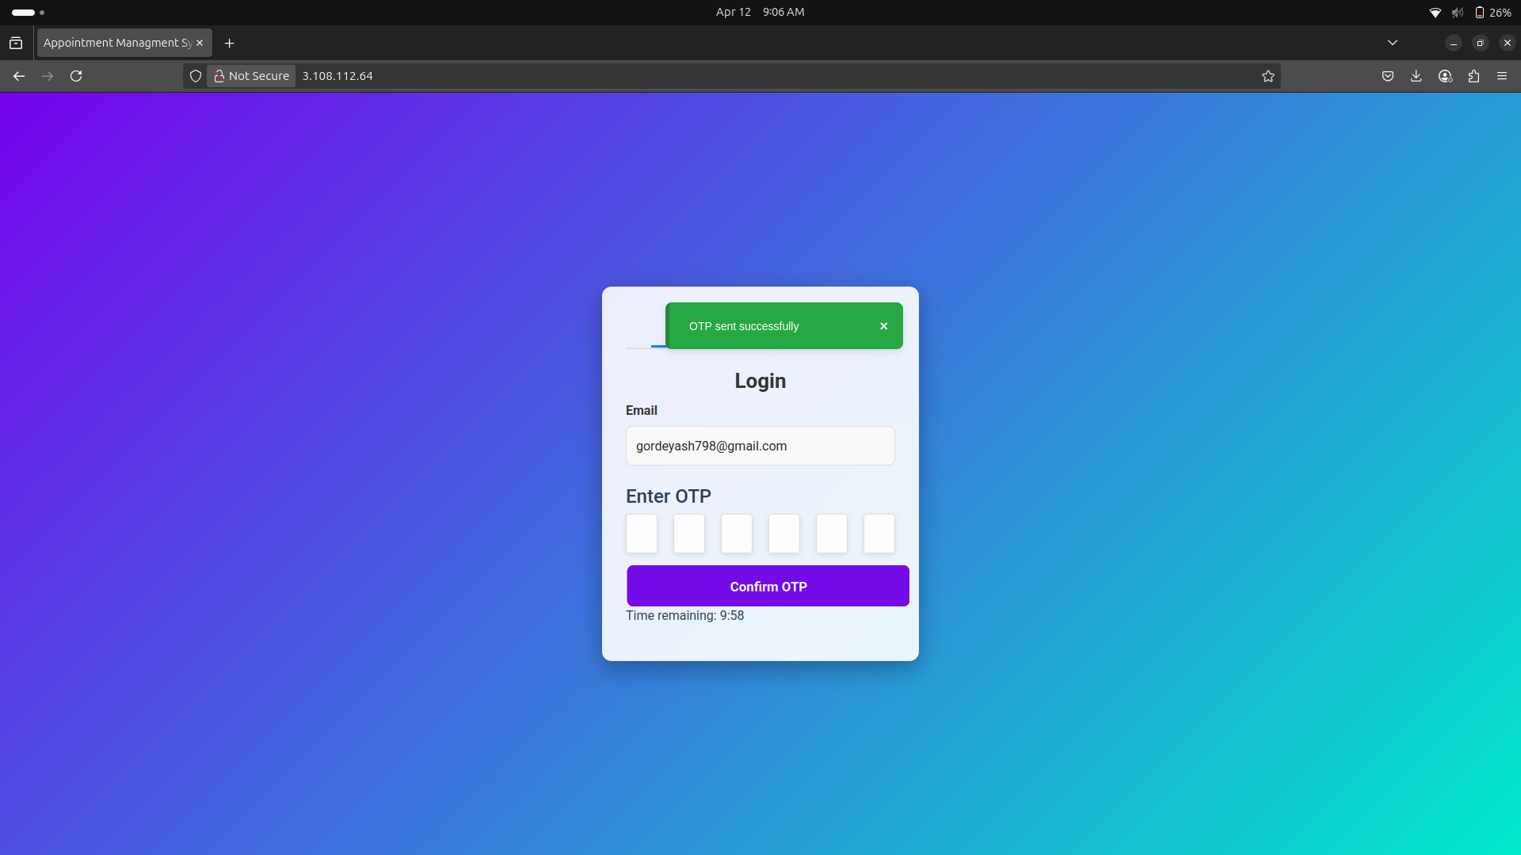
UI Screens

Slide 28
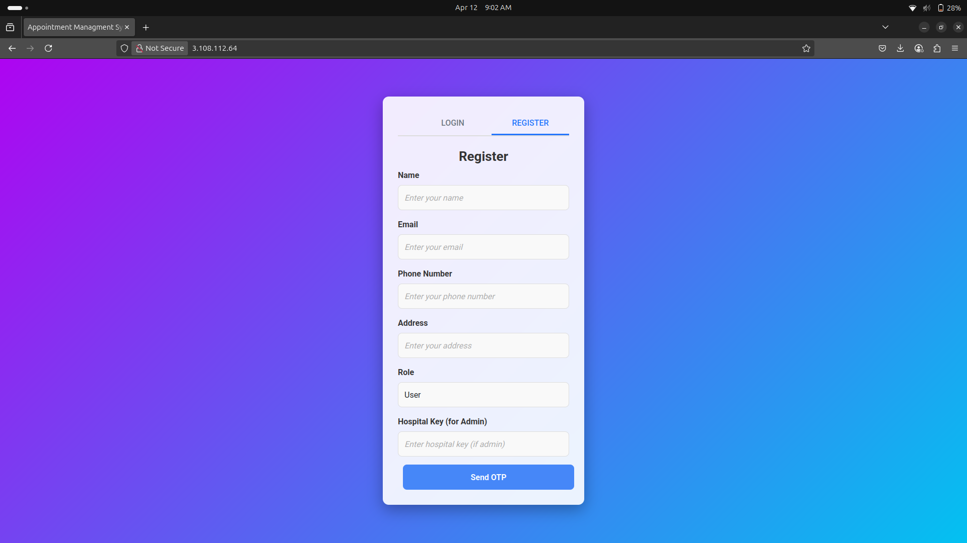
Registration UI

Slide 29
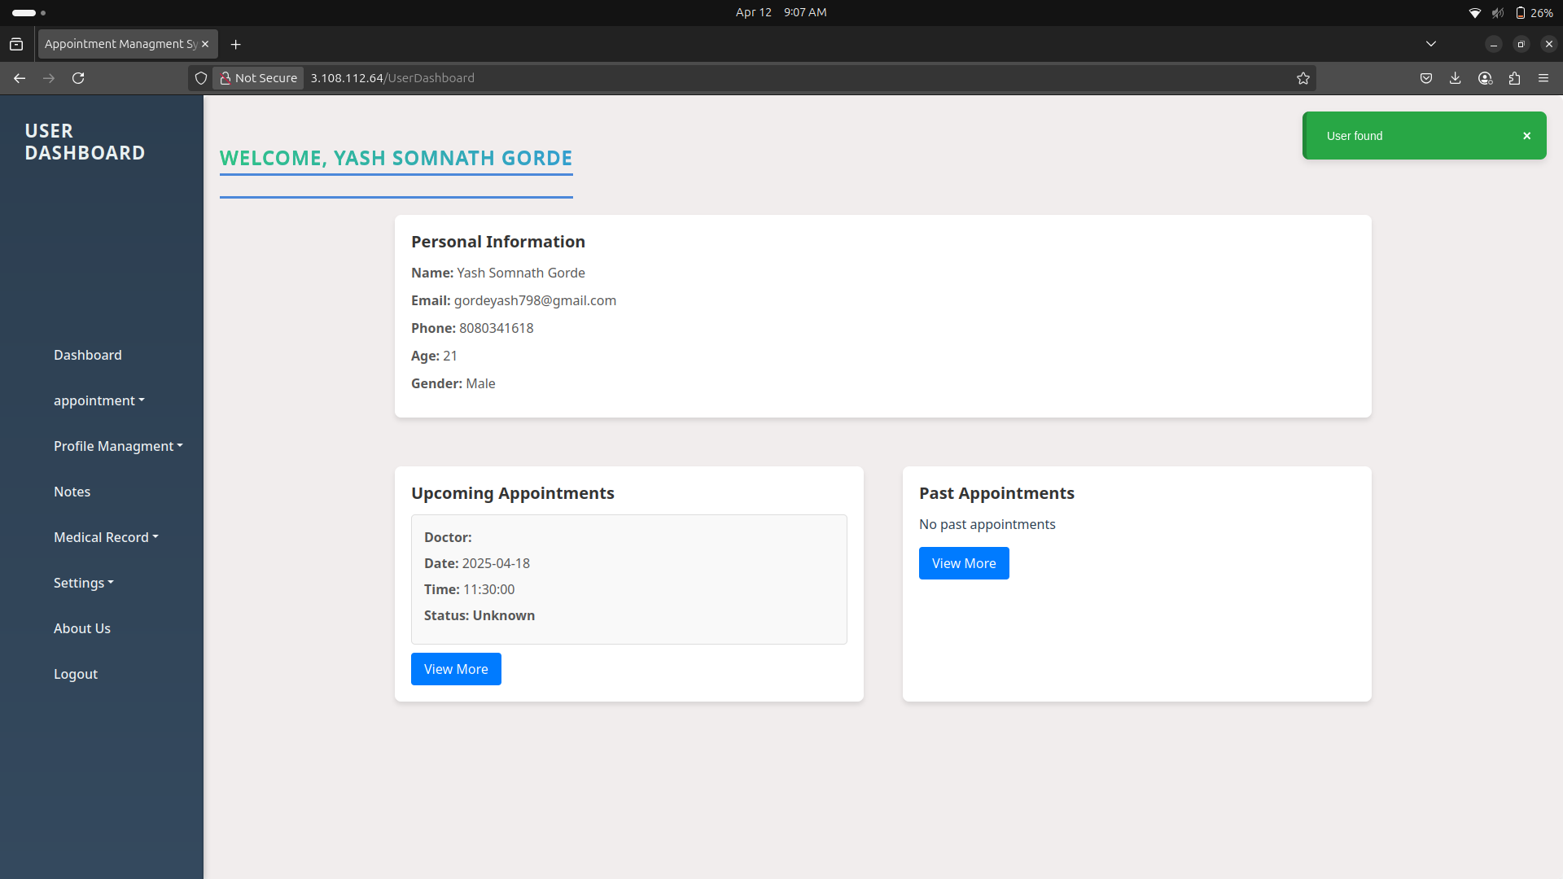
User Dashboard

Slide 30
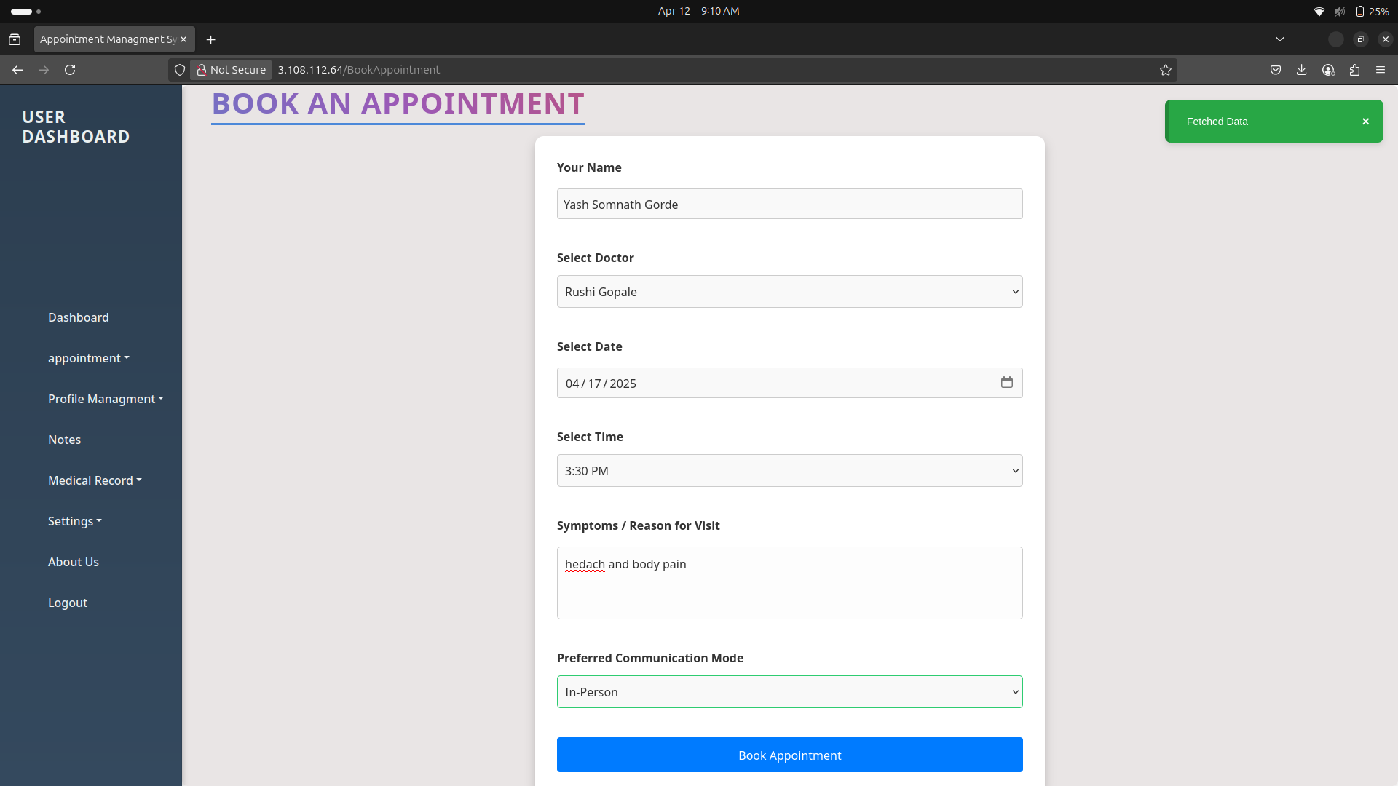
Appointment Book UI

Slide 31
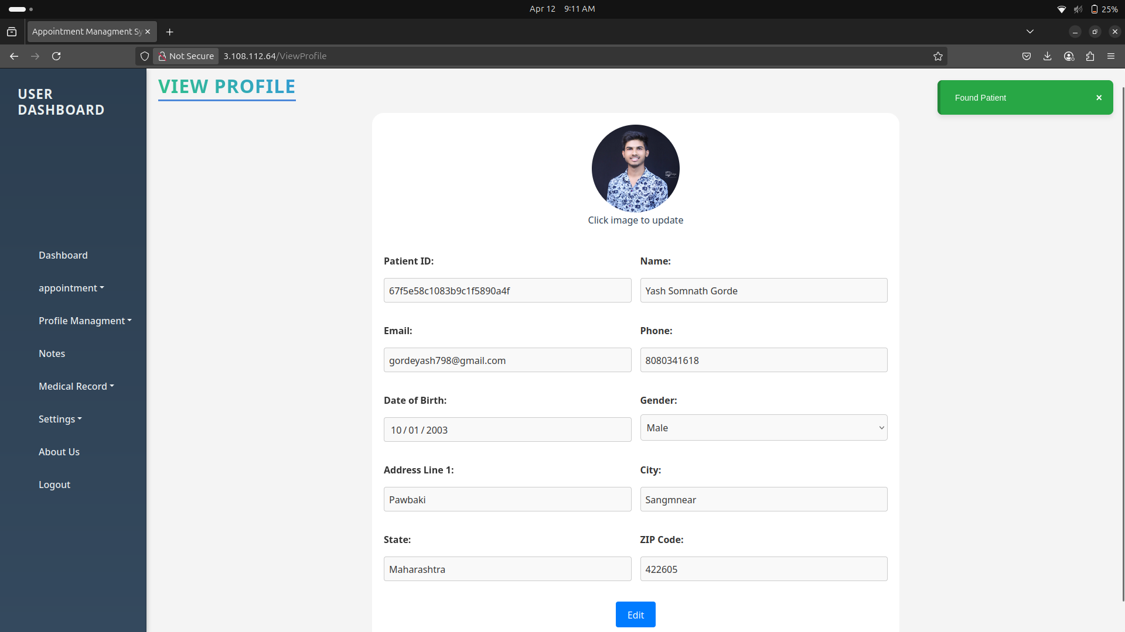
Profile UI

Slide 32
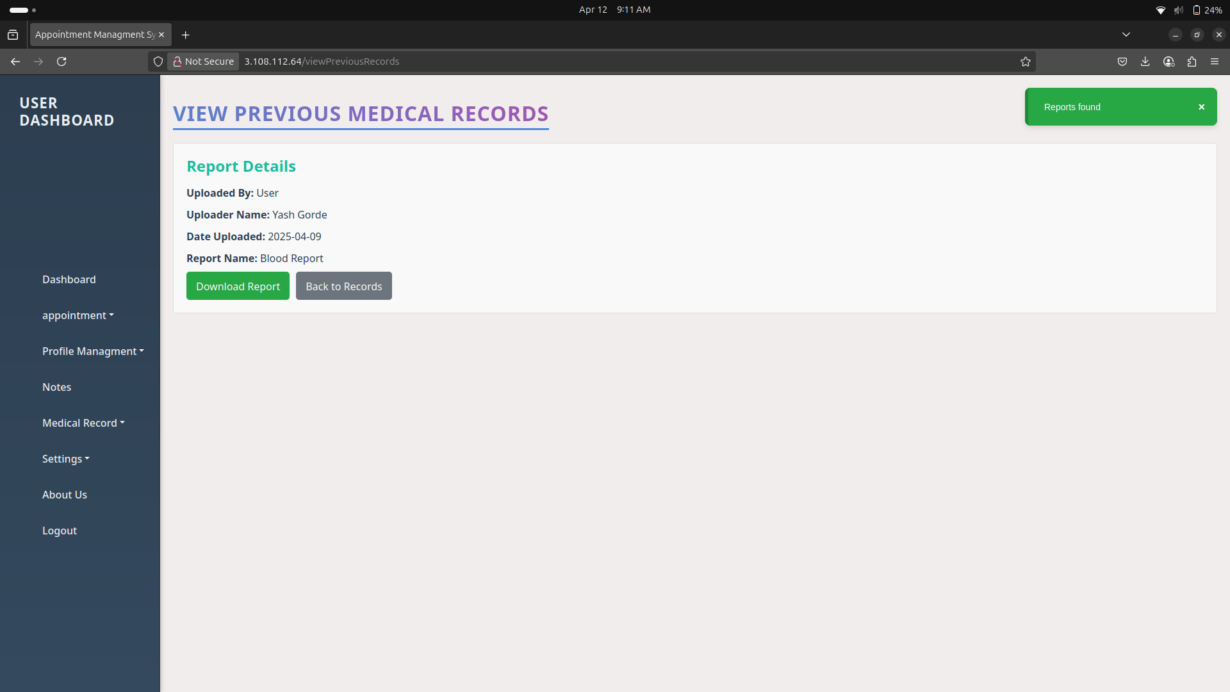
Report UI

Slide 33
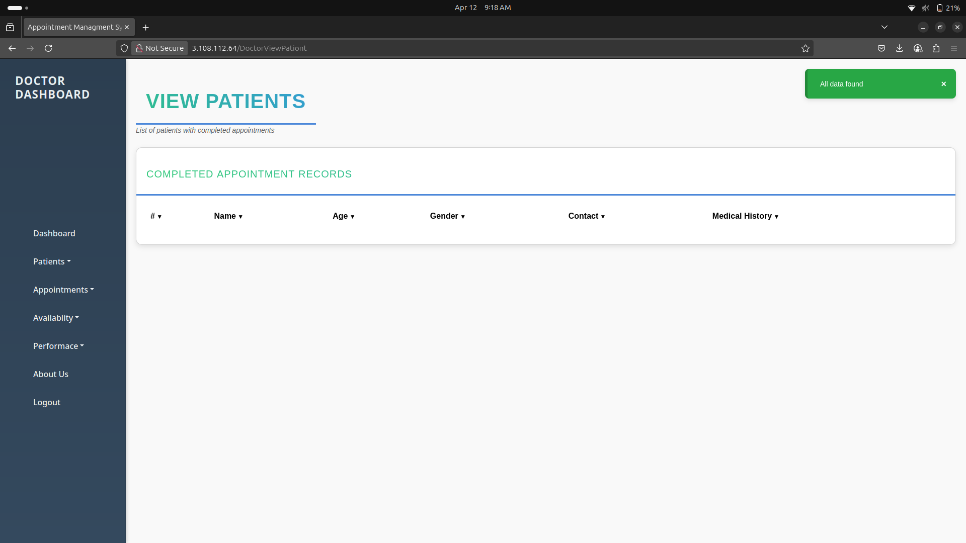
Doctor UI

Slide 34
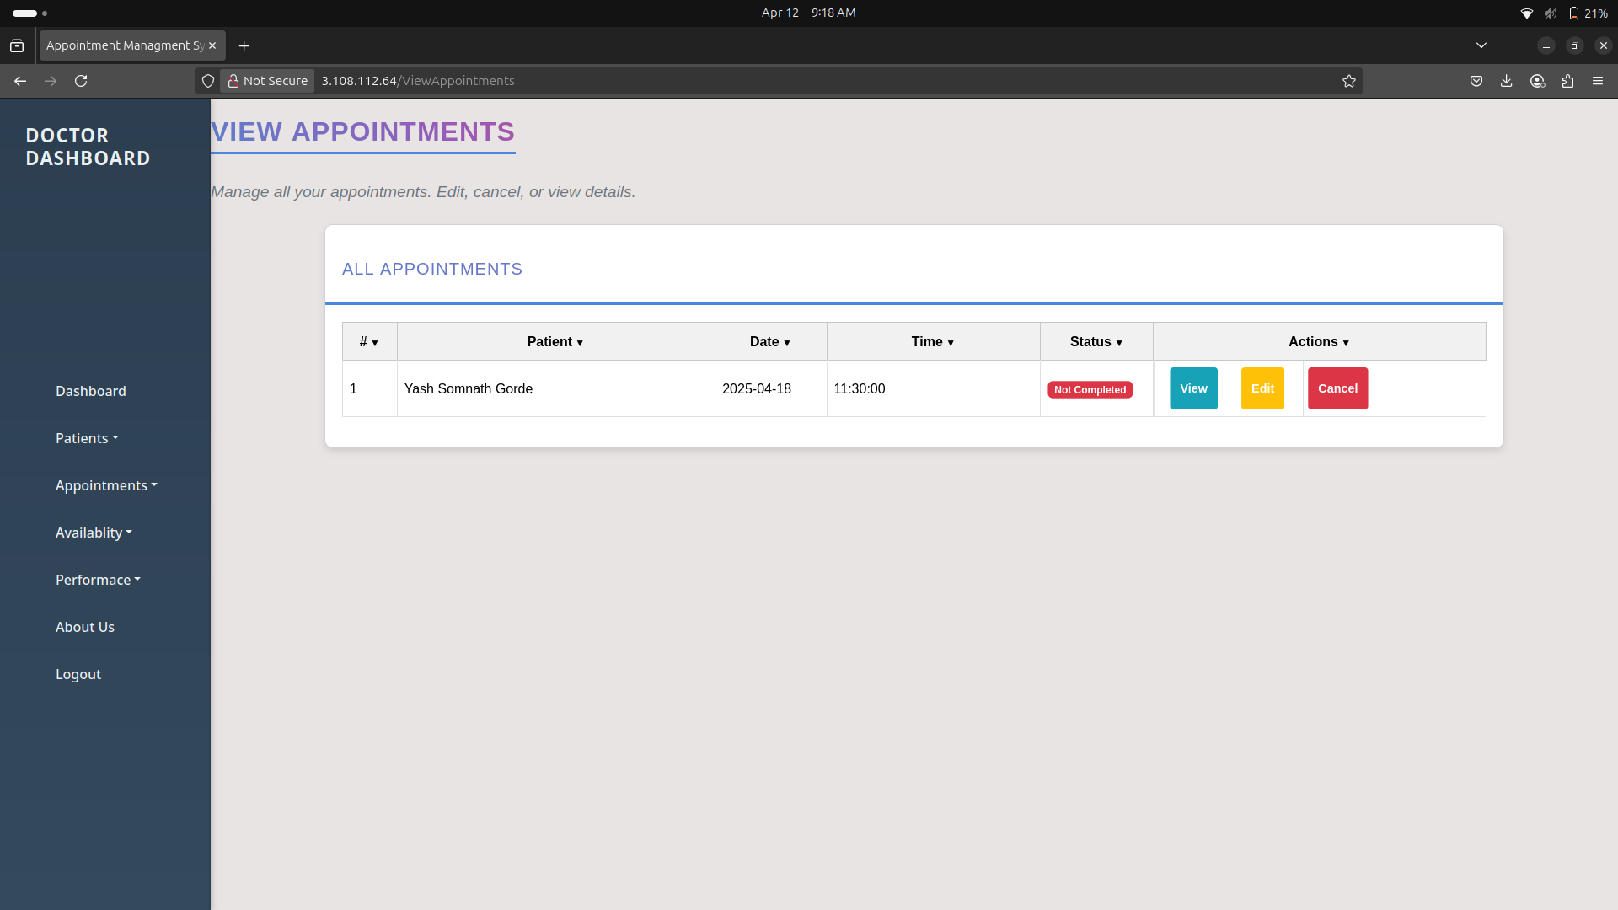
Doctor Appointment UI

Slide 35
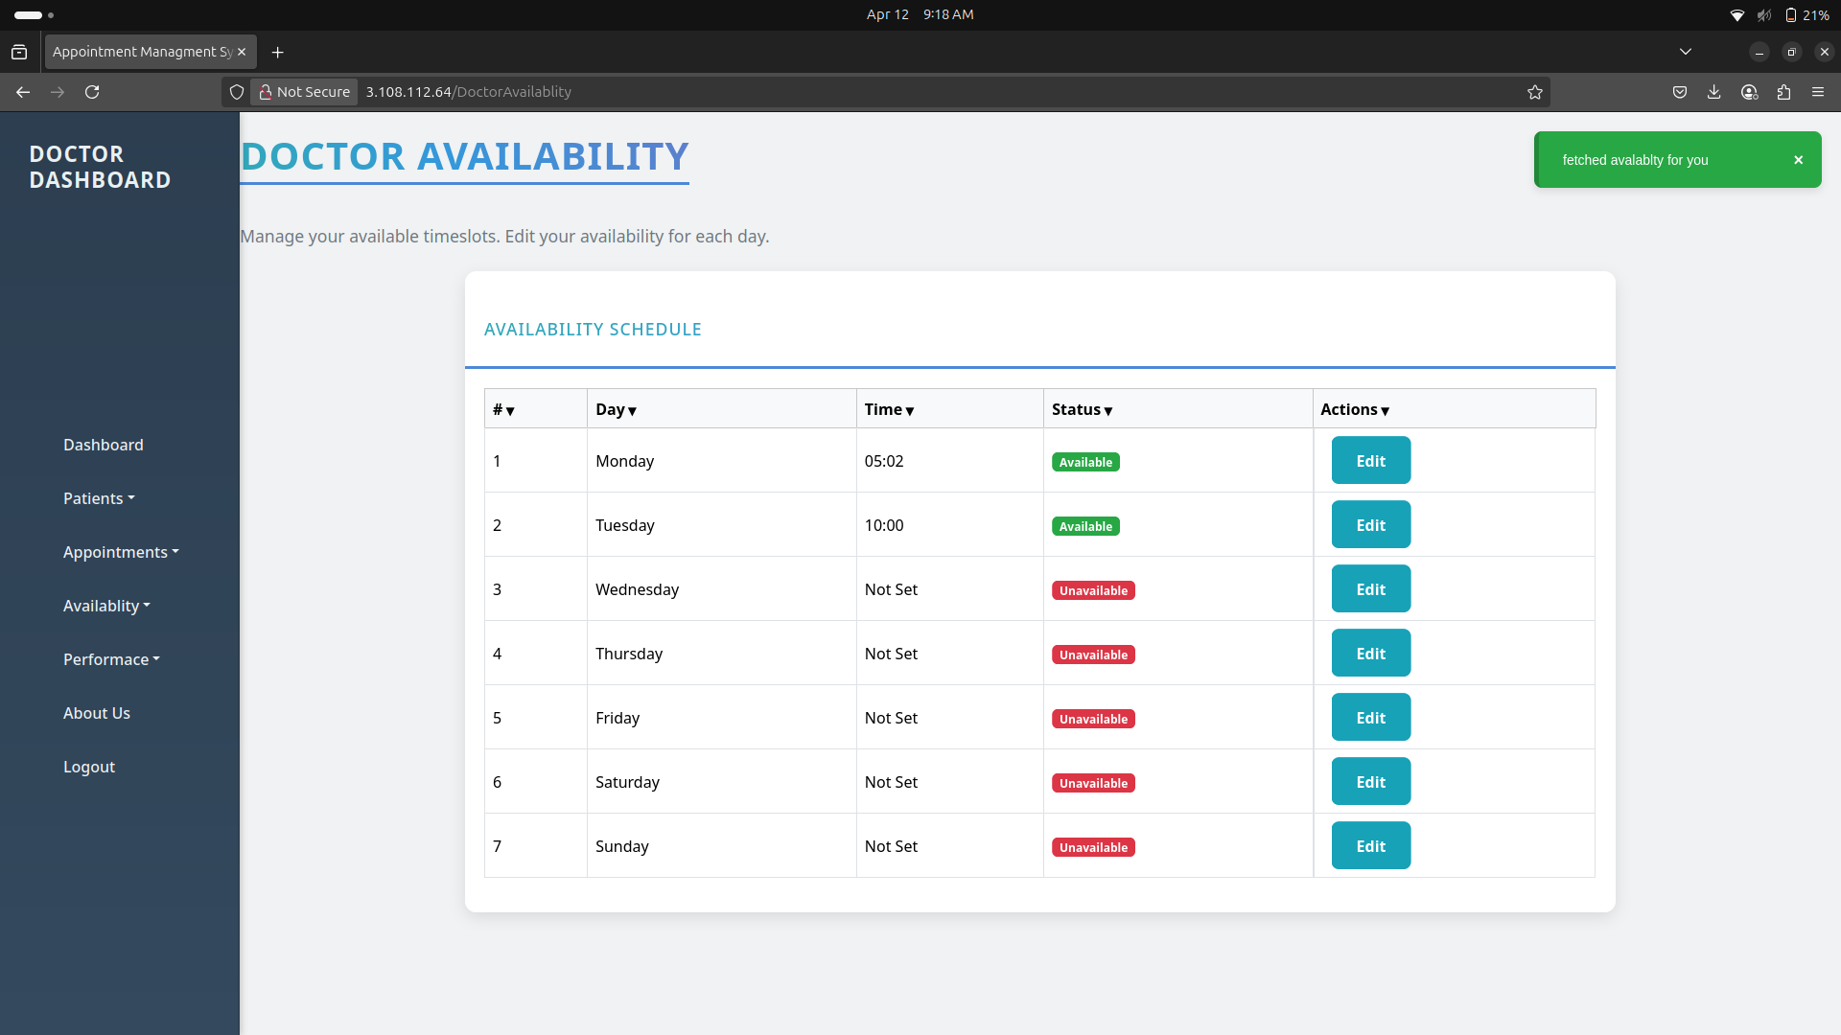
Doctor Availability UI

Slide 36
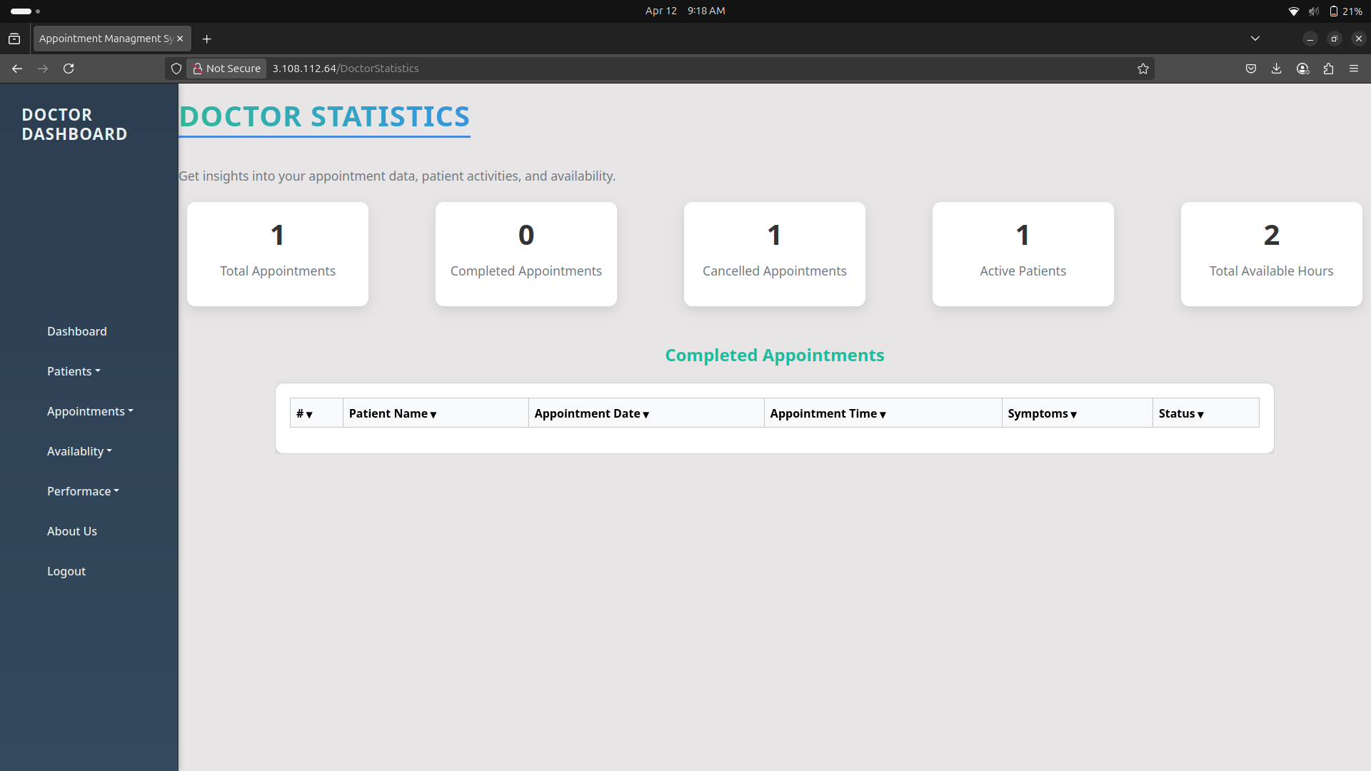
Doctor Report UI

Slide 37
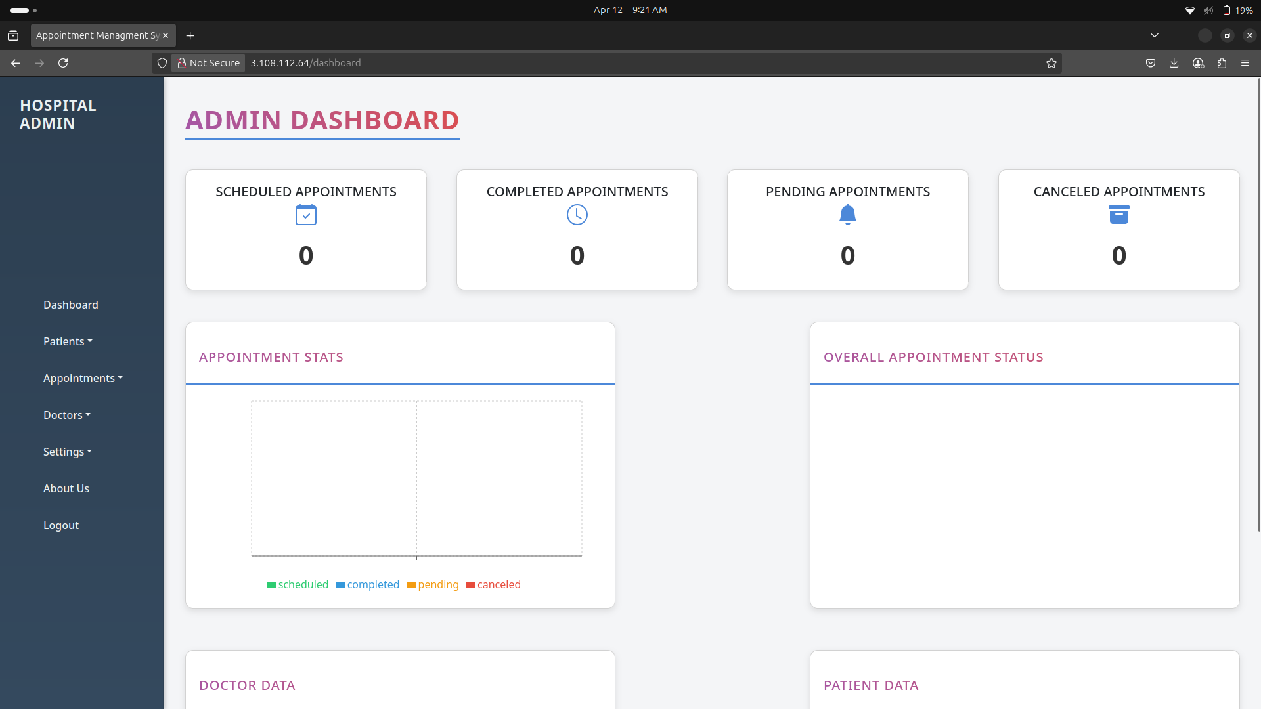
Admin Dashboard

Slide 38
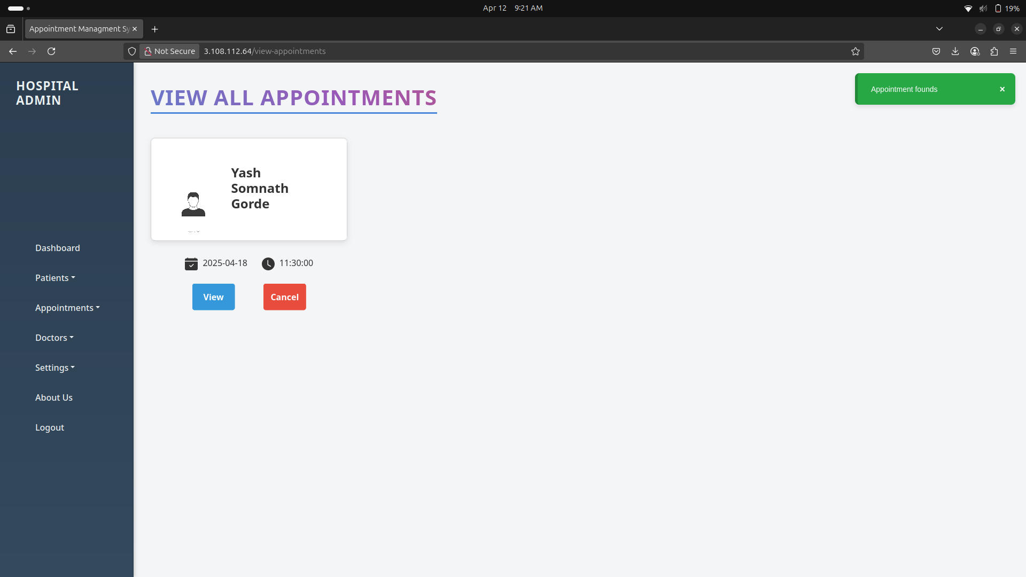
Admin Appointment

Slide 39
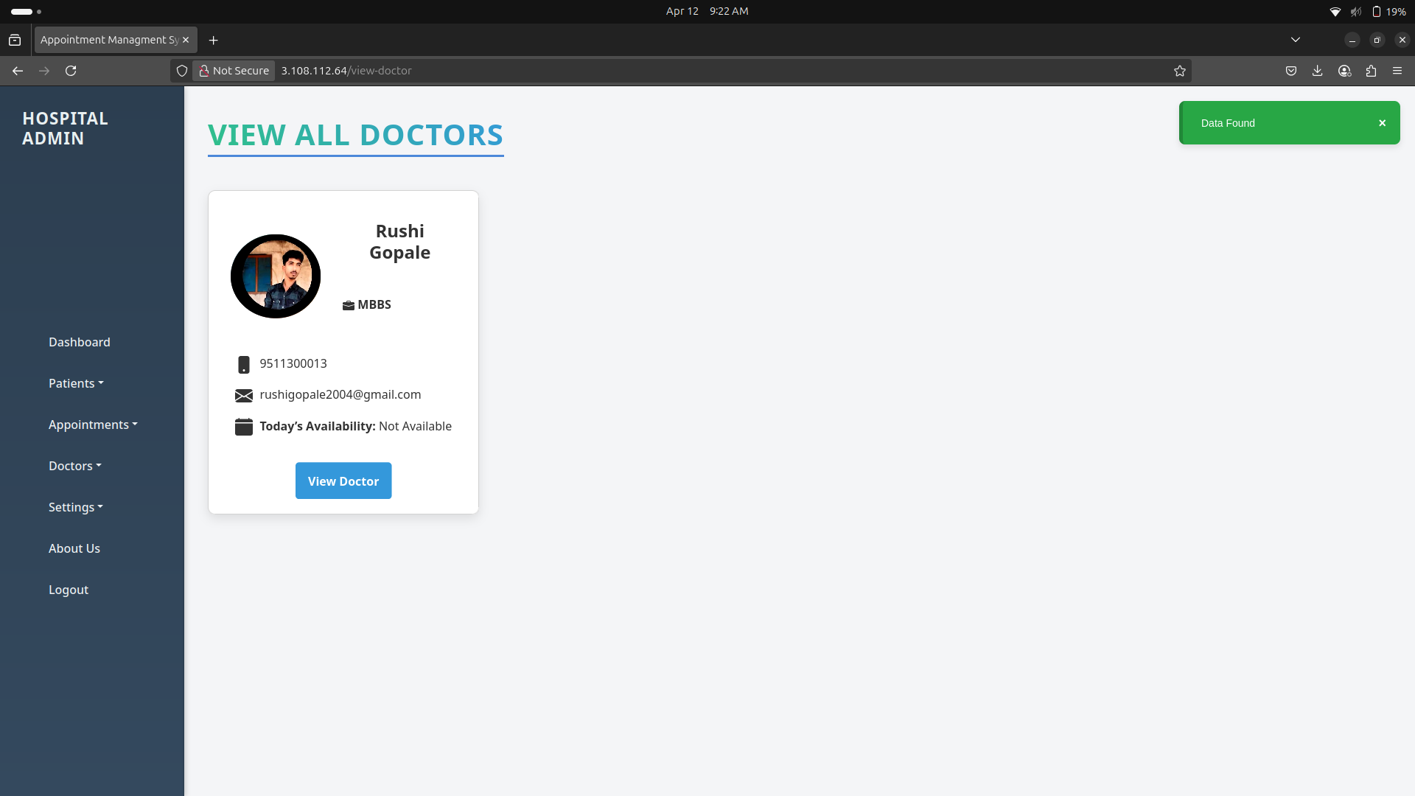
Admin Doctor UI

Slide 40
Implementation
Technology Stack: React.js, Django, Spring Boot, MySQL, MongoDB
Deployment: AWS/Heroku, CI/CD with GitHub Actions, Docker
Data Migration: Import existing patient/appointment data
User Training: Guides for Admin, Doctor, Patient roles
Monitoring: Post-deployment performance tracking

Slide 41
Drawbacks & Limitations
Complex microservices architecture
Dependency on stable internet
Security risks requiring constant updates
Limited customization for user roles
Scalability challenges for large-scale use
Lack of integration with EHR/HIS
UX challenges for elderly/technologically challenged users

Slide 42
Proposed Enhancements
Mobile app support (iOS/Android) with offline functionality
Integration with EHR/HIS systems
AI-based scheduling and analytics
Telemedicine for virtual consultations
Enhanced security (MFA, blockchain)
Payment gateway integration
Multilingual and multi-currency support

Slide 43
Conclusion
Achievements: Eﬀicient scheduling, role-based access, secure data
management
Challenges: Microservices complexity, internet dependency
Future Potential: Telemedicine, AI scheduling, EHR integration
Impact: Streamlines healthcare operations, improves patient experience

Slide 44
Bibliography
Books: ”Learning Python” by Mark Lutz, ”Spring Boot in Action” by CraigWalls
Websites: Django, Spring Boot, React.js oﬀicial docs, W3Schools, MDN
Tutorials: CodeWithHarry, Telusko, freeCodeCamp
Tools: MySQL, MongoDB, Postman, VS Code, GitHub
Articles: ”Improving Healthcare Services with Appointment Management
Systems” (IJCA)

Slide 45
Thank You
Contact: gordeyash798@gmail.com | +91-8080341618

