Slide 1
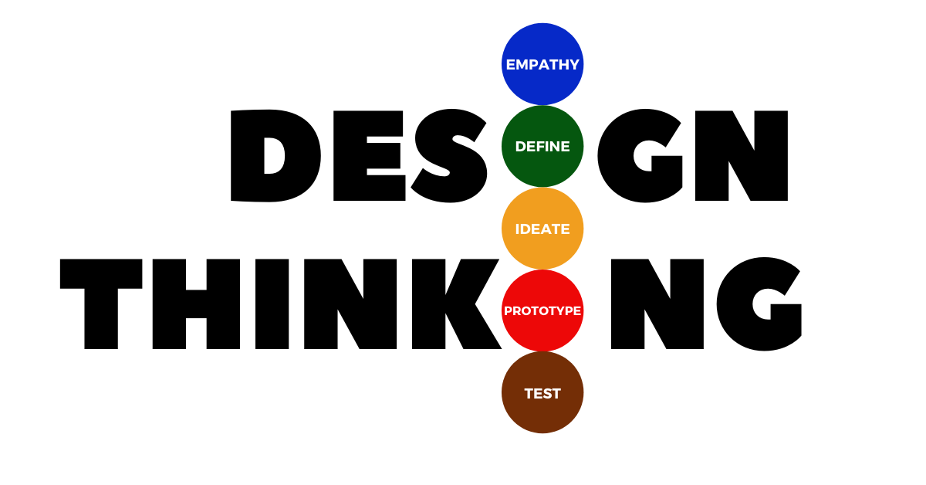

Slide 2
What I’ll Cover
Design Thinking
Steps of Design Thinking
Pillars of Design Thinking
Design Thinking in Software Development

Slide 3
Design Thinking
Design Thinking(DT) is a plan or specification for to construct an object or to construct an system or to implement an activity.
Design Thinking is an iterative method and is extremely helpful in solving problems in the best possible way.
It helps to resolve user issues and redefine problems in alternative strategy and solutions.
Hence, the Design Thinking is a very effective approach to solve business problems.
Goal of DT is to solve complex problems from a human perspective.

Slide 4


Slide 5
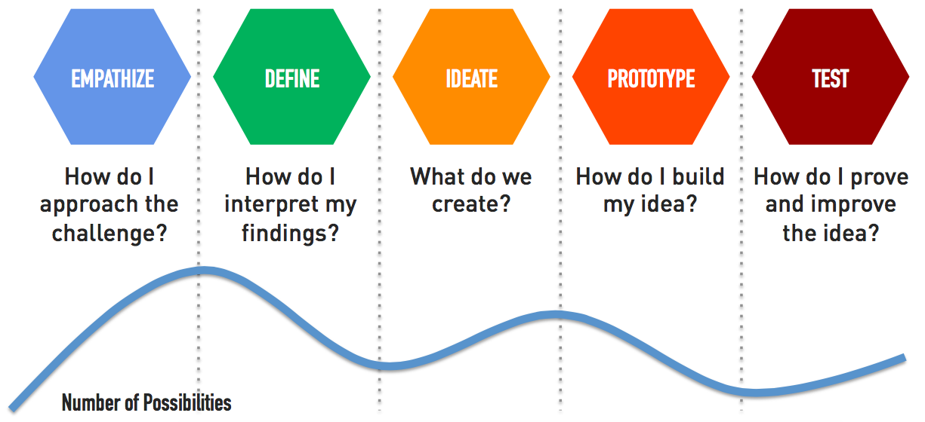

Slide 6
Pillars Of Design Thinking:
Understand by asking user’s need.
Explore by finding patterns.
Prototype by providing specifications.
Evaluate by always iterating.

Slide 7
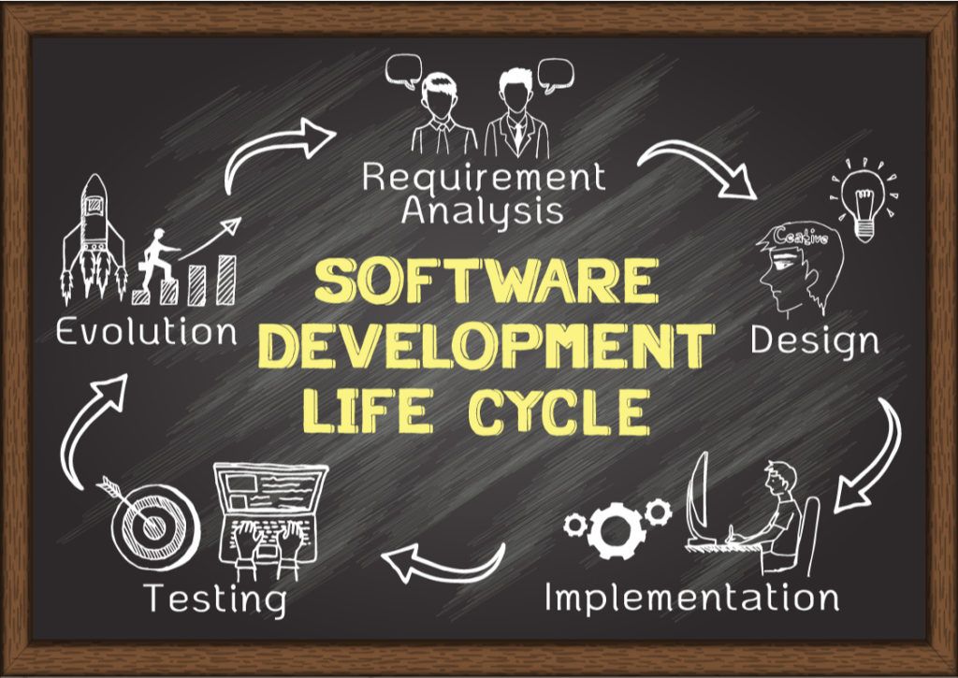

Slide 8
Design Thinking in Software Development:
Design Thinking enables software development companies to test the feasibility of the future product and its functionality at the initial stage.
It clearly specify all requirements and translate all this into product features.
Among the most forward-looking companies, close to 90% are expected to increase their investments and resources significantly in design thinking activities.
Here are a few great examples of how companies are using design thinking today:
*Intuit
*Airbnb
*Spotify

Slide 9
Thank you

