Slide 1
SALESVISTA-business performance analytics (PowerBi dashboard insights)
PRESENTED BY,
A B GOKULA PRIYAA
[01-06-2024]

Slide 2
Purpose of the dashboard
To analyse the Sales performance across products, regions, categories and time.
Track KPIs: Total Revenue, Quantity Sold, Average Order Value, Unique Customers
Understand customer behaviour and optimize decision-making.
Finding the top selling products

Slide 3
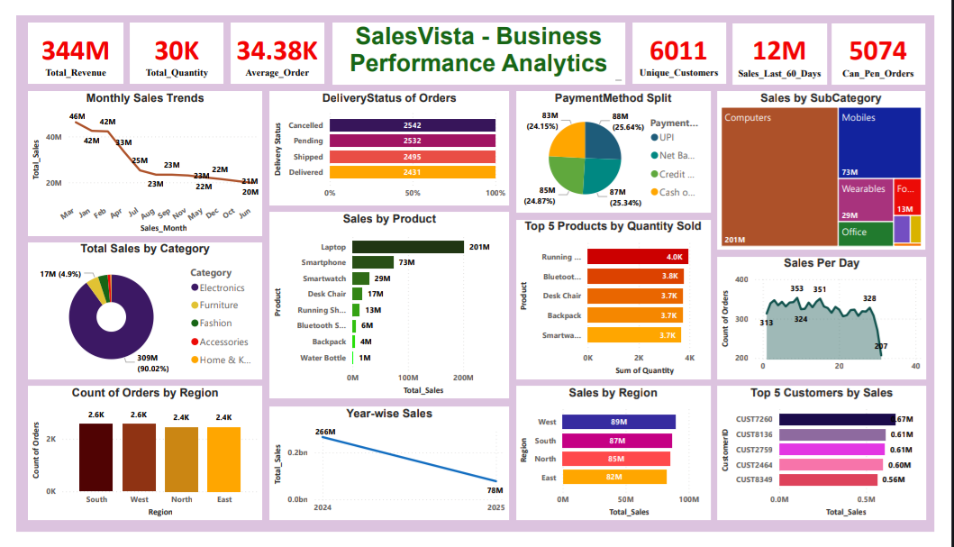

Slide 4
KPI highlights
Total Revenue: ₹344M
Total Quantity Sold: ₹30k
Average Order Value: ₹34.38k
Unique Customers: 6011
Pending Orders: 5074

Slide 5
Trends and Performance over time
Monthly Sales Trend:
Sales peaked in March (₹46M), Jan and Feb (₹42M).
Lowest sales in June (₹20M).
Sales Per Day (For 2years)
Highest: 353 Orders
Lowest 207 Orders
Insight: Seasonal spikes in March, Jan and Feb indicate promotion impact.

Slide 6
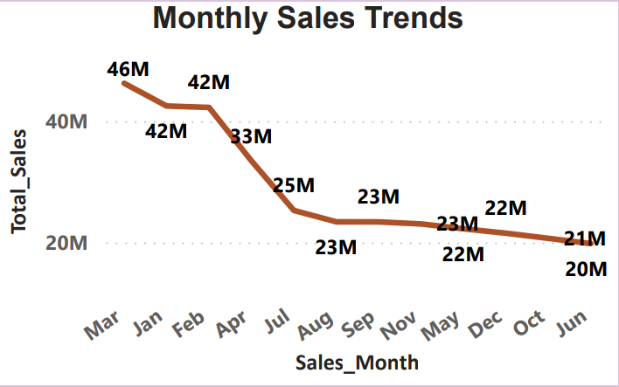
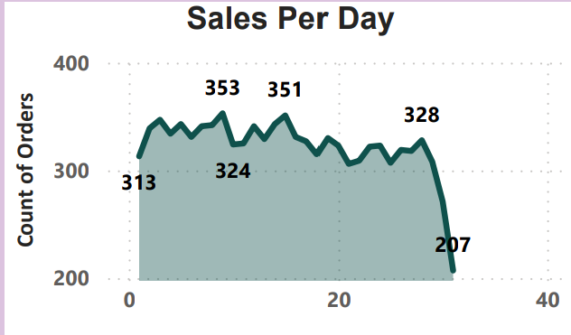

Slide 7
Regional and product breakdown
By Region:
West ₹89M, South ₹87M, North ₹85M, East ₹82M
Orders: South & West lead (2.6K each).
By Product:
Top Seller: Laptop - ₹201M
Other key products: Smart phones, Smart watches, Desk chairs.
By Category:
Electronics Dominate: 90.02% of total revenue
Furniture and Fashion follow distantly.
Insight: Electronics are the core driver of revenue.

Slide 8
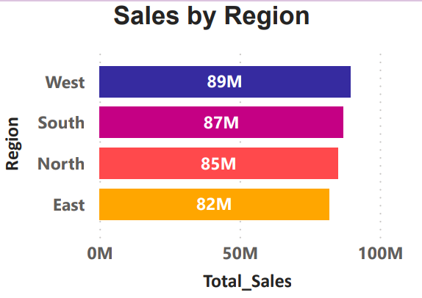
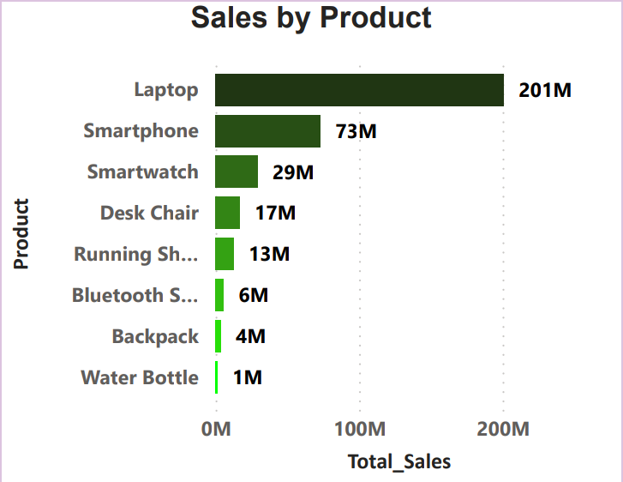
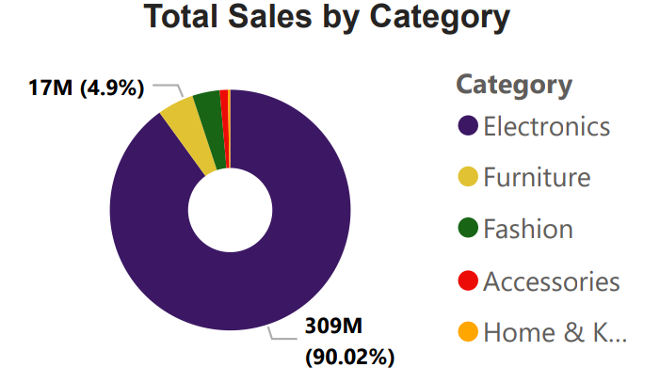

Slide 9
Insights
High reliance on electronics – product diversification recommended.
Sales consistent across regions – uniform strategy working.
Spikes align with festive seasons – promotions are effective.

Slide 10
recommendations
Improve delivery rate: balance out pending vs delivered.
Promote under performing categories (e.g., Accessories, Home & Kitchen)
Target top 5 Customers with loyalty programs

