Slide 1




Shoe Price Prediction
Using Machine Learning
This project focuses on predicting shoe prices using machine learning by analysing various shoe attributes. The footwear industry is a significant part of the global retail market, where pricing strategies impact market positioning and profitability. Traditional pricing methods rely on competitor analysis and intuition, but this project aims to develop a data-driven predictive model to estimate shoe prices accurately and provide actionable business insights.
By Priyadarshini Mohapatra
Registration No. : 12202039
Roll No. : 68
Section: K22UN
Course Code: CSM355

Slide 2

Table Of Contents:
1. Problem Understanding and Definition
2. Dataset Selection and Preprocessing
3. Visualizations
4. Model Selection and Justification
5. Methodology
6. Result and Analysis
7. Conclusion and Future Work
8. References and Github Link

Slide 3

Problem Understanding and Definition
Business Context
The footwear industry is a $365 billion global market where pricing affects consumer perception and profitability. Traditional pricing relies on competitor analysis and intuition, which may miss complex attribute-value relationships.
Project Objectives
The goal is to build predictive models to estimate shoe prices based on features like brand, type, gender, size, and material. The project aims to generate insights for pricing strategies and create a reusable framework for future applications.

Slide 4
Dataset Selection and Preprocessing
Dataset Overview
Data Cleaning & Feature Engineering
The dataset contains 1,006 entries with attributes such as Brand, Model, Type, Gender, Size, Color, Material, and Price. It covers diverse footwear categories and demographics, suitable for price prediction modelling.
Data cleaning involved formatting size and price columns for numerical analysis. Feature engineering included label encoding gender, and excluding high-cardinality features like Color and Model to avoid overfitting.

Slide 5
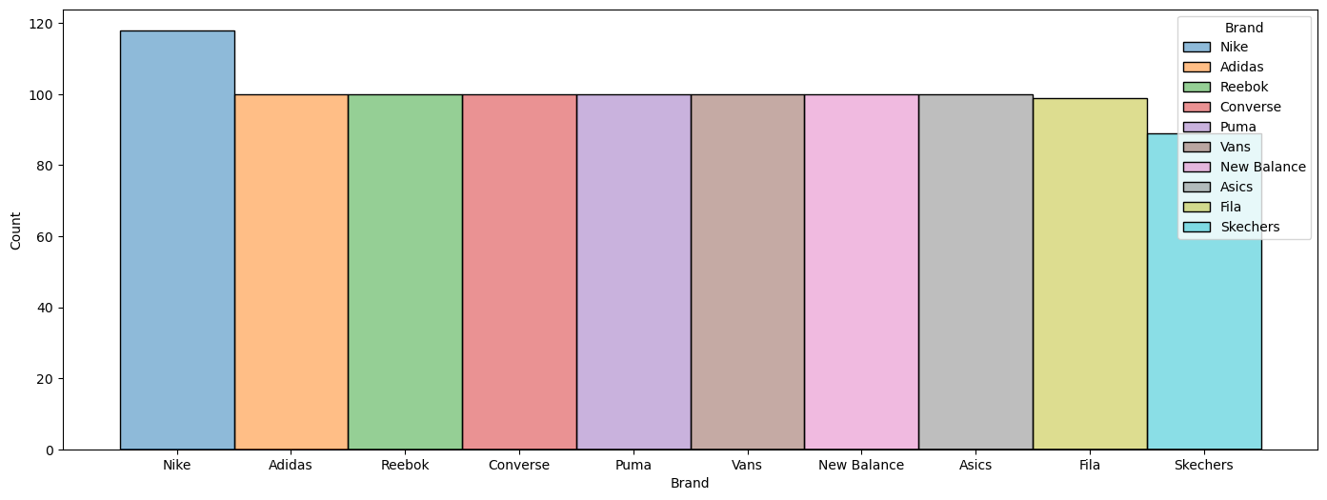
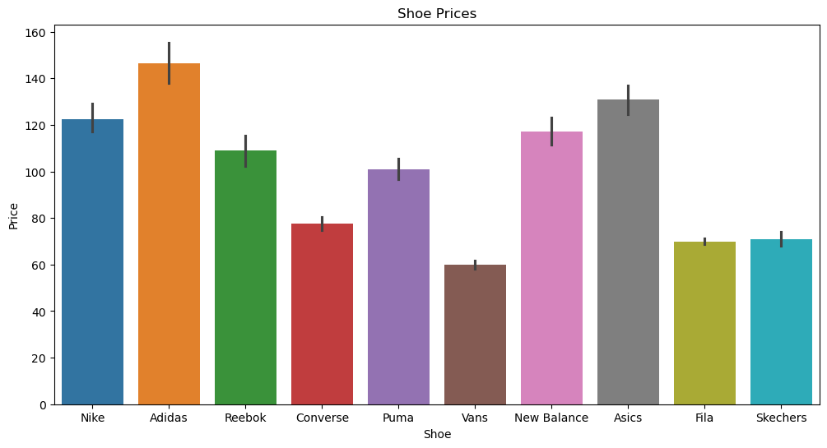

Visualizations

Slide 6

Model Selection and Justification
Regression Models Considered
Evaluation Metrics
Models were assessed using MSE, RMSE, R², and MAE to measure prediction accuracy and error magnitude in price units.
Few models were evaluated: Linear, Ridge, Lasso, Random Forest, and Gradient Boosting regressions
Model Selection Rationale
Linear Regression was chosen for its lowest error rates, interpretability, robustness, and computational efficiency despite its simplicity.

Slide 7
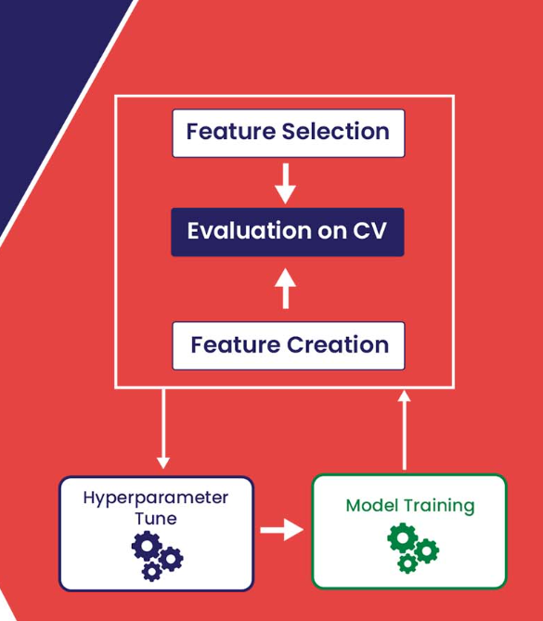



Methodology
Data Preprocessing
Applied cleaning, one-hot encoding for categorical features, and scaling for numerical features integrated into a pipeline for consistency.
Model Training
Data split into training and testing sets. Models trained on processed data with excluded high-cardinality features to reduce overfitting.
Hyperparameter Tuning & Validation
GridSearchCV with 5-fold cross-validation optimized parameters for complex models. Linear Regression required no tuning.

Slide 8
Results and Analysis
Visual Insights
Nike had the most entries, Adidas shoes had the highest average price. Running shoes were the most common type, with specialized types like Weightlifting priced highest.

Slide 9

Conclusion and Future Work
Key Findings
Linear relationships dominate shoe pricing. Brand, type, and material strongly influence price. Gender shows no significant pricing difference, and size has limited impact.
Future Enhancements
Plans include advanced feature engineering, addressing evaluation issues, incorporating time-series and market data, and developing segmented models for better accuracy.

Slide 10
References and GitHub Link
References
GitHub Repository
GeeksForGeeks: Random Forest Algorithm in Machine Learning
Access the full project code and resources at: https://github.com/priyaaaahere/ShoePricePrediction-ML-
GeeksForGeeks: Multiple Linear Regression using Python
GeeksForGeeks: Lasso Regression Implementation

