Slide 1
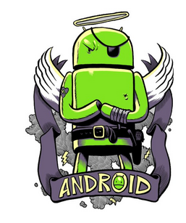
There is little choice in barrel of rotten apples.
William Shakespeare
Priyank Gupta
Android enthusiast

Slide 2
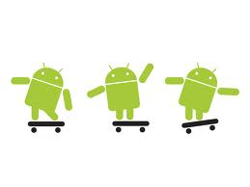
<Android />
{} It's a reference to hardware stack to support software.
{} A linux kernel.
{} Bunch of open libraries.
{} Framework to access underlying hardware with super ease.

Slide 3
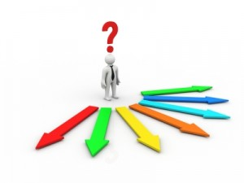
<Context />
{} Abstract class.
{} Global state of application.
{} For access to application specific resources.

Slide 4

<Intent />
{} Message that represents operation to be performed.
{} Explicit have their target specified explicitly.
{} Implicit have enough data to locate suitable target(s).

Slide 5



<Activity />
{} Implementation of Context.
{} Foreground view. Runs on UI/Main Thread.
{} Lifecycle: onCreate, onResume, onPause, onDestroy + more
{} Exposed outside app with category, data and action.

Slide 6

<Service />
{} Implementation of Context.
{} Runs in background. Not a Thread. Runs on Main Thread
{} Life cycle: onCreate, onStartCommand and onDestroy

Slide 7
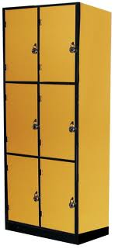
<ContentProvider />
{} Method to expose data through URI based querying.
{} May impose permissions.
{} Contacts, Messages are simple example.
Multiple developers
content://com.test.devcamppune/developers
Single developer
content://com.test.devcamppune/developers/101

Slide 8

<Responsiveness />
{} Response to input event in 5 seconds
{} Broadcast Receiver in 10 seconds
{} Blocking operation on Main Thread = Harakiri** in style
**Harakiri: (or hara-kiri) most often refers to a form of ritual suicide.

Slide 9


<Handler & Looper />
{} UI Thread is not-thread safe. So only one thread.
{} Inter-thread communication. Handler on current thread.
{} Looper, loops on a queue for incoming runnable/messages.

Slide 10
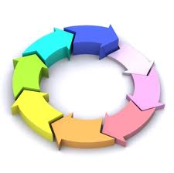
<AsyncTask />
{} Simpler implementation of Handler and Looper.
{} Much needed pre/post processing methods on UI Thread.
{} Core job in separate thread. Automatic handler/looper mgmt.
{} Ideal for activities running network/blocking operations.

Slide 11

<Time To Get Hands Dirty />

