Slide 1

PSG COLLEGE OF TECHNOLOGY
CODING CLUB
IDEATION FINALS
PROJECT TITLE: SMART LIFT
Group Members
Lakshmi Priya A (20D221)
Prakalya SK (20L231)
Kavinraj S (20L121)
Project Guide
Mr Sainath S
Assistant Professor,ECE dept,
PSG College of Technology

Slide 2
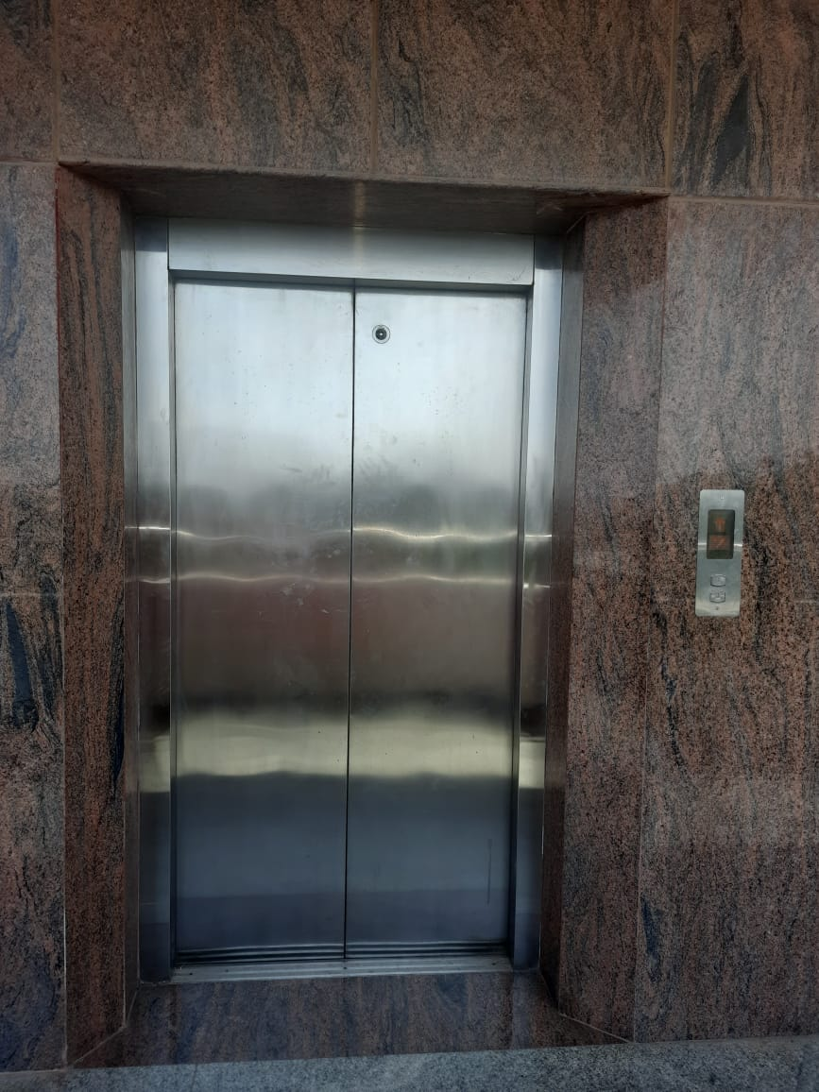

Slide 3
Problem Statement: PSG College of Technology has a very well sophisticated infrastructure equipped with lift system. Each block comprises of 3 - 5 floors. But this lift system currently is not very efficient. The lift stops in each floor, even when people are not found in front of the lift.
Target Audience: Lift users (specially G block lift users)
Need:
Time saving
More efficient working
Avoid unnecessary stoppage of the lift
Less power consumption
How is it different from existing technology: Currently lift system is not empowered with a human detection algorithm. A small change in the current system can save time and power consumed
Objective: To design a lift system with a human detection feature

Slide 4
Requirements
Software Used | Proteus
Hardware Used | Raspberry Pi, Texas Instruments TMS320C5517 Fixed-Point Digital Signal Processor
Language(s) | Python

Slide 5
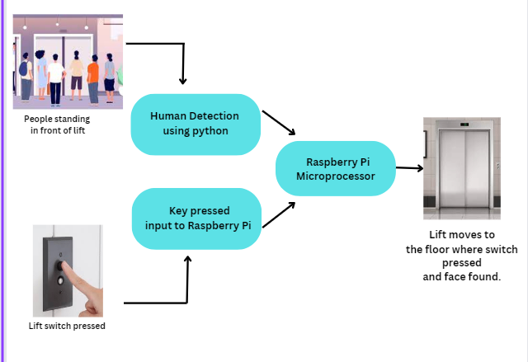
Block Diagram

Slide 6
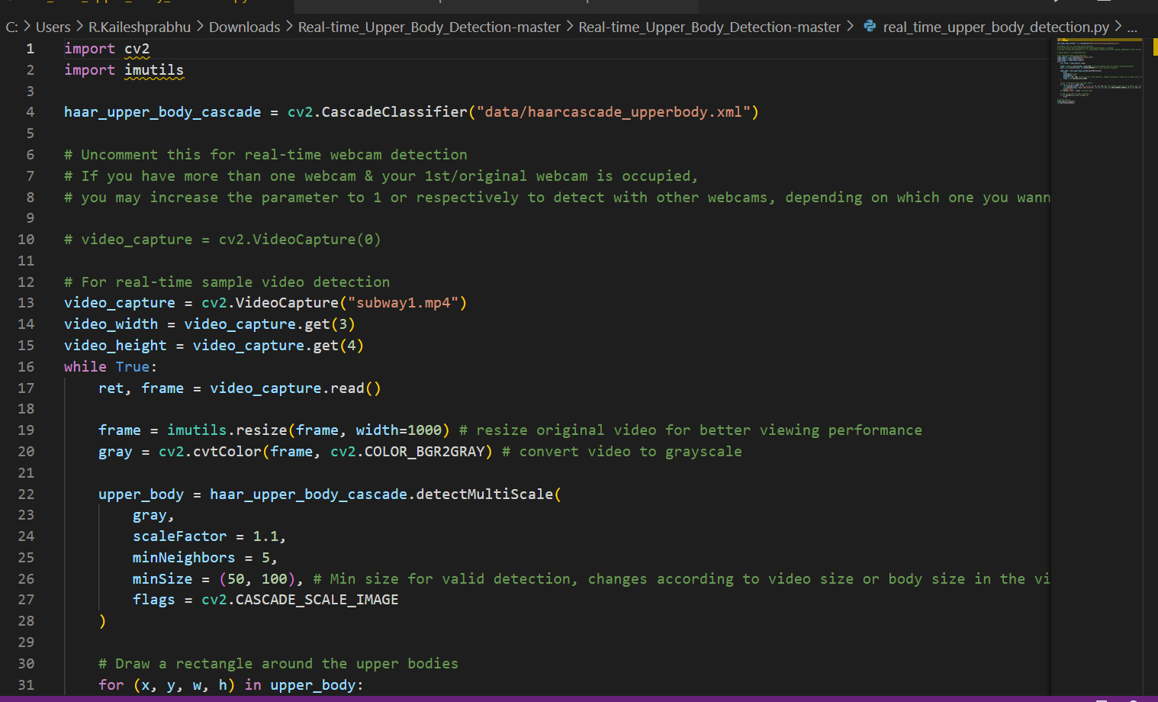
Human Detection

Slide 7
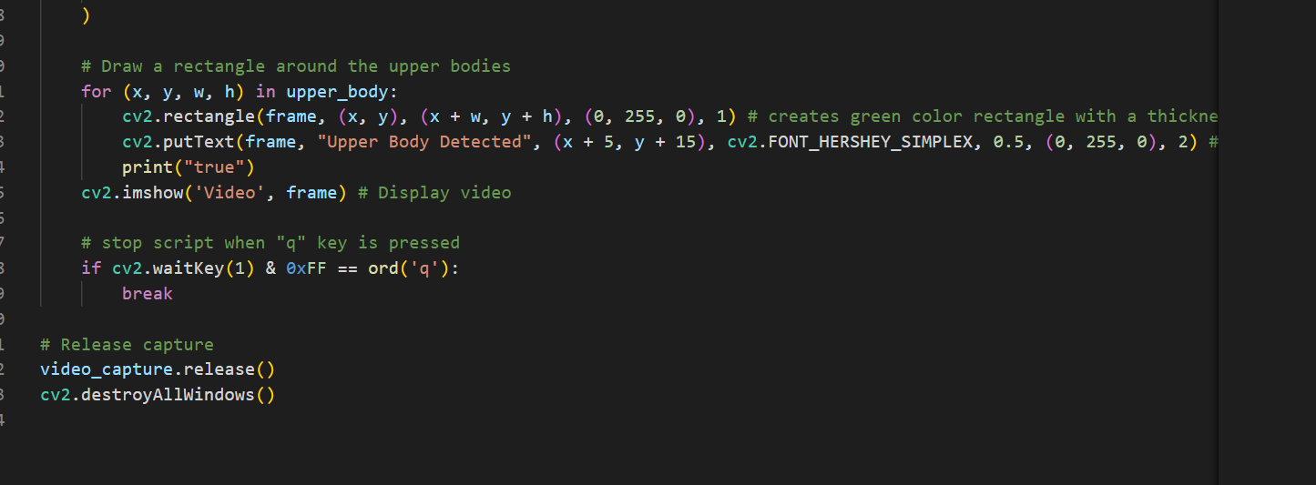
Human Detection

Slide 8
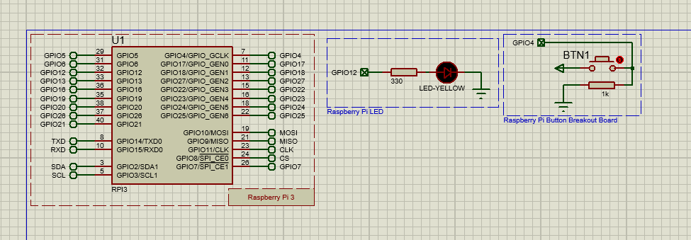
Switch

Slide 9
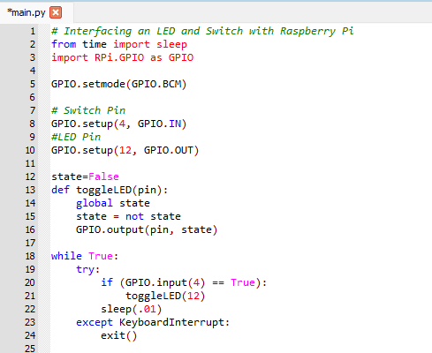
Switch

Slide 10
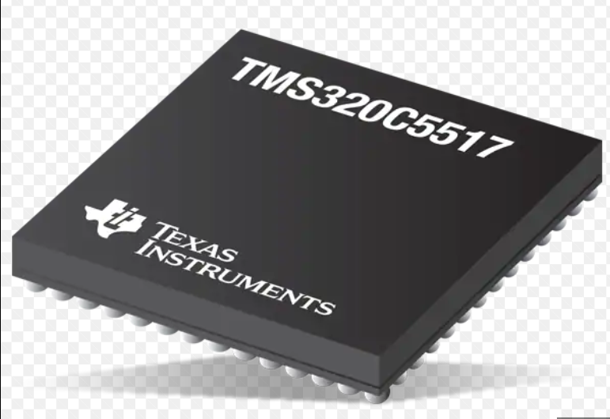
Texas Instruments TMS320C5517 Fixed-Point Digital Signal Processor

Slide 11
THANK YOU

