Slide 1
A CONTEXT-AWARE CLOUD SECURITY RESEARCH PROJECT
WHAT IF A VALID
CLOUD CREDENTIAL
SHOULD STILL BE DENIED?
CloudContextGuard
Context-Aware Cloud Access Control Using IAM and Trusted VPC Boundaries
Priyaansh Jaiswal & Shashank Sunil Hebbal | RV University, School of CSE | 2026-2027
Notes:
Open cold, no preamble. Read the headline slowly, then pause: 'What if a valid cloud credential should still be denied?' Let it sit for two seconds before continuing. Introduce yourselves and the project name: CloudContextGuard, a context-aware cloud access control system built around IAM and trusted VPC boundaries. State plainly this is a working system you built and tested, not a concept slide -- everything shown today is a real, reproducible response from a running API. Transition: 'To understand why that question matters, look at how cloud access control normally works.'

Slide 2
THE PROBLEM
A single valid permission is treated
as proof enough.
VALID IAM
CREDENTIAL
UNKNOWN
NETWORK
MISSING
MFA
POTENTIAL
BREACH
“IAM alone does not understand context.”
A stolen credential inherits every permission that identity has -- from any network, with no extra friction.
CLOUDCONTEXTGUARD
02 / 20
Notes:
Explain the conventional model in one breath: a credential that is valid grants access, full stop -- regardless of where the request came from, whether MFA was used, or how risky it looks. Point at the four-step chain and let the audience watch it end in breach. The line 'IAM alone does not understand context' is the thesis statement of the entire talk -- say it deliberately. Transition: 'So we asked a simple research question.'

Slide 3
THE QUESTION
Can authorization depend
on more than identity?
IDENTITY
+
NETWORK
+
MFA
+
POLICY
+
RISK
Five independent, explainable checks -- evaluated on every single request.
CLOUDCONTEXTGUARD
03 / 20
Notes:
Pose the question and hold it -- don't answer immediately. This is the pivot from problem to solution. Then reveal the five inputs one at a time as you name them: identity, network, MFA, policy, risk. Emphasize 'independent' -- none of these five can be skipped, and no single one is authoritative by itself. Transition: 'This is exactly what CloudContextGuard implements.'

Slide 4
THE SOLUTION
CLOUDCONTEXTGUARD
Five pure-function evaluation engines, one decision authority.
IAM
VPC
MFA
POLICY
RISK
DECISION ENGINE
ALLOW
DENY
IAM permission is necessary, but not sufficient.
CLOUDCONTEXTGUARD
04 / 20
Notes:
Introduce the five engines as they physically exist in the codebase -- IAM, VPC, MFA, Policy, Risk -- each a pure function producing a structured result, not a bare boolean. Trace the converging lines with your hand: all five feed one place, the Decision Engine, which is the only component in the system allowed to output ALLOW or DENY. Land on the tagline: 'IAM permission is necessary, but not sufficient' -- this is the project's core research claim. Transition: 'Here is where that lives in the running system.'

Slide 5
SYSTEM ARCHITECTURE
How a request actually moves through the system
REACT DASHBOARD frontend / Vite — renders only what the API returns
FASTAPI APPLICATION backend/app/main.py — the single HTTP boundary
ACCESS SERVICE resolves the database, calls every engine in order
IAM ENGINE
VPC ENGINE
POLICY ENGINE (+MFA)
RISK ENGINE
DECISION ENGINE — sole ALLOW / DENY authority
SQLITE DATABASE
AUDIT / EVENTS / ALERTS
CLOUDCONTEXTGUARD
05 / 20
Notes:
Walk the actual request path top to bottom: the React dashboard never computes a decision, it only renders API responses. FastAPI is the single HTTP boundary. The Access Service resolves the database and calls every engine in a fixed order. All four engines are pure functions with no knowledge of each other. Only the Decision Engine combines their results into ALLOW or DENY, which is persisted to SQLite, and, on deny or high risk, mirrored into Security Events and Alerts. Transition: 'Let's watch a single request travel this exact path.'

Slide 6
THE AUTHORIZATION PIPELINE
One request. Six independent gates.
Example: a legitimate request, walked stage by stage.
REQUEST
IAM
VPC
MFA
POLICY
RISK
DECISION
PASS
PASS
PASS
PASS
PASS
ALL SIX GATES PASSED → FINAL DECISION: ALLOW
Every one of these six inputs is evaluated independently, on every request, every time.
CLOUDCONTEXTGUARD
06 / 20
Notes:
This single slide should explain the whole mechanism in about ten seconds: a request enters on the left, and passes through IAM, VPC, MFA, Policy and Risk in that order, arriving at a Decision. Here every gate passes, so the outcome is ALLOW -- this is the baseline, happy-path case. Tell the audience to remember this shape, because the next few slides are about what happens when one of these gates fails even though IAM did not. Transition: 'First, look closely at how the Risk gate actually computes its number.'

Slide 7
THE RISK ENGINE
A transparent, deterministic risk score
score = min( Σ triggered factor points , 100 )
RISK LEVELS
0 - 29
LOW
External network
+40
RESTRICTED resource
+40
30 - 59
MEDIUM
CONFIDENTIAL resource
+30
Missing MFA
+30
60 - 79
HIGH
Unknown / untrusted source
+20
Suspicious request
+20
Repeated failed requests
+10
80 - 100
CRITICAL
No machine learning. Every point is a named, auditable rule.
CLOUDCONTEXTGUARD
07 / 20
Notes:
The risk score is not a black box -- it's a simple additive sum of named, documented factors, capped at 100. Point at a couple of factors: external network is worth 40, missing MFA is worth 30, and they stack. Then show the four risk bands on the right: zero to twenty-nine is LOW, all the way to eighty-plus is CRITICAL. This determinism is deliberate -- every score the system produces can be explained back to the exact rules that fired. Transition: 'Now watch all of this happen to one real, valid identity.'

Slide 8
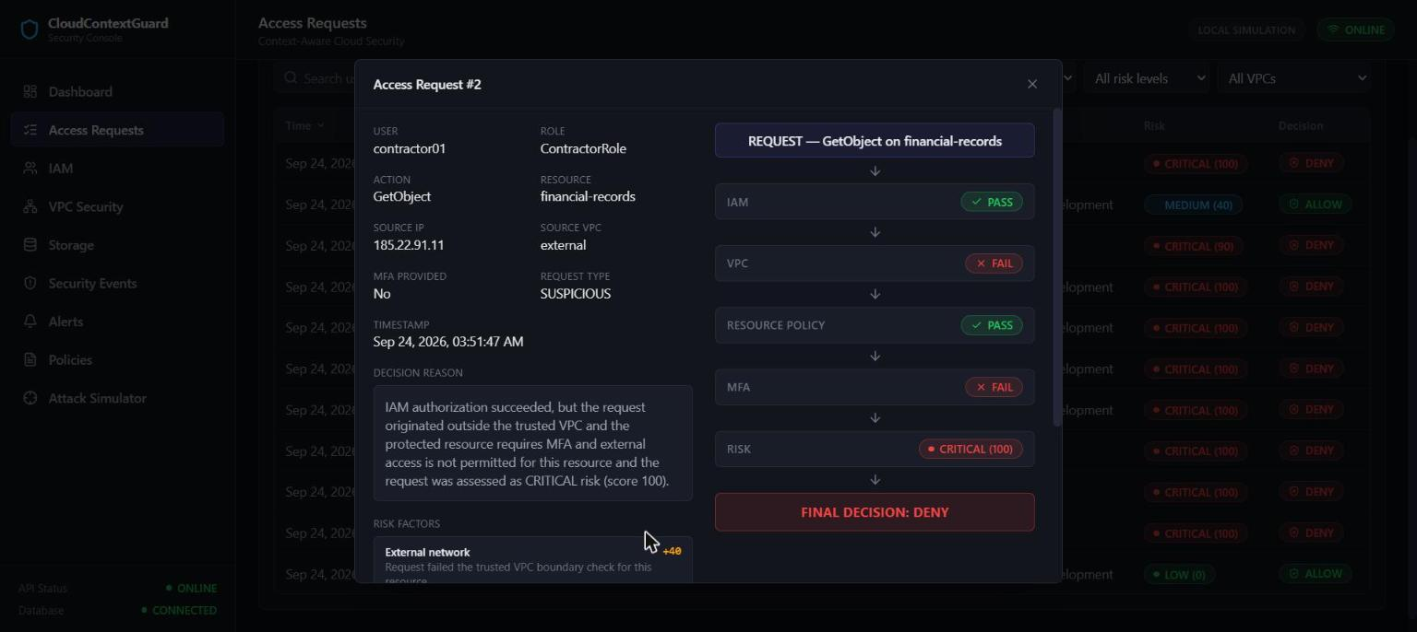
THE CENTRAL DEMONSTRATION
“VALID IAM PERMISSION.”
contractor01 requests GetObject on financial-records
IAM
PASS
ContractorRole genuinely holds GetObject:financial-records
NETWORK / VPC
FAIL
Live API response — Access Request #2 (not a mockup)
source = external ≠ required vpc-finance
MFA
FAIL
required by policy, not provided
RISK
100 / CRITICAL
External network +40, CONFIDENTIAL +30, Missing MFA +30, Untrusted +20, Suspicious +20
FINAL DECISION: DENIED
CLOUDCONTEXTGUARD
08 / 20
Notes:
This is the climax of the talk -- slow down here. contractor01 is a real, seeded identity with a genuine ContractorRole permission for GetObject on financial-records; this is not a broken or misconfigured account. Say clearly: IAM PASS. Pause for a full second and let that register -- a real, valid permission just succeeded. Then reveal the rest: the request came from an external network, so VPC FAILS; MFA was not provided, so MFA FAILS; and the risk engine independently scored this CRITICAL at 100. Point to the screenshot and note this is the live API response, request number 2, not a slide mockup. Land on: FINAL DECISION: DENIED. This is the project's single most important, empirically reproduced finding. Transition: 'This is why the comparison with conventional IAM matters.'

Slide 9
WHY THIS MATTERS
Two ways to answer “should this be allowed?”
IDENTITY-ONLY AUTHORIZATION
CONTEXT-AWARE AUTHORIZATION
CREDENTIAL
IDENTITY
NETWORK
MFA
POLICY
RISK
PERMISSION
DECISION
ACCESS
Five gates. Any single failure is sufficient to deny.
One gate. If permission exists, access follows.
Same identity, same permission, same resource -- the only variable that changed was context.
CLOUDCONTEXTGUARD
09 / 20
Notes:
Put the two models side by side with no adjectives -- let the structure speak. On the left, conventional IAM: a credential implies a permission implies access, one gate only. On the right, what CloudContextGuard actually implements: five independent inputs converging on one decision, where any single failure is sufficient to deny, regardless of the other four. This is a structural difference, not a marketing claim. Transition: 'This isn't just a diagram -- here is the actual attack simulation lab that exercises it.'

Slide 10
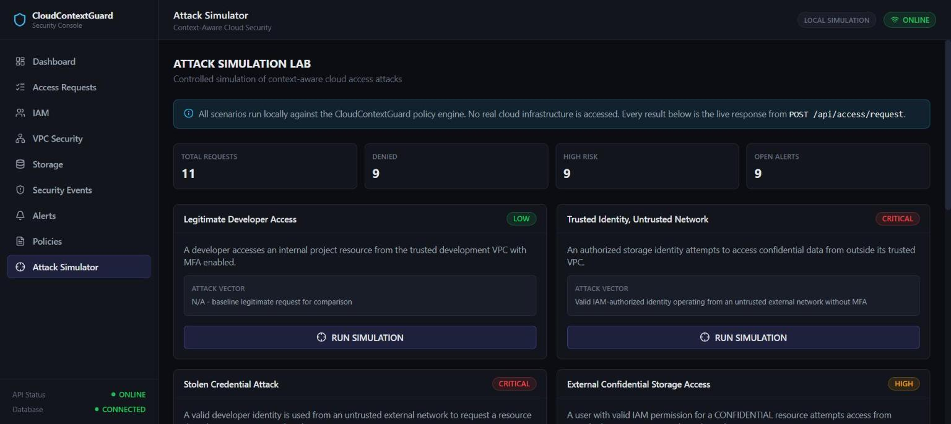
ATTACK SIMULATOR
Six real scenarios. Zero mocked results.
Legitimate Developer Access
LOW
Trusted Identity, Untrusted Network
CRITICAL
Stolen Credential Attack
CRITICAL
External Confidential Storage Access
HIGH
Repeated Unauthorized Requests
HIGH
Live simulation lab -- every run is a real request against the real API.
Privilege Escalation Attempt
CRITICAL
SIMULATOR
REAL API
REAL PIPELINE
REAL DB RECORD
SECURITY EVENT / ALERT
CLOUDCONTEXTGUARD
10 / 20
Notes:
The Attack Simulator is a real client of the API -- it defines only request inputs (user, action, resource, network, MFA); it never stores or fakes an expected outcome. Every scenario submits a genuine POST to /api/access/request and renders whatever comes back, then independently confirms a security event or alert was actually created by querying those endpoints. Point to the six scenarios and their threat levels -- these mirror the seven documented threats almost one-to-one. Transition: 'One of these controls -- the VPC boundary -- is also the one an administrator can change live. Let's do that now.'

Slide 11
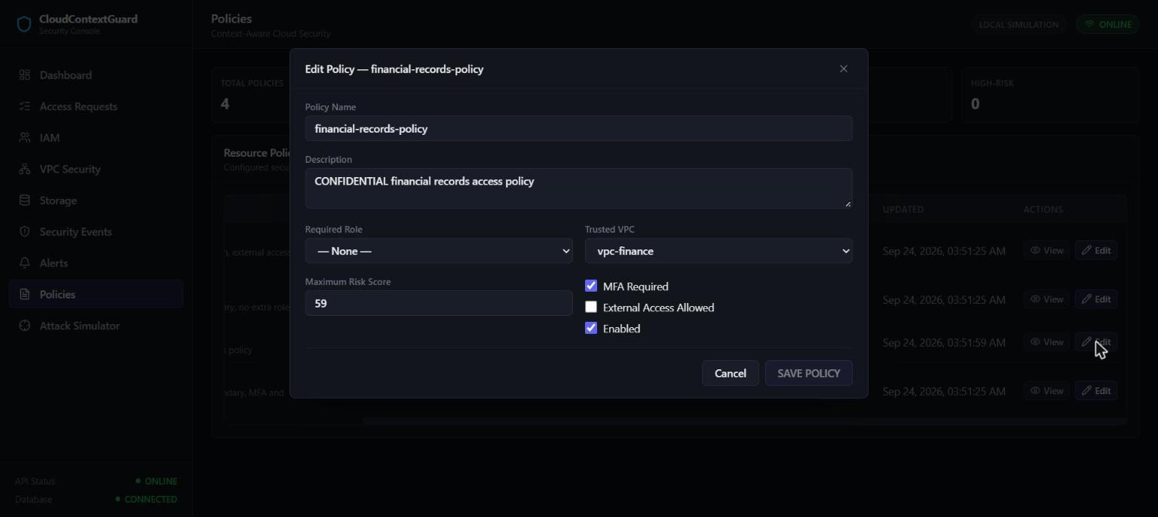
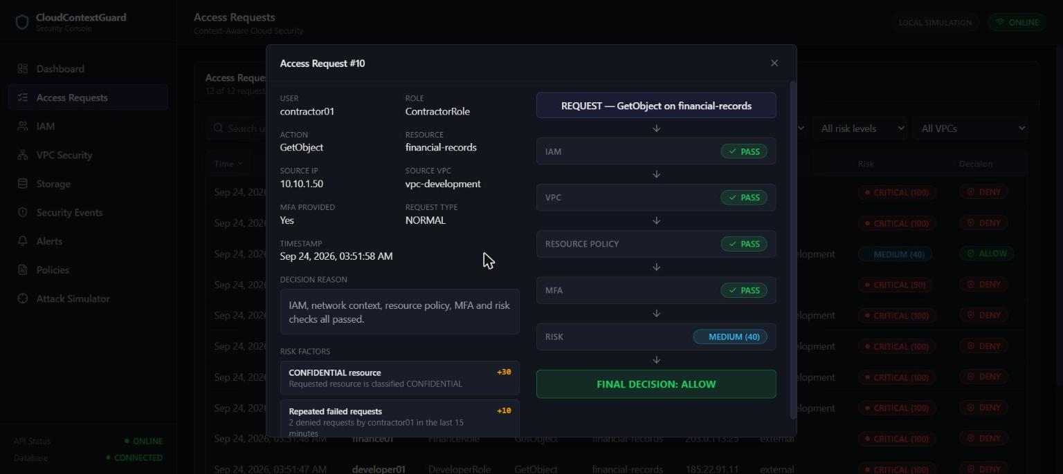
DYNAMIC POLICY, LIVE
The same request. A policy changed underneath it.
BEFORE
ADMINISTRATOR EDITS POLICY
AFTER
trusted_vpc = vpc-finance
same identity · same resource
Request from external
IAM
PASS
VPC
PASS
DENY
RISK
40 / MEDIUM
vpc-finance
vpc-development
ALLOW
NO CODE CHANGE
NO RESTART
CLOUDCONTEXTGUARD
11 / 20
Notes:
This policy is not hardcoded -- it's a database row an administrator edits live through the Policy Management page. Watch: the trusted VPC on financial-records-policy changes from vpc-finance to vpc-development, with no source code change and no application restart. Submit the exact same request -- same identity, same resource, same action -- now from vpc-development. IAM still passes, and now VPC passes too, because the access service reads the Policy table fresh on every evaluation. Risk still lands at 40, MEDIUM, from the resource's own CONFIDENTIAL classification -- but that's below the deny threshold, so the final decision is genuinely ALLOW. Transition: 'Now watch the administrator put the boundary back.'

Slide 12
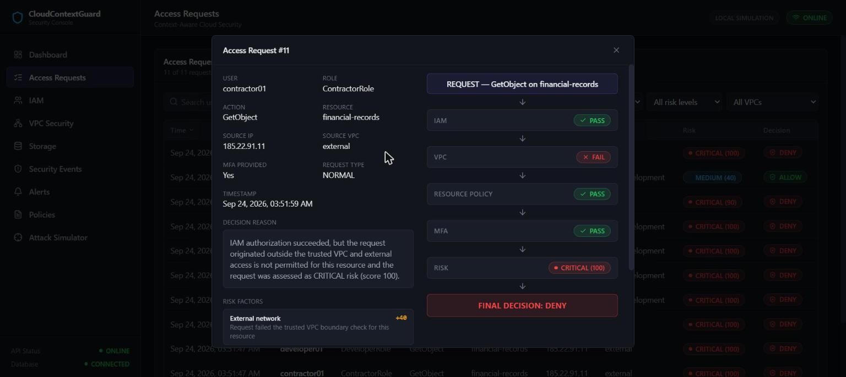
POLICY RESTORATION
The boundary returns the moment it's restored
vpc-development
vpc-finance
policy restored to its original value
EXTERNAL REQUEST
VPC FAIL
DENY
“Security policy is dynamic,
but enforcement remains
server-side.”
Live API response -- policy fully restored, evidence-matched to Step 2.
CLOUDCONTEXTGUARD
12 / 20
Notes:
Reverse the exact same edit -- trusted VPC back to vpc-finance -- through the same Policy Management page. Resubmit the original external request, unmodified. VPC fails again, exactly as it did before any policy was ever touched, and the decision returns to DENY. This matters because it demonstrates the mechanism is bidirectional and safe: an administrator can tune a boundary live, and the system can be returned to its original, secure configuration by the same mechanism, without ever touching a deployment. Transition: 'None of this would mean anything if the client could influence it -- so here is what's actually hardened server-side.'

Slide 13
SECURITY HARDENING
What was independently verified
✓
Server Authority
✓
Mass-Assignment Resistance
Client cannot submit or influence the final decision
Extra fields (role, is_admin, risk_score) are ignored
✓
Injection Resistance
✓
Foreign-Key Integrity
SQL / script / path-traversal strings treated as inert data
Zero orphaned rows, enforced on every connection
✓
Safe Error Responses
✓
CORS Allowlist
404 / 422 responses leak no stack trace or file path
Explicit origins only -- never a wildcard with credentials
✓
Security Headers
✓
Schema-Version Safety
X-Content-Type-Options, X-Frame-Options, Referrer-Policy
Incompatible on-disk schema fails loudly, never silently drops data
✓
Persistent Audit Trail
✓
Events & Alerting
Every decision persisted with the full request and outcome
Every deny and every HIGH/CRITICAL risk request raises a record
CLOUDCONTEXTGUARD
13 / 20
Notes:
A dedicated hardening pass independently verified each of these ten properties against the real, running API -- not in theory. Two are worth calling out explicitly: server authority means a client can send a decision field or a risk_score in its request body, and the server silently ignores it and recomputes everything itself; and mass-assignment resistance means the same is true of a policy update -- fields like id or updated_at are not even part of the accepted schema. Transition: 'All of this runs on a very small, very ordinary stack.'

Slide 14
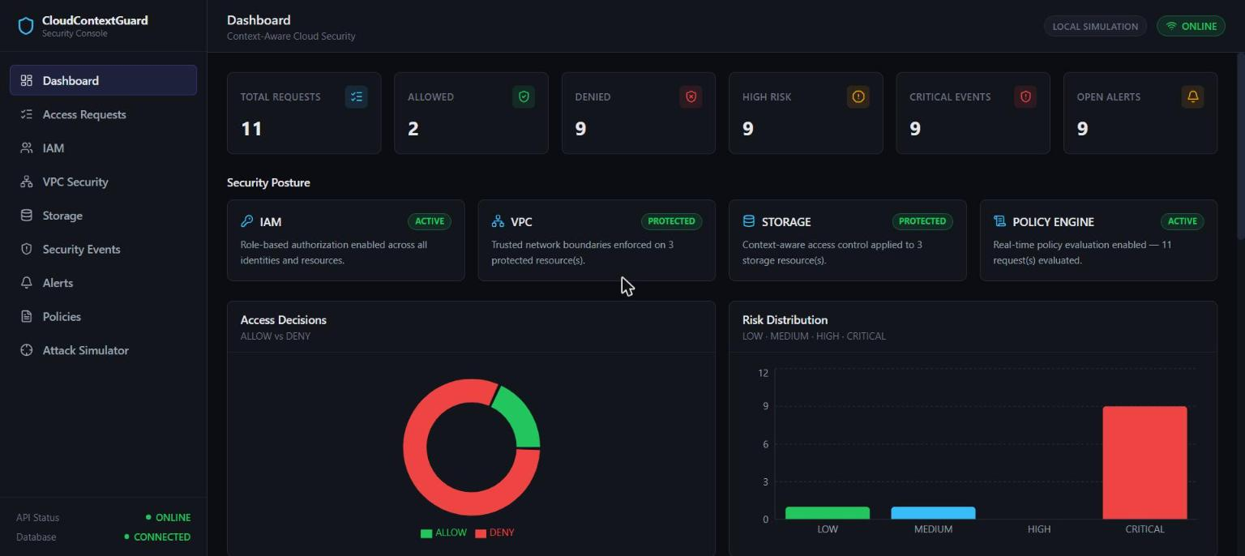
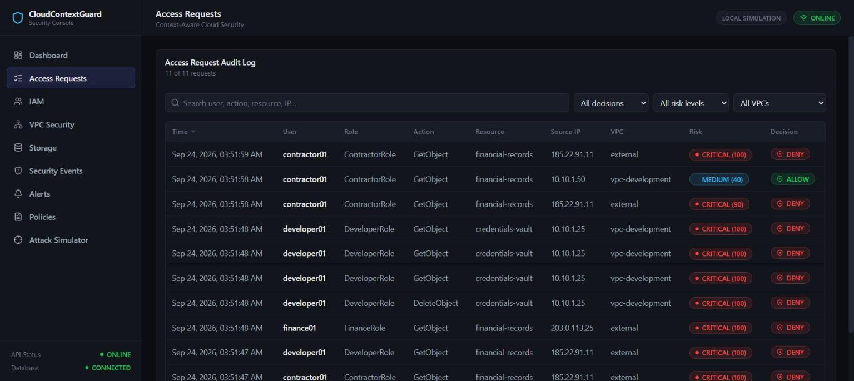
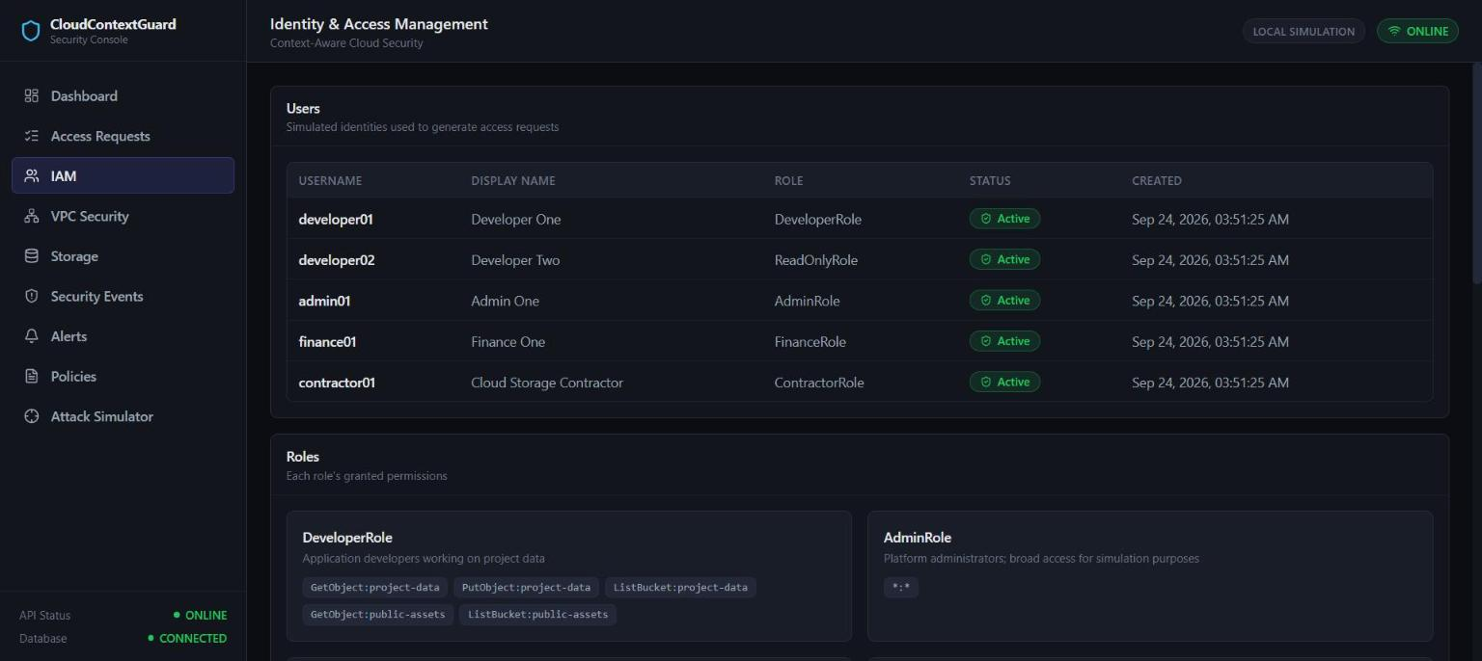
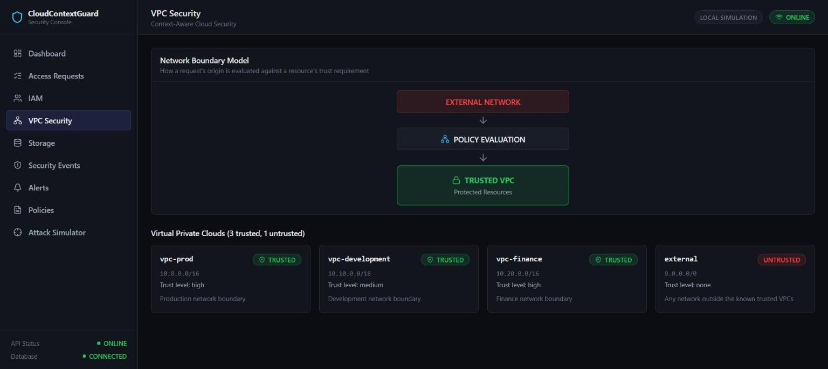
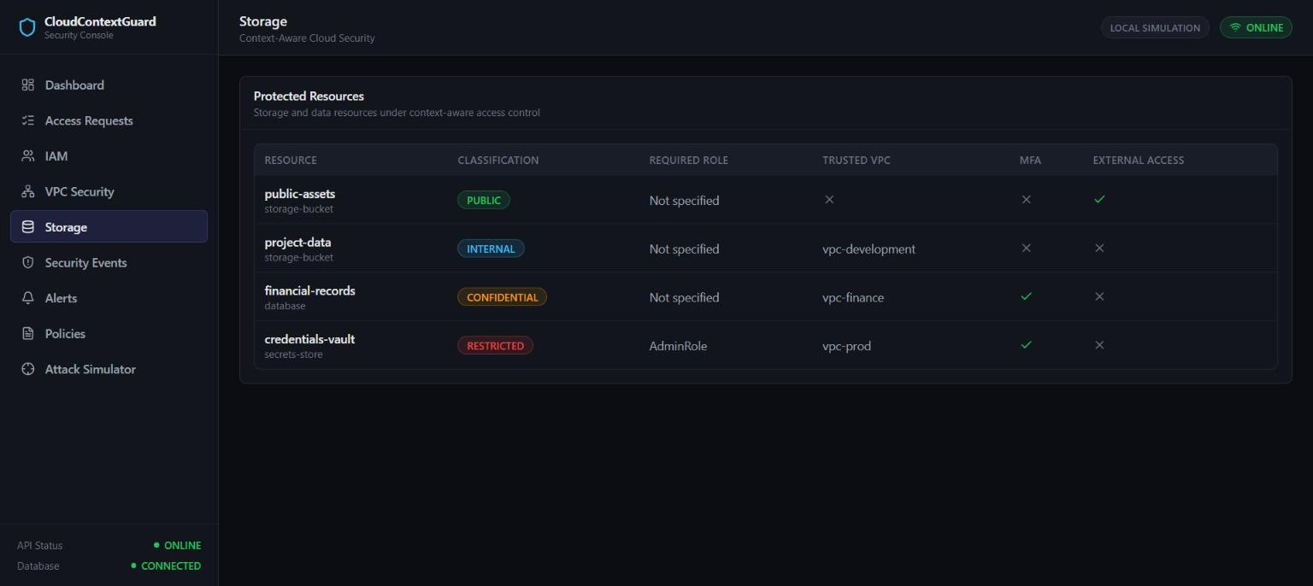
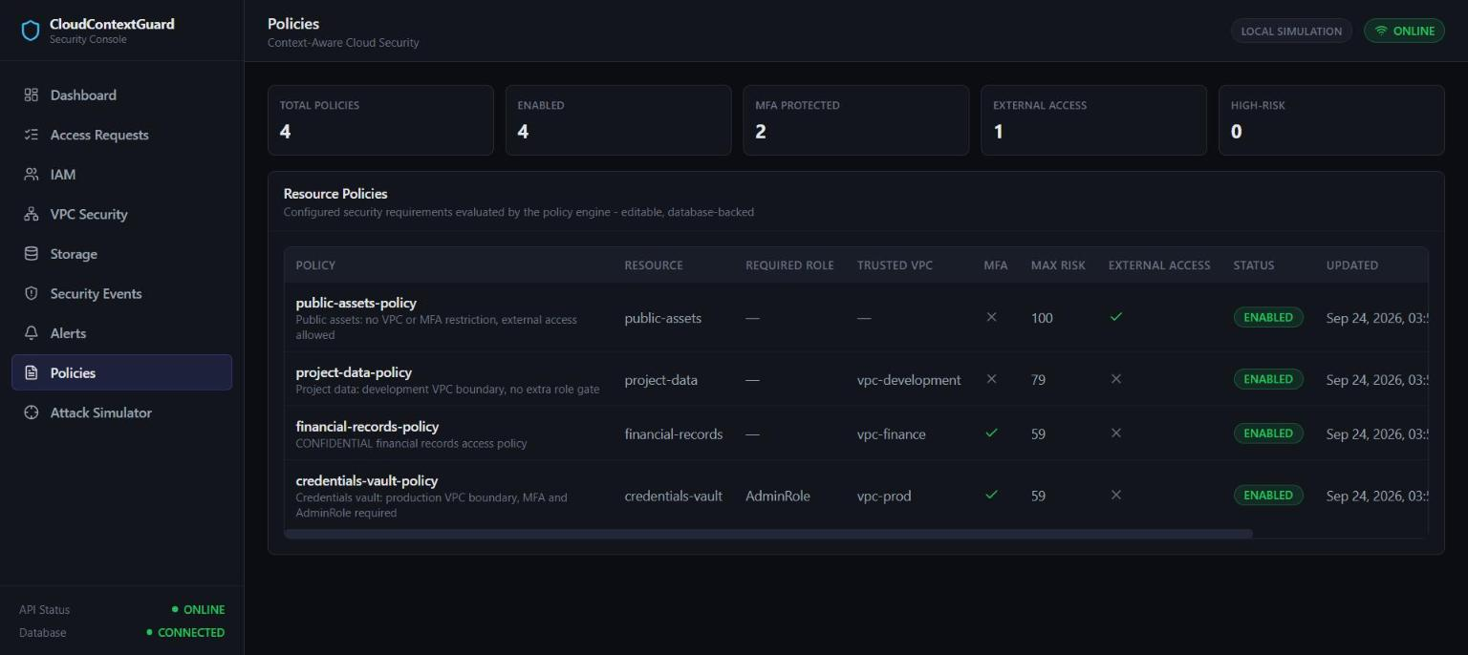
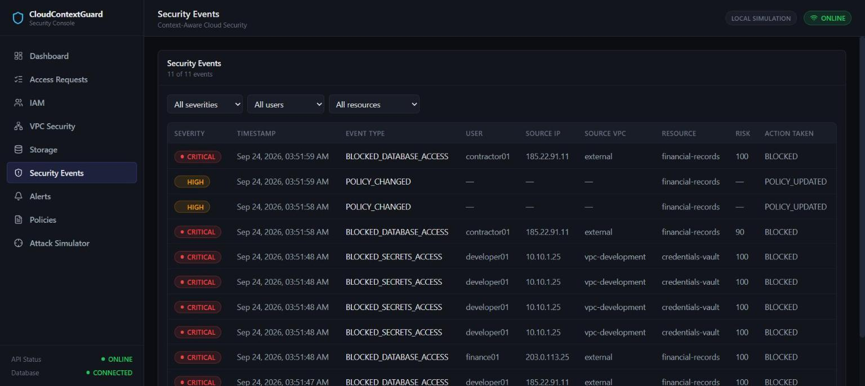
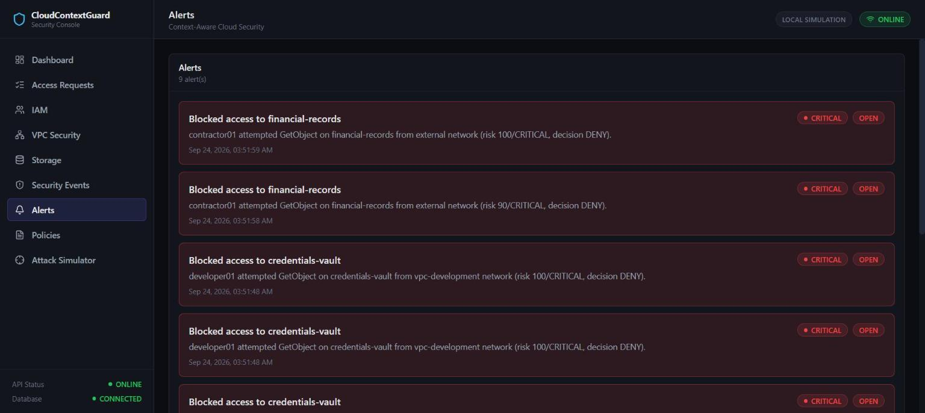
THE LIVE CONSOLE
Nine screens. One decision engine underneath.
DASHBOARD
ACCESS REQUESTS
IAM MANAGEMENT
VPC SECURITY
STORAGE RESOURCES
POLICIES
SECURITY EVENTS
ALERTS
ATTACK SIMULATOR
CLOUDCONTEXTGUARD
14 / 20
Notes:
Every one of these nine screens is a real, working page against the live API -- not mockups. Dashboard aggregates counts across every table; Access Requests, IAM, VPC Security, Storage, Policies and Security Events are full CRUD or read views over the actual database; Alerts shows every record raised by a denied or high-risk request; and the Attack Simulator drives the same access-request endpoint everything else does. Nothing here is a separate demo path. Transition: 'Underneath all nine screens is one schema.'

Slide 15
DATA MODEL
One schema, three purposes
CATALOG
AUDIT
SCHEMA
users
access_requests
schema_version
roles
security_events
permissions
alerts
resources
vpcs
policies
What exists, and who is allowed to touch what
What actually happened, and what it triggered
A guard against loading an incompatible database
CLOUDCONTEXTGUARD
15 / 20
Notes:
The schema is deliberately small and relational, not exotic. CATALOG holds the static facts an authorization decision reasons over -- identities, roles, permissions, resources, trusted VPCs and the policies that bind them. AUDIT holds what actually happened: every access request with its full evaluation trail, every security event, and every alert. SCHEMA is a single version row that makes an incompatible on-disk database fail loudly at startup rather than silently corrupt data. All foreign keys are enforced, and the earlier hardening pass verified zero orphaned rows across the entire audit trail. Transition: 'None of this is a demo we ran once -- it's an 82-test suite that runs every time.'

Slide 16
VERIFIED, NOT CLAIMED
Every number here is reproducible
82 / 82
17 / 17
BUILD OK
Backend tests passed
Portability checks passed
Frontend production build
pytest -- 0 failed
verify_portability.py
npm run build (Vite)
Breakdown: health/liveness (5) · access control (17) · policy management (10) · database safety (9) · security validation (41)
No fabricated benchmarks. No cherry-picked timing. Every figure re-runs from the commands above.
CLOUDCONTEXTGUARD
16 / 20
Notes:
None of these numbers are aspirational. Eighty-two backend tests across five suites -- health, access control, policy management, database safety, and a dedicated 41-test security validation pass -- all currently pass. Seventeen portability checks confirm the project has no hardcoded machine-specific paths and correctly detects its own root regardless of working directory or where the folder is moved. The frontend production build completes cleanly under Vite. Anyone can reproduce every one of these by running the commands shown. Transition: 'So what happens when the system is deliberately attacked?'

Slide 17
THREAT MODEL
Seven documented threats. Seven verified outcomes.
T1
T2
T3
T4
Compromised Developer Credentials
Access From Outside the Trusted VPC
Missing MFA
Unauthorized Resource Access
DENY
DENY
DENY
DENY
T5
T6
T7
Privilege Escalation Attempt
Repeated Unauthorized Requests
Sensitive Storage Exposure
DENY
DENY
WARNING
T7 is deliberately not a fabricated auto-deny -- it surfaces a visible administrative warning, because the real access decision is still governed by the documented decision rules.
CLOUDCONTEXTGUARD
17 / 20
Notes:
Seven threats are documented end-to-end in THREAT_MODEL.md, each with an exact attack condition, the control that catches it, how it's detected in code, and the verified response. Six resolve to DENY. The seventh, T7 -- an administrator enabling external access on a CONFIDENTIAL or RESTRICTED resource -- is intentionally different: rather than inventing an automatic denial that isn't backed by the decision engine's real rules, the system surfaces a visible warning on the Policies page and lets the documented decision logic govern the next actual request. That distinction matters -- it's honest about what the system does and does not enforce automatically. Transition: 'None of this means the system has no boundaries.'

Slide 18
ENGINEERING BOUNDARIES
What this is not
–
Local simulation only -- no connection to a real cloud provider
–
No real AWS integration, credentials, or account, anywhere
–
Risk scoring is rule-based, not machine-learning-based
–
No production-grade rate limiting
–
SQLite, not a production distributed database
–
Lightweight schema-version check, not a full migration framework
–
No production identity provider (OAuth / OIDC / SAML)
–
No real cloud telemetry (e.g. AWS CloudTrail) ingested
These are engineering boundaries of an academic prototype -- stated plainly, not hidden.
CLOUDCONTEXTGUARD
18 / 20
Notes:
It would be easy to let a pitch imply more than what was built -- we're doing the opposite. This is a local simulation with no real AWS account, no real credentials, and no production infrastructure anywhere. The risk engine is transparent and rule-based, not machine learning. The database is SQLite. None of this diminishes the finding -- the authorization logic itself, and the proof that a valid IAM permission is not sufficient, would evaluate identically inside a real AWS environment. It just means we're telling you exactly where the prototype ends. Transition: 'And exactly where it would go next.'

Slide 19
ROADMAP
From simulation to production
01
Real AWS IAM Integration
Map simulated roles/permissions onto real IAM policy evaluation
02
AWS VPC + S3 Integration
Real network-origin verification via VPC endpoints; the same model applied to real S3 bucket policies
03
CloudTrail Ingestion
Replace simulated audit data with real AWS event data; push events live instead of polling
04
Identity Provider Integration
OAuth / OIDC / SAML in place of local identity rows
05
Policy-as-Code
Terraform / IaC-managed policies outside the application database
06
ML-Assisted Risk
Anomaly detection as a complement to, not a replacement for, the current rule-based engine
CLOUDCONTEXTGUARD
19 / 20
Notes:
This roadmap is deliberately ordered -- it starts by connecting the exact same decision engine you just saw to real AWS IAM, then real network context through VPC endpoints and real S3 policies, then real CloudTrail telemetry instead of simulated events. Identity-provider integration and policy-as-code come next, and machine-learning risk scoring is explicitly positioned as a complement to the current rule-based engine, not a replacement for its transparency. Transition: 'But none of that changes what's already true today.'

Slide 20
IAM TELLS US WHO CAN ACCESS.
CONTEXT TELLS US WHETHER THEY SHOULD.
CloudContextGuard
Context-Aware Cloud Access Control Using IAM and Trusted VPC Boundaries
github.com/priyaansh21/CloudContextGuard
CLOUDCONTEXTGUARD
Notes:
Leave this on the screen. The entire project, in one sentence: a permission check tells you what an identity is allowed to do; it says nothing about the network it's coming from, whether it proved who it is, or what the resource's own policy allows in this moment. CloudContextGuard evaluates all of that together, server-side, and it's fully reproducible -- 82 tests, 17 portability checks, and a live system you can run right now. Thank you. Happy to take questions or walk through any part of the pipeline again live.

