Slide 1
SVKM’S NMIMS
NMIMS
MUKESH PATEL SCHOOL OF
TECHNOLOGY MANAGEMENT
& ENGINEERING
Railway Reservation System
RAILNEXUS
Reservations • Queue promotion • Announcements
Boarding • Reports • Audit
Priyanshu Tiwari
Roll No.: [Enter roll number] | Faculty: [Enter faculty name]
Advanced Database Management Systems • October 2026
RailNexus | Advanced Database Management Systems
1

Slide 2
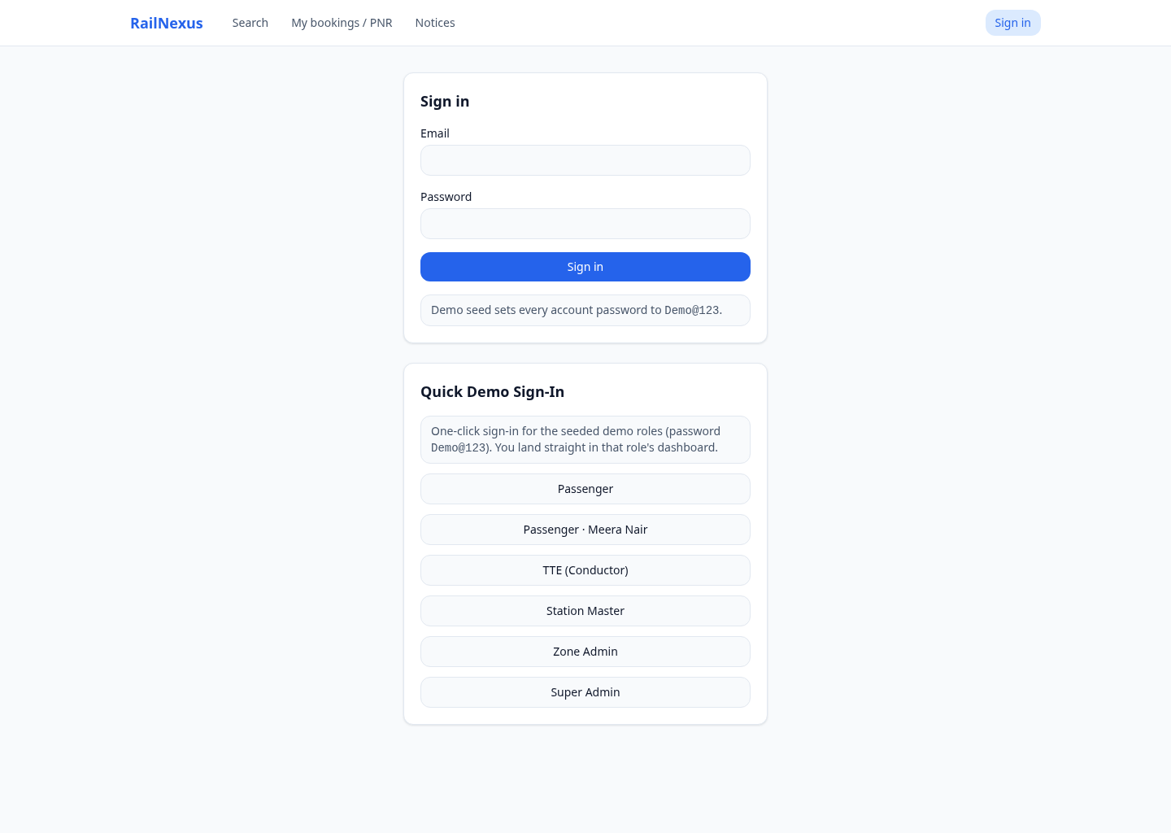
SVKM’S NMIMS
NMIMS
MUKESH PATEL SCHOOL OF
TECHNOLOGY MANAGEMENT
& ENGINEERING
Project Scope and Five Actors
Passenger
Search, book, pay, cancel and view notices.
Operational staff
TTE records boarding; Station Master publishes announcements.
Administration
Zone Admin sees assigned-zone reports; Super Admin sees all zones and audit events.
RailNexus | Advanced Database Management Systems
2

Slide 3
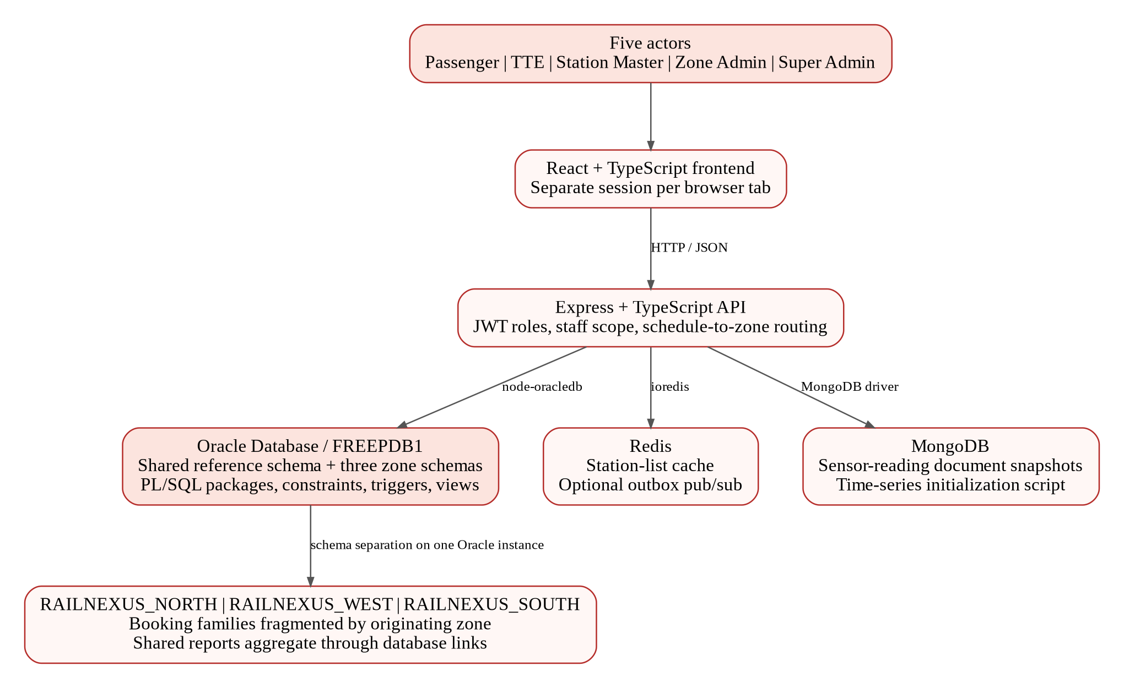
SVKM’S NMIMS
NMIMS
MUKESH PATEL SCHOOL OF
TECHNOLOGY MANAGEMENT
& ENGINEERING
Three Database Technologies
Oracle
Bookings, tickets, payments, announcements, triggers and reports.
Redis
Fast station-list caching; optional outbox pub/sub.
MongoDB
Best-effort sensor-reading document snapshots.
RailNexus | Advanced Database Management Systems
3

Slide 4
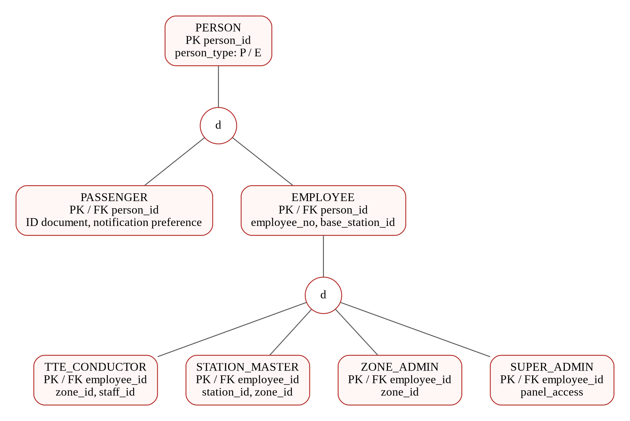
SVKM’S NMIMS
NMIMS
MUKESH PATEL SCHOOL OF
TECHNOLOGY MANAGEMENT
& ENGINEERING
EER: Identity and Role Specialization
PERSON → Passenger / Employee; Employee → four staff roles.
d = disjoint. Subtype primary keys also reference their supertype.
RailNexus | Advanced Database Management Systems
4

Slide 5
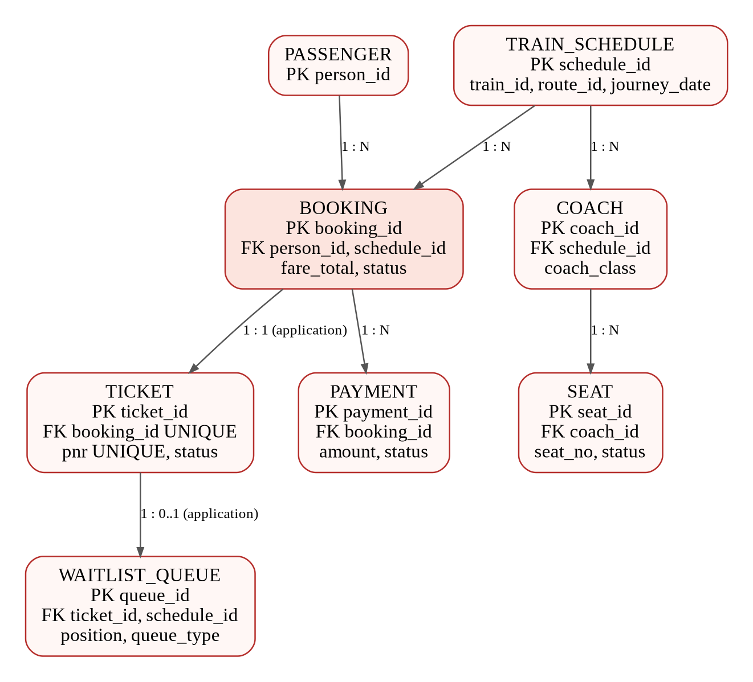
SVKM’S NMIMS
NMIMS
MUKESH PATEL SCHOOL OF
TECHNOLOGY MANAGEMENT
& ENGINEERING
EER: Reservation Relationships
One passenger → many bookings
One journey → coaches → seats
One booking → one ticket
Payments and queue entries reference the reservation lifecycle.
RailNexus | Advanced Database Management Systems
5

Slide 6
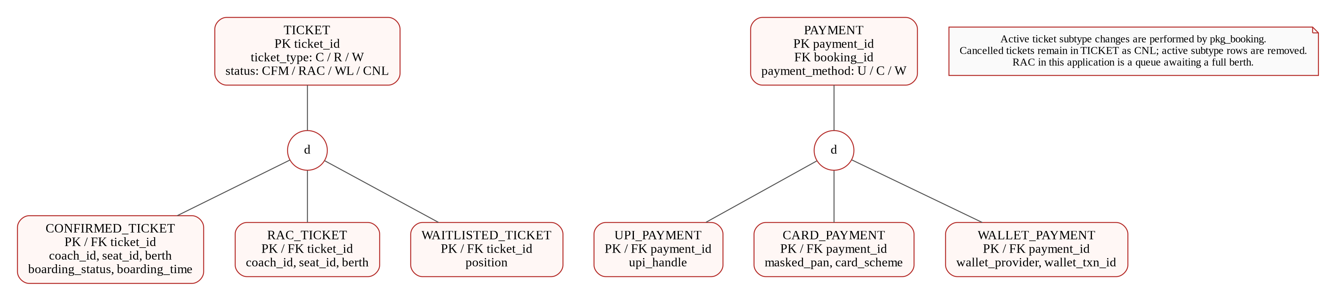
SVKM’S NMIMS
NMIMS
MUKESH PATEL SCHOOL OF
TECHNOLOGY MANAGEMENT
& ENGINEERING
EER: Ticket and Payment Specialization
Common identity remains in the supertype; status- or method-specific fields remain in detail tables.
RailNexus | Advanced Database Management Systems
6

Slide 7
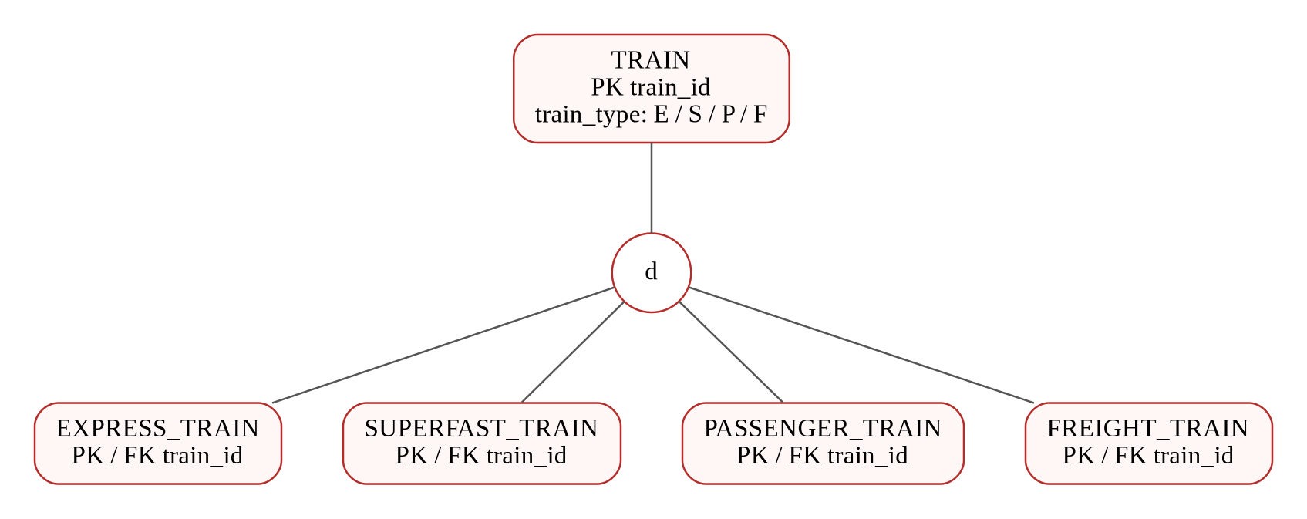
SVKM’S NMIMS
NMIMS
MUKESH PATEL SCHOOL OF
TECHNOLOGY MANAGEMENT
& ENGINEERING
EER: Train Specialization
TRAIN → Express / Superfast / Passenger / Freight. Passenger search excludes freight services.
RailNexus | Advanced Database Management Systems
7

Slide 8
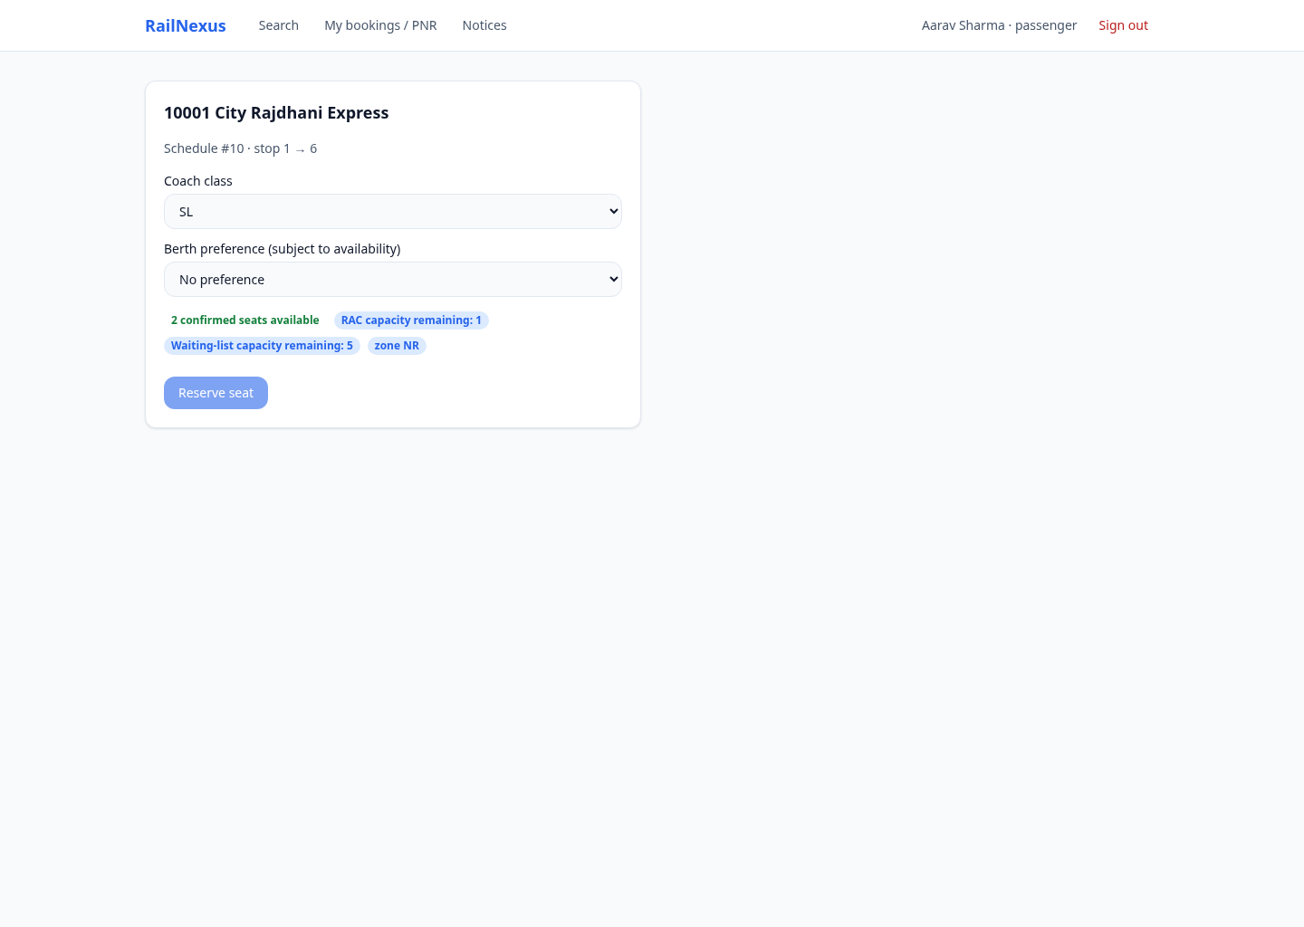
SVKM’S NMIMS
NMIMS
MUKESH PATEL SCHOOL OF
TECHNOLOGY MANAGEMENT
& ENGINEERING
Search and Limited Inventory
Regular journeys
1–30 October 2026.
Per class
2 confirmed seats, 1 RAC place, 5 WL places.
Normal frontend
Search → Book → My bookings.
RailNexus | Advanced Database Management Systems
8

Slide 9
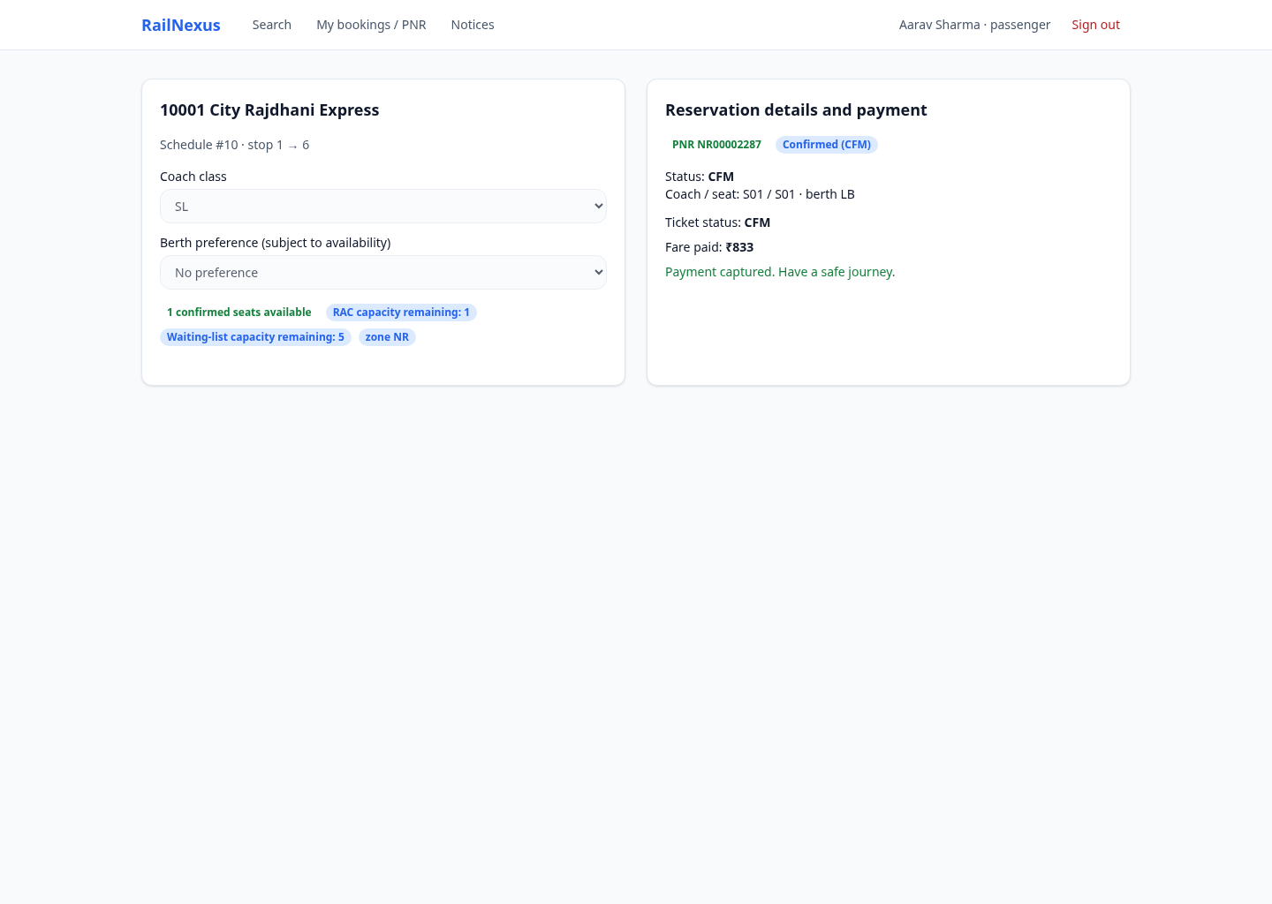
SVKM’S NMIMS
NMIMS
MUKESH PATEL SCHOOL OF
TECHNOLOGY MANAGEMENT
& ENGINEERING
PL/SQL: Booking and Fare Calculation
Booking procedure
pkg_booking.book_ticket validates, locks inventory and allocates CFM / RAC / WL.
Fare function
pkg_fare.compute_fare uses distance, class and the effective fare rule.
Request safety
Unique request IDs support repeated-call handling.
RailNexus | Advanced Database Management Systems
9

Slide 10
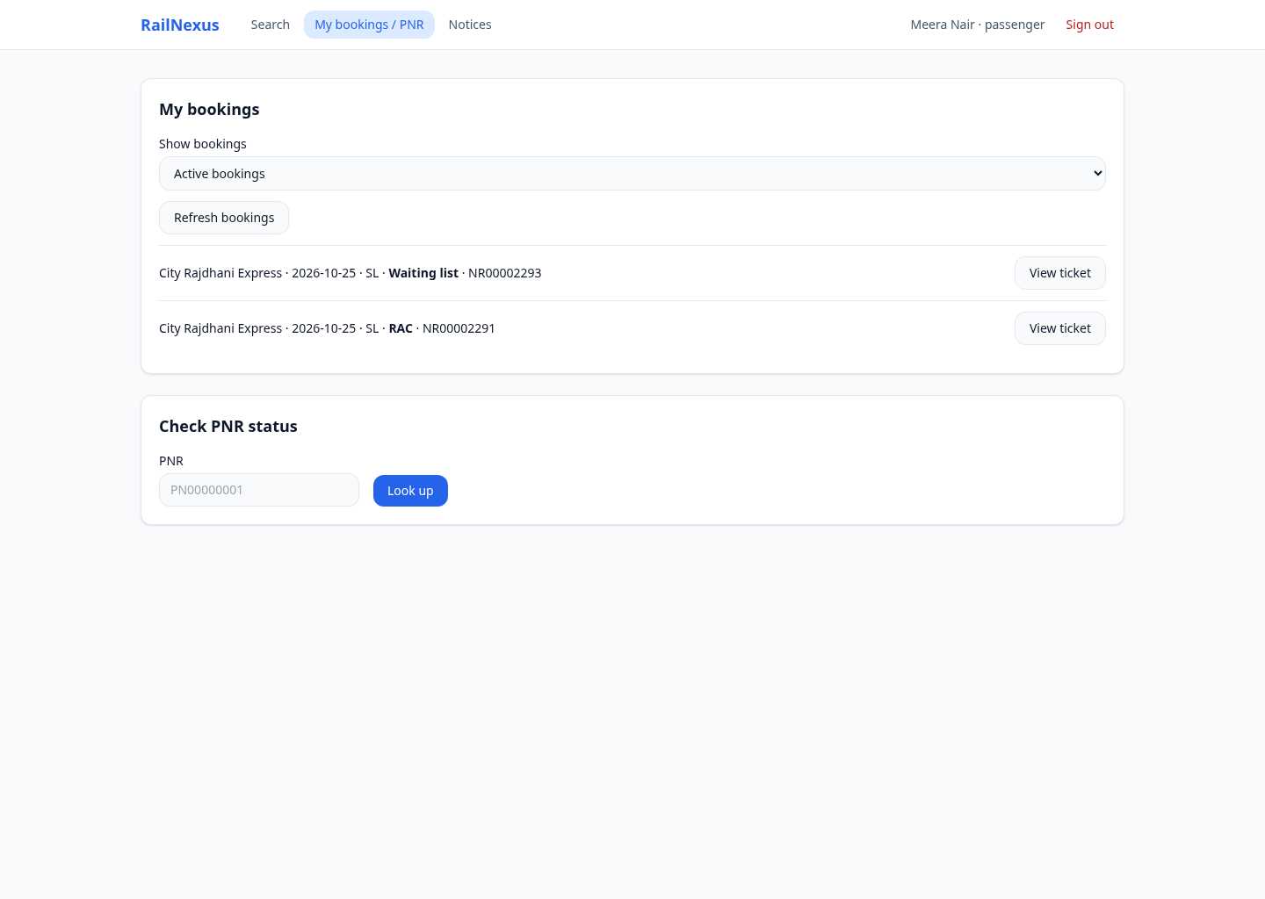
SVKM’S NMIMS
NMIMS
MUKESH PATEL SCHOOL OF
TECHNOLOGY MANAGEMENT
& ENGINEERING
Two Passengers: Before Cancellation
Same train, date and class
Aarav: 2 Confirmed
Meera: RAC + WL
No confirmed seats remain.
RailNexus | Advanced Database Management Systems
10

Slide 11

SVKM’S NMIMS
NMIMS
MUKESH PATEL SCHOOL OF
TECHNOLOGY MANAGEMENT
& ENGINEERING
Cancellation: Automatic Queue Promotion
Aarav cancels one CFM ticket.
Meera: RAC → CFM
Meera: WL → RAC
pkg_booking.cancel_ticket updates allocation, queue and audit in a transaction.
RailNexus | Advanced Database Management Systems
11

Slide 12
SVKM’S NMIMS
NMIMS
MUKESH PATEL SCHOOL OF
TECHNOLOGY MANAGEMENT
& ENGINEERING
Payment, Refund and Integrity
Payment
UPI / Card / Wallet capture is simulated; fare is validated on the server.
Refund
Cancellation requests the captured refundable amount.
Integrity
Keys, status checks, ownership and request identifiers protect records.
RailNexus | Advanced Database Management Systems
12

Slide 13
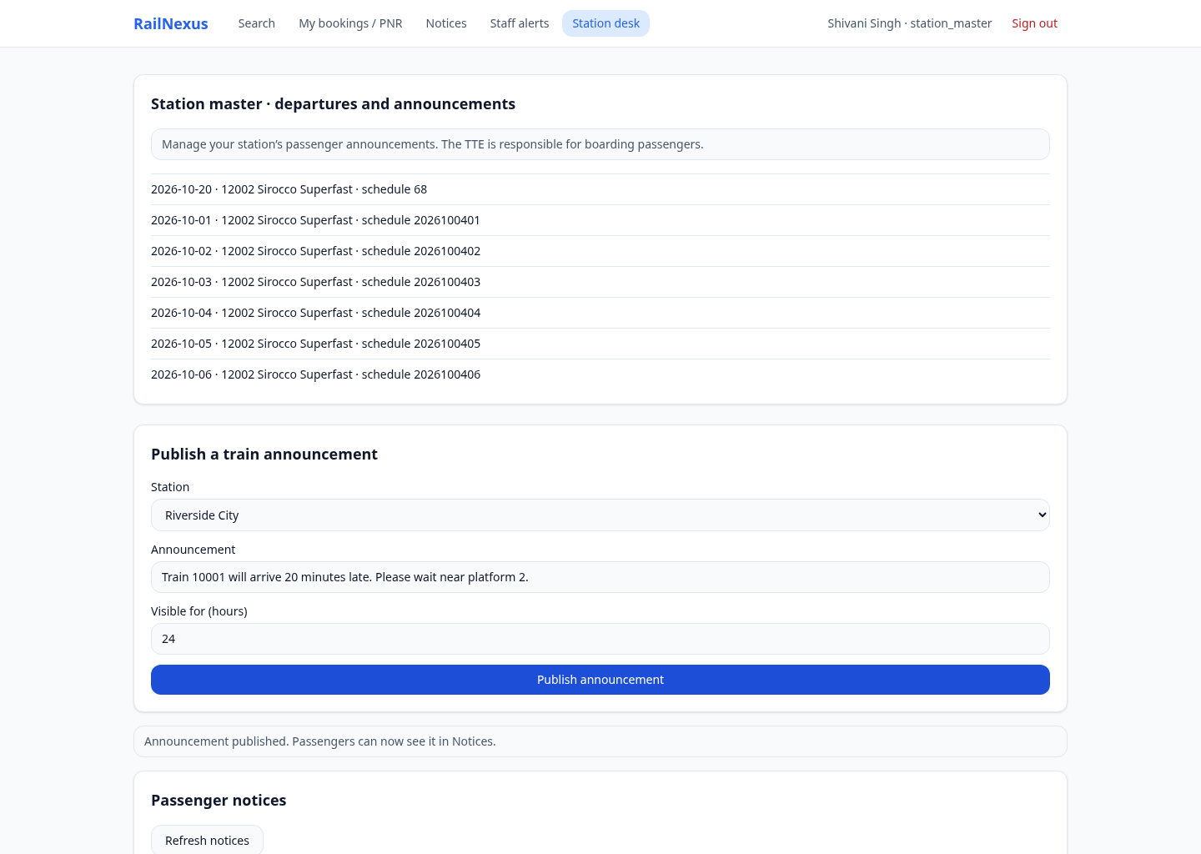
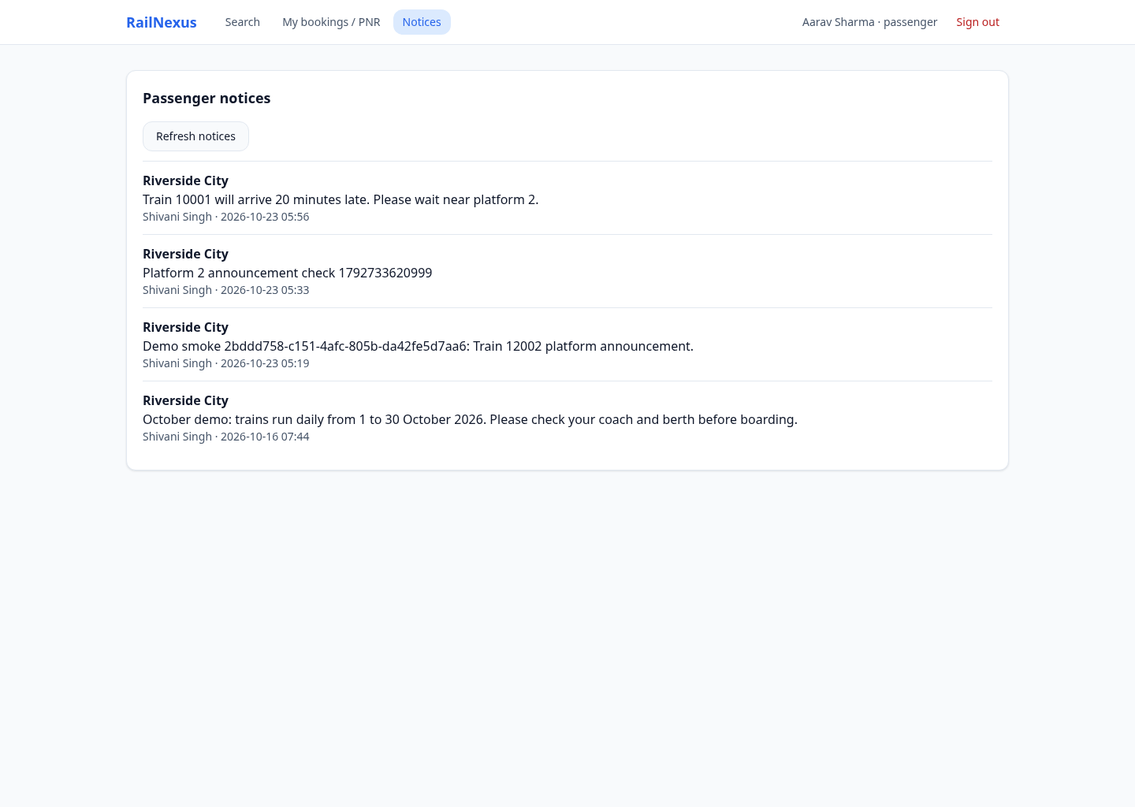
SVKM’S NMIMS
NMIMS
MUKESH PATEL SCHOOL OF
TECHNOLOGY MANAGEMENT
& ENGINEERING
Station Master → Passenger Notice
Publish at the assigned station → refresh Passenger Notices → the same message appears.
RailNexus | Advanced Database Management Systems
13

Slide 14
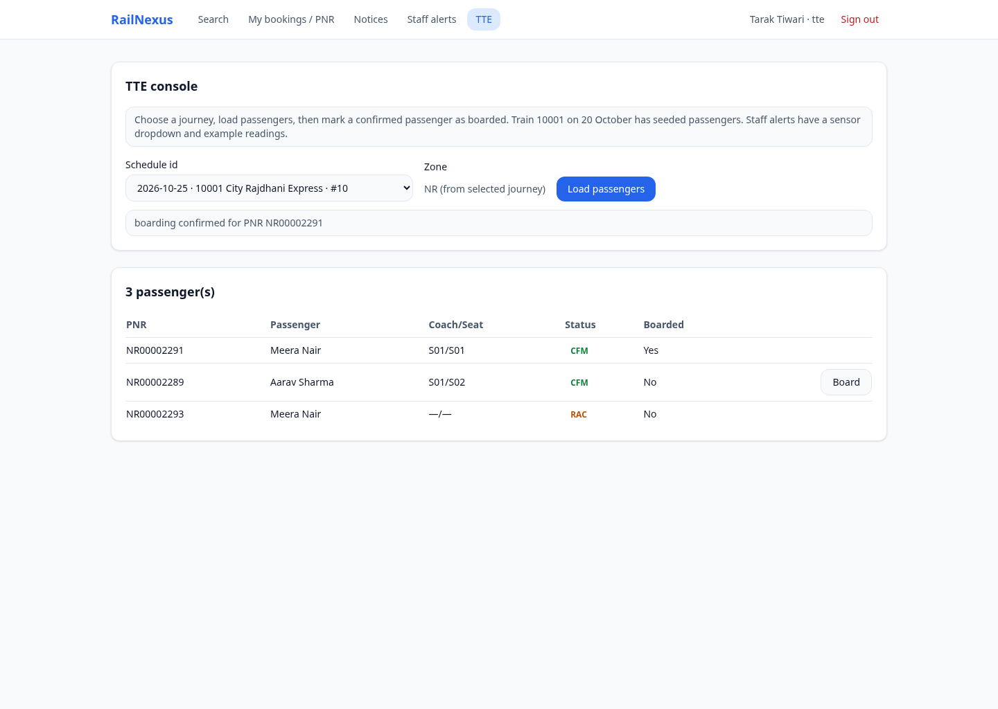
SVKM’S NMIMS
NMIMS
MUKESH PATEL SCHOOL OF
TECHNOLOGY MANAGEMENT
& ENGINEERING
Passenger Booking → TTE Boarding
Select the same journey.
Load the passenger list.
Mark a CFM passenger as boarded.
pkg_tte.board_ticket records the update.
RailNexus | Advanced Database Management Systems
14

Slide 15
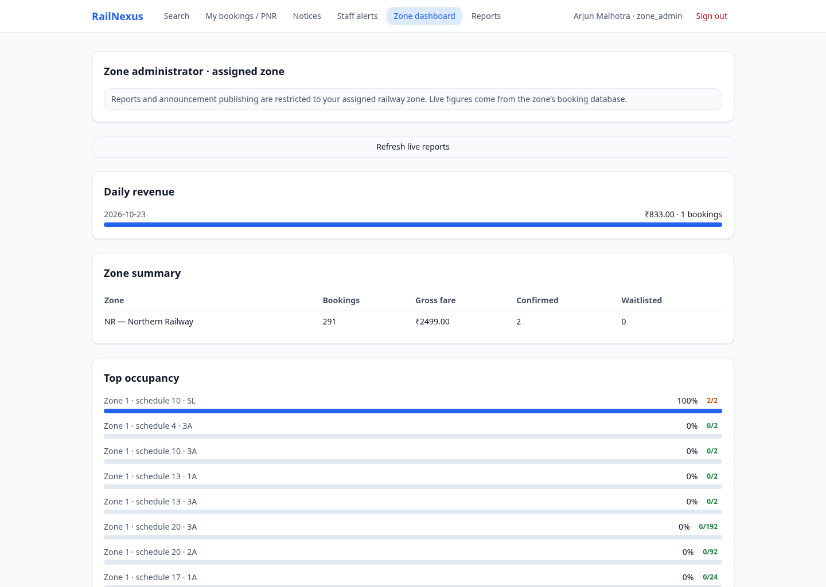
SVKM’S NMIMS
NMIMS
MUKESH PATEL SCHOOL OF
TECHNOLOGY MANAGEMENT
& ENGINEERING
Zone and Super Administrator Reports
Zone Admin: assigned zone only.
Super Admin: all three zones.
Views show live aggregates.
Materialized reporting data is refreshed on demand.
RailNexus | Advanced Database Management Systems
15

Slide 16
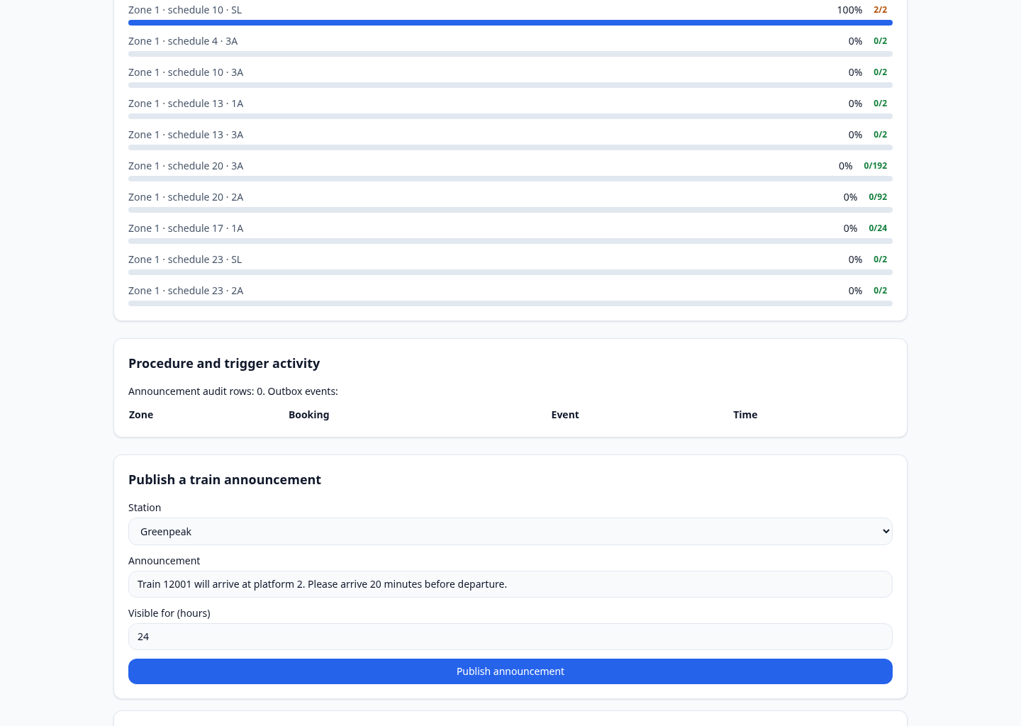
SVKM’S NMIMS
NMIMS
MUKESH PATEL SCHOOL OF
TECHNOLOGY MANAGEMENT
& ENGINEERING
Triggers and Audit Evidence
Package inserts booking audit.
trg_audit_to_outbox inserts an outbox event.
Announcement trigger records publication.
Queue promotion itself is procedure logic.
RailNexus | Advanced Database Management Systems
16

Slide 17
SVKM’S NMIMS
NMIMS
MUKESH PATEL SCHOOL OF
TECHNOLOGY MANAGEMENT
& ENGINEERING
ADBMS Concepts and Source Files
Procedures / functions
db/plsql/pkg_booking.sql; pkg_fare.sql
Triggers
db/plsql/outbox_audit_trigger.sql; pkg_announcements.sql
EER and constraints
db/shared_ddl/01_core_schema.sql; db/zone_common/booking_family.sql
Fragmentation / views
db/distributed/db_links.sql; db/reporting/report_views.sql
Object types / JSON
db/or/route_journey_types.sql; db/json/pkg_json_rules.sql
RailNexus | Advanced Database Management Systems
17

Slide 18
SVKM’S NMIMS
NMIMS
MUKESH PATEL SCHOOL OF
TECHNOLOGY MANAGEMENT
& ENGINEERING
Validation and Project Boundaries
Verified
276 real API assertions; 31 backend + 2 frontend unit tests; production builds passed.
Connected workflows
Two-passenger promotion, staff publication, TTE boarding and role restrictions.
Prototype limits
Simulated payments; one Oracle instance with three zone schemas; refresh-based updates.
RailNexus | Advanced Database Management Systems
18

Slide 19
SVKM’S NMIMS
NMIMS
MUKESH PATEL SCHOOL OF
TECHNOLOGY MANAGEMENT
& ENGINEERING
Conclusion
One actor changes data.
Another actor sees the database result.
Booking → CFM / RAC / WL
Cancellation → promotion and refund
Announcement → Passenger Notices
Boarding → updated TTE record
Transactions → consistent records and audit
RailNexus | Advanced Database Management Systems
19

