Slide 1
Project Overview
- A terminal-based event ticket booking system
- Features include:
- User registration and login
- Viewing available events
- Seat selection and booking
- Persistent data storage via files

Slide 2
Features
- Register/Login with username and password
- View list of available events with time and price
- Book specific seats from seat map
- View all your past bookings
- Save/Load data using file handling (users.txt, bookings.txt)

Slide 3
System Design
- Data Structures:
- User – Stores username/password
- Event – Contains name, time, price, and seat map
- Booking – Holds booking info per user

Slide 4
File Handling
- Files Used:
- users.txt – For storing registered users
- bookings.txt – For formatted ticket records
- Functions:
- save_users() / load_users()
- save_bookings() / load_bookings()

Slide 5
Seat Booking Logic
- Seat layout: 5 rows (A–E), 5 columns (1–5)
- 'A' = Available, 'X' = Booked
- Seat selected using format (e.g., A1, B2)
- Validation: prevents double booking or invalid inputs

Slide 6
User
Authentication
- register_user():
- Ensures unique usernames
- Stores credentials in file
- login():
- Verifies credentials
- Grants access to booking features

Slide 7
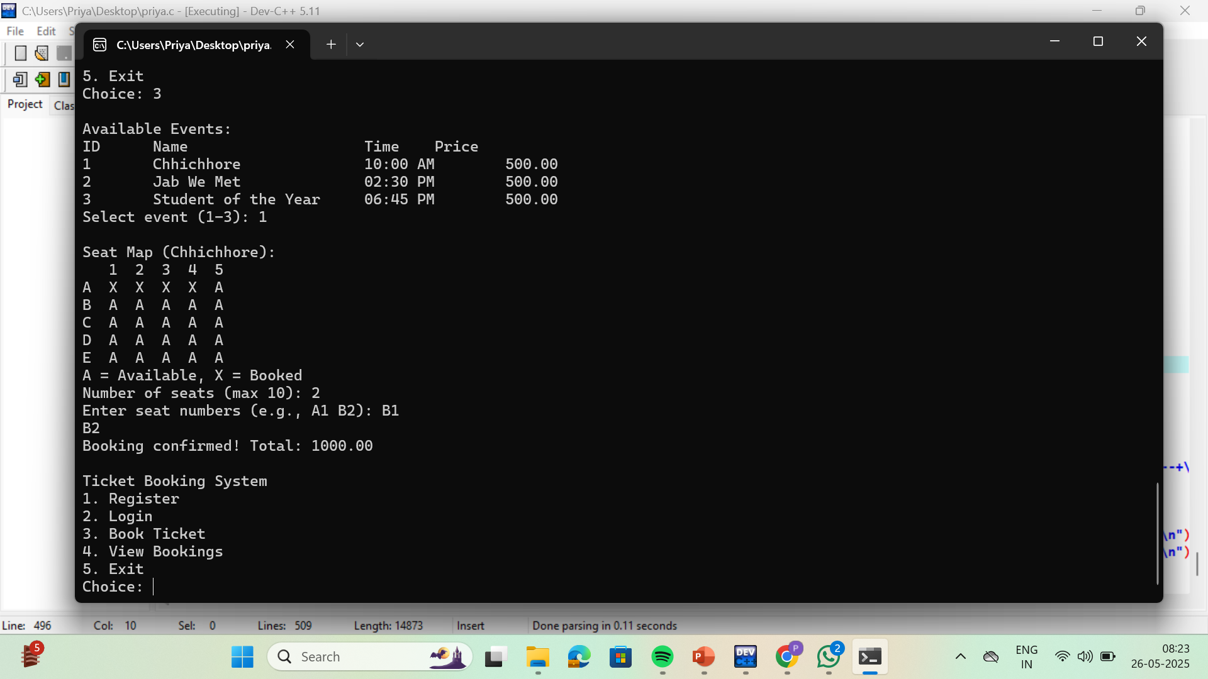
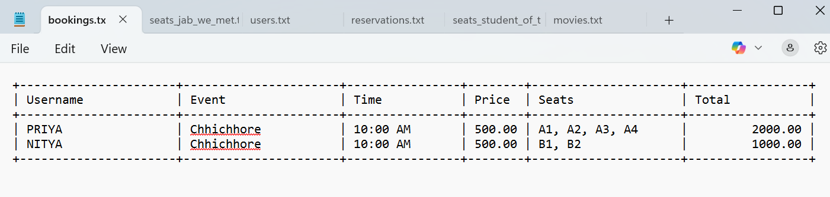
Sample Output
- Event list display - Seat map with 'A' and ‘X’
-Booking table:

Slide 8
Conclusion
- Simple and effective ticket booking system
- Demonstrates:
- File handling
- Structures and arrays
- Real-world application in C

