Slide 1
Over-the-counter financial trading optimization
Name:
Shubham Rawlani
Shraddhaa Parkar
Priya Balgi
Subject: PR 590
Year: Fall 2018
Date: 9th December 2018

Slide 2
Agenda
Page | Title
3 | Introduction: OTC Market Trading
4 | OTC Market Figures
5 | OTC vs. Exchange
6 | Case Study : OTC Trading in Commodity marketplaces
7 | Working: OTC Trading in Commodity marketplaces

Slide 3



Introduction : OTC Market Trading
OTC market is a significant part of the world of global finance.
A security is a tradable financial asset.
OTC trading is a security traded directly between 2 parties without an exchange.
The securities that can be traded are:
Commodities:
Soft : Agricultural
Hard: Metals
Financial instruments:
Stocks
Loan
Deposits
Derivatives:
Forward
Futures
Options
Swaps
Traded through phone, email, electronic trading system
Source : Investopedia/Wikipedia

Slide 4
OTC Market Figures
~ $595 Trillion outstanding
~40% of US Stocks are traded OTC
10,000 Stocks traded per year
200k individual investors
OTC Market Figures
~ $10 Trillion gross market value
~1.8 Million trades per year
Source : U.S. Securities and Exchange Commission Investopedia/Wikipedia/BIS

Slide 5
OTC vs Exchange
Difference Between OTC and Exchange Trading
Over-the-Counter Trading
They do not have a physical location
They consist of network of dealers; No regulators
Players are connected by phone or computer networks
Example: NASDAQ
Exchange Trading
They have a physical location where trading takes place.
They are transparent; Monitored by regulators
Players are bound to trade on the exchange
Example: NYSE, LSE, AMEX
Source : Investopedia/Wikipedia/IMF

Slide 6

Case Study : OTC Trading in Commodity marketplaces
Client
NBFC/IB *
Supplier
Client can be Trader
Client buys the commodity
Client contacts NBFC/IB to request for commodity procurement.
NBFC/IB act as a broker to Client & Supplier.
NBFC & IB have many-to-many relation with client & Supplier
NBFC/IB take client request for commodity procurement.
NBFC/IB contact suppliers to fulfil client requests.
Supplier can be Trader/
Farmer
Supplier sells the commodity to the NBFC/IB
Client’s and Supplier’s contact NBFC/IB as it is easier to buy and sell commodity.
NBFC/IB have larger access to the client supplier network.
NBFC/IB : Non Banking Financial Services / Investment Bank

Slide 7

Case Study : OTC Trading in Commodity marketplaces
Working:
Key Players: Client A; Supplier A, B, C, D; NBFC: Edelweiss
Client A has a commodity procurement request and will contact Edelweiss
Edelweiss will capture the procurement details and enter it in the system
Supplier A,B,C,D receive a push message on their registered numbers and contact Edelweiss on priority to seal the deal
Challenges in Commodity OTC Trading Strategy
N suppliers contact Edelweiss and hence, it is very essential to prioritize every call and if not done, the following repercussion may take place:
Supplier relation disrupted
Loss of better deal
Client’s loss of trust

Slide 8
Working: OTC Trading in Commodity marketplaces
To prioritize every supplier call, it is essential to perform an in depth analysis
The simulation variables of uncertainty to be considered are :
number of suppliers
average call time of supplier
time the supplier is willing to hold the call before hanging up
average response time from IB/NBFC
number of employees required to reduce the average response time from IB/NBFC.
Hypothesis before running the simulation:
As the number of employees increase, there should be a decrease in response time and call drop percentage.
Number of suppliers decrease will cause response time to drop provided the number of employees from IB/NBFC are constant.
Assumptions:
The case considered is post a client request.
Call timings are only recorded in minutes.

Slide 9
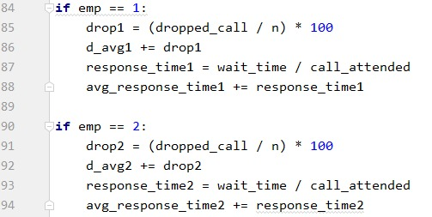
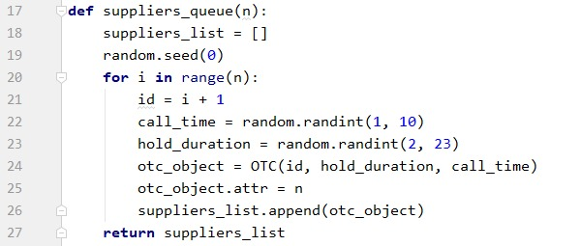
Working: OTC Trading in Commodity marketplaces
Fig: Formula for Drop-out percentage
Fig: Supplier call time information

Slide 10
Working: OTC Trading in Commodity marketplaces
Monte-Carlo Simulation
Output:
Future Scope:
Display output in graphical format as below
Consider case for multiple client requests.
Consider seconds in call timings.
Employees | Call Drop Percentage
1 | 80
2 | 30
3 | 25
4 | 10
Employees | Average Response Time (Minutes)
1 | 10
2 | 5
3 | 3
4 | 2

Slide 11
Thank You.

