Slide 1
Chaffing and Winnowing media files for security
The broker are facing the problem in management side, since they cannot find their shares visually. This happens because, to hide secret images, noise-like random pixels are generate using conventional visual secret sharing schemes.
The cover images are added in every shared using a stamping algorithm in the second phase. The display quality of the recovered image is very close to that obtained using conventional VC schemes.
A meaningful cover image is added in each share using extended visual cryptography scheme (EVCS) to avoid this problem.
Still, EVCS which was used in previous version, general access structures suffer from a pixel expansion problem. In spite of it, a codebook design for various schemes is required to the visual cryptography (VC)-based approach Here we solve the above mentioned problem using a general approach.
Binary secret images in non computer-aided decryption environments use this approach. We are going to use two phases in the proposed approach. We construct meaningless shares using an optimization technique and the creation for conventional VC schemes based on a given access structure in the initial phase.

Slide 2
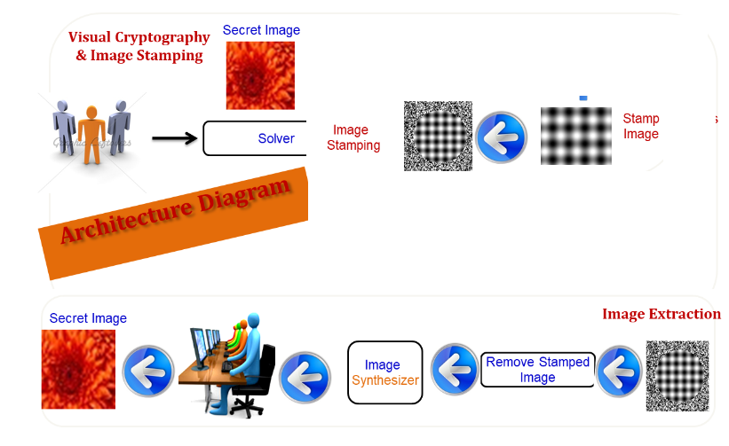
Architecture Diagram

Slide 3
Modules
Text Encryption & Steg Module
Credential Retrieval Steg Module
Image Embed Module
Huffman Encode Module
Image Retrieval Module

Slide 4
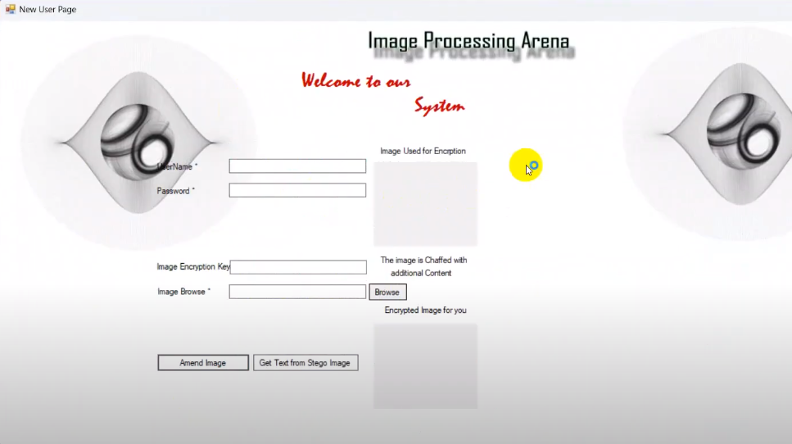

Slide 5
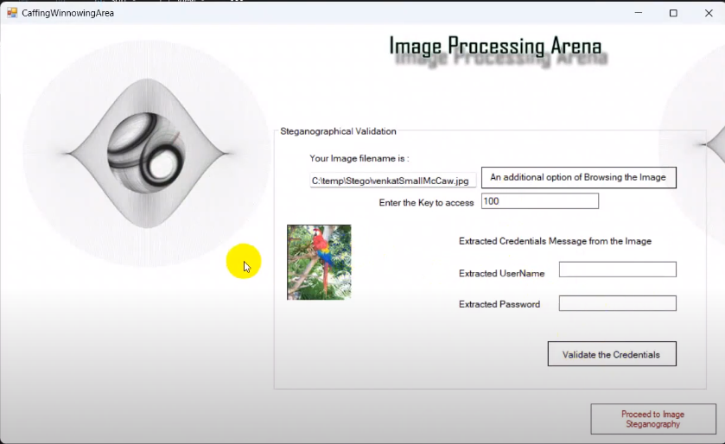

Slide 6
