Slide 1
Event

Slide 2
What is event?
Events are actions or occurrences that happen in the browser. They can be triggered by various user interactions or by the browser itself.

Slide 3
Event Types
Mouse Event
Keyboard Event
Window Event
Form Event

Slide 4
Mouse Events
Event | Event Handler
Click | onclick
Double Click | ondblclick
Right Click | oncontextmenu
Mouse Over | onmouseover
Mouse Down | onmousedown
Mouse Up | onmouseup
Mouse Out | onmouseout
Mouse Move | onmousemove
Mouse Enter | onmouseenter
Mouse Leave | onmouseleave
Mouse Wheel | onmousewheel

Slide 5
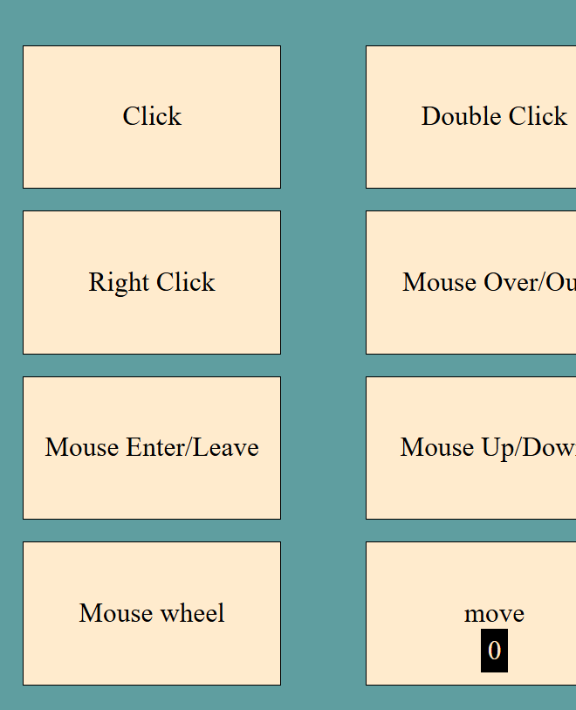
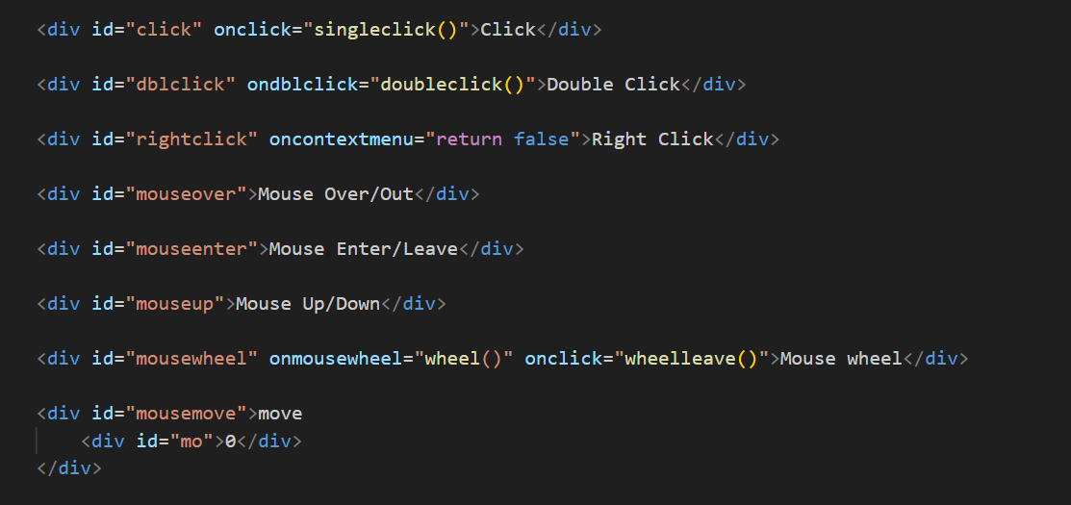
Mouse Event - Html Code

Slide 6
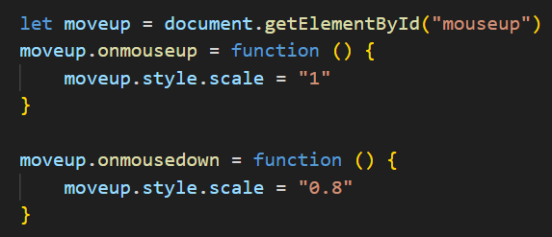
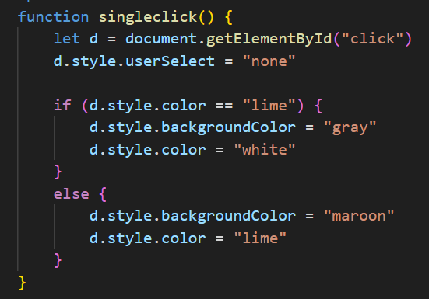
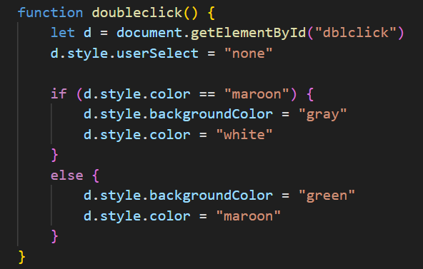
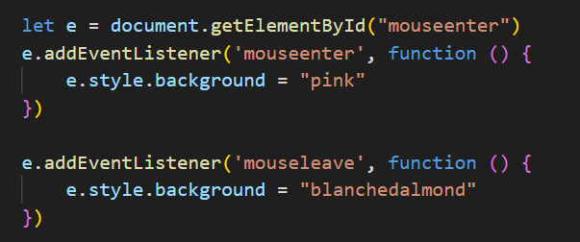
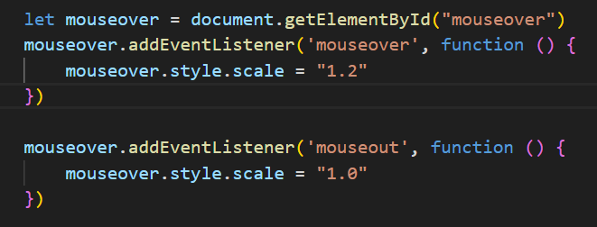
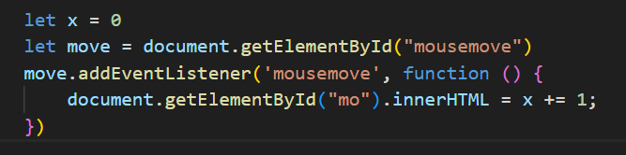
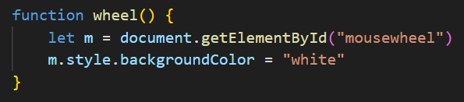
Mouse Event – Js Code
file:///D:/priya/website_designing/event/mouseevent.html

Slide 7
Keyboard Events
Event | Event Handler
Key Press | onkeypress
Key Up | onkeyup
Key Down | onkeydown

Slide 8
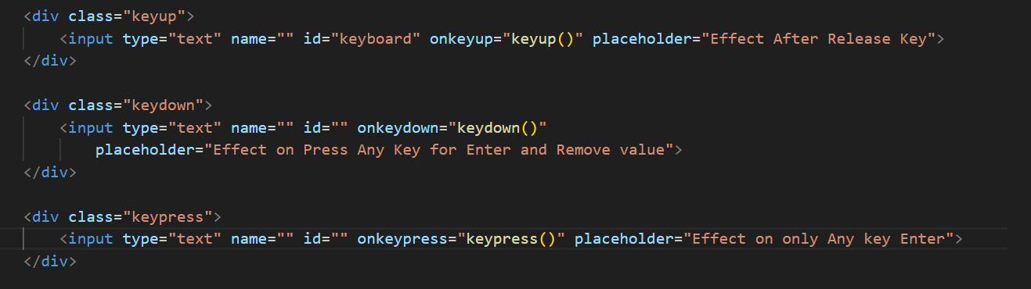
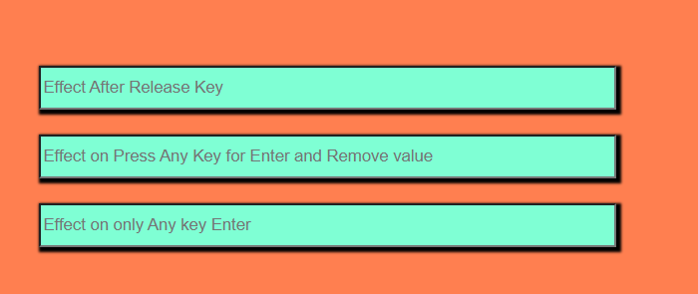
Keyboard Event - Html Code

Slide 9
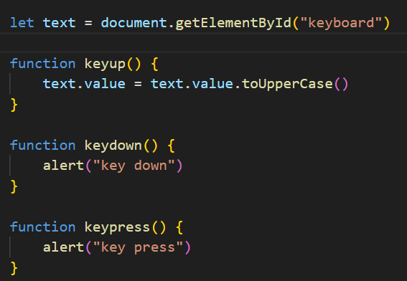
Keyboard Event – Js Code
Key up – This event is sent to an element when the user releases a key on the keyboard.
Key Down – This event occurs when the user has pressed down the key. It will occur even if the key pressed does not produce a character value.
Key Press – This event occurs when the user presses a key that produces a character value.
file:///D:/priya/website_designing/event/keyboardevent.html

Slide 10
Form Events
Event | Event Handler
Blur | onblur
Change | onchange
Submit | onsubmit
Focus | onfocus
Reset | Onreset

Slide 11
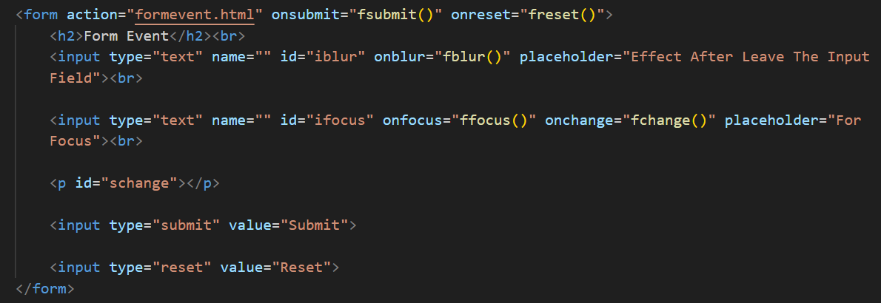
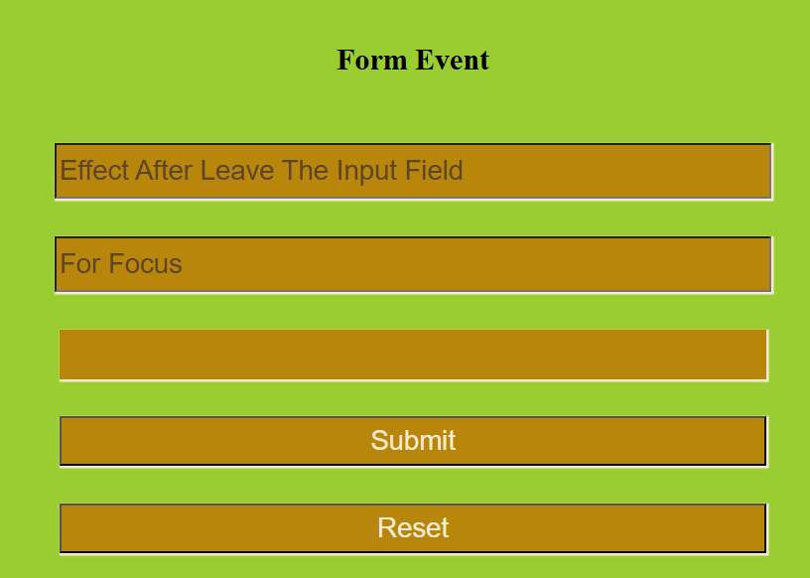
Form Event - Html Code

Slide 12
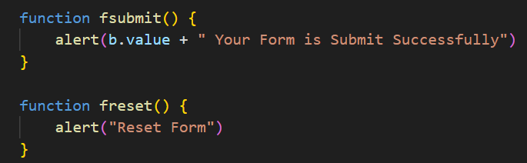
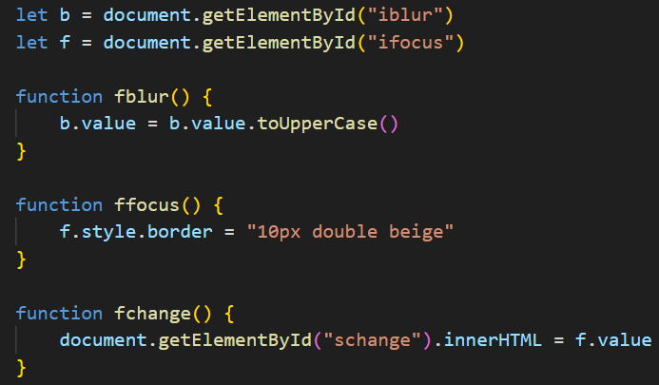
Form Event – Js Code
file:///D:/priya/website_designing/event/formevent.html

Slide 13
Window Events
Event | Event Handler
Resize | onresize
Load | onload
Unload | onunload
Scroll | onscroll

Slide 14
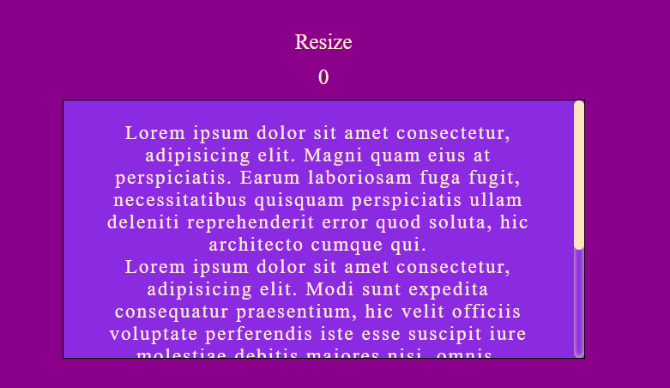
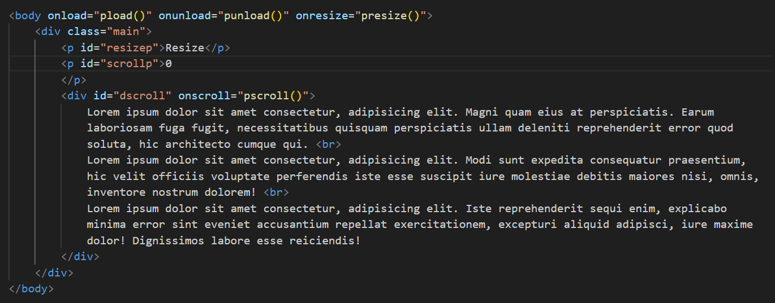
Window Event - Html Code

Slide 15
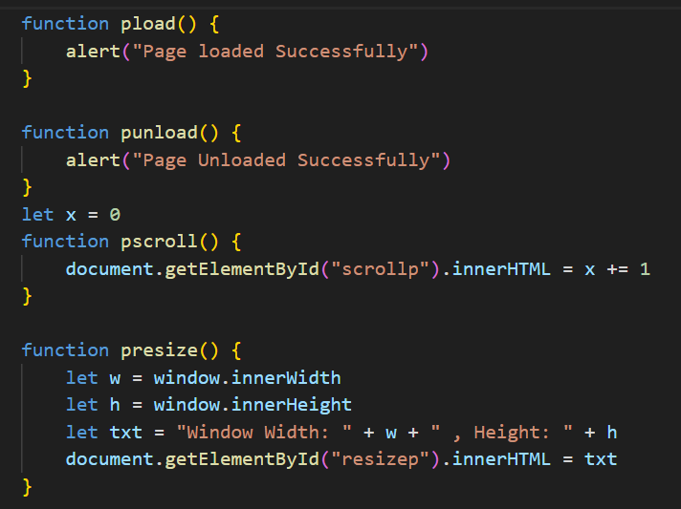
Window Event – Js Code
file:///D:/priya/website_designing/event/windowevent.html

Slide 16
Thank You

