Slide 1

BY
R.PRIYADARSHINI

Slide 2
INTRODUCTION
Cashity provides a digitalised way of managing an individual's expense.
In this system one can enter their daily spending according to the various different categories.
A Database is maintained to store all the user’s details.
A mobile application named “Cashity” is developed to achieve this goal

Slide 3
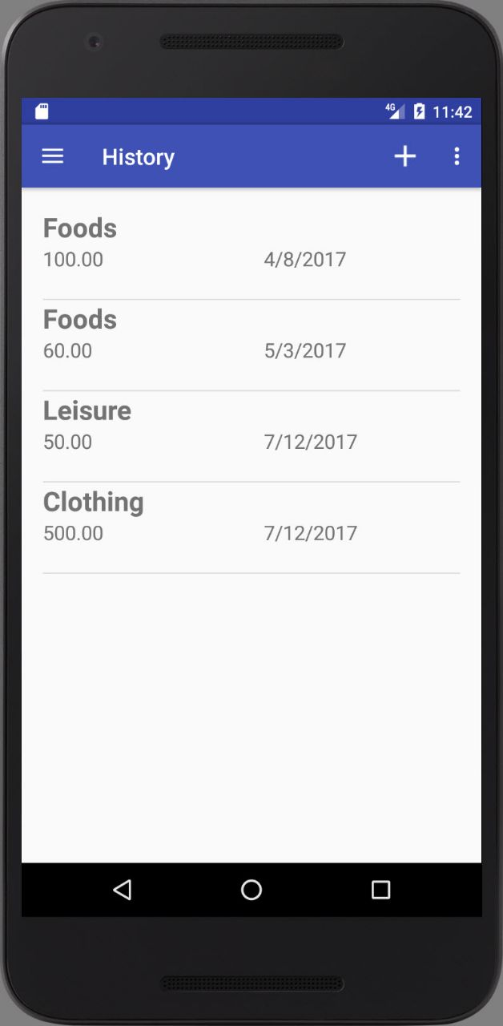
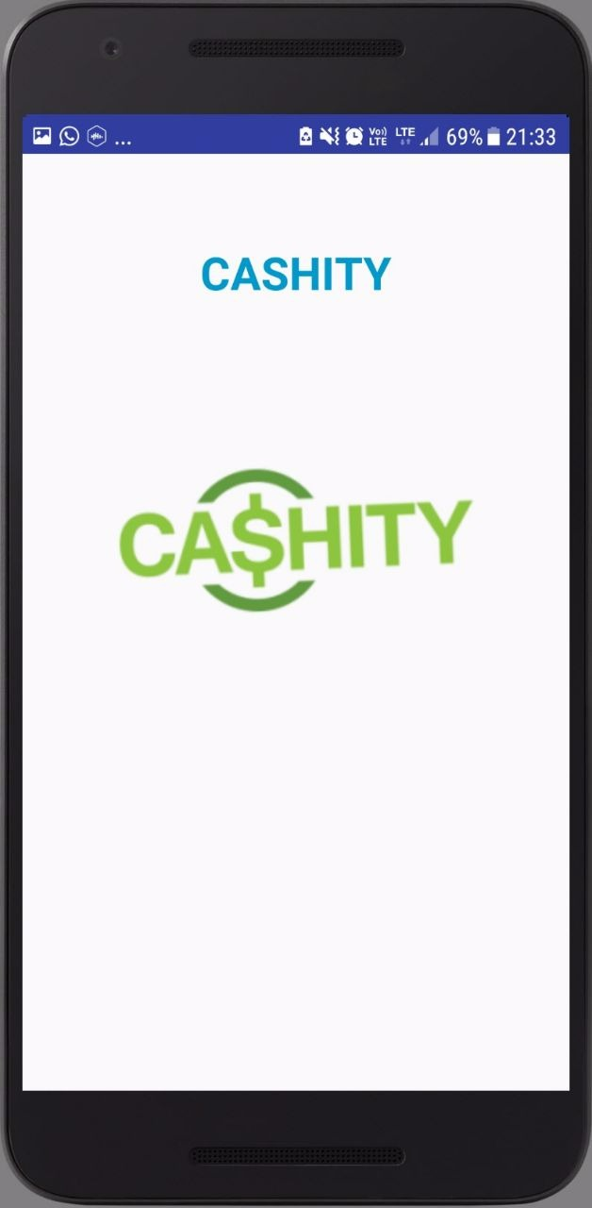
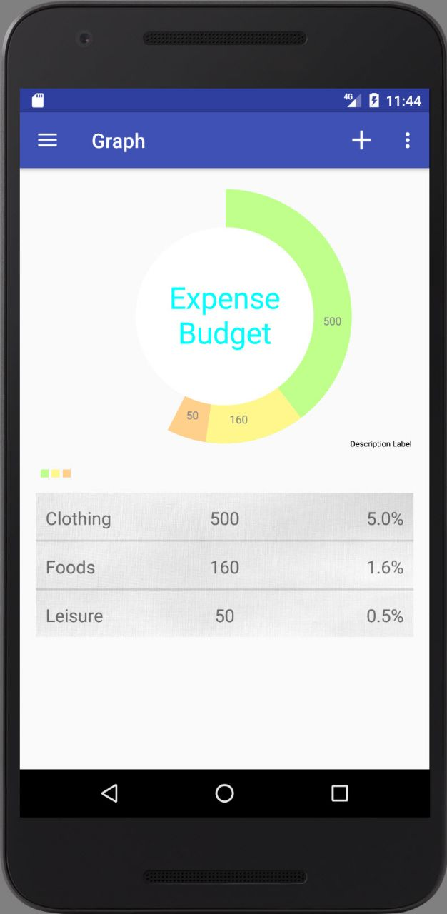
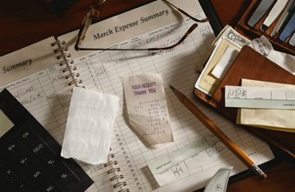
PROBLEM STATEMENT
Traditional way of calculating expenses using pen and paper
Tedious process
Not Accurate
Time Consuming

Slide 4
SYSTEM REQUIREMENTS
SOFTWARE REQUIREMENTS
Android Studio Version 3.0.1
SQLite for database server
Sublime Text Editor
GIT (Version Control System)
Programming Skills-JAVA, MySQL, XML

Slide 5
SYSTEM REQUIREMENTS
HARDWARE REQUIREMENTS
Operating System – ANDROID v5.0 and above
Storage Capacity – Minimum of 50MB
Memory – 128MB of RAM
Processor Chip – 14nm FinFET Exynos 7420 Octa-core processor
Processor Speed – 2.1 GHz for Cortex-A57 cores and 1.5 GHz for Cortex-A53 cores.
Graphics Chip – Adreno 200 series and above

Slide 6
APPLICATION MODULES
Overview
Category creation
Additional Infos
Logging expenses
History
Report generation

Slide 7
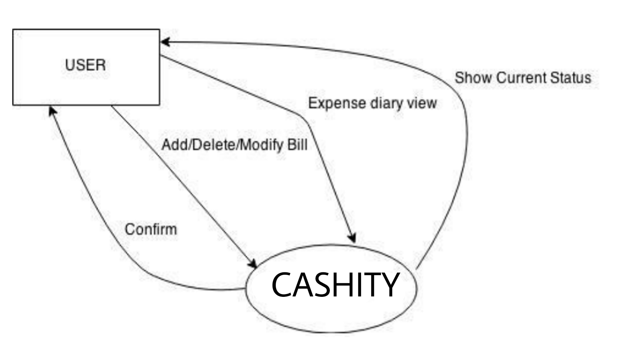
PROCESS FLOW

Slide 8
CONCLUSION
This application is very useful for calculating personal expenses. Tracking your expenses daily can save you money, but it can also help you set financial goals for the future.
If you know exactly where your money is going every month, you can easily see where some cutbacks and compromises can be made.
It will also give you a good outlook on your spending habits and those impulse buys will stick out like little red flags.

Slide 9


