Slide 1
CH303: Process Control Presentation
By
Shubham Priyadarshi

Slide 2
Dynamic Simulation of Two Interacting Sysytem
2

Slide 3
Table of Contents
1
Problem Description
2
Initial Parameters
3
Identification of FOPTD Model
4
Feedback Control Design
5
Identification of FOPTD Model
6
Closed Loop Stability
7
Conclusion
2

Slide 4
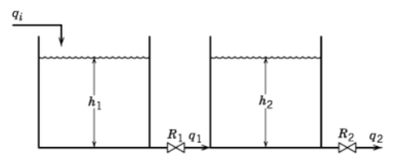
Problem Description
2025 August 24
Two liquid surge tanks are connected in series so that the outflow from Tank 1 becomes the inflow to Tank 2.
Analyze the dynamics of h2 after step change is introduced.
In this process the inlet is qi and final outlet is q2.
3
2

Slide 5

Initial Parameters
From Assignment 1
Here,
G_Qi = h2 to qi
G_Q2 = h2 to q2
2

Slide 6
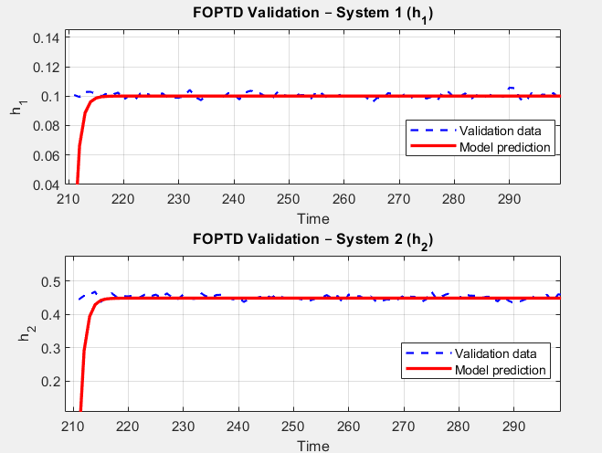
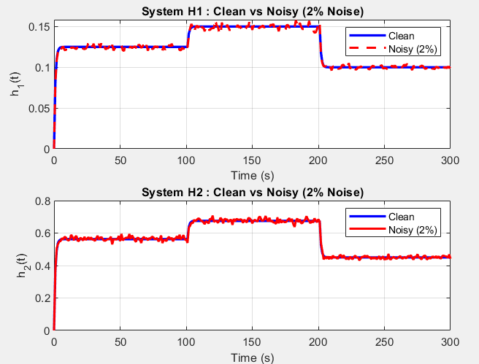
FOPTD MODEL
The identified FOPTD model was simulated using the validation dataset.
2

Slide 7
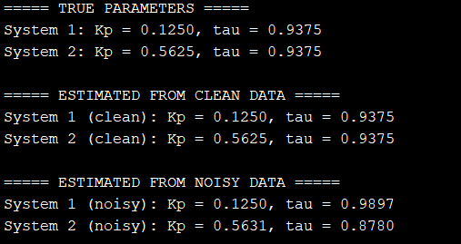
FOPTD MODEL
This FOPTD model predicts the actual system behaviour using 30% validation dataset.
2

Slide 8
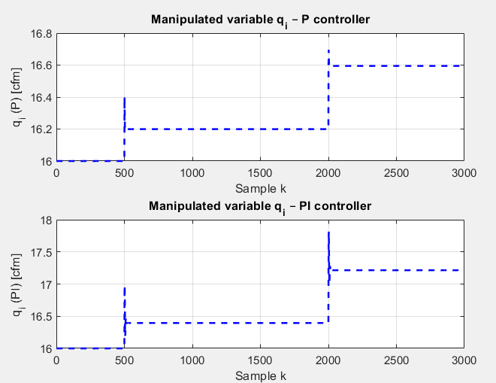
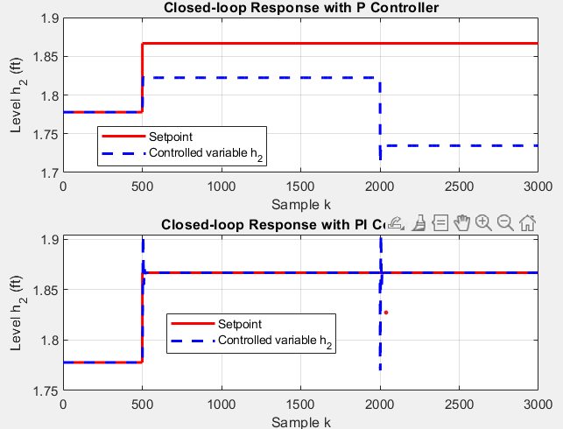
Feedback Control Design
CLOSE LOOP SIMULATION
Setpoint step +5% at t=500, disturbance +5% at t=2000.
2

Slide 9
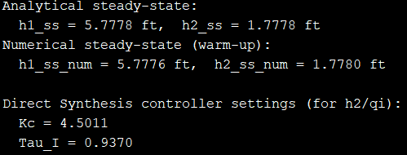
Feedback Control Design
P Controller:
The proportional controller responds to setpoint changes but shows a steady-state offset. The controlled level h2 does not exactly reach the setpoint, and disturbance rejection is poor.
PI Controller:
Adding integral action eliminates steady-state error, allowing h2​ to accurately track the setpoint. Although small transient spikes appear during changes, overall tracking and disturbance rejection are significantly improved.
Oscillations in the curve is made smooth after decreasing Kc
2

Slide 10
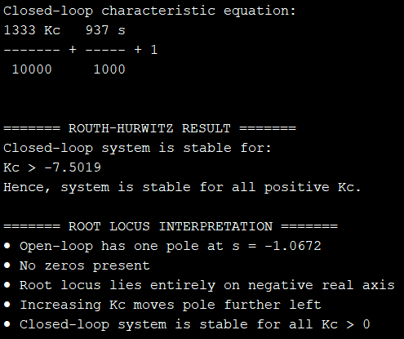
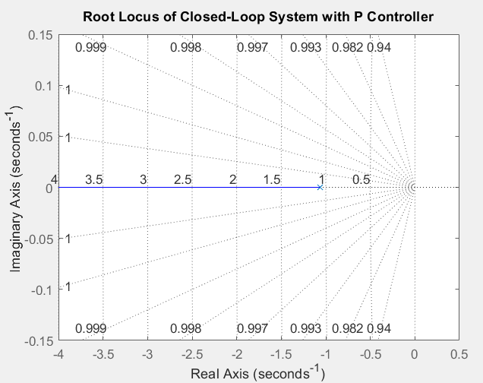
STABILITY ANALYSIS
Poles are on LHP side whisch ensures stability of system
2

Slide 11
CONCLUSION
The dynamic simulation of two tank interacting system is successfully analyzed.
Successfully validate time constant, process gain and time delay using FOPTD model.
System will be always stable if Kc will be greater than zero but Kc will be stable for finite region.
2

Slide 12
Thank You
2

