Slide 1
Final Project
PRIYADARSHNI V
- 2021503538
05/04/2024 Annual Review

Slide 2
PLANT DISEASE PREDICTION USING CNN
05/04/2024 Annual Review

Slide 3


AGENDA
The objective of the project is to develop a predictive system capable of identifying plant diseases from images.
By leveraging deep learning techniques, specifically convolutional neural networks (CNNs), the goal is to create a model that can accurately classify images of plant leaves or crops into various disease categories.
To automate the process of disease diagnosis, reducing the reliance on human expertise and enabling scalable solutions for disease detection across large agricultural areas.
This can lead to more efficient resource allocation and decision-making in farming practices.
3/21/2024 Annual Review

Slide 4

PROBLEM STATEMENT
Traditional manual inspection methods for identifying plant diseases in agriculture are inefficient, leading to delays and potential inaccuracies in diagnosis.
Implementing automated disease detection systems using image analysis technologies is crucial to enable prompt intervention and ensure sustainable farming practices.
By automating disease detection, we can mitigate crop losses, enhance food security, and improve livelihoods in agricultural communities.
05/04/2024 Annual Review

Slide 5

PROJECT OVERVIEW
Objective: The project aims to develop an automated system for identifying plant diseases in agriculture using deep learning techniques, specifically convolutional neural networks (CNNs).
Challenges: Current methods of disease identification rely on manual inspection, leading to inefficiencies and delays. Automating disease detection through image analysis can address these challenges and enable timely intervention.
Solution: By leveraging CNNs and image analysis, the project seeks to create a scalable and accurate solution for detecting plant diseases from images of plant leaves or crops.
Impact: Implementing automated disease detection systems can mitigate crop losses, enhance food security, and improve agricultural productivity by enabling prompt intervention and sustainable farming practices.
05/04/2024 Annual Review

Slide 6

WHO ARE THE END USERS?
Farmers
Agricultural Extension Workers
Researchers
Agribusinesses
Government Agencies
05/04/2024 Annual Review

Slide 7

YOUR SOLUTION AND ITS VALUE PROPOSITION
The use of deep learning techniques ensures accurate classification of diseases from images, leading to more reliable diagnoses compared to traditional methods.
ACCURACY
TRAINING | 97
TESTING | 86
LOSS
TRAINING | 4.0
TESTING | 4.0
05/04/2024 Annual Review

Slide 8

THE WOW IN YOUR SOLUTION
Cutting-Edge Technology: The solution harnesses the power of convolutional neural networks (CNNs), a cutting-edge deep learning technique, to automate plant disease detection from images.
Accurate and Efficient: By utilizing CNNs, the system achieves remarkable accuracy in disease identification while also being highly efficient.
Scalability and Accessibility: The solution is designed to be scalable and accessible, making it suitable for deployment across diverse agricultural settings and geographical regions. Farmers, researchers, and agricultural stakeholders can easily adopt and utilize the system to improve crop health and productivity.
Real-World Impact: With its ability to provide timely disease detection and decision support, the solution has a tangible impact on agricultural practices.
05/04/2024 Annual Review

Slide 9
MODELLING
Modeling Approach: Plant Disease Prediction
Data Preparation: Utilize the PlantVillage dataset, preprocess images, and split into training and validation sets.
Model Architecture: Implement a CNN using TensorFlow and Keras for feature extraction and classification.
Training and Evaluation: Compile and train the CNN model, evaluate performance on validation data, and visualize training metrics.
Predictive System Development: Develop functions for image preprocessing and prediction, and deploy the system for user accessibility.
TECHNOLOGY USED:
TensorFlow and Keras for CNN implementation.
PIL for image processing.
NumPy for data handling.
Matplotlib for visualization.
3/21/2024 Annual Review

Slide 10
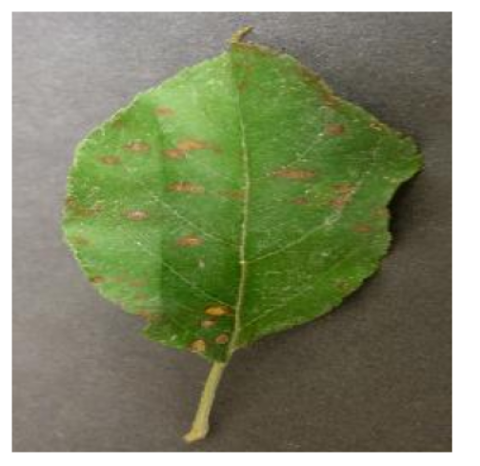
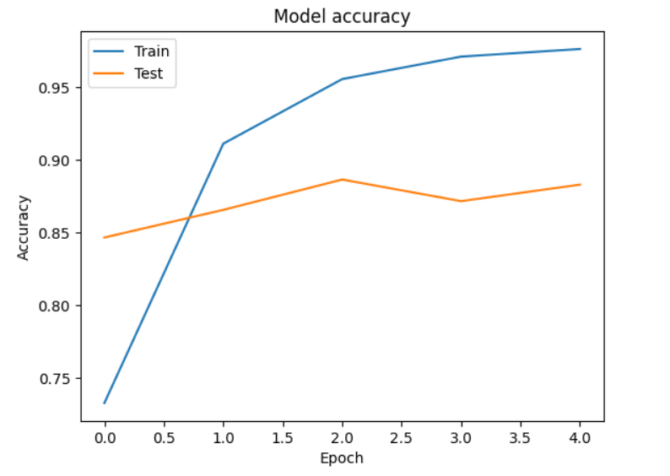
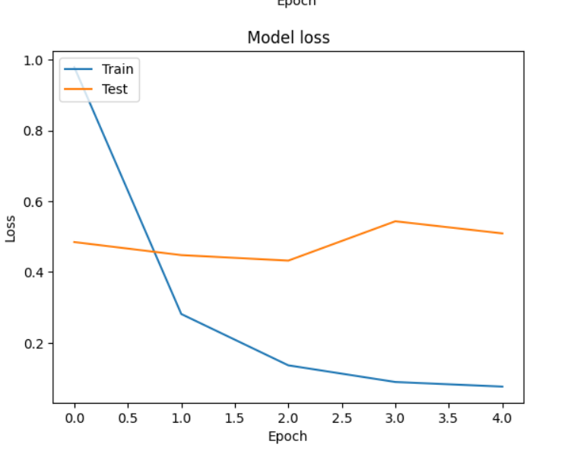
RESULTS
The CNN model achieved a validation accuracy indicating its effectiveness in identifying plant diseases from images.
The developed CNN model demonstrates promising performance in automated plant disease identification, offering a scalable and accurate solution for farmers and agricultural stakeholders.
05/04/2024 Annual Review

