Slide 1
DEPARTMENT OF DEFENCE APPLICATION
Created by:- Priya Dash

Slide 2
INTRODUCTION
This dashboard is designed to provide insight
into the budget for the INDIAN Department of
Defense. The Department of Defense budget request
allows the INDIA to invest in military readiness
and ground force strength, to develop the capabilities to
deter and defeat future threats to the Nation's security
while also improving the quality of life for service
members and their families.

Slide 3
OBJECTIVE
To calculate the total budget and %budget in 2012 and 2013
To calculate the total budget allocation year over year by authorized amount and approved amount.
To calculate the %budget difference, total budget and category shortened in the category of Army, Navy, Air force, marine corps and national guard in the year of 2013 and 2012.
Base of the military personnel organization.
Contingency spending in the year of 2012 and 2013.
Total budget by organization.
Activity group title by base and budget amount.

Slide 4
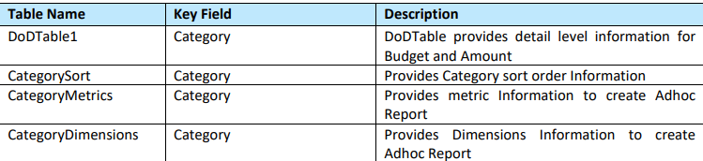
TABLE DETAILS

Slide 5
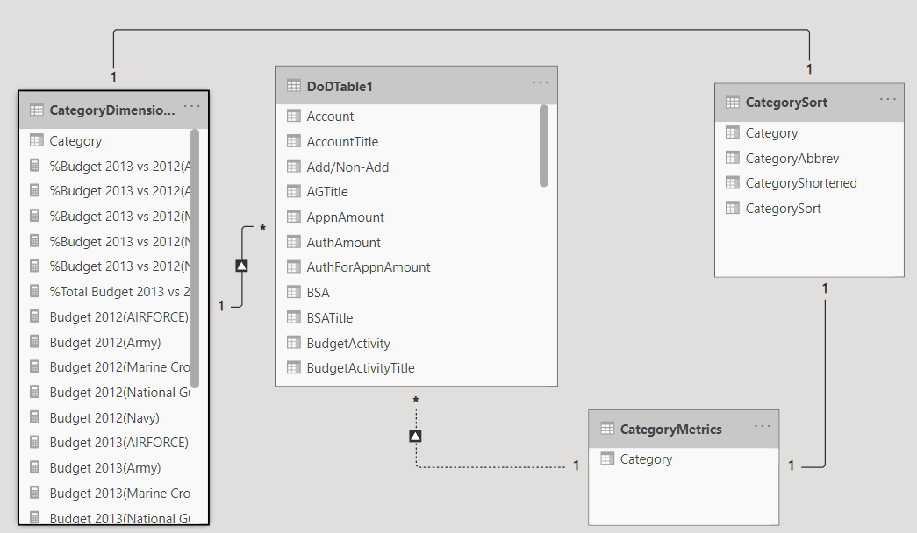
DATA MODEL

Slide 6
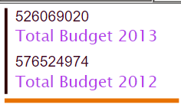
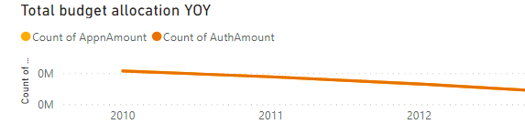
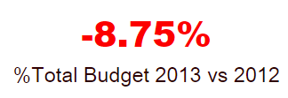
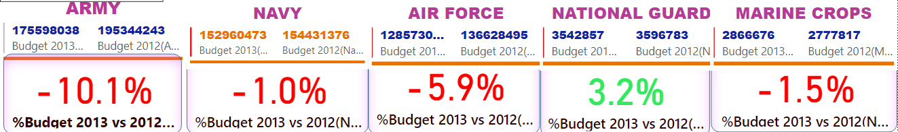
FUNCTIONAL REQUIREMENTS
Total Budget of 2012 and 2013
% total budget of 2013 and 2012
Budget and %Budget of Army,Navy,Air force,national guard and marine corps
Total budget allocation YOY

Slide 7
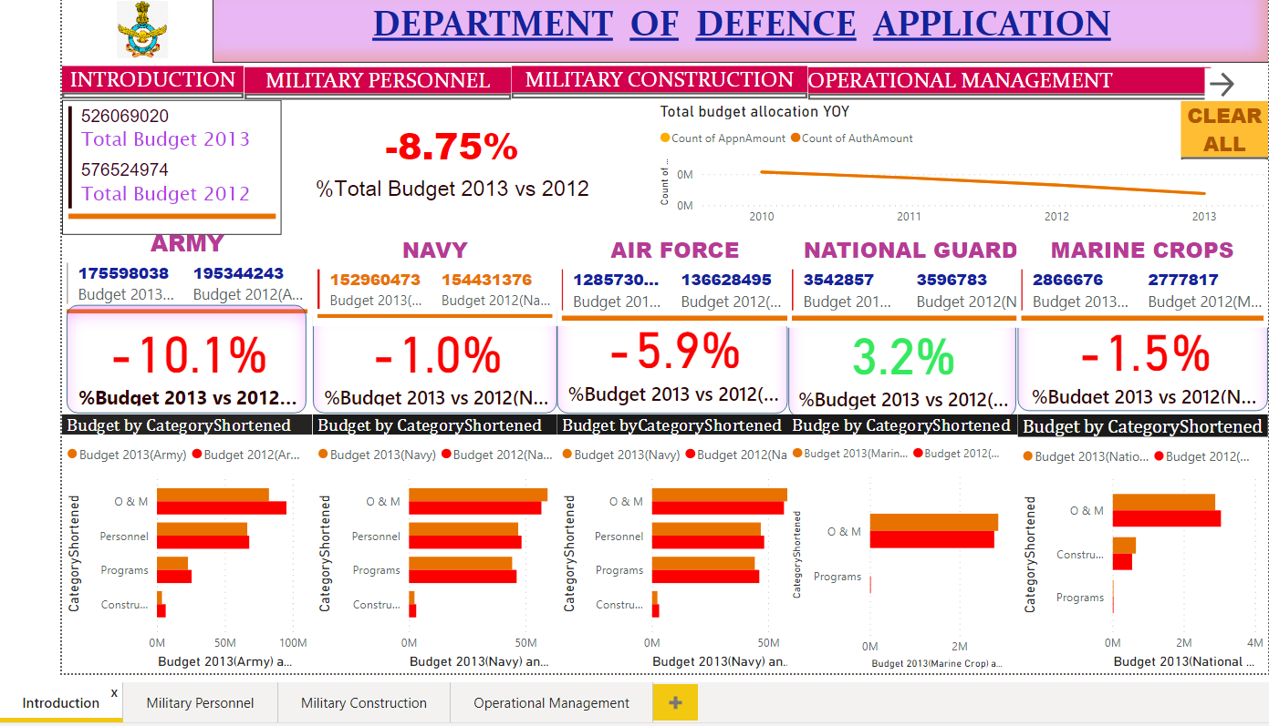
MAIN PAGE

Slide 8
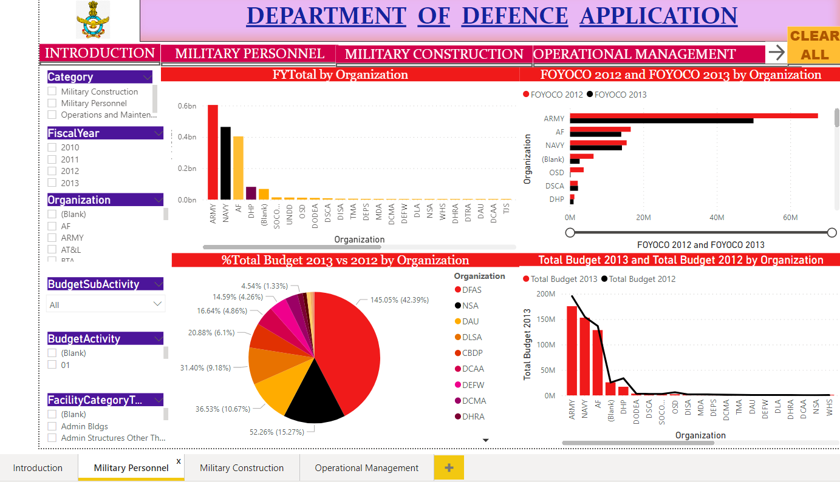
Military Personnel Page
Budget Amount of organization
Contingency Spending of 2012 and 2013 by organization

Slide 9
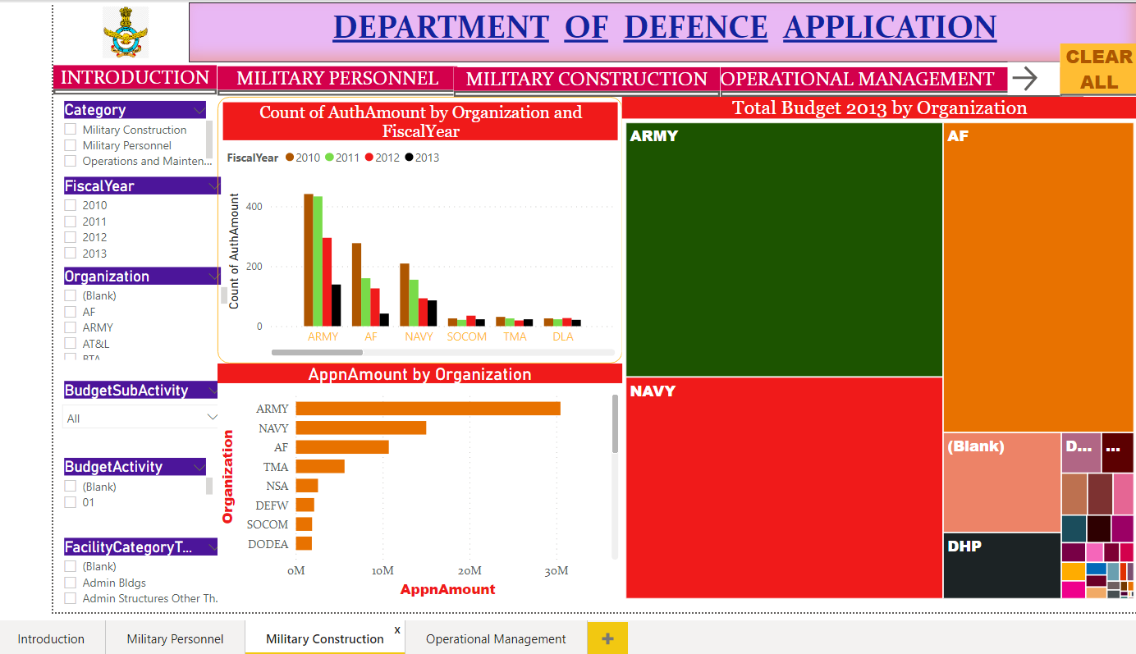
Military Construction Page
Count of authorization amount by organization and fisacal year
Tree Map of the organization by budget

Slide 10
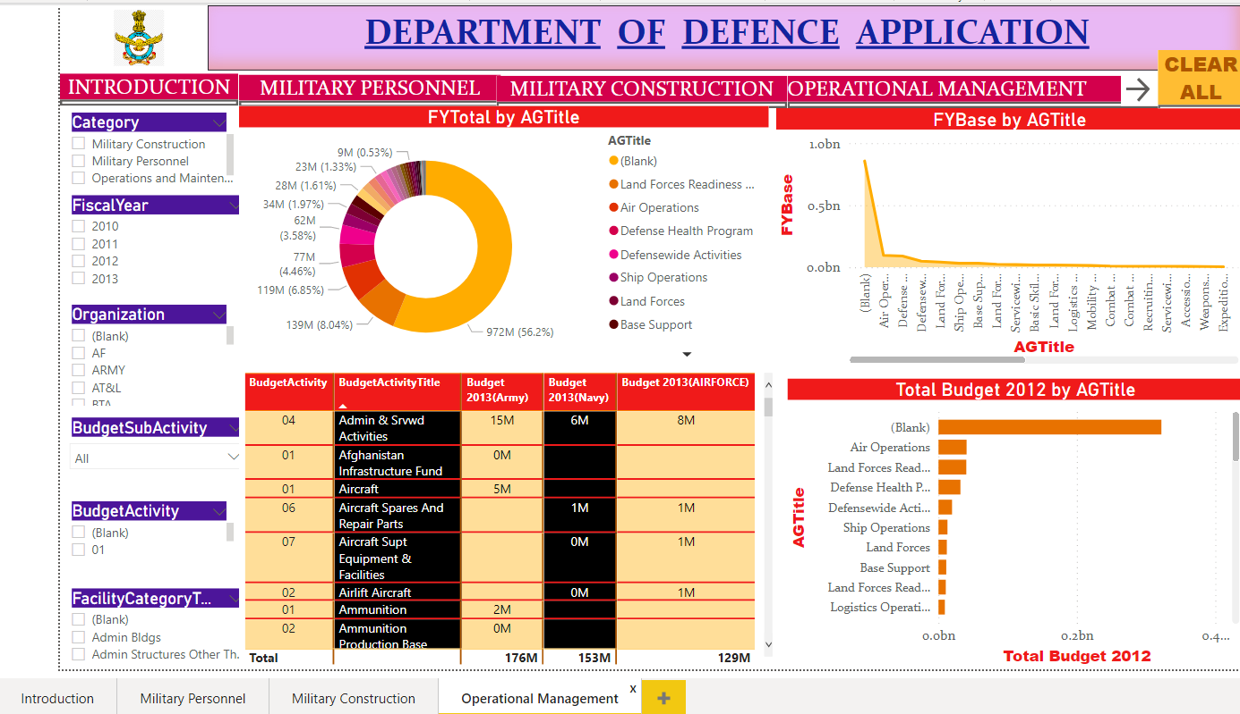
Operational Management
Fiscal year total by AGtitle
Total budget by AGtitle

Slide 11
THANK YOU

