Slide 1

PROJECT WORK ON:- YOUTUBE DATA ANALYSIS
SUBMITTED BY=>PRIYA DASH

Slide 2
INTRODUCTION
YouTube is a video sharing service where users can watch ,like ,share , comment and upload their own videos. The video service can be accessed on PCs, laptops, tablets and via mobile phones.
YouTube users watch more than one billion hours of videos each day.
YouTube content creators , popularly referred to as YouTubers ,upload over 100 hours of content per minute.
Video playback on YouTube will use as much as 2.7GB of data every hour.
Global community use around 440,000 Terabyte of data on YouTube every day.

Slide 3
ANALYSIS OF YOUTUBE DATA:-
Sentiment of the customer is basically a overview of positive sentiment and negative comment analysis of data with respect to customer.
Especially when it comes to kids accessing site , there are many concerned about the negative effect of YouTube on youth. In positive ways , it is an essential part of classroom-both virtual and in-person-around the world.
YouTube allows to add a list of tags to new or existing YouTube videos. YouTube tags are descriptive keywords you can add to your video to help people find your content.Over 750 YouTube tags for your video within a sec.

Slide 4
TYPES OF ANALYSIS:-
What exactly the sentiment of the customer.
Positive and negative comments .
Trending video tags on YouTube .
Analysis for likes and views, dislikes and views(regression plot).
Correlation between likes , dislikes and views.

Slide 5
SOFTWARE REQUIRMENT:-
SOFTWARE REQUIREMENTS:-
IDLE Python 3.8
Jupyter Notebook
Anaconda Navigator
Datasets containing csv and excel files
PANDAS:-It is a python library used for working with data sets . It has functions for analysing ,cleaning , exploring and manipulating data.
SEABORN:-It is a Python visualization library based on matplotlib. It provides a high level interface for drawing attractive and informative statistical graphics.
MATPLOTLIB.PYPLOT:-It is a low level graph plotting library in a python that serves as a visualization utility.
RE:-A regular expression(RE) specifies a set of strings that matches.

Slide 6
STEPS:-
1.Through polarity,Analysis the comment whether
it is positive or negative.
2.Analysis the most popular positive and negative tags
in comment by using wordcloud.
3.Analysis the most popular tags in videos by using
wordcloud.
4.Analysis of views and likes as well as views and
dislikes by using the Regression plot.
5.Analysis of co-relation of views,likes and dislike
by using heatmap.

Slide 7
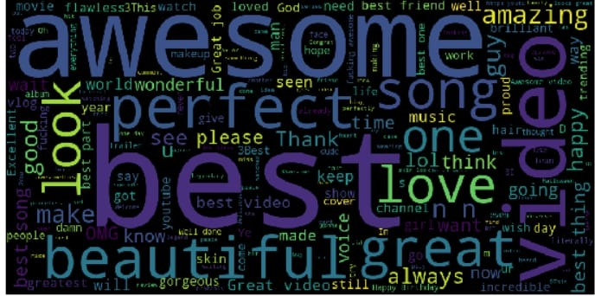
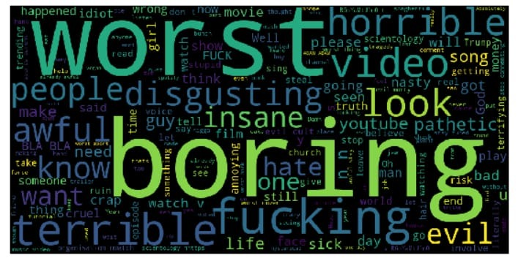
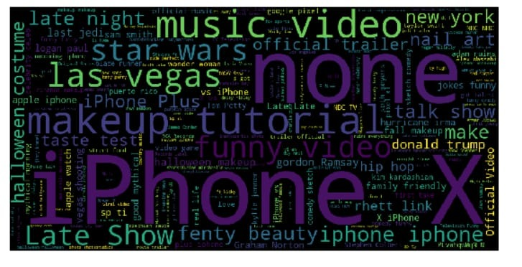
CODING IMAGES:-

Slide 8
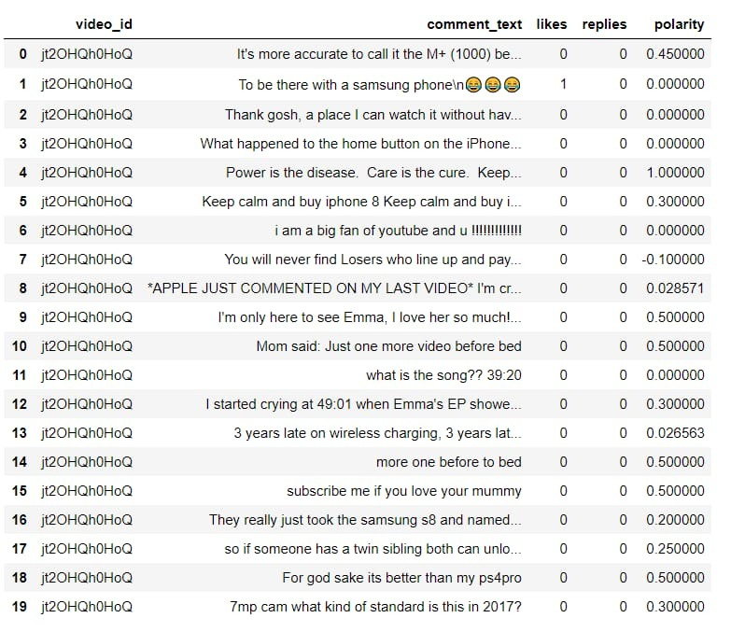
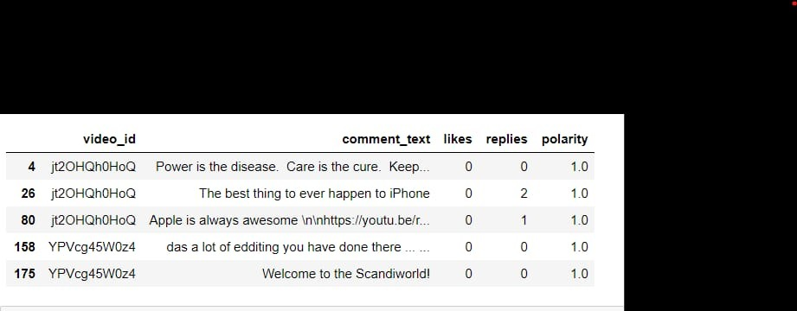
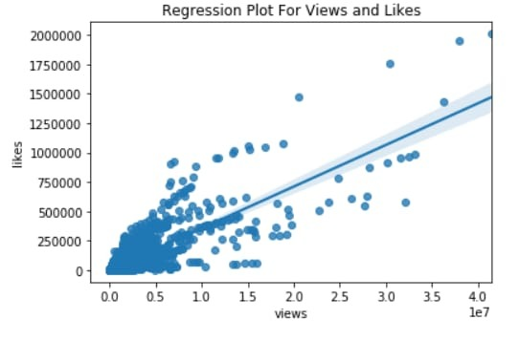
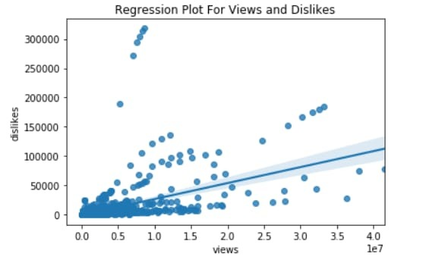
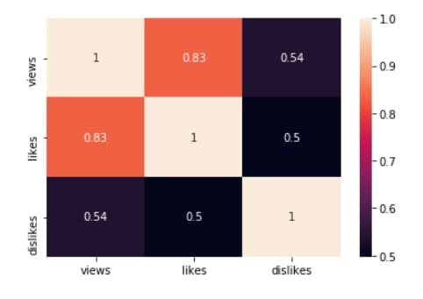
CODING IMAGES:-

Slide 9
REFERENCE
https://methods.sagepub.com/video/analyzing-youtube-data-using-python https://medium.com/greyatom/youtube-data-in-python-6147160c5833 https://blog.jovian.ai/youtube-channel-analysis-4f4f515a07f8

Slide 10
CONCLUSION
Python is a very flexible and interesting language to work with.It was very knowledge gaining time while working out the project using python.we understood the concepts and successfully executed the code. The output being obtained on the command prompt makes it easily accessible to everyone.
We can make further use of project by doing emotion analysis as they are very popularly used now a days which will help creators a lot by giving them the exact sentiment felt by the viewers after seeing their videos and this analysis can be basis for them to know the impact of their content on the audience and can improve on it or make the videos that the viewers seek so that viewers entertainment remain intact with quality content and creators can increase their earning in a win-win situation.

Slide 11
THANK YOU

