Slide 1
Company Name- Nexthikes IT Solutions
Intern Name- Priya Dhamija
Project-Building Basic Calculator

Slide 2
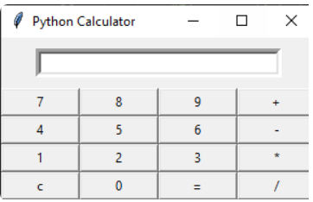
Basic Calculator

Slide 3
Visual Studio Code
Create a Python File: with a .py extension (e.g., main.py).
Write Python Code:
Run the Code:
Using Code Runner:
Using the Terminal:
Running Selections:

Slide 4
3 . Tkinter Library
1.Importing the module – tkinter
2.Create the main window (container)
3.Add any number of widgets to the main window
4.Apply the event Trigger on the widgets.

Slide 5
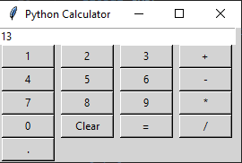
4. Final Output

Slide 6
Thank You

