Slide 1
Company Name- Nexthikes IT Solutions
Intern Name- Priya Dhamija
Report- Bike Sharing Demand Analysis Project Using Excel

Slide 2
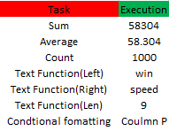
1. Excel Foundations & Data Handling

Slide 3
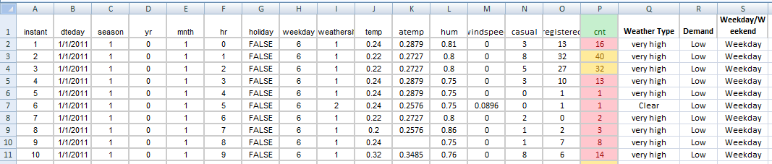
2.Data Loading, Merging & Cleaning

Slide 4
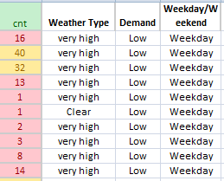
3 . Conditional Logic & Lookup Functions

Slide 5
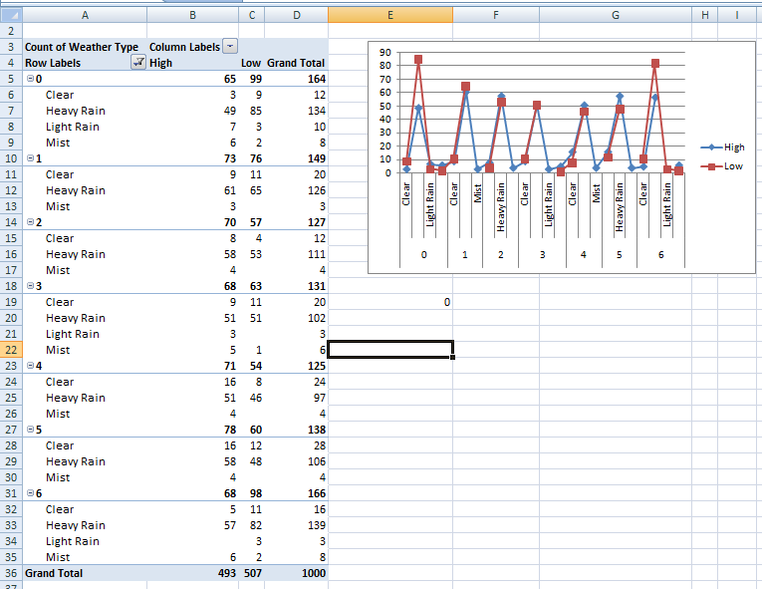
4. Analysis Data Visualization & Business Intelligence

Slide 6

5.Use COUNTIF, SUMIF, STDEV, CORREL functions for statistics.

Slide 7
Thank You

