Slide 1
Exploratory Data Analysis of
Online Job Postings
Understanding Patterns Associated with Recruitment Fraud
Recruitment / Employment Industry
Priyadharshan Sivakumar
Student ID: AF05311608 | Course: AIML | Batch Code: ANP-D7444
Python Data Analysis Project

Slide 2
Industry Overview
Selected Industry
Industry Challenge
Role of Data Analysis
Recruitment / Employment
Online job platforms connect employers and job seekers through job advertisements.
Job platforms can contain both genuine employment opportunities and fraudulent postings.
Data analysis helps examine job-posting characteristics and identify patterns associated with recorded fraud labels.
Project focus
Job characteristics and employment information
Company and recruitment-related indicators
Industry patterns
Text characteristics of job descriptions, company profiles and requirements
Statistical association between company-logo presence and the fraud label
2

Slide 3
Problem Statement
Online job platforms contain genuine employment opportunities as well as fraudulent postings.
Identifying patterns associated with suspicious job advertisements can help understand potential recruitment risks.
The project examines job-posting characteristics in relation to the recorded fraudulent label.
The analysis covers company profile availability, salary disclosure, employment type, job-description length, industry, location and recruitment-related indicators.
The project distinguishes observed patterns and statistical associations from evidence that a particular posting is fraudulent.
Affected stakeholders
Job seekers • Recruitment platforms • Employers
3

Slide 4
Project Objectives
01
Understand the dataset structure and data quality.
02
Identify missing, duplicate and inconsistent data.
03
Clean and prepare the dataset for analysis.
04
Analyze genuine vs. fraudulent job postings and related characteristics.
05
Visualize important patterns and perform statistical analysis.
4

Slide 5
Proposed Solution & Analysis Questions
Proposed solution
Analysis questions
Use Python-based data cleaning, exploratory analysis, visualization and statistical testing to examine patterns associated with the recorded fraudulent label.
What is the distribution of genuine and fraudulent postings?
How does fraud vary across employment types?
How does fraud vary across industries?
How is company-logo presence associated with the fraud label?
How do screening questions and telecommuting relate to the fraud label?
Do text-length characteristics differ between genuine and fraudulent postings?
5

Slide 6
Dataset Information
Dataset files
Combined size
File format
`fake_job_postings.csv`
`Job_Fraudlent_Cleaned_Dataset.csv`
35,479 rows
18 columns
CSV files
Loaded with Pandas
Important features
`job_id`, `title`, `location`, `department`, `salary_range`, `company_profile`, `description`, `requirements`, `benefits`, `telecommuting`, `has_company_logo`, `has_questions`, `employment_type`, `required_experience`, `required_education`, `industry`, `function`, `fraudulent`
Target variable
`fraudulent`: 0 = genuine, 1 = fraudulent, NaN = missing/unknown label.
Dataset source URL: Not specified in the notebook.
6

Slide 7
Data Collection & Understanding
Two CSV files are loaded using Pandas and combined using `pd.concat()`.
Initial combined dataset: 35,479 rows × 18 columns.
Data types: 1 float column, 4 integer columns and 13 string columns.
The raw inspection found 5,599 missing `fraudulent` labels.
Exact duplicate rows identified during initial inspection: 269.
The largest missing-value counts were in `salary_range` (15,012), `department` (11,553), `required_education` (8,105), and `benefits` (7,220).
The fraud label distribution before cleaning was 28,425 genuine, 1,455 fraudulent and 5,599 missing.
Notebook evidence
`df.info()` • `df.describe()` • missing-value summary • duplicate checks • `value_counts()`
7

Slide 8
Data Cleaning & Transformation
Duplicate removal
Text cleaning
Exact duplicate rows are removed using `drop_duplicates()`.
Extra spaces are removed from string columns using `.str.strip()`.
Missing values
Target preparation
Missing categorical/text fields are filled with values such as `unknown`, `not_mentioned`, `Not_Applicable` and `Unspecified`.
`fraudulent` is converted to numeric; missing fraud labels remain missing.
Feature creation
Final validation
Creates description length, description word count, company profile length and requirements length.
Checks duplicates, missing values, data types and final shape.
Final cleaned dataframe: 29,577 rows × 18 columns
8

Slide 9
Exploratory Data Analysis (EDA)
Fraud-label distribution: 22,805 genuine (95.11%) and 1,173 fraudulent (4.89%) labelled postings.
Categorical analysis covers employment type, required experience, required education, industry and function.
Recruitment indicators analyzed: company-logo presence, screening questions and telecommuting.
Text features compare description length, description word count, company-profile length and requirements length.
Top fraudulent-posting counts by industry include unknown (373), Oil & Energy (141), Hospital & Health Care (74), Marketing and Advertising (70) and Accounting (67).
Fraud rate
Genuine
Fraudulent
4.89% of labelled postings
22,805 labelled postings
1,173 labelled postings
9

Slide 10
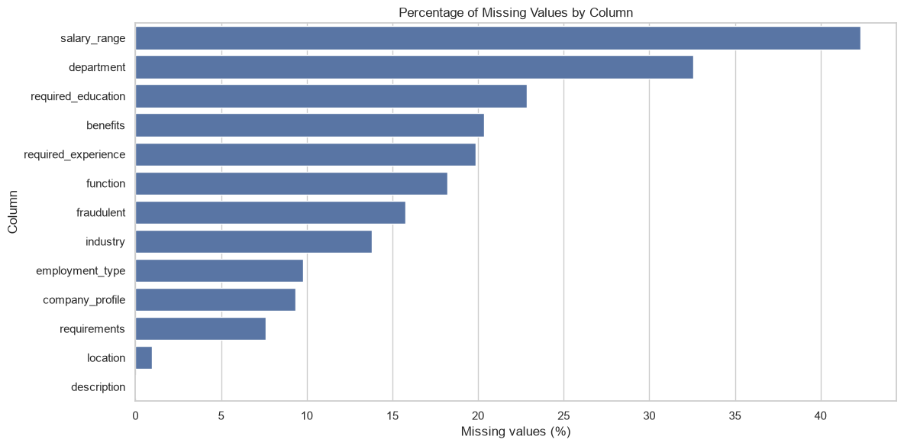
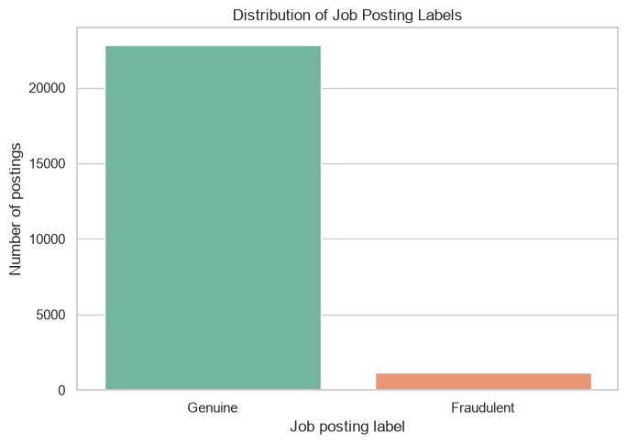
Data Visualization – Actual Notebook Charts
The following charts are the visualizations embedded in the executed notebook.
Missing values before cleaning → identifies columns requiring preprocessing.
Genuine vs fraudulent postings → shows the recorded label distribution.
10

Slide 11
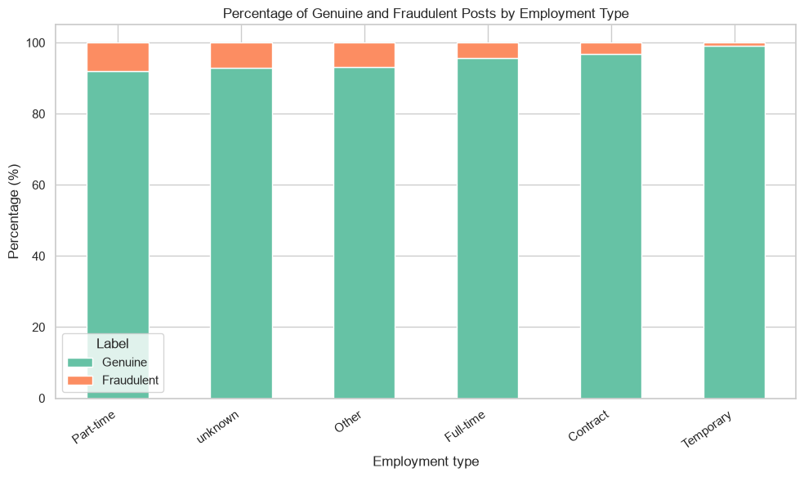
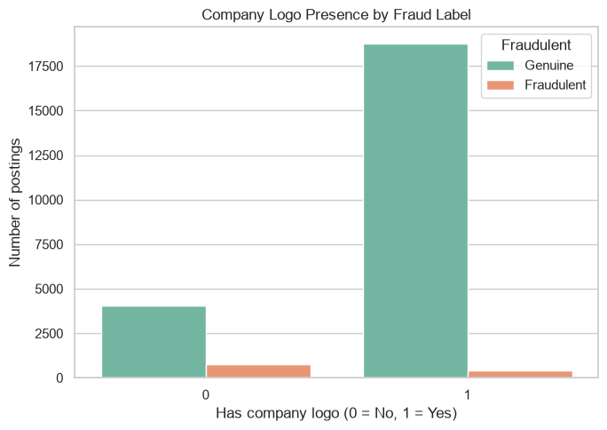
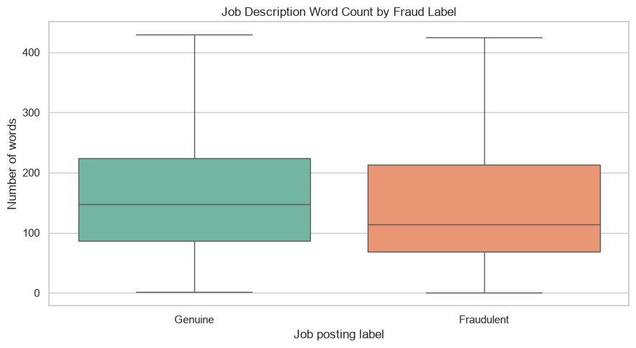
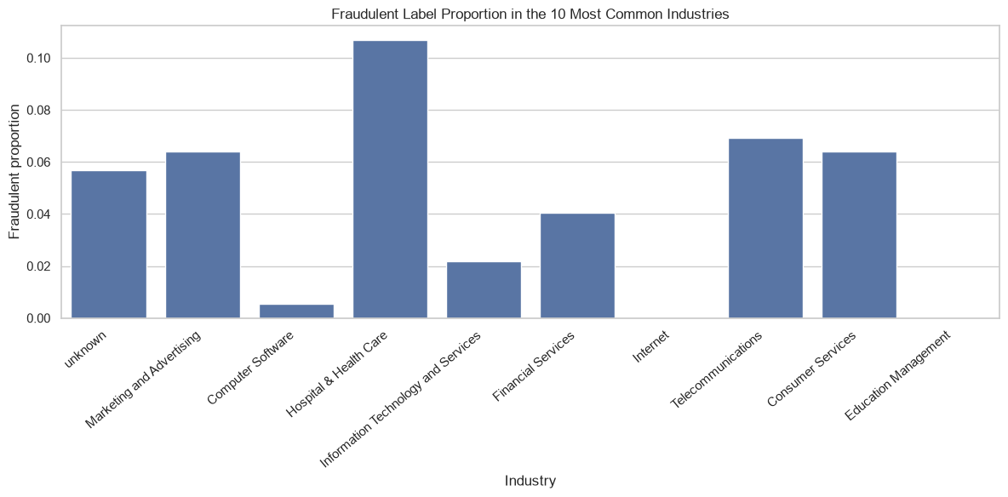
Data Visualization – Recruitment & Text Patterns
Fraud percentage by employment type → compares fraud proportions across employment categories.
Company logo vs fraud label → compares the recorded fraud label by logo presence.
Job description length → compares description word counts by fraud label.
Industry visualization → shows fraudulent-label proportion across the 10 most common industries.
11

Slide 12
Key Insights, Recommendations & Conclusion
Key insights
Recommendations
The labelled dataset is imbalanced: 95.11% genuine vs 4.89% fraudulent.
Postings without a company logo had a 15.98% fraudulent proportion, compared with 2.10% for postings with a logo.
Fraudulent postings had lower median description word count (114) than genuine postings (147).
The Chi-Square test gave χ² = 1592.44, df = 1, p = 0.0, and the notebook reports evidence of an association between logo presence and the fraud label.
Use company-logo presence as one recruitment-related indicator when examining fraud patterns.
Consider text characteristics as additional features for further investigation.
Interpret industry-level patterns alongside the number of records in each category.
Keep missing fraud labels separate rather than treating them as genuine.
Conclusion
The project completed data loading, quality assessment, cleaning, transformation, EDA, visualization and statistical testing. The results describe associations and observed patterns in the available job-posting data; they do not prove that any single characteristic causes a posting to be fraudulent.
Future scope: further investigation and automated job-posting risk assessment.
12

Slide 13
THANK YOU

