Slide 1
Supply Chain Analysis
Excel • Power Query • Power BI

Slide 2
Project Objective
Analyze sales, inventory, manufacturing, supplier, lead-time and logistics data.
Identify useful patterns and possible bottlenecks from the available records.
Build a Power BI dashboard to monitor the main measures.

Slide 3
Dataset Overview
The raw dataset contains product, sales, inventory, supplier, manufacturing, shipping and route information.
Key fields used include Product Type, SKU, Price, Products Sold, Revenue Generated, Stock Level, Lead Time, Supplier, Defect Rate, Shipping Cost and Transportation Mode.
Analysis was focused on fields that could be interpreted from the supplied data.

Slide 4
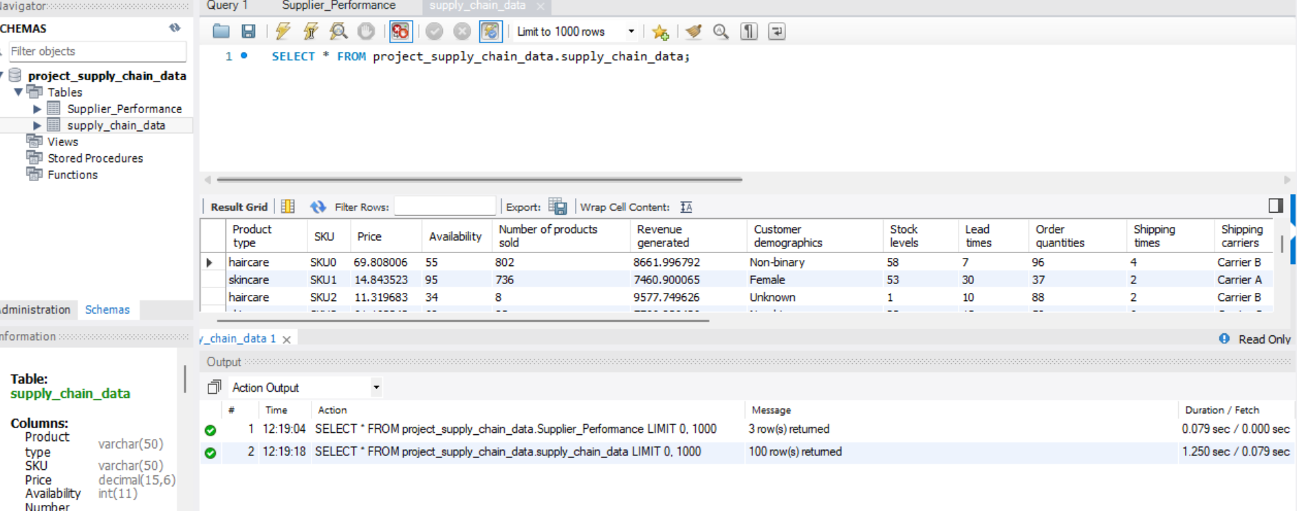
Raw data accessed from SQL

Slide 5
Data Cleaning & Validation
Used Excel and Power Query to inspect and prepare the raw data.
Checked the fields used for analysis and investigated unexpected values.
Revenue Generated did not consistently match Price × Products Sold, so the original field was retained and the issue was documented.
Unknown customer demographic values were retained as Unknown.

Slide 6
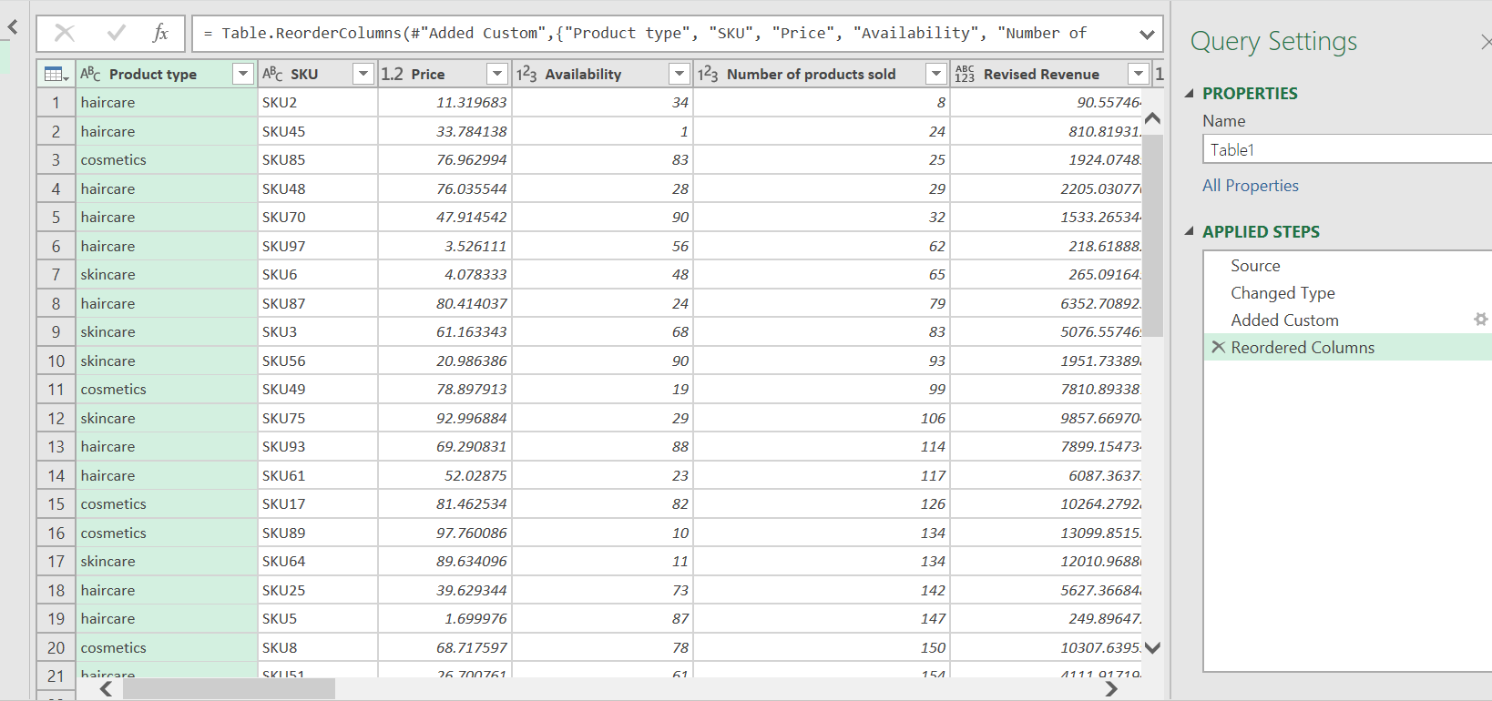
Data cleaning in Power qwery

Slide 7
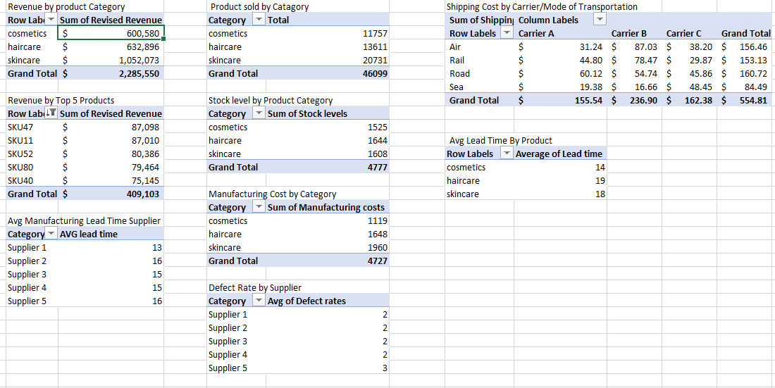
Key KPIs
Total Revenue: approximately 2.29M
Total Products Sold: 46,099
Recorded Stock Level: 4,777
Average Lead Time: 17.08

Slide 8
Sales & Product Performance
Skincare generated the highest revenue at approximately 1.05M.
Skincare also recorded the highest products sold at approximately 20,731.
Haircare generated approximately 633K and Cosmetics approximately 601K.
Skincare is therefore the largest contributor to the current sales measures.

Slide 9
Top Products & Location Performance
Top revenue SKUs identified were SKU 47, SKU 11, SKU 52, SKU 80 and SKU 40.
SKU 47 was the highest in the current visual at approximately 87.1K..
Revenue was also compared across locations.

Slide 10
Inventory & Manufacturing
Recorded stock: Skincare 1,608; Haircare 1,644; Cosmetics 1,525.
Manufacturing cost: Skincare $1,960; Haircare $1,648; Cosmetics $1,119.
Stock and sales should be interpreted together rather than assuming a difference is automatically an error.

Slide 11
Supplier & Lead-Time Performance
Supplier 5 had the highest recorded defect rate at approximately 2.7.
Supplier 1 had the lowest among the listed suppliers at approximately 1.8.
Haircare had the highest average lead time at approximately 19.
Skincare averaged about 18 and Cosmetics about 14.

Slide 12
Logistics / Shipping Performance
Carrier B had the highest shipping cost in the current analysis at approximately $236.90.
Carrier C was approximately $162.38 and Carrier A approximately $155.54.
Transportation mode costs: Road $160.72, Air $156.46, Rail $153.13 and $Sea 84.49.
Carrier cost should be compared with delivery performance before changing carrier allocation.

Slide 13
Power BI Dashboard
Dashboard includes KPI cards, product and sales comparisons, SKU performance, location analysis, supplier quality, lead time and shipping views.
Filters allow the analysis to be explored interactively.
The KPI card interaction with the Top 5 SKU visual was set to None so selecting an SKU does not change the overall KPI.

Slide 14
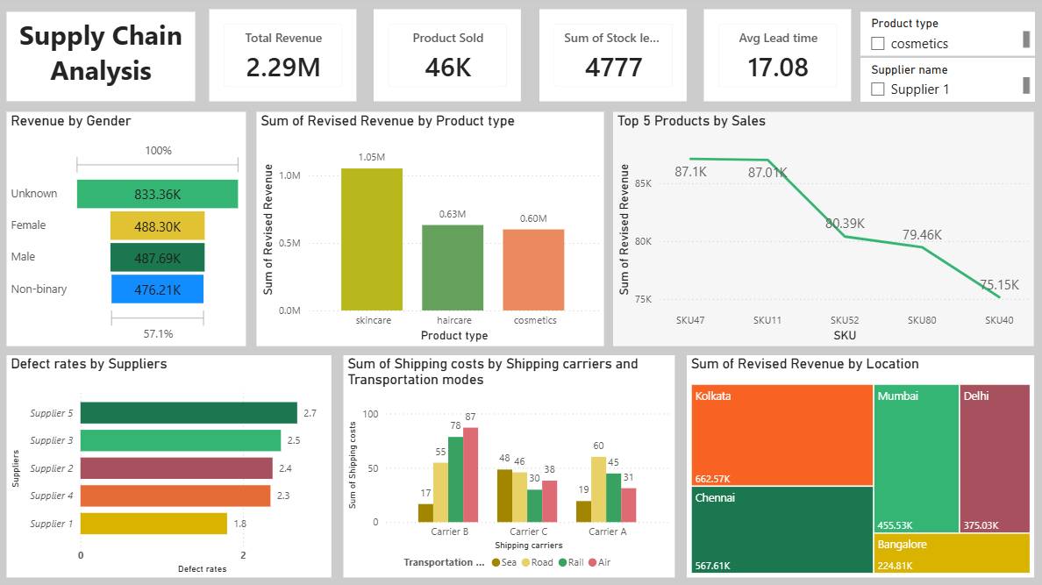

Slide 15
Recommendations
Review Supplier 5's quality results and investigate the cause of the higher defect rate.
Investigate the stages contributing to Haircare's longer lead time.
Compare Carrier B's cost with delivery performance before deciding whether to change carrier allocation.
Monitor stock and replenishment for high-demand products, especially Skincare.
Confirm the official definition and calculation of Revenue Generated before formal reporting.
Continue monitoring the main KPIs through Power BI.

