Slide 1
DIGITAL COUNTER
PRIYADHARSHINI C
ECE B
2303811710622080

Slide 2
OBJECTIVE
1. Design and build a digital counter circuit using the IC CD 4046 and flip-flops.
2. Implement binary counting logic with reset functionality using NAND gates.
3. Display the binary count using LEDs.
4. Generate clock pulses to drive the counter.
5. Test the counter for accurate incrementing and resetting.

Slide 3
ADVANTAGES
Enhanced understanding of digital logic
Customizable design
Real time counting
Hands on experience

Slide 4
Components required
Push-button switches
LEDs
Resistors (330Ω - 1kΩ)
Breadboard
Jumper wires
Power supply (9V)
IC CD 4046
Capacitor
Seven segment display

Slide 5
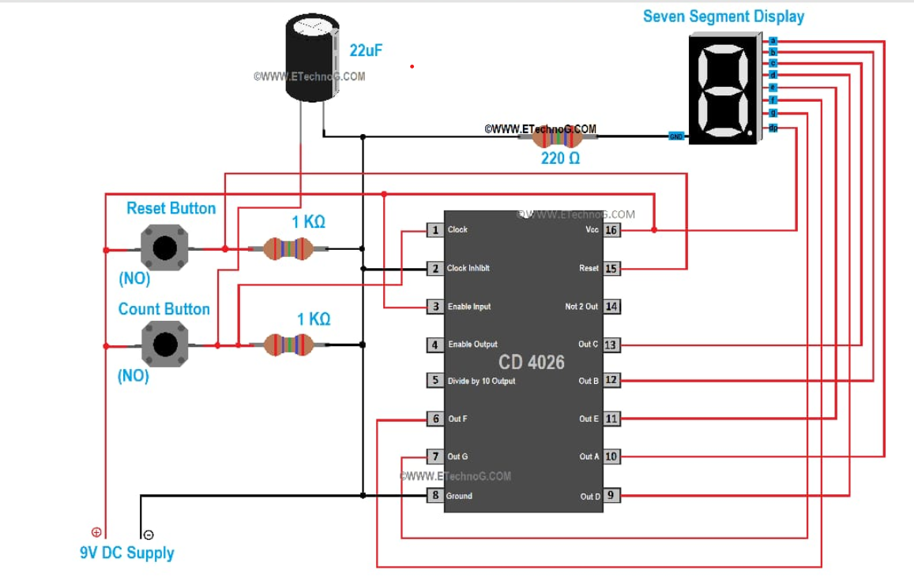
CIRCUIT DIAGRAM

Slide 6
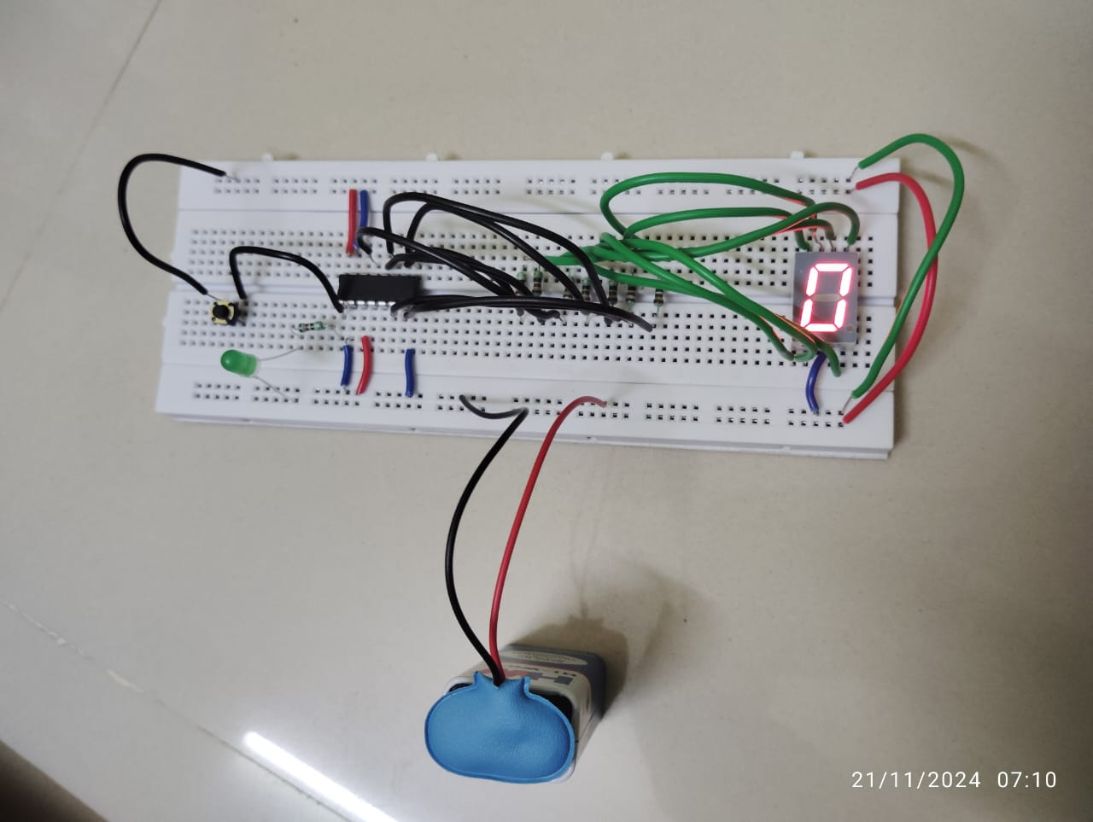
CIRCUIT DESIGN

Slide 7
CONCLUSTION
The project successfully counts numbers from 0 to 9 and displays them on a 7-segment display.
The circuit design is simple and uses basic, easily available components.
The CD4026 IC ensures efficient counting and display operation.
Manual button control allows accurate and user-friendly input.
This project demonstrates practical applications like tally counters and basic digital systems.

