Slide 1
Adidas Sales Analysis Report
Power BI Dashboard Creation
Presented by: Priyadharshini

Slide 2
Objectives
To analyze Adidas sales data and create a dynamic, interactive dashboard for better decision-making using Power BI.
Dataset : Adidas Sales Dataset (sourced from Kaggle)
To create KPI Cards :
Total units sold
Total operating profit
Total operating margin
Total sales

Slide 3
Dashboard Components
Filters : Sales method (In-store, Online, Outlet)
Visualizations: Bar chart : Sum of Total Sales by State Donut chart : Total Sales by Region Line chart : Total Sales over Time (Year, Quarter, Month, Day) Funnel chart : Units Sold by Product

Slide 4
Tools Used
Power BI Desktop
Data Transformation using Power Query
Visualization tools and Slicers for interactivity

Slide 5
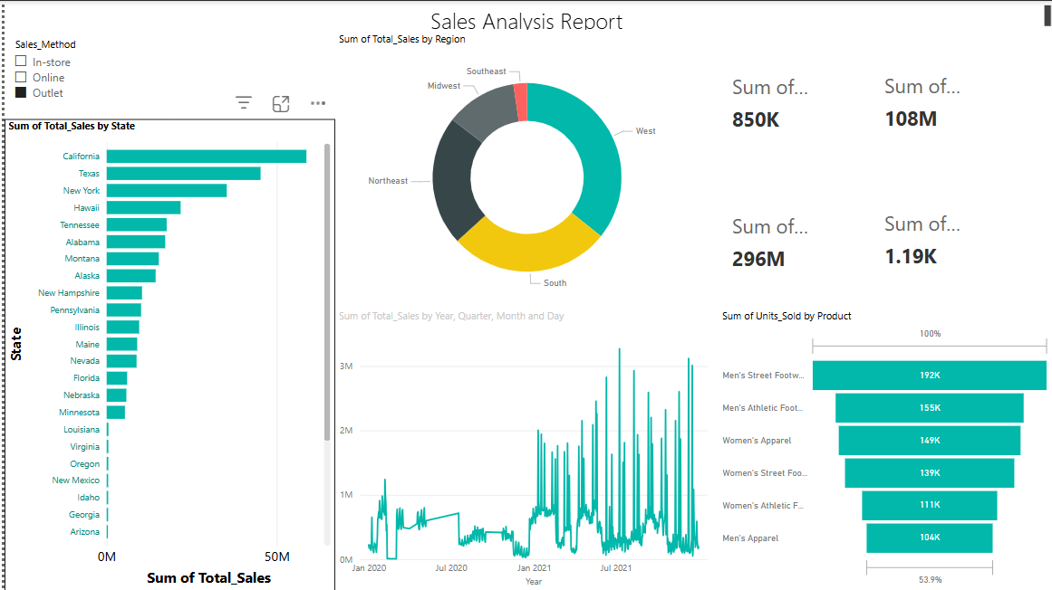
Screenshot of Dashboard

Slide 6
Thank You

