Slide 1
1. Introduction
1.1 overview
An HR (Human Resources) scorecard is a strategic tool used by organizations to measure and manage their human resources functions and activities. It provides a comprehensive overview of how HR contributes to an organization's goals and objectives. Here's an overview of what an HR scorecard typically includes:
Key Performance Indicators (KPIs): HR scorecards start by identifying specific KPIs that are relevant to the organization's strategic goals. These KPIs can vary depending on the organization but often include metrics related to recruitment, retention, employee engagement, training and development, and diversity and inclusion.
Objectives and Targets: The scorecard sets clear objectives and targets for each KPI. These objectives should be aligned with the organization's overall strategic plan and business goals.
Metrics and Data Collection: HR teams collect data on a regular basis to measure progress towards the established KPIs and objectives. This data can come from various sources, such as surveys, performance reviews, turnover rates, and more.
Benchmarking: Organizations often compare their HR metrics and KPIs to industry benchmarks or peer organizations to gain insights into their performance relative to others in the same industry.
Performance Analysis: The HR scorecard includes analysis of the data collected to assess the effectiveness of HR programs and initiatives. This analysis helps identify areas of strength and weakness within the HR function.

Slide 2
Action Plans: If the analysis reveals that certain KPIs are not meeting their targets, the HR scorecard can include action plans to address these issues. These plans may involve changes to HR policies, processes, or initiatives.
Strategic Alignment: HR scorecards aim to demonstrate how HR activities are aligned with the overall strategic direction of the organization. This alignment is crucial for ensuring that HR activities contribute to the achievement of business objectives.
Communication: The results of the HR scorecard are often shared with key stakeholders within the organization, including senior management, to provide transparency and inform decision-making.
Continuous Improvement: HR scorecards are not static; they are regularly reviewed and updated to reflect changes in the organization's strategy and to continuously improve HR processes.
Return on Investment (ROI): Some HR scorecards may include measures of the return on investment for HR initiatives, such as the impact of training programs on employee productivity or the cost savings associated with reduced turnover.
In summary, an HR scorecard is a strategic tool that helps organizations measure, manage, and improve their HR functions by aligning them with the overall business strategy. It provides a structured way to track and analyze HR-related data and performance to ensure that HR activities contribute positively to the organization's success.
1.2 Purpose

Slide 3
The purpose of an HR (Human Resources) scorecard is multifaceted, and it serves several key objectives within an organization. Here are some of the primary purposes of an HR scorecard:
Strategic Alignment: HR scorecards help align HR activities and initiatives with the overall strategic goals and objectives of the organization. This ensures that HR efforts are in sync with the broader business strategy.
Measurement and Accountability: They provide a framework for measuring the performance and effectiveness of HR functions, processes, and initiatives. This, in turn, holds HR teams accountable for their contributions to the organization's success.
Data-Driven Decision Making: By collecting and analyzing HR-related data, scorecards enable data-driven decision-making. This helps organizations make informed choices about HR policies, programs, and resource allocation.
Identifying Areas of Improvement: HR scorecards highlight areas where HR can improve its practices and processes. It serves as a diagnostic tool to identify weaknesses and areas in need of attention.
Resource Allocation: They aid in optimizing resource allocation by showing which HR initiatives are most effective and where investments should be made for the greatest impact.
Employee Engagement and Satisfaction: HR scorecards often include measures related to employee engagement and satisfaction, helping organizations track and improve the well-being and motivation of their workforce.
Talent Management: They assist in talent management by monitoring recruitment

Slide 4
and retention efforts, as well as employee development and succession planning.
Compliance and Risk Management: HR scorecards can include metrics related to compliance with labor laws, regulations, and risk management, ensuring that the organization is meeting legal requirements and mitigating potential HR-related risks.
Communication and Transparency: By sharing the results of the HR scorecard with key stakeholders, including senior management and employees, it promotes transparency and communication regarding HR activities and their impact.
Continuous Improvement: HR scorecards support a culture of continuous improvement within the HR function, encouraging HR teams to adapt and evolve in response to changing organizational needs and challenges.
Benchmarking: Organizations can use HR scorecards to compare their HR performance to industry benchmarks and peer organizations, identifying areas where they may lag or excel relative to others in their field.
In essence, the primary purpose of an HR scorecard is to ensure that the HR function plays a strategic role in achieving the organization's objectives, to measure its performance and contributions, and to guide continuous improvement in HR practices to benefit both the organization and its employees
2.problem defination & design thinking
2.1 Empathy map

Slide 5
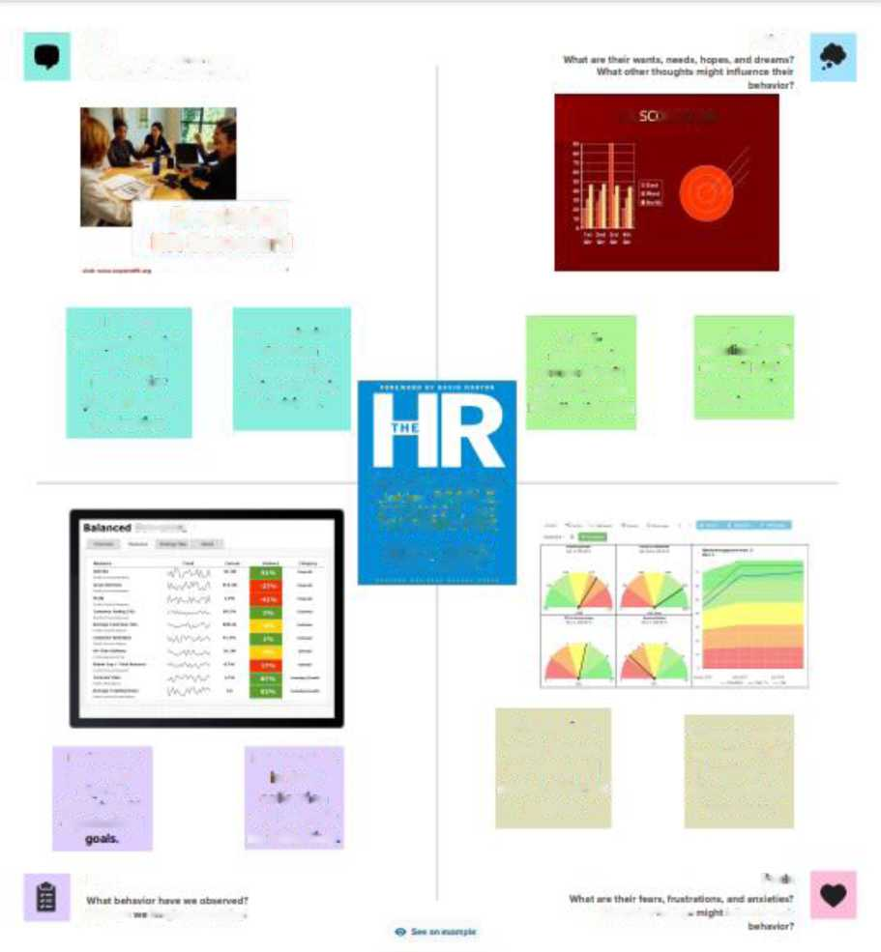
Soys
Thanks
W*arl hava mm hawd Ttmrr uyT Whrt can tm vaagana than wyngT
hR JRECTRD
Developing
HR Scorecard
I need a
We need insights
a mm
Clear
BMamrnmnmm
■■I the
structured
HfeM ■ BM ■
view of HR
scorecard to
scorecard will
data will aid in
iwcrtca tor
guide strategic
help me assess
understanding
naifnw—in
decisions.
Mi ammmmmm
HR's impact.
evaluation
SCORECARD
Linking PtOPLc, ST R Art GY. and PERFORMANCE
wm k»i .o
BRIAN E. BECKER NARK A HOSELIO OAVE ULRICH
Renews the
Invests time
Frustration when metrics are scattered across different systems
Concern about optimizing HR practices to drive business outcomes.
scorecard to
■ Mi
align HP
collection
&traceg»es wrtri
and analysis
organizational
for reporting
Dm
f- e« s
What can miQra halt Both)'
What oT'mr ‘»#lr»p rawn» thaa
2.2 ideation & brainstorming map

Slide 6
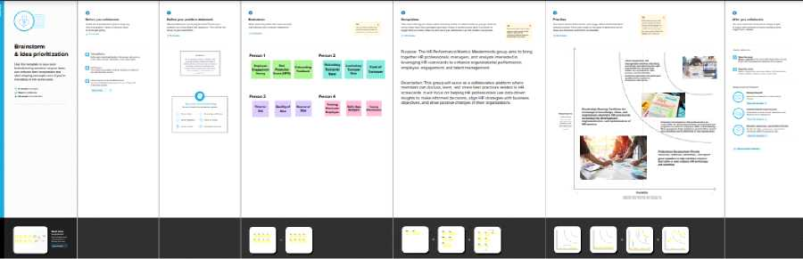
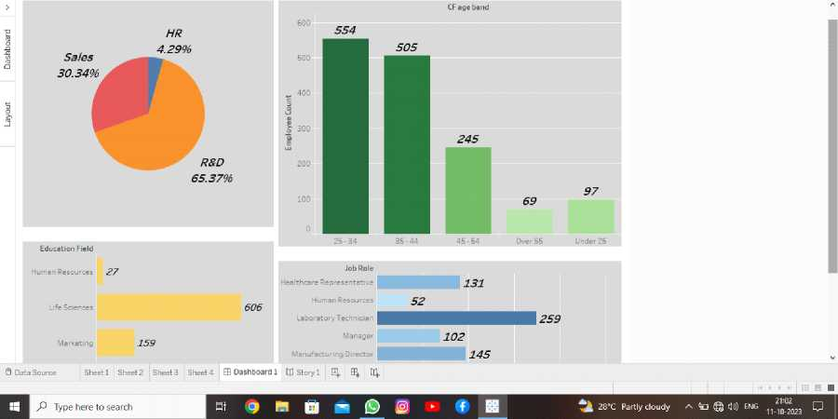
3.Result

Slide 7
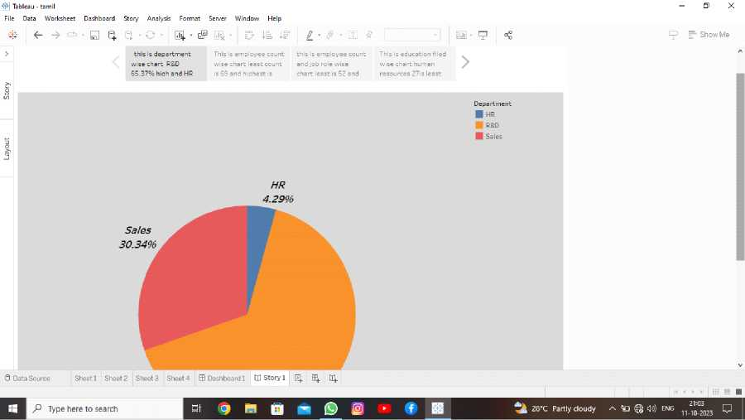
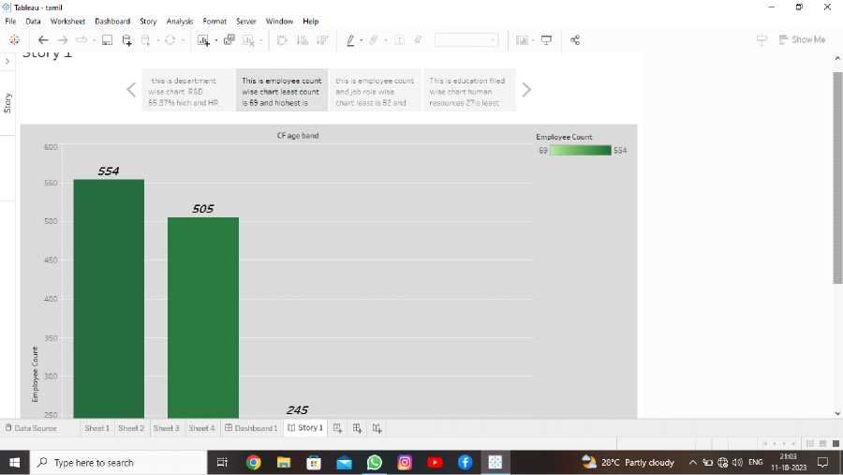

Slide 8

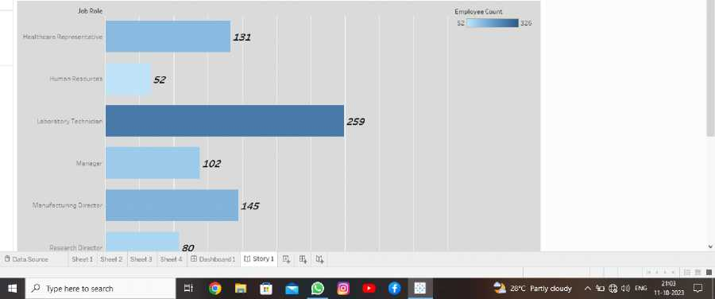
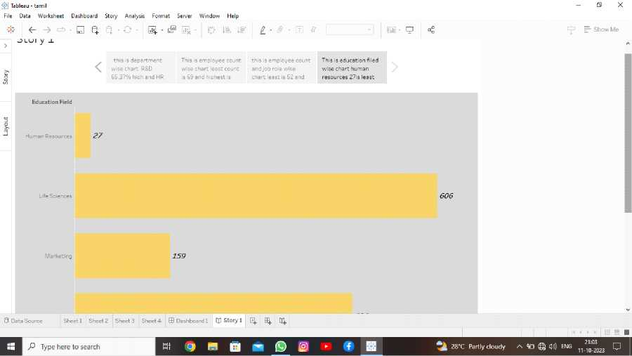
4.ADVANTAGES & DISADVANTAGES

Slide 9
Advantages of HR Scorecard:
Alignment with Business Objectives: The HR Scorecard helps HR departments align their activities with the overall business strategy. This ensures that HR activities are directly contributing to the organization's goals.
Measurable Results: It allows for the measurement of HR performance in quantitative terms. This helps in tracking progress and understanding where improvements are needed.
Data-Driven Decision Making: HR Scorecards rely on data and metrics, which facilitate data-driven decision-making. This can lead to more informed choices regarding HR policies and practices.
Improved Communication: It provides a common language for HR professionals and business leaders, improving communication and understanding between these two groups.
Talent Management: The HR Scorecard can help in identifying and retaining top talent. It enables HR to track employee engagement, satisfaction, and development, which can lead to better talent management.
Disadvantages of HR Scorecard:

Slide 10
Data Overload: Collecting and analyzing HR metrics can be time-consuming and resource-intensive. It can lead to data overload and may divert HR's focus from other important tasks.
Quality of Metrics: The quality of metrics used in the HR Scorecard is crucial. If the wrong metrics are chosen or if they are not accurately measured, it can lead to misguided decisions.
Short-Term Focus: In some cases, HR Scorecards may lead to a short-term focus on metrics, neglecting long-term HR development and strategic planning.
Resistance to Change: Implementing an HR Scorecard can be met with resistance from employees and HR staff who are not accustomed to data-driven decision-making.
Complexity: Developing and maintaining a comprehensive HR Scorecard can be complex, especially for smaller organizations with limited resources. It requires expertise in both HR and data analysis.
Risk of Gaming the System: Incentives tied to specific HR metrics may lead to manipulation or "gaming" of the system. Employees or managers may prioritize achieving these metrics at the expense of overall organizational performance.

Slide 11
Lack of Standardization: There is no one-size-fits-all HR Scorecard. Organizations must develop their own, which can lack standardization and make benchmarking between organizations more challenging
conclution
In conclusion, the HR Scorecard is a valuable tool for organizations seeking to align their human resources activities with strategic business objectives and measure the impact of HR initiatives. When used effectively, it can lead to improved communication between HR and business leaders, data-driven decision-making, and better talent management. However, it is important to consider the potential disadvantages, such as data overload, the need for high-quality metrics, and the risk of short-term focus or gaming the system. Organizations should carefully design and implement their HR Scorecard to fit their specific needs and resources, ensuring that it enhances overall performance and contributes to long-term success.

Slide 12
Future scope
The future scope of HR Scorecards is likely to evolve in response to emerging trends and challenges in the field of human resources management. Here are some potential future developments for HR Scorecards:
Integration of AI and Data Analytics: As technology continues to advance, HR Scorecards will likely integrate more advanced data analytics and artificial intelligence tools. This will enable organizations to make more accurate predictions about workforce trends, employee engagement, and talent management.
Predictive Analytics for HR: HR Scorecards may
increasingly incorporate predictive analytics to forecast future HR trends and challenges. This can help organizations proactively address issues like turnover, talent gaps, and skills shortages.

Slide 13
Real-time Monitoring: HR Scorecards might transition from periodic reporting to real-time monitoring, providing instant insights into HR metrics. This can enable quicker responses to changing HR dynamics and help organizations stay agile.
Customization and Personalization: HR Scorecards could become more customized to individual organizations' needs. This will allow HR departments to measure and track metrics that are most relevant to their unique business strategies.
Employee Experience Metrics: With an increased focus on employee experience, HR Scorecards of the future may include metrics related to employee well-being, satisfaction, and engagement. This can help organizations create a more positive workplace culture.
Diversity and Inclusion Metrics: In response to growing awareness of diversity and inclusion, HR Scorecards may include metrics related to

Slide 14
diversity, equity, and inclusion efforts. This can help organizations track progress and hold themselves accountable.
Global Workforce Metrics: As remote work and global workforce trends continue, HR Scorecards may expand to cover metrics related to managing a dispersed workforce, including cross-border legal compliance, cultural diversity, and collaboration.
Sustainability Metrics: In line with environmental and social responsibility goals, HR Scorecards may integrate metrics related to sustainability and corporate social responsibility, including employee wellness and community engagement.
Cybersecurity and Data Protection Metrics: Given the increasing importance of data security, HR Scorecards may include metrics related to cybersecurity training, compliance, and data protection efforts.
Regulatory Compliance Metrics: As labor laws and

Slide 15
regulations change, HR Scorecards may evolve to ensure organizations remain compliant with evolving legal requirements.
Holistic HR Metrics: Future HR Scorecards may consider a broader range of HR metrics that reflect the holistic health and well-being of the organization, including not just traditional HR functions but also elements of organizational culture and social impact.
In the future, HR Scorecards are likely to adapt to meet the evolving needs and challenges faced by organizations. The integration of technology, advanced analytics, and a broader understanding of HR's role in organizational success will continue to shape the development and application of HR Scorecards.

