Slide 1
UNVEILING MARKET INSIGHTS ANALYZING SPENDING BEHAVIOUR

Slide 2
1. INTRODUCTION
1.1 OVERVIEW
Unveiling Market Insights: Analysing Spending Behaviour and Identifying Opportunities for Growth. Creating Dashboard, Story using Tableau and analyzing Spending Behaviour and Identifying Opportunities for Growth.
1.2 PURPOSE
1. Understanding Customer Behavior.
2. Informed Decision-Making.
3. Tailoring Marketing Strategies.
4. Product Innovation.
5. Reducing Risk.

Slide 3
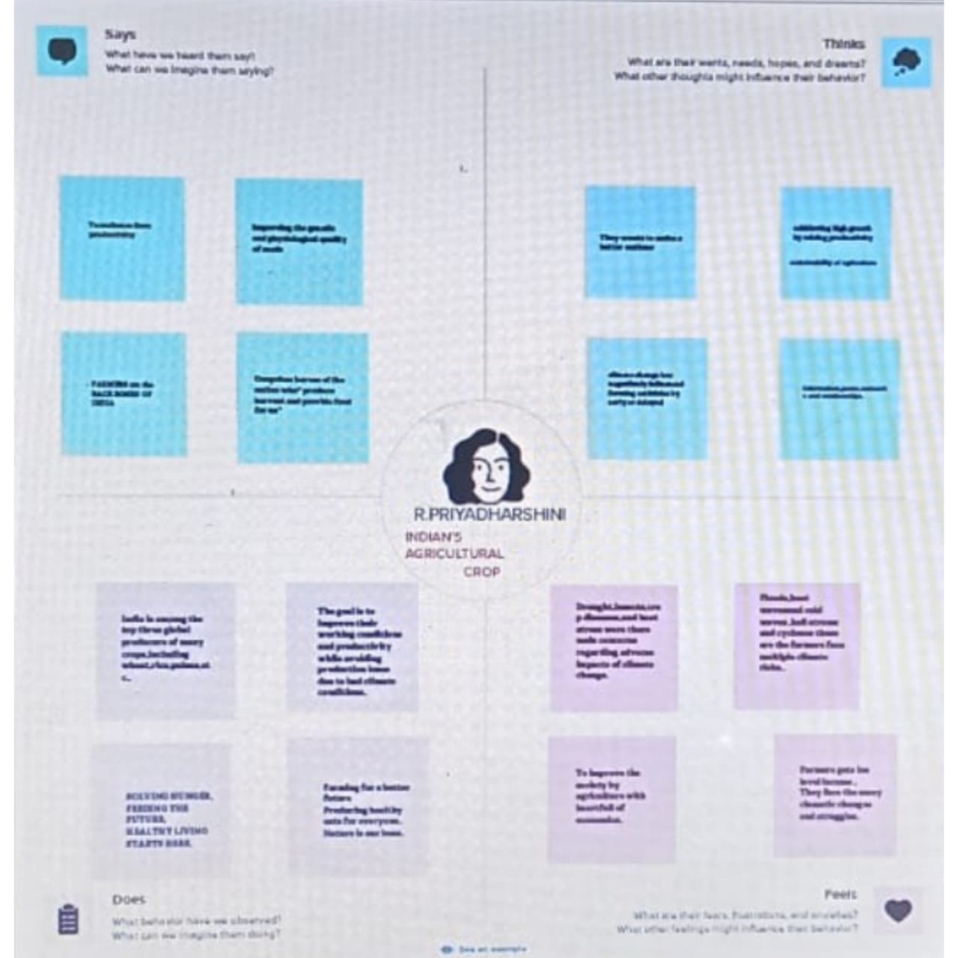
2. PROBLEM DEFINITION AND DESIGN MAP
2.1 EMPATHY MAP

Slide 4
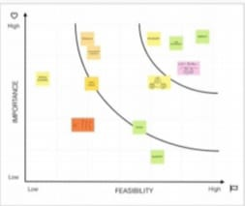
2.2 IDEATION & BRAINSTORMING MAP

Slide 5
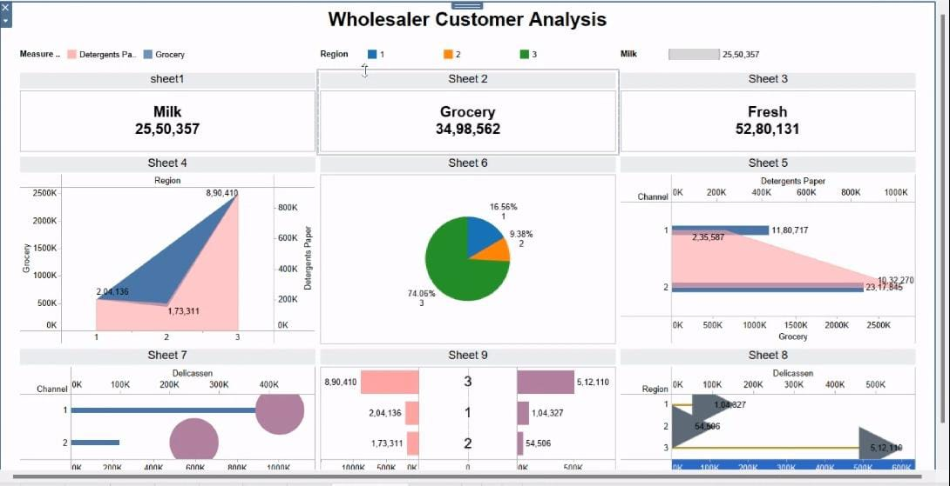
3. RESULT

Slide 6
4. ADVANTAGES & DISADVANTAGES
ADVANTAGES
Advantage Research Services, Inc., is a full-service marketing research firm with notable expertise in consumer, business-to-business, healthcare, media, financial, and technical research.
DISADVANTAGES
A disadvantage is an unfavorable position that makes it more difficult to thrive and achieve goals. These include social, economic, personal and situational disadvantages that make things more difficult for a person or community.

Slide 7
5. APPLICATION
Among the strategic areas, marketing research applications would be demand forecasting, sales forecasting, segmentation studies, identification of target markets for a given product, and positioning strategies identification.

Slide 8
6. CONCLUSION
In a nutshell, consumer behaviour plays an important role for sales folks or marketers. As products are made to cater to consumer’s needs and demands, the products should be carefully marketed for the successful achievements of organizational goals.

Slide 9
7. FUTURE SCOPE
1. Huge potential for marketers that implement AI, VR technologies.
2. Customer engagement behaviors and customer journeys enhanced via SMM. 3. Importance of ethical practice and explainability in use of AI and ML. 4. Trust is positively impacted via the cultivation of customer engagement. 5. eWOM overload can be mitigated by applying new tools and mechanisms.

