Slide 1
Sales Data Analysis and Reporting
NAME:Priyadharshini N
TITLE:Data Analytics Internship

Slide 2
About Internship
Domain: Data Analytics
Tools: Python, SQL, Excel
Objective: Analyze sales data & generate insights

Slide 3
Problem Statement
Large raw data
Hard to analyze
Need insights for decisions

Slide 4
Dataset Description
TransactionID, ItemDescription, Quantity, Price, Country, Time

Slide 5
Project Phases
Data Collection → SQL Setup → Cleaning → Analysis → Reporting

Slide 6
Data Collection
Downloaded CSV
Loaded into Python & SQL

Slide 7
Database Setup
Created tables
Inserted data
Used SQL queries

Slide 8
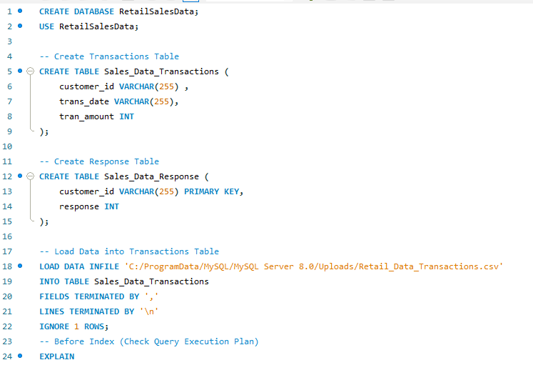
SCREENSHOTS OF SQL:

Slide 9
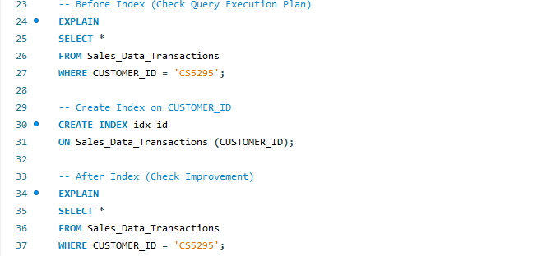
contd

Slide 10
Data Cleaning
Removed nulls, duplicates
Fixed formats

Slide 11
Data Preparation
Created Total Sales
Extracted Month & Year

Slide 12
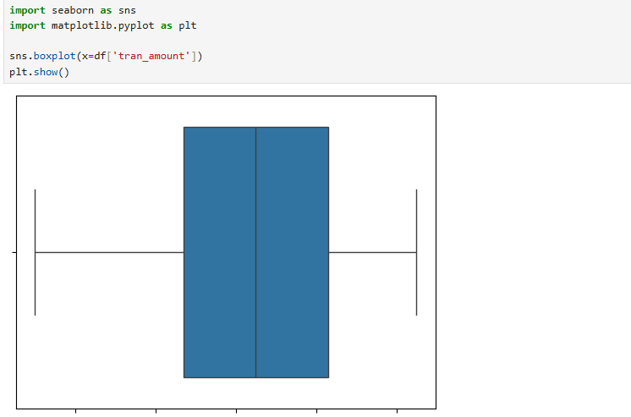
SCREENSHOTS:

Slide 13
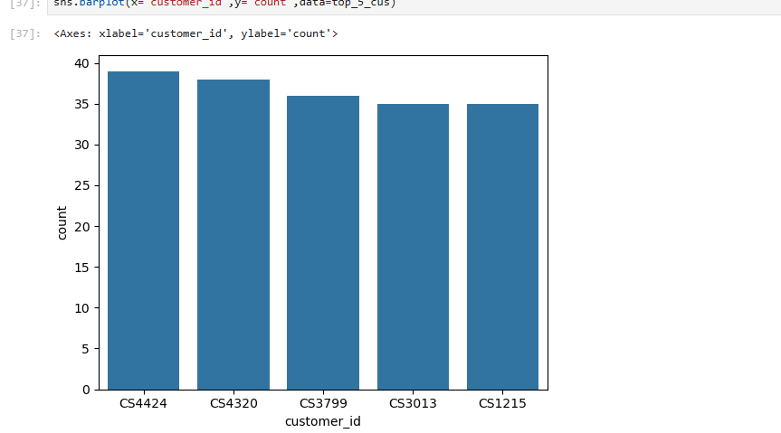
CONTD…

Slide 14
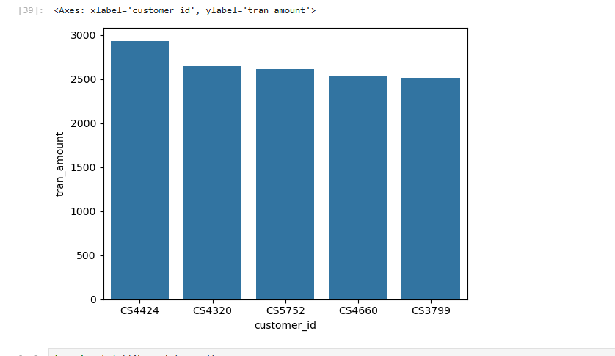
CONTD…

Slide 15
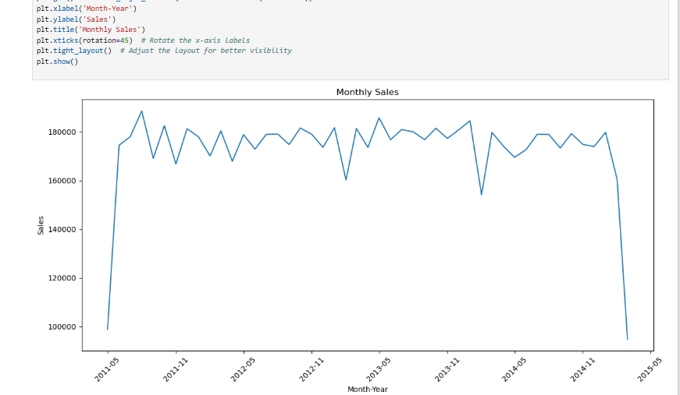
CONTD…

Slide 16
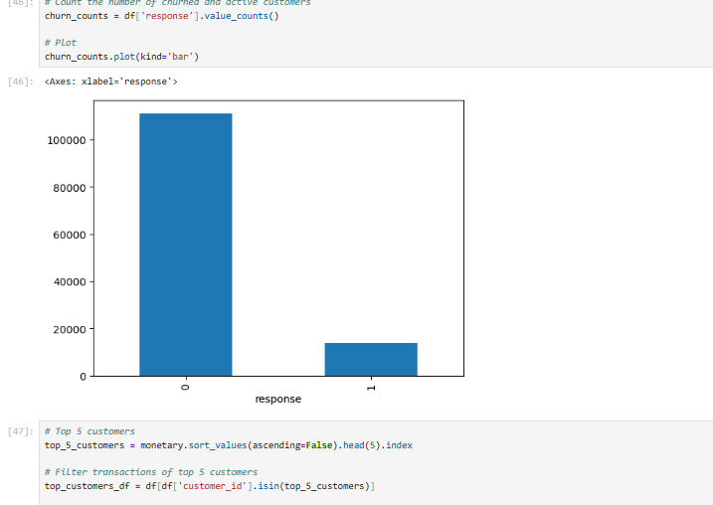
CONTD…

Slide 17
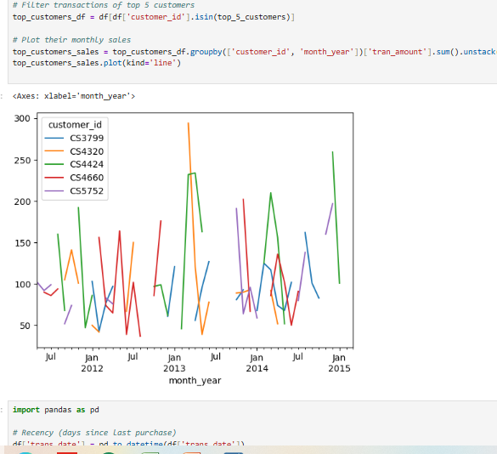
CONTD…

Slide 18
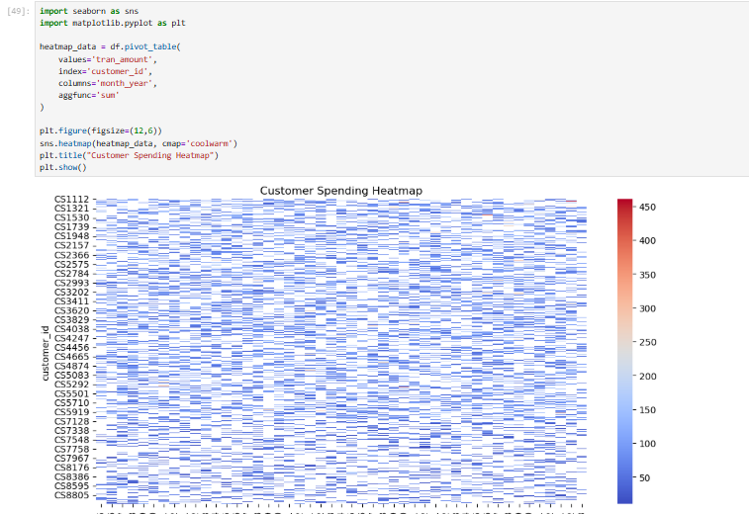
SOME EXERCISES TRIED ‘;

Slide 19
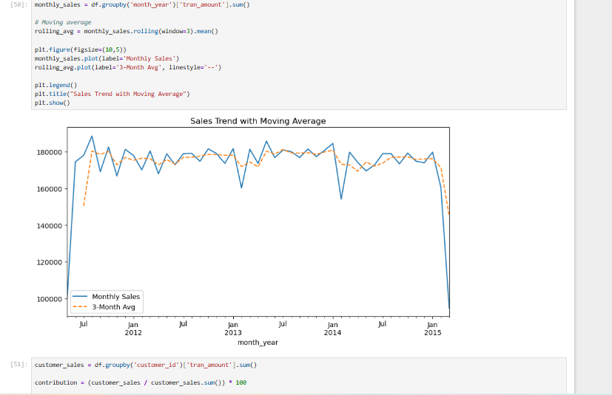
CONTD….

Slide 20
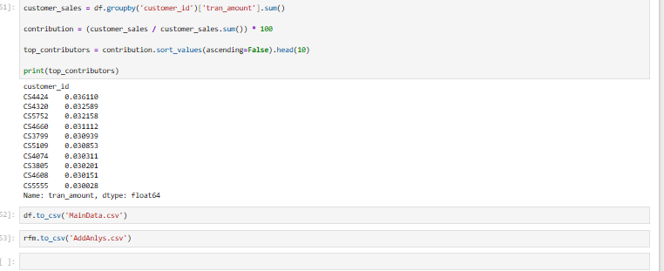
CONTD…

Slide 21
Tools Used
Python (pandas, matplotlib)
SQL
Excel

Slide 22
Data Analysis
Monthly trends
Top products
Country sales

Slide 23
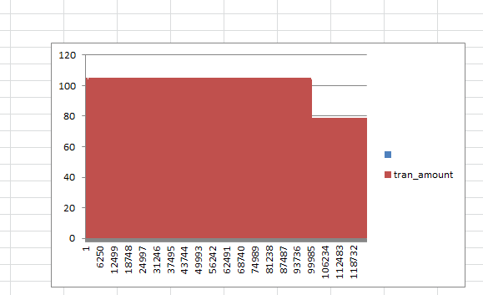
Transaction Amount Distribution
LINE GRAPH
• Most transactions fall in a common range
• Few high-value transactions exist

Slide 24
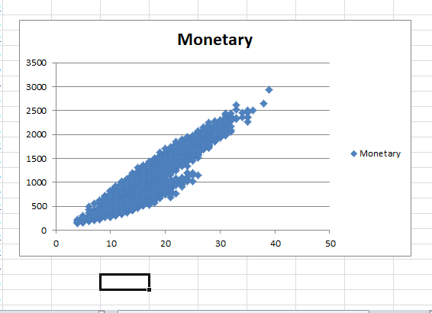
Monetary Analysis (Customer Spending)
BAR CHART
• Positive trend in customer spending
• High-value customers contribute more revenue

Slide 25
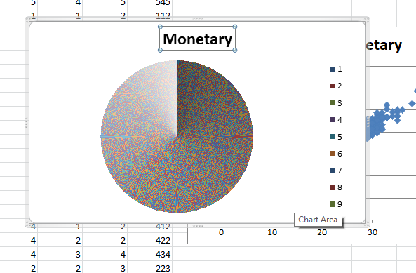
Country Sales

Slide 26
Key Insights
• Sales show clear distribution patterns
• High-value transactions are fewer but important
• Customer spending increases steadily
• Data reveals potential premium customers

Slide 27
Recommendations
Focus top products
Improve low sales
Plan offers

Slide 28
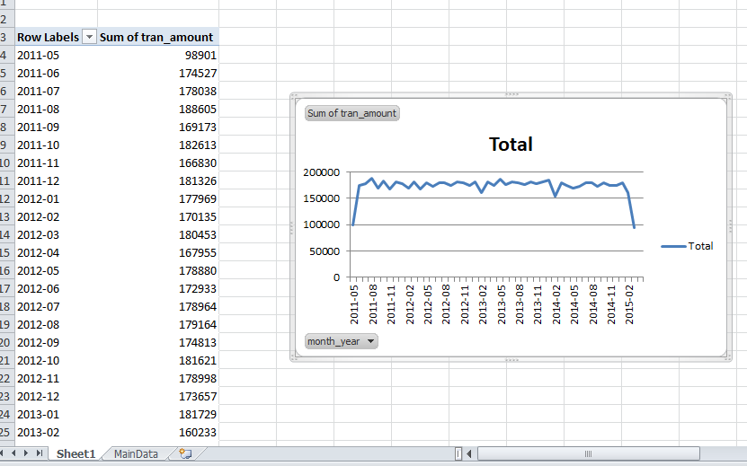
Excel Dashboard

Slide 29
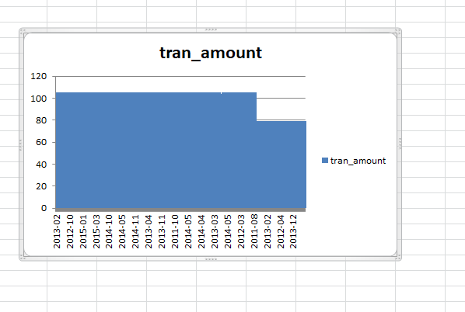
CONTD…

Slide 30
What I Learned
Data cleaning
Analysis
SQL
Visualization

Slide 31
Challenges
Missing data
Errors
Tool issues

Slide 32
Future Scope
ML prediction
Real-time dashboard

Slide 33
Conclusion
• Successfully analyzed retail data
• Identified key trends and customer behavior
• Provided actionable business insights

Slide 34
Thank You

