Slide 1
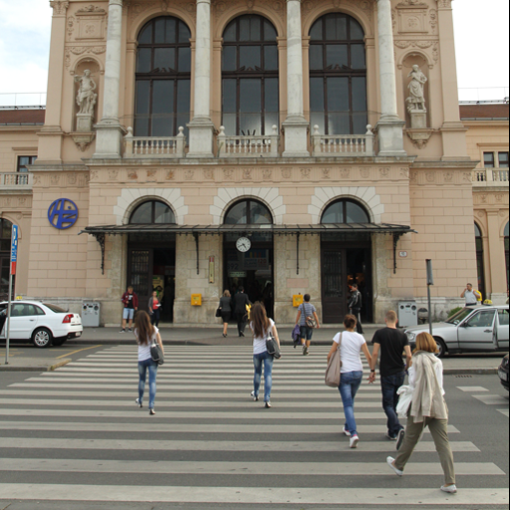



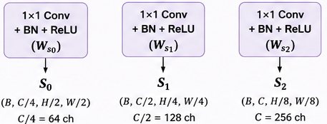


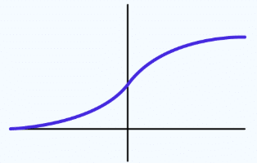
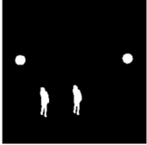

























SYSTEM ARCHITECTURE
Module 1 FORENSIC FEATURE EXTRACTION + CROSS ATTENTION
2. Dual Feature Extraction
3. SRM Guided Multi-head Cross-Attention (h=4 heads)
1. Input Image
Appearance Stream (ResNet-50)
SRM Stream (3 Filters)
…
SRM filters
Query (Q) from$F_{srm}∈ℝ^{N×256}$and Key (K) from $F_{srm}∈ℝ^{N×256}$
Head 1
Head 2
Head 4
$$F_{app}∈ℝ^{N×256}$$
3 high pass filters
…
SRM CNN
4. Residual Fusion
(Attention Output + $F_{app})$
($N×256)$
Layer 1
Layer 2
5. L2 Normalization $F_{norm}=\frac{F}{{\left\|F\right\|}_{2}}$
($N×256)$
conv
+
1X1 conv (256 ch)
1X1 conv (256 ch)
Value (V) from ${ F}_{app}∈ℝ^{N×256}$
Concat
$$I∈ℝ^{3×256×256}$$
Avg pool (k=2 stride=2)
Avg pool (k=2 stride=2)
$$F_{app}∈ℝ^{N×256}$$
$$F_{srm}∈ℝ^{N×256}$$
Linear Projection ($N×256)$
N=16 X 16=256 nodes/patches
Module 2 HYPERGIN BLOCK
Step 1: LEARNABLE 2-CRITERIA HYPERGRAPH + HGNN AGGREGATION
Step 2: DISPLACEMENT-AWARE GIN
(PAIRWISE CONTEXT)
Step 3: FORENSIC GATE
(ADAPTIVE FUSION)
(c) Suspicion Scores & Attention-Weighted HGNN
(a) Build kNN Graph (cosine similarity)
$$Z^{\left(hyper\right)}$$
$$Z^{\left(GIN\right)}$$
$$F_{norm}$$
(a) 2 – Criteria Hyperedge Assignment
(b) Construct Incidence Matrix
(Group)
(Pairwise)
(Initial)
$$H∈ℝ^{N×K}$$
$${Suspicion Score s}_{n}∈ℝ^{N×1}$$
Criterion 1:
Criterion 2:
…
Feature Similarity
SRM Consistency
$$K−number of hyperedges$$
S₁
S₂
S_{n}
$${(h}_{feat})$$
$${(h}_{srm})$$
e₁ e₂ …. e_{k}
Attention $α_{n}=\operatorname{softmax}{​}\left(v^{⊤}\tanh{​}\left(WF_{norm}\left[n\right]\right)\right)$
X 2
Repeat the
HyperGIN block
Twice
+
V₁
V₂
...
v_{N}
…
(b) Dominant Displacement d*
Concatenate
$α$₁
$α$₂
$α$_{n}
|$Z^{\left(GIN\right)}|{|Z}^{\left(hyper\right)}||F_{norm}|$
Gate Computation
HGNN Aggregation
(c) Gaussian Edge Weighting
$$g=σ​\left(W_{g}\left[Z^{\left(gin\right)} ‖ Z^{\left(hyper\right)} ‖ F_{norm}\right]+b_{g}\right)$$
$$Z^{\left(hyper\right)}∈ℝ^{N×256}$$
$$w_{ij}=\exp{​}\left(−\frac{{\left\|d_{ij}−d^{∗}\right\|}^{2}}{2σ^{2}}\right)$$
Refined Node Embedding
(d) Gin Propagation
$$Z^{\left(out\right)}=\operatorname{LN}{​}\left(\operatorname{MLP}{​}\left(g⊙\left(Z^{\left(gin\right)}+Z^{\left(hyper\right)}+F_{norm}\right)\right)+F_{norm}\right)$$
$$Z^{\left(GIN\right)}∈ℝ^{N×256}$$
Module 3 U-NET DECODER (MULTI-SCALE RECONSTRUCTION)
Skip: S₁(32X32X128)
Skip: S₂(16X16X256)
Skip: S₀(64X64X64)
Input from HyperGIN
Decoder Block 3 
Decoder Block 2 
Decoder Block 1 
Bilinear Upsample
(X2)
sigmoid
Predicted Forged
Probability Map
(16 →32)
(32 →64)
Conv 3X3 +
BN+ ReLU
Conv 3X3 +
BN+ ReLU
(64→128)
1X1 conv
σ(.)
$$Z^{\left(out\right)}∈ℝ^{N×256}$$
Conv 3X3 +
BN+ ReLU
Conv 3X3 +
BN+ ReLU
Conv 3X3 +
BN+ ReLU
Conv 3X3 +
BN+ ReLU
(Reshape to 16X16X256)
Bilinear
Upsample
X2
Concatenate
Bilinear Upsample
X2
Concatenate
Bilinear Upsample
X2
Concatenate
256X256X1
Output: 32X32X128
Output: 64X64X64
Output: 128X128X32
(128X128→
256X256)

Slide 2
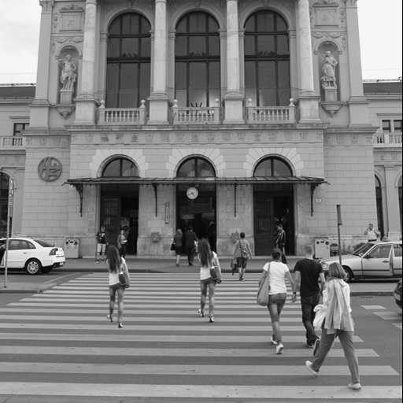
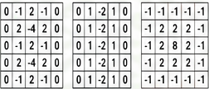
Forensic Feature Extraction
(A) APPEARANCE STREAM (ResNet-50)
X_{app}
S₀
S₁
S₂
F_{app}
RGB Image
(C) SKIP CONNECTIONS
(3X256X256)
1X1 Conv +
BN +ReLU
(W_{app})
AvgPool
k=2,s=2
From S₀
_{(Conv1 Output)}
16X16XC
(C=256)
H/8XW/8X256
1X1 Conv +
BN +ReLU
(W_{s0})
Conv1
7X7, 64 ch
Stride 2
MaxPool
3X3
Stride 2
Layer 1
C2,x
256 ch
Layer 2
C3,x
512 ch
H/2XW/2XC/4 (64ch)
H/2XW/2X64
H/4XW/4X256
H/8XW/8X256
From S₁
_{(Layer1 Output)}
1X1 Conv +
BN +ReLU
(W_{s1})
(B) FORENSIC NOISE STREAM (SRM)
SRM Filters (fixed, 5X5)
X_{srm}
Luminance (Y)
f₁
Conv Layers
(3-layers)
RGB Image
f₂
f₃
H/4XW/4XC/2 (128ch)
(3X256X256)
Grayscale
Second order
derivative
Horizontal
High-Pass
Laplacian
From S₂
_{(Layer2 Output)}
1X1
Conv
AvgPool
k=2,s=2
1X1 Conv +
BN +ReLU
(W_{s2})
H/8XW/8XC/2
H/8XW/8XC
(C=256)
/12
/12
/12
16X16XC
(C=256)
H/8XW/8XC (256ch)

Slide 3



SRM-Guided Multi-head Cross-Attention
Q
(NXC)
SRM Features
Split into h=4 heads
(d=C/h = 64 per head)
X_{srm}
W_{q}
_{(CXC)}
Scaled Dot-Product Attention
(per head)
head₁
Q₁ (NX64)
(NX64)
Q₂ (NX64)
Attn
K
(NXC)
Q =
head_{i}
(i=1,…,4)
(NXC)
Q₃ (NX64)
head₂
Q₄ (NX64)
$$A_{i}=\operatorname{Softmax}{​}\left(\frac{Q_{i}K_{i}^{⊤}}{\sqrt{64}}\right)$$
(NX64)
W_{k}
_{(CXC)}
Concat
(4X64=256)
W0
(CXC)
K₁ (NX64)
head₃
K=
K₂ (NX64)
(NX64)
K₃ (NX64)
V_{i}
(NX64)
head_{i}
(NXC)
(NX64)
Appearance
Features
K₄ (NX64)
head₄
X_{app}
V
(NXC)
(NX64)
Residual Fusion
V₁ (NX64)
X 4 parallel heads
F_{fuse} = Attn + X_{app}
V=
V₂ (NX64)
W_{v}
_{(CXC)}
V₃ (NX64)
(NXC)
V₄ (NX64)
L2 normalization
(per node)
$$F_{norm}=\frac{F_{fuse}}{{\left\|F_{fuse}\right\|}_{2}}$$
$$F_{norm}$$

Slide 4









Learnable Hyper Graph Construction + HGNN
Forensic Suspicion Score (per node)
$$F_{norm}$$
Layer 1
$$F_{norm}$$
D_{e}=diag(H^{T}.1N)
$$F_{norm}$$
W_{sus}
_{(CXC/4)}
tanh
V_{sus}
_{(CXC/4)}
Softmax
(over N nodes)
α⊙ $F_{norm}$
H
(NxK)
Z⁽¹⁾
(NXC)
H^{T}
F _{hyp}⁽¹⁾
(NxC)
(KxN)
/D_{e}
(KxK)
α
α
(KxC)
(NXC)
(NXC)
(NX1)
(NX1)
$$F_{norm}$$
ReLU
Two-Criteria Hyperedge Assignment
X⁽¹⁾
(Residual)
$$F_{norm}$$
(NxC)
θ₁
h_{feat}
_{(NXK)}
Learnable weight W=[W₁,W₂]
LN
Softmax
W_{feat}
_{(CXK)}
W₁
W₂
Weighted combination
X⁽¹⁾
Layer 2
W₁ . h_{feat} +W₂ . h_{srm}
$$X_{srm}$$
(NXC)
D_{e}=diag(H^{T}.1N)
$$X_{srm}$$
Softmax
α⊙ X⁽¹⁾
H^{T}
H
(NxK)
Z⁽²⁾
h_{srm}
_{(NXK)}
(NXC)
(KxN)
F _{hyp}⁽²⁾
(NxC)
(NXC)
H
(NXK)
/D_{e}
(KxK)
W_{srm}
_{(CXK)}
α
(KxC)
$$\text{X}\text{(1)}$$
ReLU
Z^{(hyper)}
(Residual)
θ₂
(NxC)
(NXC)
LN

Slide 5
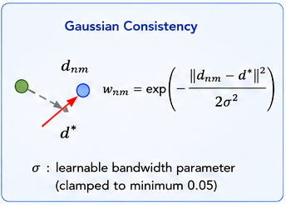
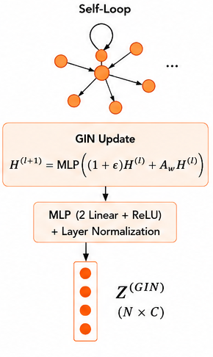
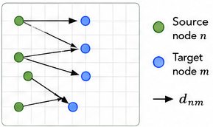
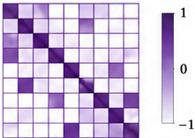
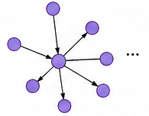
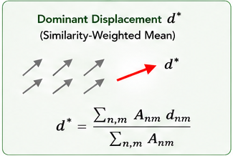
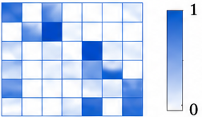
Displacement-Aware Forensic GIN
Dominant Displacement
Estimation
Displacement Consistent
Edge -Weighting
Forensic GIN Propagation
Correspondence Graph
Input from HGNN
Z^{(hyper)}
(NxC)
Cosine Similarity Matrix
Node Features
Displacement of edges n→m
Top-K neighbor K=10
N nodes
(16x16 patches)
C feature dim
Weighted Adjacency Martix A_{w}

Slide 6




Adaptive Forensic Gate
From Hypergraph
(Group-level context)
Concatenate
Gate Computation
Gated Fusion
Output with Residual
Connection
Z^{(hyper)}
Z^{(hyper)}
g
Z^{(hyper)}
(NxC)
MLP
(NxC)
Linear
(Linear→ReLU→Linear)
(NxC)
(NxC)
fused
(W_{g,} b_{g})
(NxC)
h
From Forensic GIN
(Pairwise
Correspondence)
Z^{(GIN)}
Z^{(GIN)}
+
⊙
(NxC)
$$F_{norm}$$
(NxC)
Sigmoid
(NxC)
+
Z^{(GIN)}
$$F_{norm}$$
(NxC)
(NxC)
$$F_{norm}$$
g
LayerNorm
Normalized
Fused Features
(NxC)
fused
(NxC)
(NxC)
(NxC)
Z^{(out)}
$$F_{norm}$$
gate_in=concat(Z^{(GIN)},Z^{(hyper)}, $F_{norm})$
(NxC)
(NxC)
(Nx3C)

Slide 7
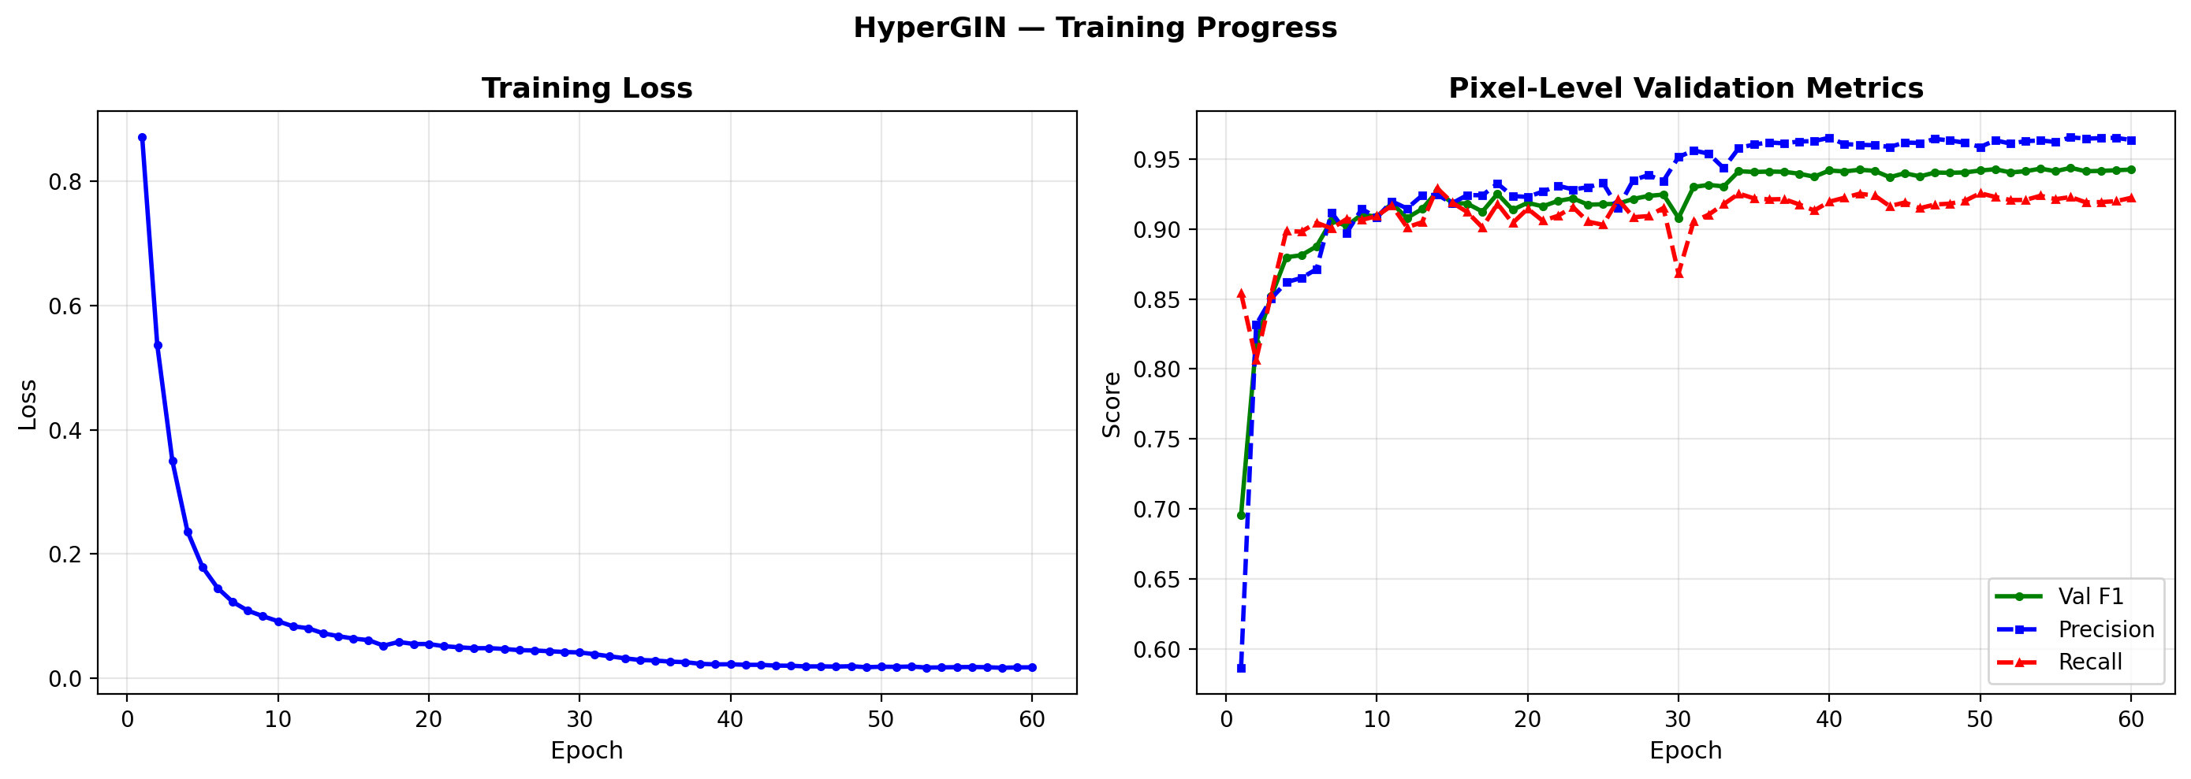

Slide 8
HyperGIN — Final Test Results 5-Stage Full-Image Architecture Pixel-level evaluation
==============================================================
Best epoch : 56
──────────────────────────────────────────────────
Metric Value
──────────────────────────────────────────────────
f1 0.9303
precision 0.9595
recall 0.9028
iou 0.8696
Best Threshold 0.36
──────────────────────────────────────────────────

Slide 9
============================================================
HyperGIN — Final Test Results
Protocol: per-image threshold sweep [0.20-0.80]
Test images: 500
────────────────────────────────────────────────────────────
F1 : 0.8267
Precision : 0.8924
Recall : 0.8206
IoU : 0.7852
────────────────────────────────────────────────────────────
F1 > 0.8 : 374/500
F1 > 0.5 : 453/500
F1 = 0.0 : 25/500
============================================================

Slide 10
Method F1 Prec Rec IoU
────────────────────────────────────────
BusterNet 0.508 - - -
Serial Net 0.477 - - -
DOA-GAN 0.420 - - -
CMCF-Net 0.489 - - -
DCM-Net 0.534 - - -
CAGRL 0.533 - - -
────────────────────────────────────────
HyperGIN 0.8267 0.892 0.821 0.785

Slide 11
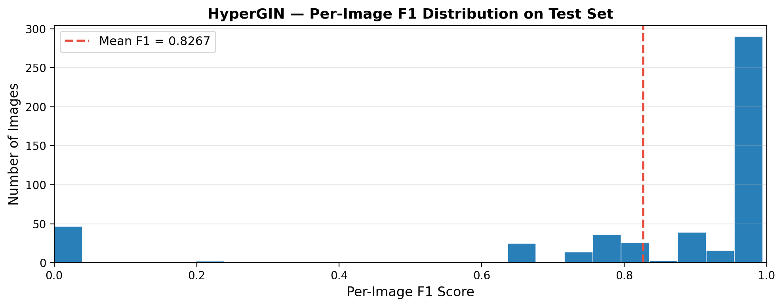

Slide 12
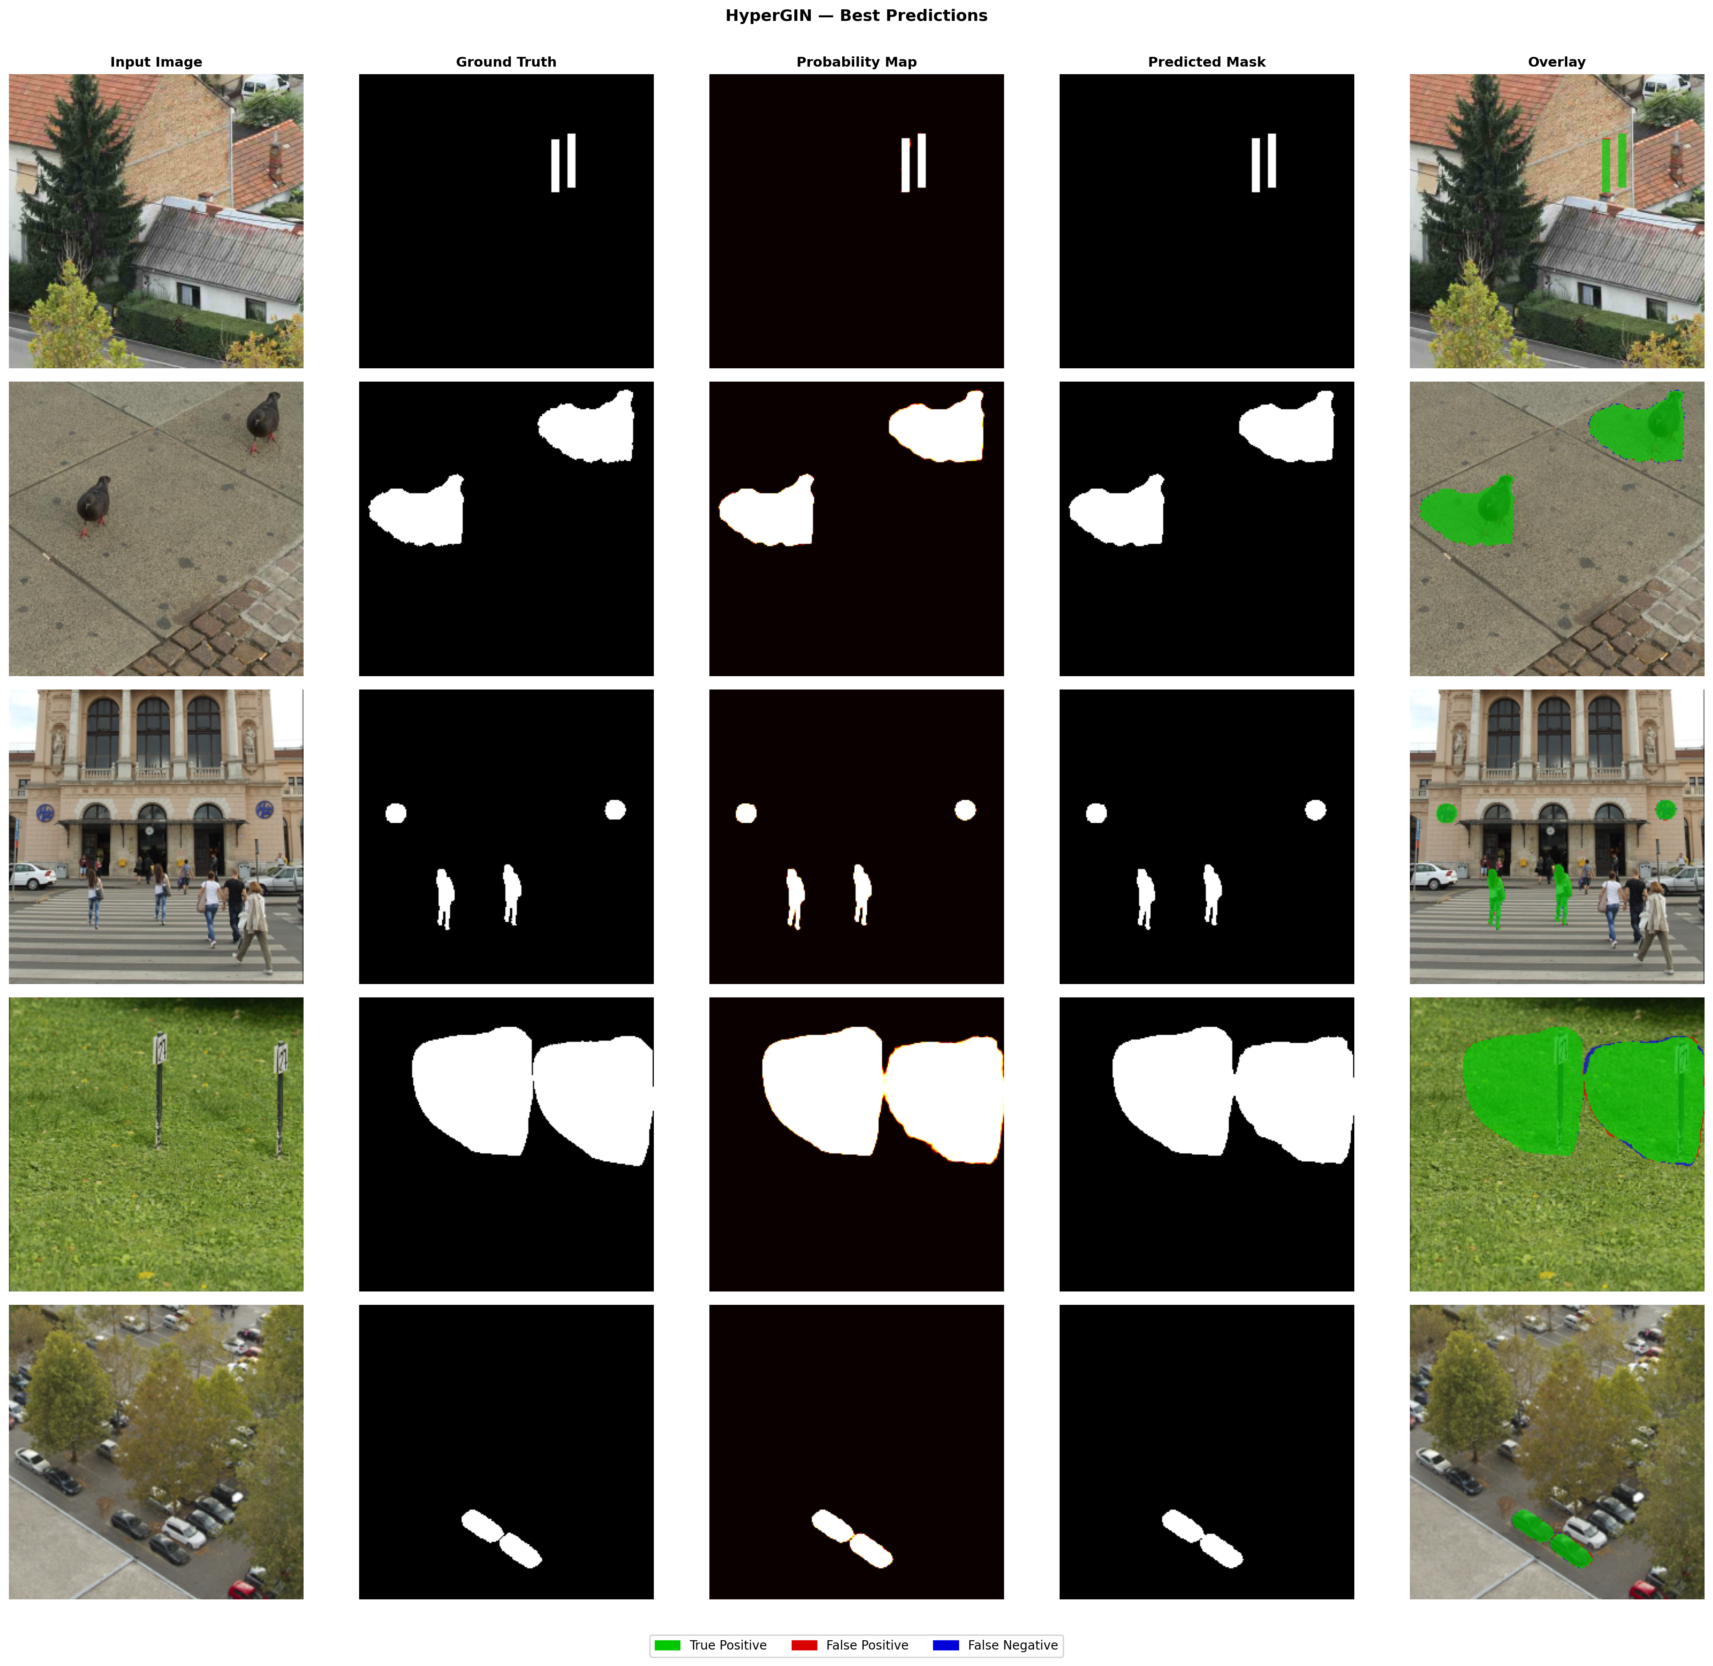

Slide 13
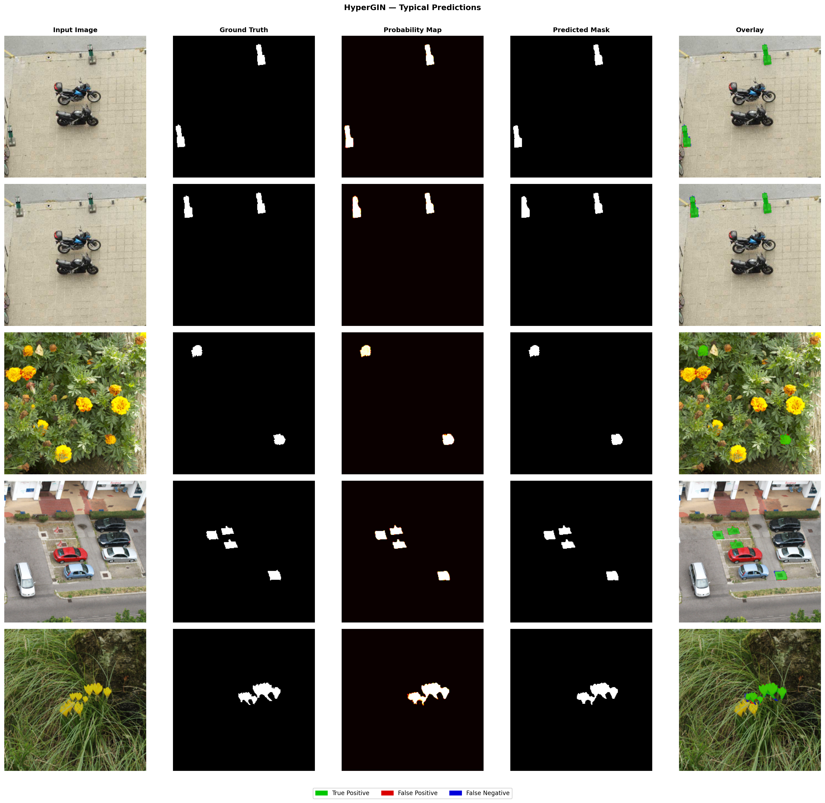

Slide 14
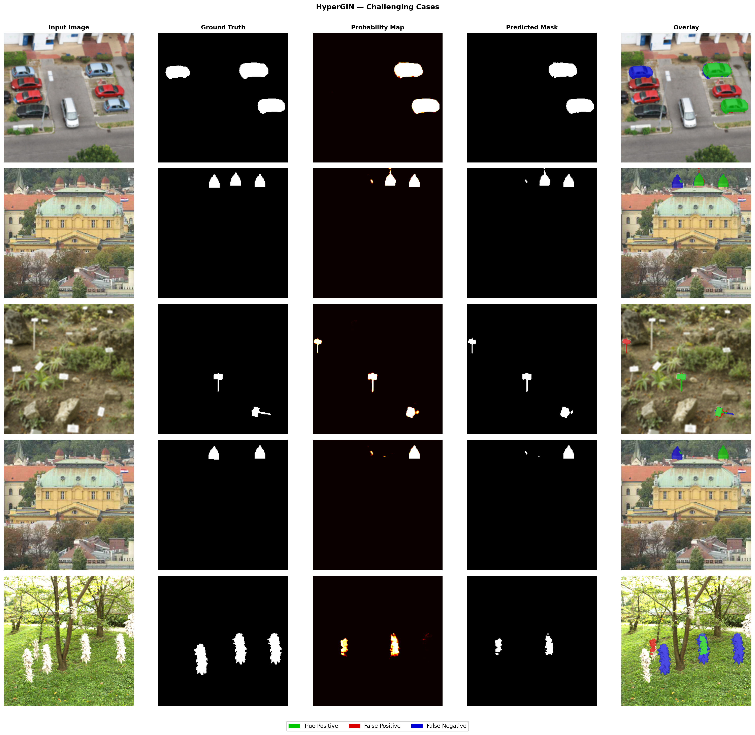

Slide 15
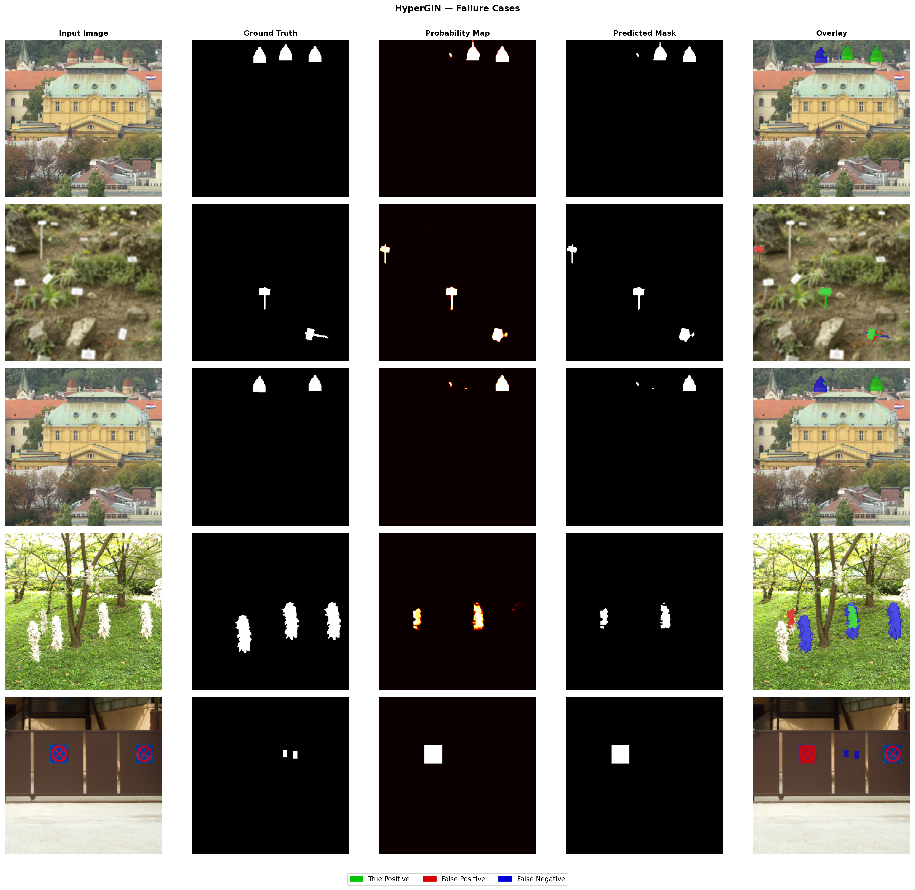

Slide 16
======================================================================
HyperGIN — Complete Ablation Study Results
Dataset: CoMoFoD test set (500 images)
All variants trained from scratch, seed=42
======================================================================
Variant F1 P R IoU ΔF1 ─────────────────────────────────────────────────────────────────
Full HyperGIN 0.9568 0.9640 0.9498 0.9172 —
w/o Cross-Attention 0.9365 0.9412 0.9318 0.8805 -0.0203
w/o Hypergraph+HGNN 0.9328 0.9434 0.9224 0.8740 -0.0240
w/o Forensic GIN 0.9397 0.9497 0.9298 0.8862 -0.0171
w/o Forensic Gate 0.9313 0.9667 0.8985 0.8715 -0.0255 ─────────────────────────────────────────────────────────────────
======================================================================

Slide 17
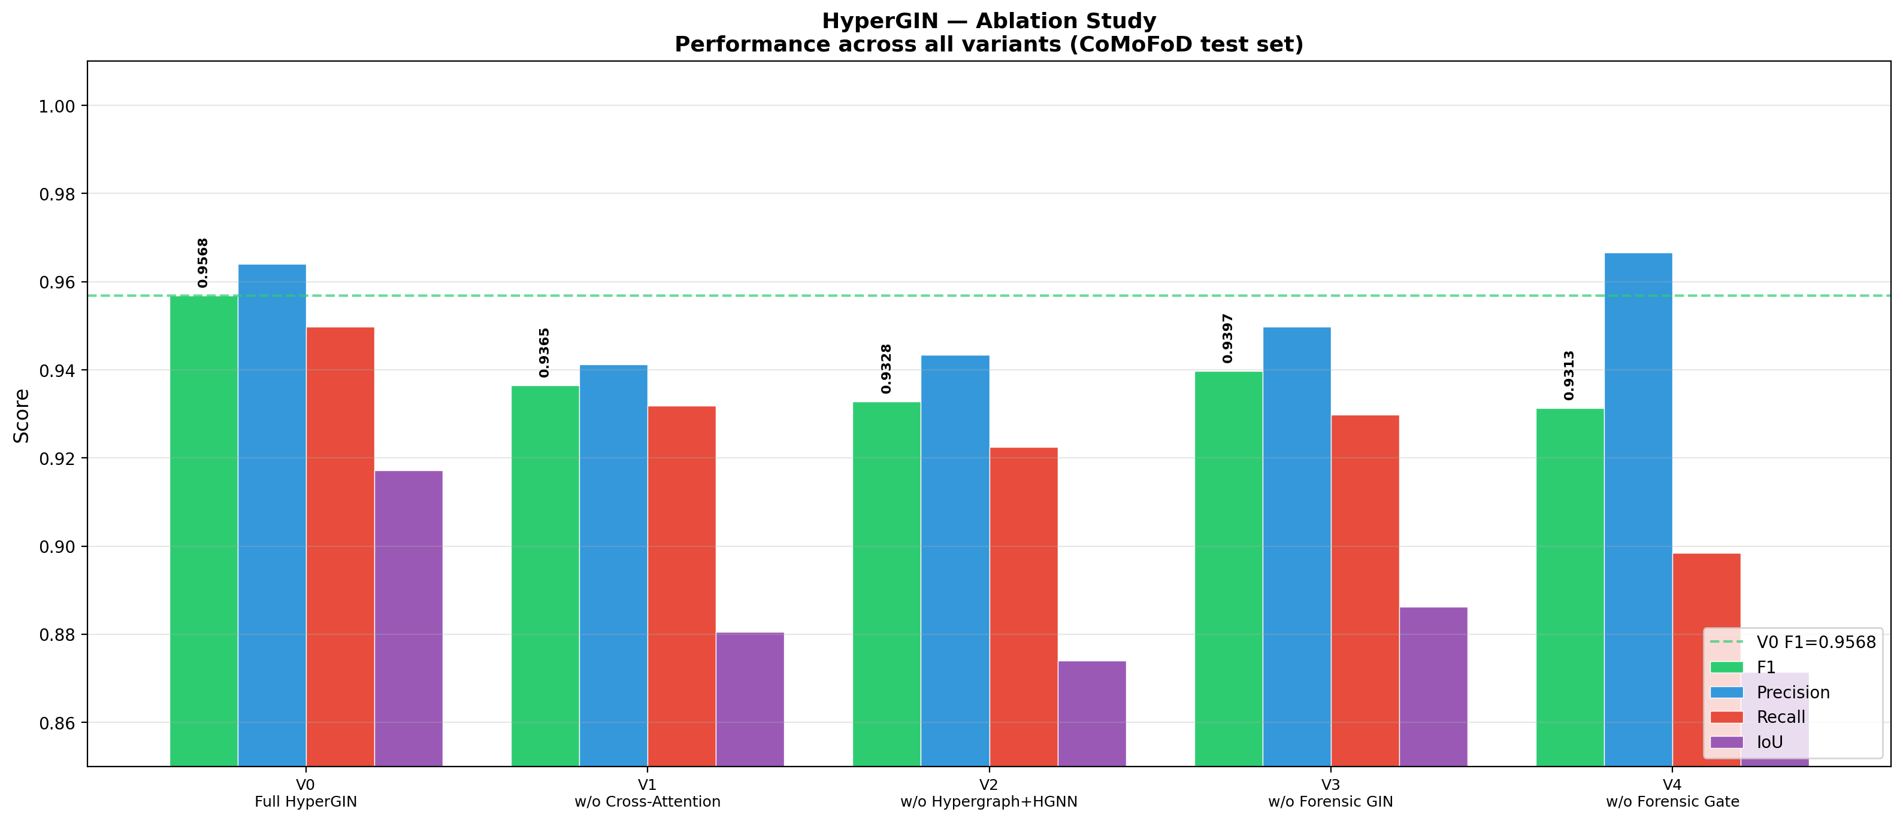

Slide 18
