Slide 1
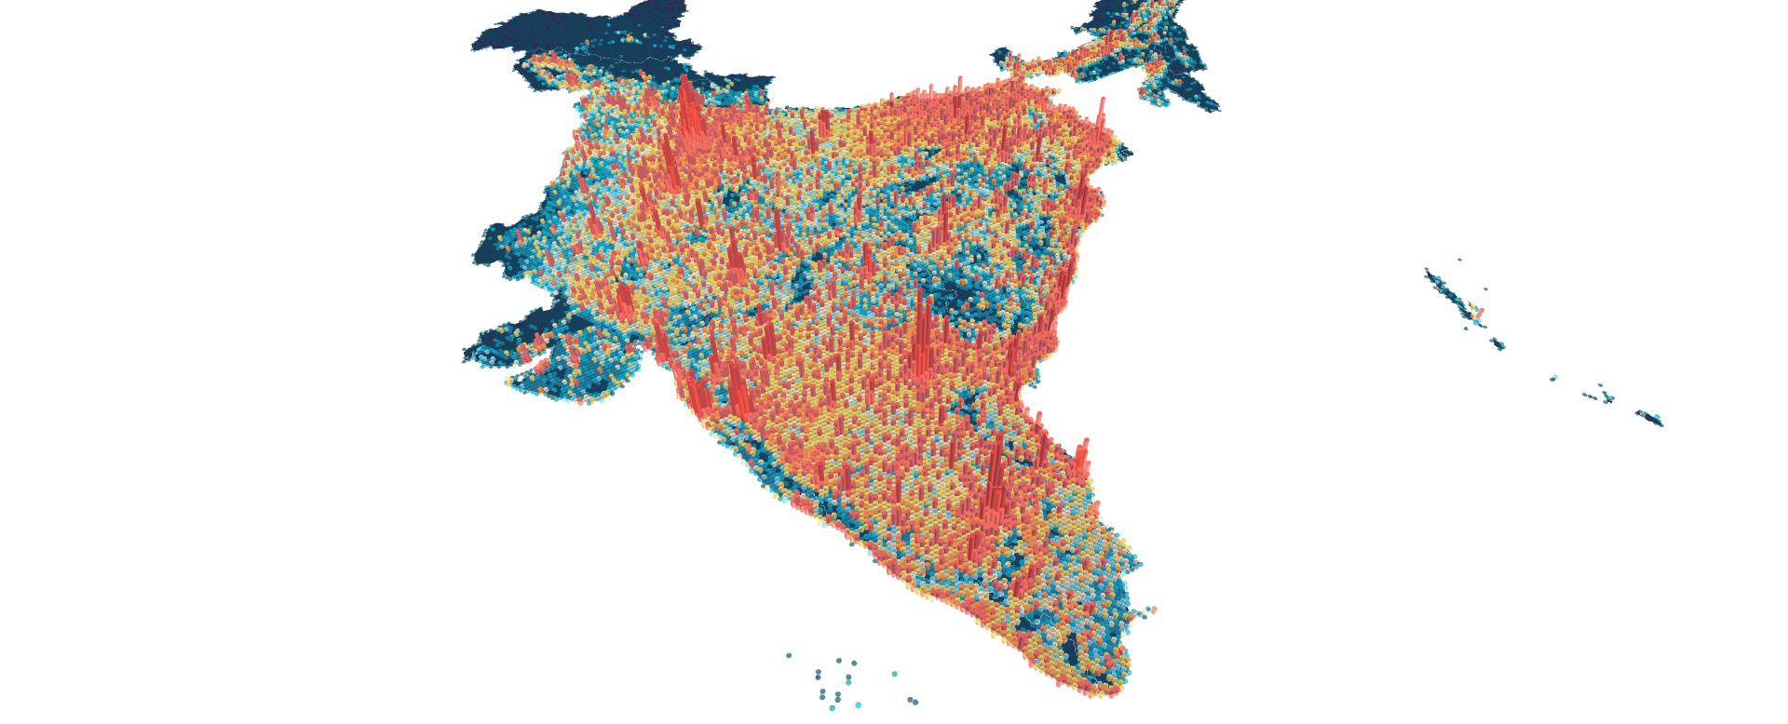

Phonepe Transaction Insights
Domain: Finance/
Payment Systems
Developed by
Priyadharshini S

Slide 2
Introduction
Phonepe is a leading Indian digital payments and financial services company that has revolutionized, simplified, and accelerated the adoption of digital payments in India.
Advantages and Unique Selling Points
High Reliability: Built on robust, scalable architecture to handle high-volume transactions.
Massive Merchant Network: Accepted at over 40 million+ offline and online outlets.
Security: Uses UPI PIN, device binding, and AI-based fraud monitoring to ensure secure transactions.

Slide 3
Problem Statement:
1. Decoding Transaction Dynamics on PhonePe
2. Device Dominance and User Engagement Analysis
3. Insurance Penetration and Growth Potential Analysis
4. Transaction Analysis for Market Expansion
5. User Engagement and Growth Strategy

Slide 4
Approach:
Data Extraction
Clone the GitHub repository containing PhonePe transaction data and load it into a PgAdmin database.
Then successfully built a structured DataFrame from the PhonePe Pulse dataset!
Dashboard Creation: Develop an interactive dashboard using Streamlit, to present the analysis coming problams. Ensure the dashboard integrates visualizations for real-time data exploration and insights.

Slide 5
1. Decoding Transaction Dynamics on PhonePe
1.State-Level Transaction
which states drive the highest transaction volumes and values
2.Quarterly Growth
this means measuring how transaction values change from one quarter to the next, either in absolute terms or as a percentage growth rate.
3.Top 10 Transactions
To get the Top 10 Transactions
4. highest revenue
5. lowest revenue

Slide 6
Recommendations
Track repeat usage and retention metrics
Track total transactions over time (daily, monthly, yearly).
Compare growth across categories: money transfers, recharges, loans, insurance.
Monitor success rates, failure causes (network, insufficient balance, technical errors).
Track repeat usage and retention metrics

Slide 7
2. Device Dominance and User Engagement Analysis
1.Registered Users by Device Brand
Registered Users by Device Brand from the PhonePe Pulse dataset
2. transaction percentage per year
3. Top 10 States per Year by Registered Users
4. Top 3 states overall total user
5. maximum registered users each year

Slide 8
Recommendations
Identify brands with high registrations but low engagement
Compare registered users vs. active users across device brands.
Map device usage trends by region
Spot regions where certain brands dominate or lag
Assess app responsiveness, crash rates, and feature adoption across devices.
rack app opens, session length, and repeat usage by device brand.

Slide 9
3. Insurance Penetration and Growth Potential Analysis
1.Quarterly Premiums by State
Group by State and Quarter, then sum the premium values.
2. Quarterly Premiums by State
group your dataset by State, Year, and Quarter, then sum the premium values
3. Insurance Product Segmentation by State and Year
4.High premiums in a particular year
5. Top 10 Performing States by Insurance Premium Amount

Slide 10
Recommendations
  Track the ratio of insurance users to total registered PhonePe users
  Identify regions and demographics with high transaction activity but low insurance usage.
  Profile age groups, income segments, and device brands linked to insurance adoption.
  Map insurance adoption by state/district to identify underpenetrated regions

Slide 11
4. Transaction Analysis for Market Expansion
1.Top 10 States by Transaction
2. Transaction Volume Over year
3. Average Transaction Value by State
4. Top 10 Ranking transaction amounts by state
5. Highest Transaction Count per Quarter

Slide 12
Recommendations
Use transaction data to cluster customers by behavior, highlighting high-value segments for targeted expansion
Simulate transaction flows under different regulatory or currency conditions to anticipate risks.
Automate compliance checks, fraud detection, and reconciliation to reduce overhead.
Collaborate with local firms to share transaction infrastructure and reduce entry barriers.

Slide 13
5. User Engagement and Growth Strategy
1.Total Registered Users by State
2.Total App Opens by State (Stacked by District)
3.Top 10 District-Year-Quarter by Registered Users
4.Yearly Registered Users
5.Top 10 Districts by App Opens

Slide 14
Recommendations
Proactively monitor user health and provide support before issues escalate.
Celebrate milestones and incentivize long-term use
Collect feedback regularly and act on it to show responsiveness
Group users by lifecycle stage or behavior to deliver relevant communication
Add badges, milestones, or progress tracking to make engagement fun and rewarding
Proactively monitor user health and provide support before issues escalate.

Slide 15
Using Python libraries in this project
Pandas(Exraction
Matplotlib
Seaborn
Altair
Streamlit(visualization)
Sqlalchemy (SQL)
Plotly

Slide 16
Skills gained From This Project
Data Extraction
SQL Proficiency
Data Visualization
Analytical Thinking
Documentation,
Streamlit

Slide 17
Conclusion
Successfully built an end-to-end data dashboard
Integrated backend database with frontend visualization
Improved understanding of real-world data analytics workflow
Project demonstrates skills in Python ,SQL,Data Visualization

Slide 18


