Slide 1
Employee Data Analysis using Excel
STUDENT NAME: E. PRIYADHARSHINI
REGISTER NO: 312219308(asunm1709312219308)
DEPARTMENT: B.COM (GENERAL) COMMERCE
COLLEGE : LAKSHMI BANGARU ARTS AND SCIENCE COLLEGE

Slide 2
PROJECT TITLE
Employee Performance Analysis using Excel

Slide 3


AGENDA
Problem Statement
Project Overview
End Users
Our Solution and Proposition
Dataset Description
Modelling Approach
Results and Discussion
Conclusion
3/21/2024 Annual Review

Slide 4

PROBLEM STATEMENT
Our Organization faces challenges in accurately assessing employee performance across departments, leading to inefficiencies and overlooked talent. We aim to use Excel to analyze performance data, identify trends, and pinpoint areas for improvement to enhance overall productivity.

Slide 5

PROJECT OVERVIEW
Employee performance analysis in Excel involves evaluating employee metrics like productivity, attendance, and quality of work. The goal is to gain insights that support decisions on promotions, training, and performance improvements. Data is typically collected from HR records, productivity logs, and performance reviews, which are then analyzed using Excel's functions, charts, and pivot tables. The outcome helps identify high performers, areas for development, and overall trends in employee performance.

Slide 6
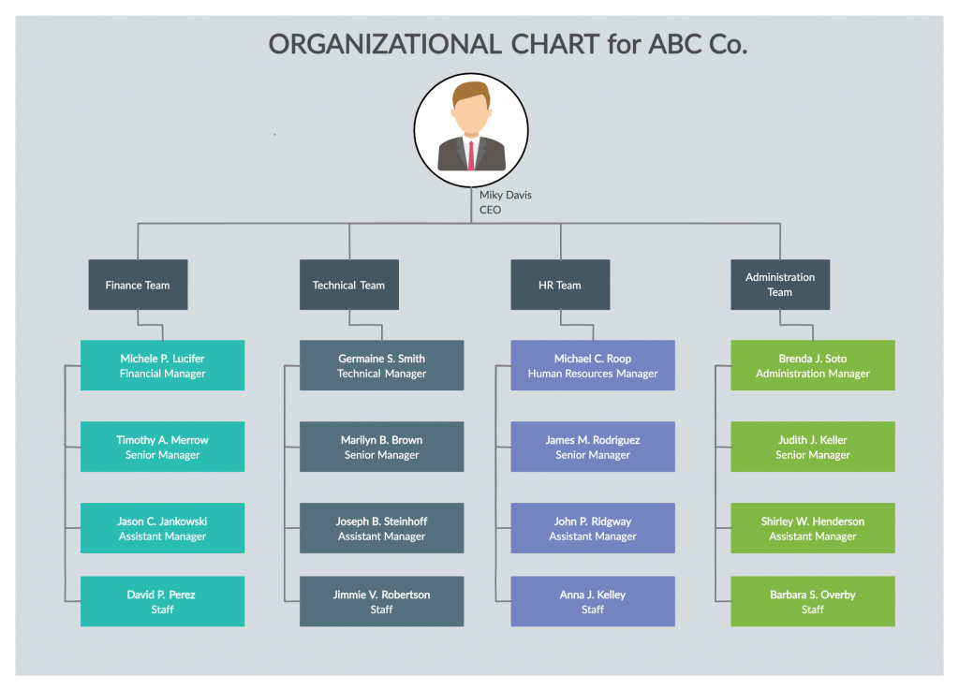

WHO ARE THE END USERS?

Slide 7

OUR SOLUTION AND ITS VALUE PROPOSITION Conditional formatting – missing Filter – remove Formula – performance Pivot – summary Graph – data visualization

Slide 8
Dataset Description Employee – Kaggle 26 - features 9 - features Emp id - num Name - text Emp type Performance level Gender - male/female Employee rating - num

Slide 9

THE "WOW" IN OUR SOLUTION
Performance level=IFS(Z8>=5,"VERY HIGH",Z8>=4,"HIGH",Z8>=3,"MED",TRUE,"LOW")
3/21/2024 Annual Review
9

Slide 10
MODELLING
Data collection :
1) Collect relevant employee data.
2) Example: 21 data points.
Feature collection :
1) Identify and select key performance metrics.
2) Example: 21 features.
Data cleaning :
1) Clean and prepare data for analysis.
2) Example: 11 data points cleaned.
10

Slide 11
Performance level determination : 1) Assign performance levels (e.g., A,B,C,D) to employees. 2) Example: 21 employees classified as level D. Summary and Reporting : 1) Summarize data and insights. 2) Example: Summary for 12 employees in category D. Visualization and Final Analysis : 1) Create visual reports and final summaries. 2) Example: 11 visualizations, 12 key insights.

Slide 12
RESULTS
12

Slide 13
RESULTS

Slide 14
Conclusion To analyze employee performance using Excel, organize your data into a structured table, including columns for key performance metrics such as sales, project completion rates, customer satisfaction, attendance, and feedback. Use Excel tools like pivot tables, charts, and conditional formatting to compare identify high and low performers, and determine areas needing improvement. Conclude by summarizing the overall performance and identifying actionable insights for employee development or recognition.

