Slide 1
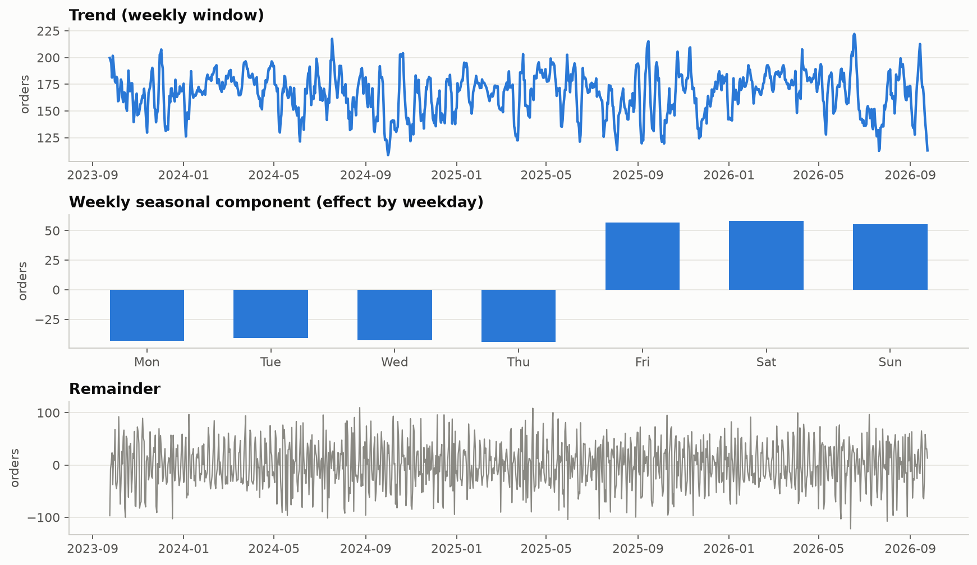
Forecasting daily orders: method and setup
P1 · T04–T06
Weekly pattern + festival days; weather given as observed
• Series is stationary (ADF −6.08, p < 0.001; KPSS p ≥ 0.10).
• Strong weekly pattern (seasonal strength 0.56) plus festival days; no yearly term, because the generator has none.
• Models: seasonal naive, weekday mean, SARIMAX (with and without weather), SARIMAX on log orders, Prophet.
• Festival flag is given to every regression model.
• Rolling-origin backtest: 131 folds, 7-day forecasts, 917 forecast days.
• Weather is given as observed (best case); a real forecast would carry weather-forecast error.
Weather-Driven Food Order Patterns · Coimbatore, Tamil Nadu · Review 2 (Time-series forecasting)

Slide 2
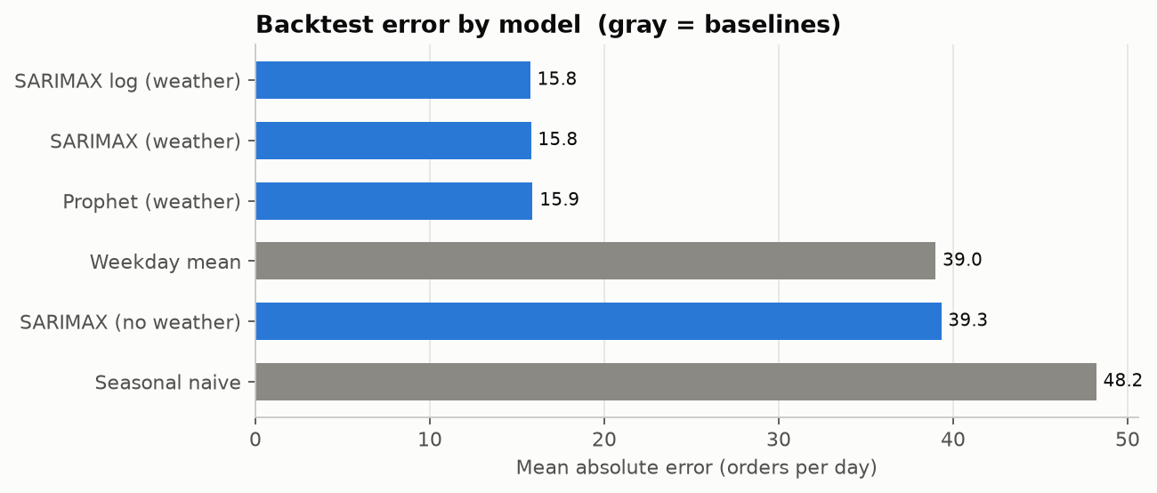
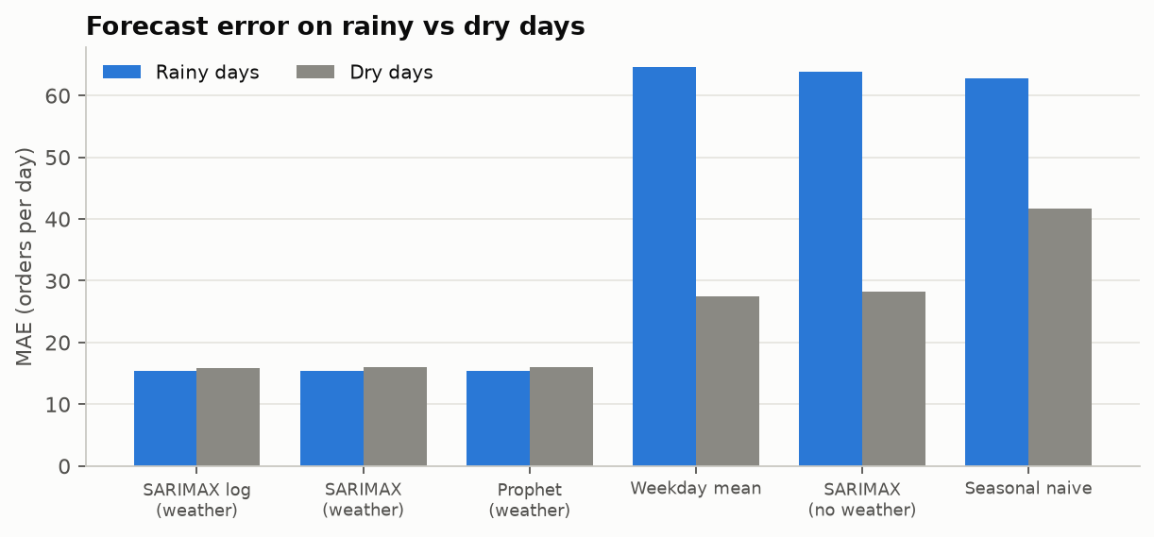
Forecasting daily orders: results
P1 · T04–T06
Knowing the weather cuts the error by 60%; plan forecast + 25 orders
• Best MAE 15.8 orders/day (10.1% MAPE), against 39.0 for the weekday-mean baseline and 48.2 for seasonal naive.
• Weather lowers SARIMAX error by 23.5 orders/day (95% CI 21.5 to 25.5).
• Rainy-day error 15.4 vs dry-day 15.9: once weather is known, rainy days are no harder to plan.
• Within about 0.2 orders/day of the best possible score (generator expected value, MAE 15.5).
• Planning buffer: forecast + 25 orders (about 17%) covers 9 days in 10; 27 on rainy days, 24 on dry days.
• Caveat: the data is synthetic, so this shows the generator's rules are recovered, not real customer behaviour.
Weather-Driven Food Order Patterns · Coimbatore, Tamil Nadu · Review 2 (Time-series forecasting)

