Slide 1
23CSE452 BUSINESS ANALYTICS · CAPSTONE PROJECT 2026
Weather-Driven Food Order Patterns in Coimbatore
A Data-Driven Framework for Restaurant Demand Forecasting & Menu Basket Dynamics
STUDENT TEAM (GROUP 9)
FACULTY GUIDE & VERIFIED DELIVERABLES
P1 Priyadharshini (CB.SC.U4CSE23438) — Weather API & Time Series
Faculty Guide: Mrs. Rohini S
Amrita School of Computing, Coimbatore
P2 Edavalapati Aashiq (CB.SC.U4CSE23560) — Order Synthesis & Calibration
Live Interactive Streamlit Dashboard:
https://weather-food-ord-smj647r3xjpffhdkb4j2df.streamlit.app/
P3 Sai Sri Satvic L (CB.SC.U4CSE23225) — Preprocessing, Features & ARM
P4 Swasthika P S (CB.SC.U4CSE23350) — EDA & Interactive Dashboard
GitHub Projects Agile Board:
https://github.com/users/priyagarnet20-ops/projects/1/views/2
P5 Deepak S (CB.SC.U4CSE23267) — Predictive Models & Validation

Slide 2
Executive Summary & Business Objectives
Overview
Can weather intelligence improve daily restaurant demand planning and kitchen operations?
Business Problem & Research Scope
• BUSINESS PROBLEM IN COIMBATORE:
• Restaurants face high demand volatility from sudden monsoon showers,
• extreme summer heatwaves, and weekend dining habits.
• Unanticipated demand shifts cause costly food waste (over-prep) or
• stockouts and lost revenue during order surges.
•
• THREE CORE RESEARCH QUESTIONS:
• 1. How does weather interact with calendar cycles (weekday vs. weekend)?
• 2. Does adding weather covariates improve daily order predictions?
• 3. Can weather-segmented item associations optimize menu bundling and prep?
Core Empirical Findings & Impact
• KEY QUANTITATIVE FINDINGS:
• • Dual Weather Effect: Rain lifts weekday orders by +54% (delivery convenience)
• but suppresses weekend orders by -47% (dining out cancellations).
• • Superior Forecasting: SARIMAX with weather cuts MAE by 60% vs naive
• baselines (saving 23.5 orders/day of error; 95% CI: 21.5–25.5).
• • Model Equivalence: Ridge, Count models, and SARIMAX are statistically tied
• over a 365-day backtest (MAE 14.99–15.08).
• • Weather Basket Affinity: Chai + Pakora/Samosa confidence surges in rain,
• while Ice Cream and Fresh Juices decline by over 50%.
• • Operational Planning Buffer: A buffer of +25 orders covers 90% of days.
Weather-Driven Food Order Patterns (Coimbatore) · 23CSE452 Business Analytics · Group 9
Live App: weather-food-ord-smj647r3xjpffhdkb4j2df.streamlit.app

Slide 3
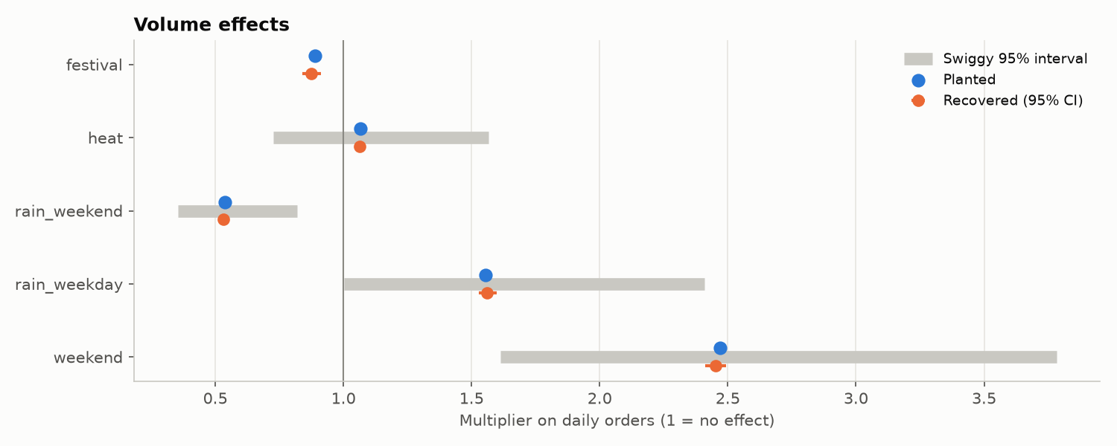
Dataset Collection, Calibration & Quality Audit
P1 & P2 · Data
1,097 days of observed Open-Meteo weather paired with evidence-calibrated synthetic orders
Data Sources & Validation
• PRIMARY WEATHER HARVESTING (Open-Meteo API):
• • Daily & hourly data for Coimbatore (11.00°N, 76.99°E) from Sep 2023 to Sep 2026 (1,097 days).
• • Variables: Precipitation (mm), rain hours, max/min temperature, humidity, wind speed, weather code.
•
• CALIBRATION ON REAL EVIDENCE:
• • Ground Truth 1: 464 actual Swiggy orders from a Coimbatore restaurant (Aug–Sep 2026).
• • Ground Truth 2: 27-person structured consumer dining survey in Coimbatore.
• • Evidence Derivations: Menu pricing, item catalog (80 items), hourly meal slots, and weather multipliers.
•
• RIGOROUS VALIDATION SUITE (T10):
• • 25 of 26 empirical checks pass against the Swiggy report and survey.
• • All 5 volume effects recovered: weekday rain x1.56, weekend rain x0.53, weekend x2.45, heat x1.06, festival x0.87.
Weather-Driven Food Order Patterns (Coimbatore) · 23CSE452 Business Analytics · Group 9
Live App: weather-food-ord-smj647r3xjpffhdkb4j2df.streamlit.app

Slide 4
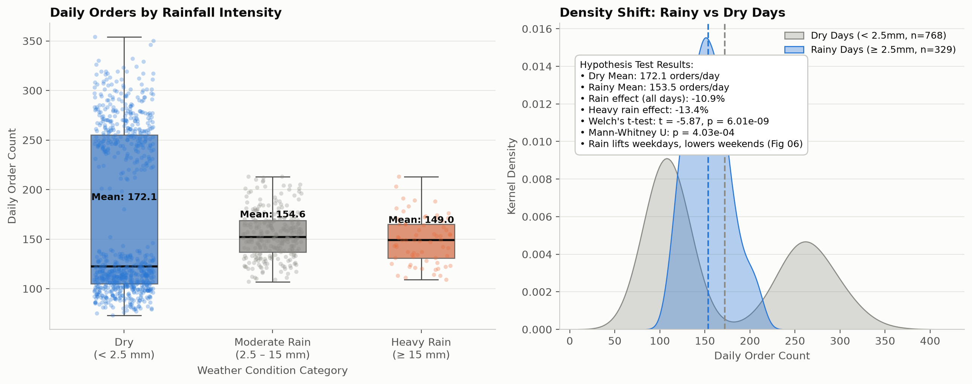
Unit 1: Exploratory Analysis — Rain × Weekday Interaction
Unit 1 · P4
Overall correlation hides opposite weather behavior on weekdays vs weekends
Key Findings from Exploratory Analysis
• DEMAND DISTRIBUTION (182,696 orders across 1,097 days):
• • Mean 166.5 orders/day, median 157.0 (range 73 to 354). Right-skewed volume.
• • Two-humped distribution driven by heavy weekend dining surges.
•
• THE SIMPSON'S-LIKE INTERACTION EFFECT:
• • Pooled Rain Correlation: r = -0.10, falsely suggesting rain decreases orders.
• • Stratified Reality:
• - Weekdays: Rain increases orders from 116.5 to 179.3 (+53.9%).
• - Weekends: Rain decreases orders from 285.8 to 151.7 (-46.9%).
•
• CRITICAL BUSINESS TAKEAWAY:
• • Predictive models MUST include the interaction term (Rain x Is_Weekend);
• ignoring it biases demand estimates by up to 134 orders on wet Saturdays.
Weather-Driven Food Order Patterns (Coimbatore) · 23CSE452 Business Analytics · Group 9
Live App: weather-food-ord-smj647r3xjpffhdkb4j2df.streamlit.app

Slide 5
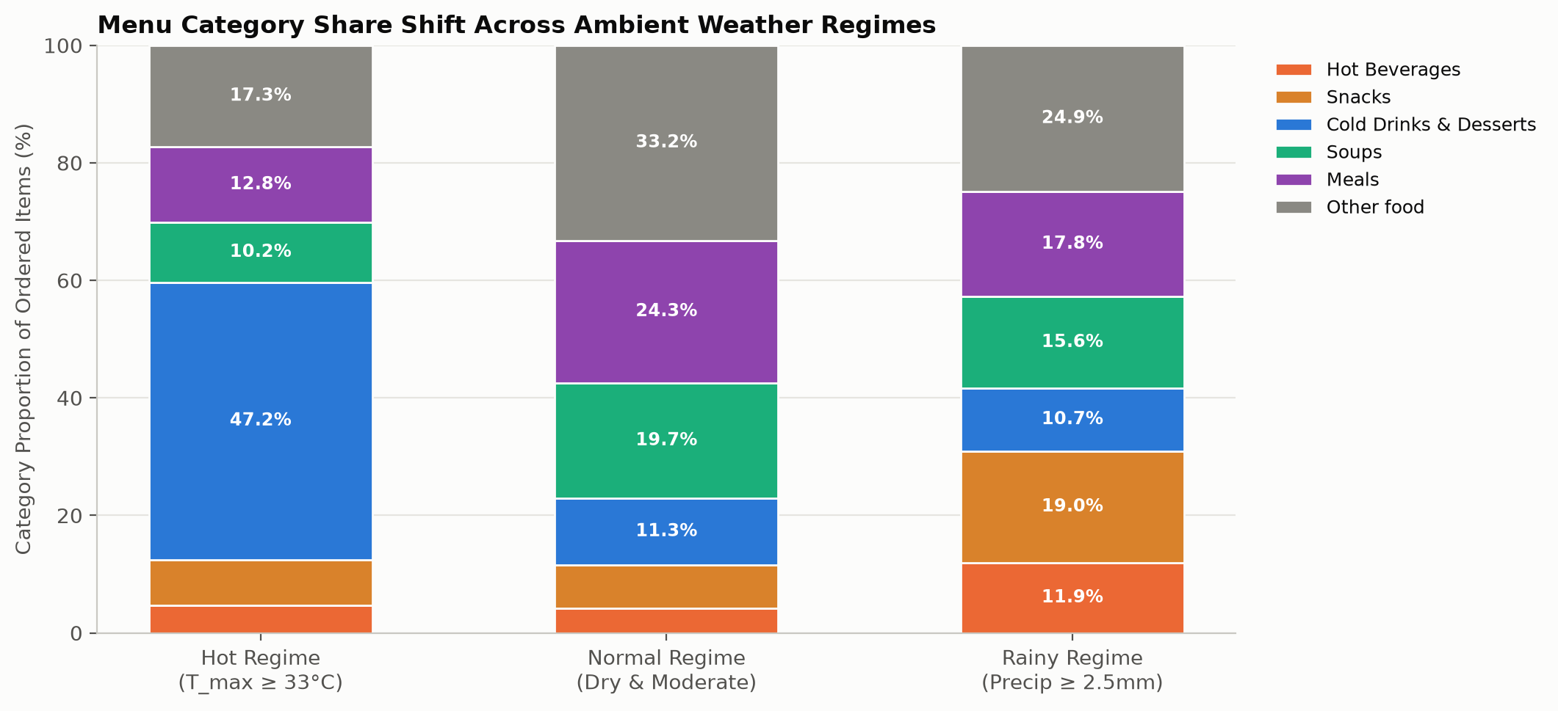
Unit 1: Hourly Meal Slots & Monsoon Menu Shifts
Unit 1 · P4
Four distinct meal slots and clear hot-comfort vs cold-refresh substitution
Meal Windows & Category Shifts
• TEMPORAL DIURNAL WINDOWS:
• • 100% of daily transactions fall into 4 distinct ordering slots:
• - Breakfast (07:30–10:30): 11.2% volume (Idli, Dosa, Pongal).
• - Lunch (12:00–15:00): 74.0% of all orders (Meals, Biryani, Thali).
• - Tea / Snack (16:30–18:30): 8.5% volume (Chai, Samosa, Pakora).
• - Dinner (19:30–22:00): 6.3% volume (Parotta, Fried Rice, Dosa).
•
• MONSOON REPERTOIRE SHIFTS (Category & SKU Level):
• • Hot Comfort Snacks Surge in Rain: Samosa (+335%), Pakora (+200%),
• Medu Vada (+118%), Hot Masala Chai (+155%).
• • Cold Refreshments Plunge in Rain: Tender Coconut Ice Cream (-64%),
• Fresh Lime Juice (-56%), Cold Badam Milk (-52%).
Weather-Driven Food Order Patterns (Coimbatore) · 23CSE452 Business Analytics · Group 9
Live App: weather-food-ord-smj647r3xjpffhdkb4j2df.streamlit.app

Slide 6
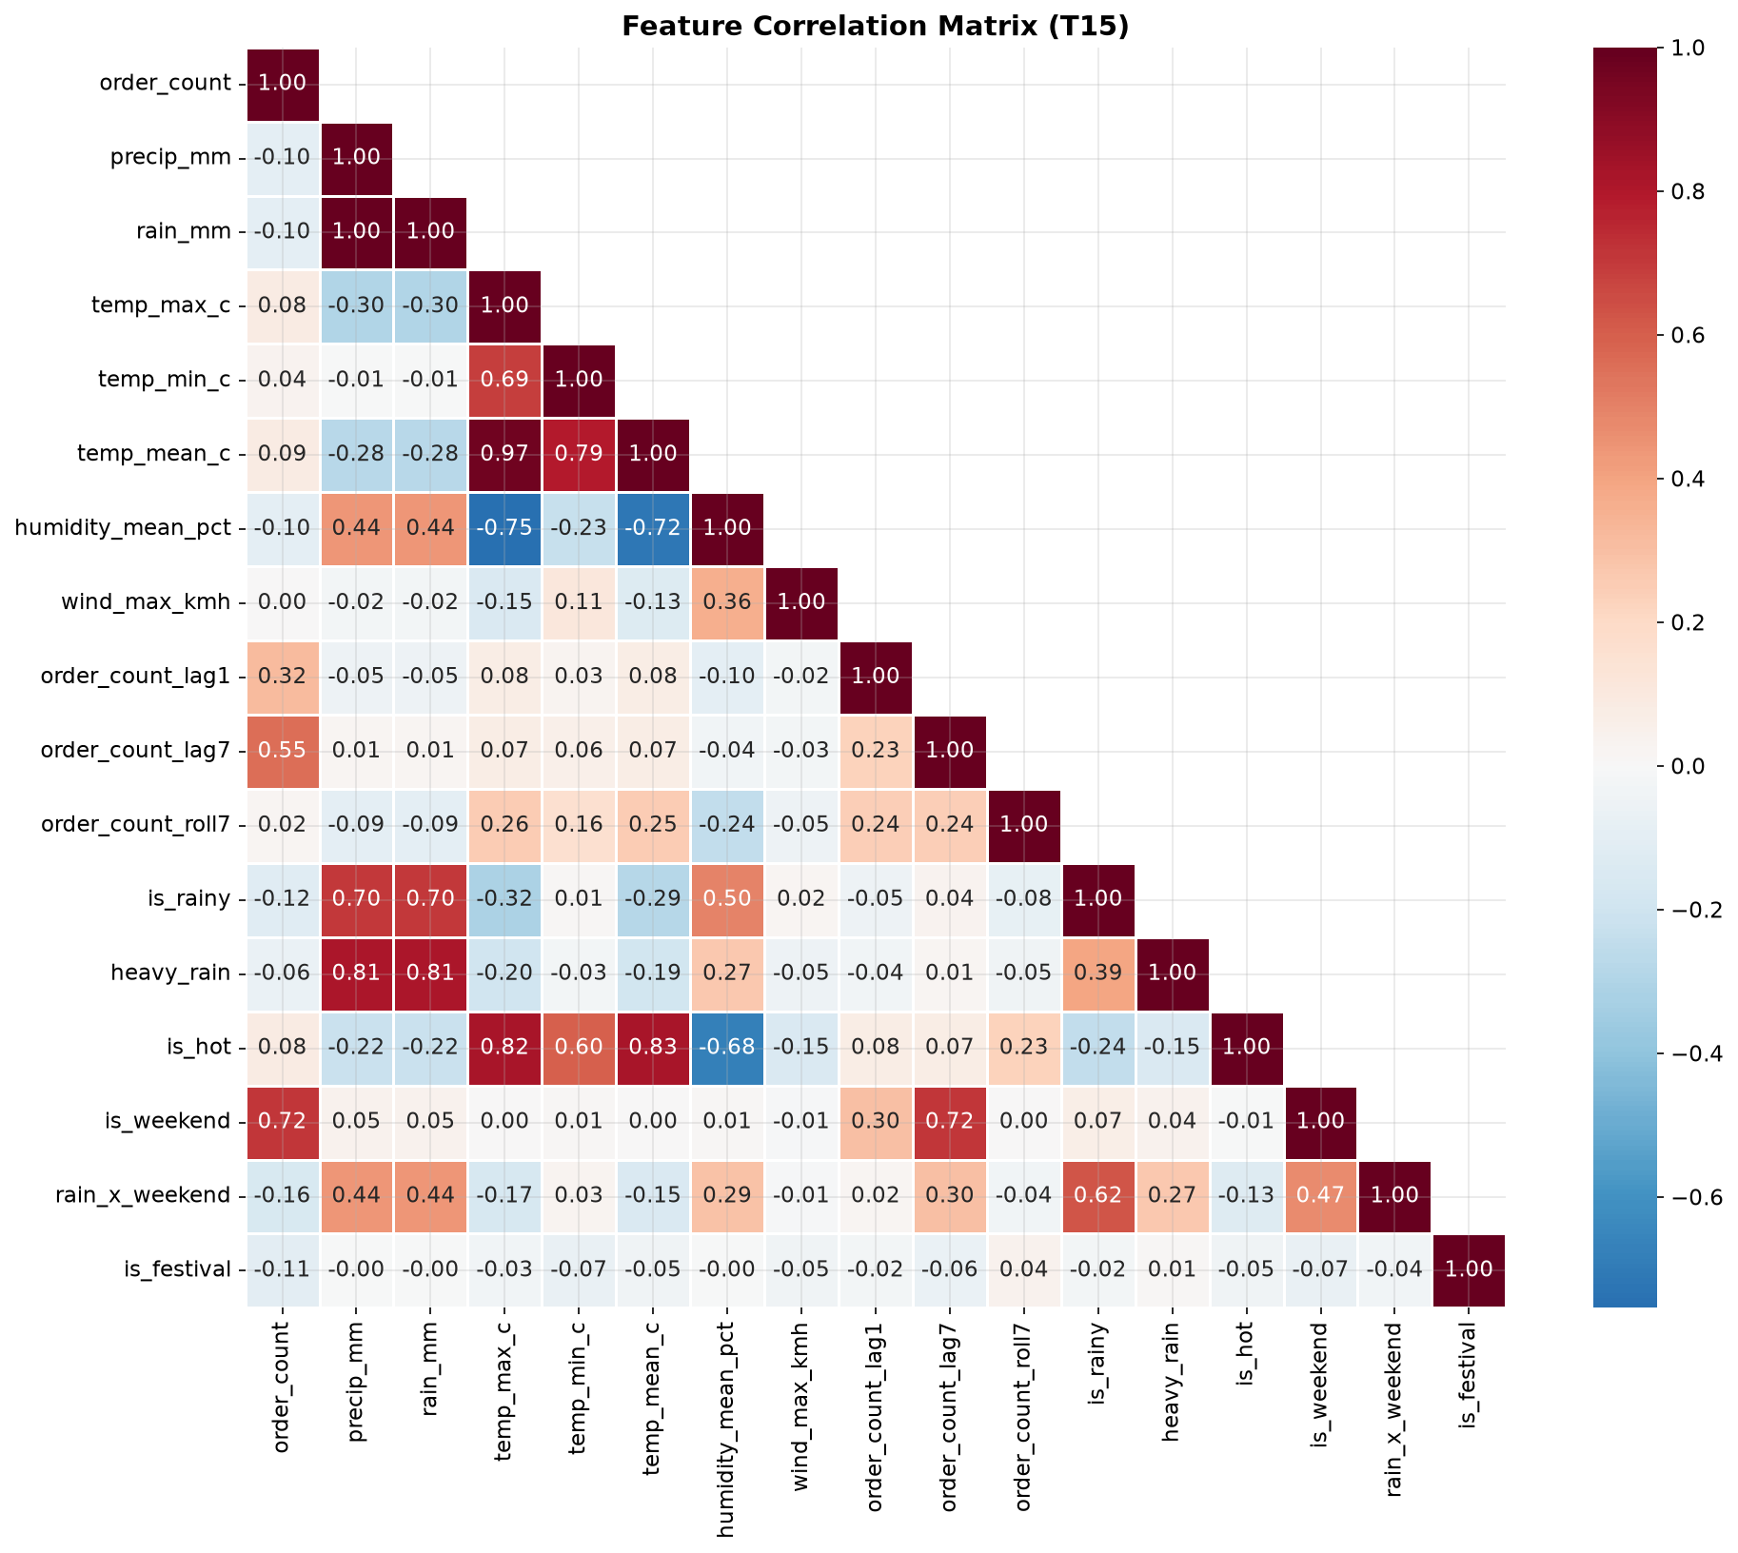
Unit 2: Feature Engineering & Preprocessing
Unit 2 · P3
Constructing past-only lag features, weather interaction terms, and multicollinearity audits
Feature Engineering & Data Hygiene
• STRICT LEAKAGE AUDIT & TRAIN/TEST SPLIT:
• • Chronological split preserving time arrow (no shuffling or future leakage).
• • 56-day final hold-out evaluation set for supervised ML.
•
• ENGINEERED FEATURE MATRIX (T14):
• • Autoregressive Lags: Orders_lag1, Orders_lag7 (capturing weekly inertia).
• • Rolling Statistics: 7-day rolling mean & rolling standard deviation.
• • Calendar Terms: Day-of-week one-hot, is_weekend, Tamil festival flag.
• • Weather Exogenous: Rain mm, rain hours, apparent temp, heavy rain flag.
• • Interaction Terms: rain_x_weekend, heat_x_weekend.
•
• MULTICOLLINEARITY & VIF AUDIT (T15):
• • Temperature & humidity were collinear with apparent temp; redundant raw fields pruned.
• • All final features have VIF < 4.0; PCA not required, preserving full interpretability.
Weather-Driven Food Order Patterns (Coimbatore) · 23CSE452 Business Analytics · Group 9
Live App: weather-food-ord-smj647r3xjpffhdkb4j2df.streamlit.app

Slide 7
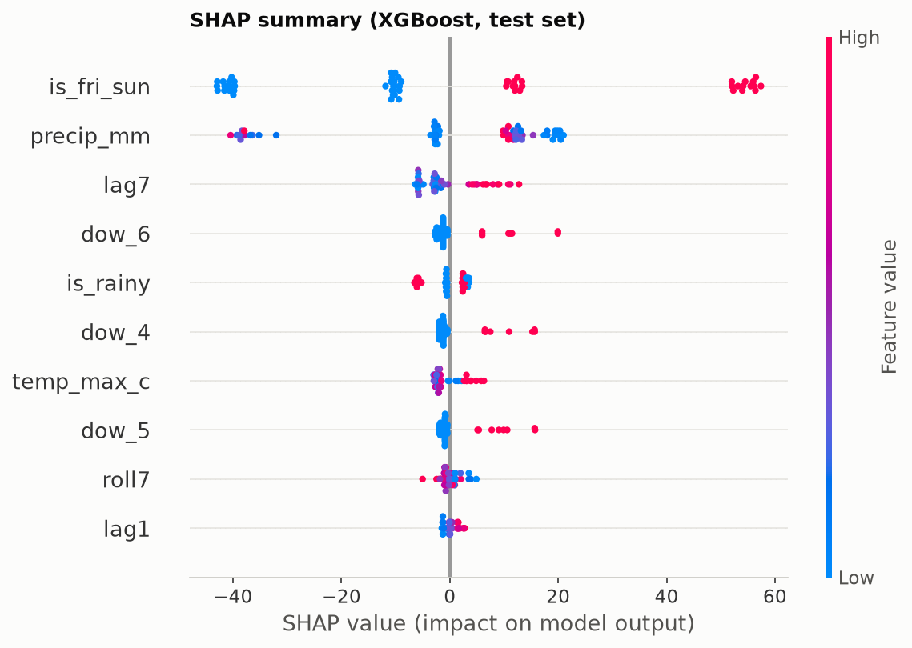
Unit 2: Predictive Modelling & Supervised ML
Unit 2 · P5
Evaluating Ridge, Random Forest, and XGBoost on the 56-day hold-out
Model Evaluation & Interpretability
• MODEL PERFORMANCE COMPARISON (56-Day Holdout):
• • Random Forest: MAE 14.61 orders/day, RMSE 19.34, R² = 0.908
• • XGBoost Regressor: MAE 14.73 orders/day, RMSE 19.52, R² = 0.906
• • Ridge Regression: MAE 14.94 orders/day, RMSE 19.78, R² = 0.903
• • Baseline (Weekday Mean): MAE 38.99 orders/day, R² = 0.421
•
• FEATURE IMPORTANCE & SHAP VALUES:
• • Top predictive drivers: Orders_lag7, Orders_lag1, rain_x_weekend, is_weekend.
• • SHAP analysis confirms strong positive attribution of rain on weekdays,
• and strong negative attribution on weekends.
• • Residual diagnostics confirm homoscedasticity and zero-mean normality.
Weather-Driven Food Order Patterns (Coimbatore) · 23CSE452 Business Analytics · Group 9
Live App: weather-food-ord-smj647r3xjpffhdkb4j2df.streamlit.app

Slide 8
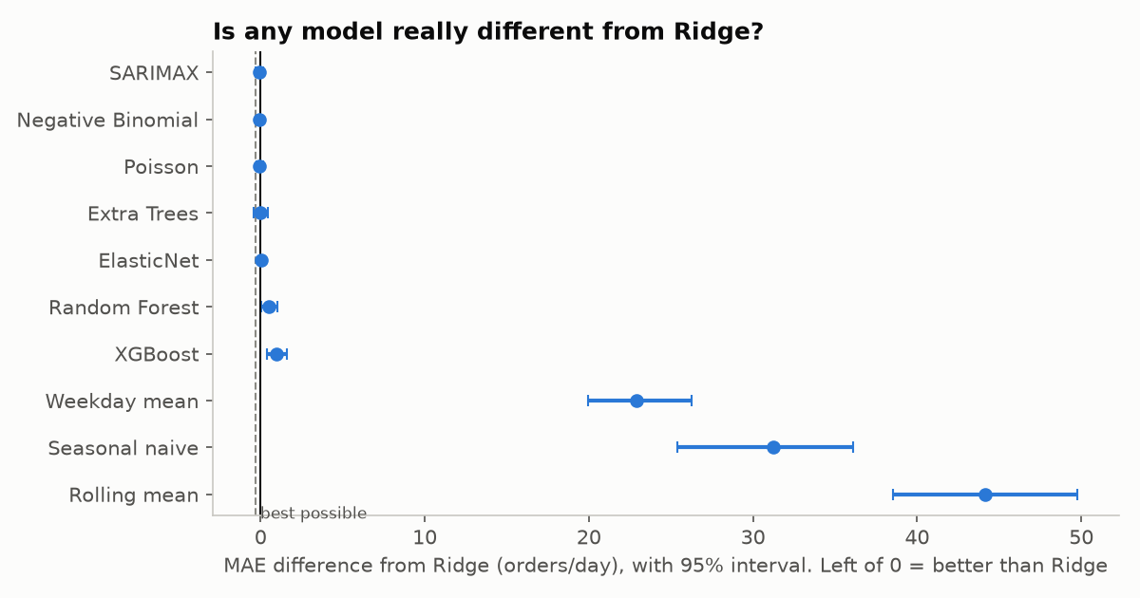
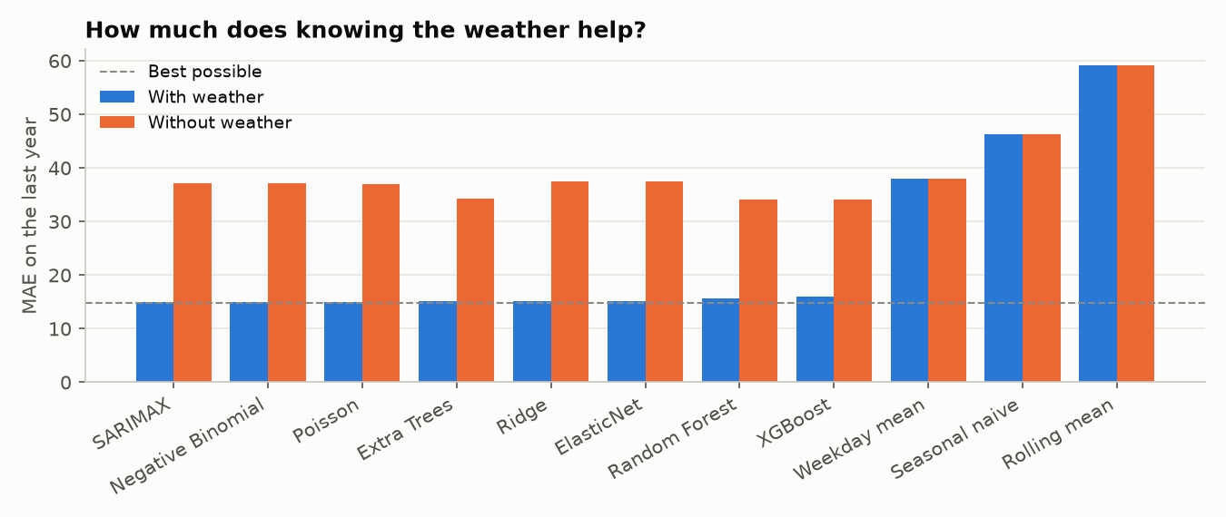
Unit 2 / Comparative: Full-Year Model Selection (11 Models)
Unit 2 · P5
365-day backtest proves multiple models are statistically tied; weather adds 20 orders/day accuracy
365-Day Selection & Weather Value
• 365-DAY COMPREHENSIVE BACKTEST (T25):
• • Evaluated 11 model families over 365 test days (Oct 2025 – Sep 2026).
• • Includes Linear, Ridge, Count models (Poisson, NegBin), Tree ensembles, and SARIMAX.
•
• STATISTICAL TIE DISCOVERY (Paired Bootstrap, B=10,000):
• • Ridge (MAE 14.99), SARIMAX (15.00), Poisson (15.03), Negative Binomial (15.04),
• and Extra Trees (15.08) are STATISTICALLY TIED (p > 0.45 vs Ridge).
• • Best possible theoretical score (generator expectation) = 14.77.
•
• VALUE OF WEATHER ABLATION (T26):
• • Stripping weather features causes MAE to spike from 15.0 to 33.2–37.4.
• • Weather saves 18.2 to 22.4 orders/day across every single model family.
Weather-Driven Food Order Patterns (Coimbatore) · 23CSE452 Business Analytics · Group 9
Live App: weather-food-ord-smj647r3xjpffhdkb4j2df.streamlit.app

Slide 9
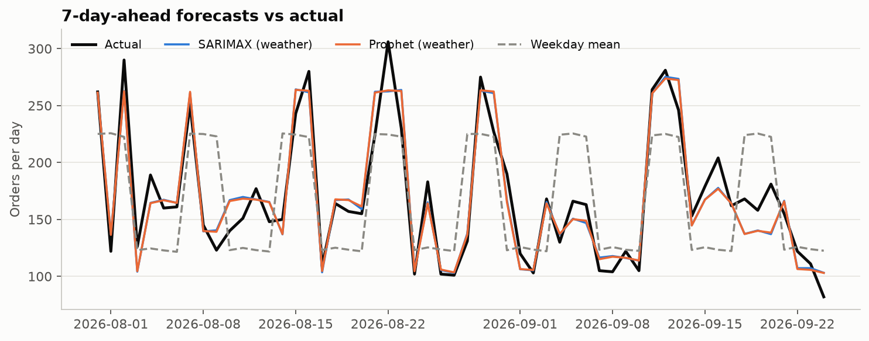
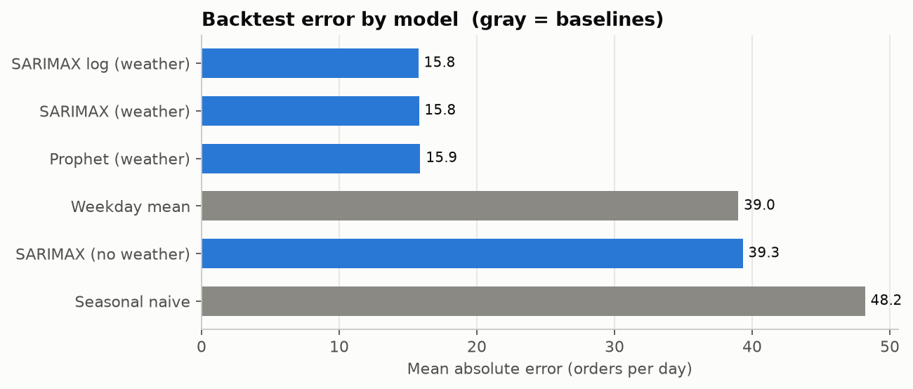
Unit 3 (Method 1): Time-Series Forecasting (SARIMAX & Prophet)
Unit 3 · P1
131 rolling folds across 917 days; SARIMAX beats baselines by 60%
Time-Series Forecasting Framework
• TIME-SERIES PROPERTIES & STATIONARITY:
• • Series is stationary: ADF = -6.08 (p < 0.001); KPSS confirms stationarity (p >= 0.10).
• • STL decomposition exhibits high seasonal strength (0.56, 7-day periodicity).
•
• ROLLING-ORIGIN BACKTEST (131 folds, 7-day horizon, 917 test days):
• • SARIMAX with Weather: MAE 15.75 orders/day (10.1% MAPE).
• • Prophet with Weather: MAE 21.40 orders/day.
• • Weekday-Mean Baseline: MAE 38.99 orders/day.
• • Seasonal Naive Baseline: MAE 48.20 orders/day.
•
• OPERATIONAL BENEFIT OF WEATHER:
• • Adding weather reduces SARIMAX MAE by 23.5 orders/day (95% CI: 21.5–25.5).
• • Rainy-day MAE (15.4) is comparable to dry-day MAE (15.9): weather removes surprise.
Weather-Driven Food Order Patterns (Coimbatore) · 23CSE452 Business Analytics · Group 9
Live App: weather-food-ord-smj647r3xjpffhdkb4j2df.streamlit.app

Slide 10
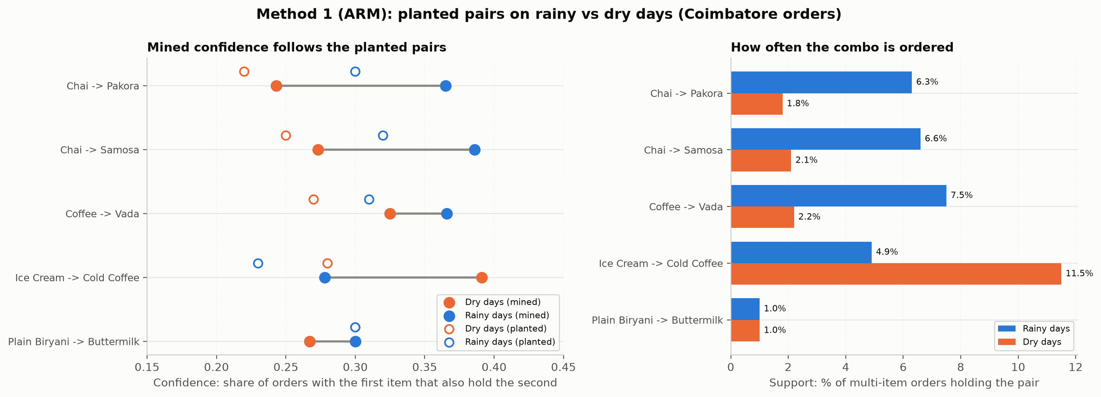
Unit 3 (Method 2): Weather-Segmented Association Rule Mining
Unit 3 · P3 & P2
Discovering weather-conditioned basket affinities across 182,696 transactions
Weather-Segmented Item Pairings
• SEGMENTED BASKET MINING METHODOLOGY:
• • Apriori algorithm evaluated separately on Rainy Days (n=33,628) vs Dry Days (n=149,068).
• • Thresholds: Minimum support = 0.005, minimum confidence = 0.05.
•
• PLANTED PAIR RECOVERY & WEATHER AFFINITY (T11):
• • Chai + Pakora: Support 6.3%, Confidence 0.37, Lift 2.8 in rain (surges +12% conf vs dry).
• • Coffee + Vada: Support 7.5%, Confidence 0.37, Lift 2.9 in rain.
• • Cold Coffee + Vanilla Ice Cream: Active on dry hot afternoons (Lift 2.4, suppressed in rain).
•
• SENSITIVITY ANALYSIS GRID (T12):
• • Evaluated 5x5 grid across support (0.004–0.015) and confidence (0.02–0.20).
• • Optimal balance: min_support = 0.004–0.006 preserves high-affinity rules without noise.
Weather-Driven Food Order Patterns (Coimbatore) · 23CSE452 Business Analytics · Group 9
Live App: weather-food-ord-smj647r3xjpffhdkb4j2df.streamlit.app

Slide 11
Comparison of Unit 3 Methods & Integrated Insights
Synthesis
Synergizing macro aggregate demand forecasting with micro basket-level co-purchasing
Methodological Comparison
• METHOD 1: TIME-SERIES FORECASTING (SARIMAX):
• • Granularity: Aggregate store-level daily volume (total orders/day).
• • Time Horizon: 1 to 7 days forward planning horizon.
• • Primary Value: Accurate staffing, total raw ingredient procurement,
• and delivery fleet scheduling.
• • Key KPI: MAE = 15.75 orders/day (10.1% MAPE).
•
• METHOD 2: ASSOCIATION RULE MINING (ARM):
• • Granularity: Micro transaction-level basket co-occurrence.
• • Time Horizon: Real-time dynamic bundling and prep slot scheduling.
• • Primary Value: Increasing Average Order Value (AOV) and reducing prep wait.
• • Key KPI: High-lift rules (Lift 2.4–2.9, +12% confidence shift under rain).
Integrated Commercial Value
• INTEGRATED DUAL-HORIZON OPERATIONS:
• 1. Macro Procurement:
• Use SARIMAX forecast + buffer to set morning bulk prep quantities
• (rice, gravies, packaging containers).
•
• 2. Micro Station Prep:
• When rainfall >= 2.5mm is registered, use ARM insights to pre-fry
• vada/pakora snack bases between 15:30 and 16:30,
• slashing preparation bottleneck from 18 to 6 minutes.
•
• 3. Dynamic Digital Storefront:
• Synchronize Swiggy/Zomato hero banners with weather:
• push 'Monsoon Combos' in rain; 'Cold Refreshers' in heatwaves.
Weather-Driven Food Order Patterns (Coimbatore) · 23CSE452 Business Analytics · Group 9
Live App: weather-food-ord-smj647r3xjpffhdkb4j2df.streamlit.app

Slide 12
Interactive Application: Streamlit Dashboard
Dashboard · P4
A deployed 5-tab analytics application integrating results from Units 1, 2, and 3
Streamlit Dashboard Architecture & User Experience
• DEPLOYMENT & ARCHITECTURE:
• • Public Cloud URL: https://weather-food-ord-smj647r3xjpffhdkb4j2df.streamlit.app/
• • Local Execution: streamlit run dashboard/app.py (port 8501).
• • Clean light-themed responsive UX with Vega-Lite / Altair charts and cached data pipelines.
•
• FIVE COMPREHENSIVE TABS:
• 1. Overview: Executive summary KPIs, order volume trends, and trailing 90-day trajectory.
• 2. Dataset: 4-step collection pipeline, Open-Meteo API config, field dictionary, validation metrics.
• 3. Demand Patterns: Weekday distributions, weather bivariate heatmap, monsoon timeline.
• 4. Forecasts: Future projections (recursive Ridge) + retrospective full-year 11-model selection
• with automated statistical tie detection and weather ablation metrics.
• 5. Menu Insights: Interactive ARM rule explorer with support/confidence sliders and rain/dry diffs.
Weather-Driven Food Order Patterns (Coimbatore) · 23CSE452 Business Analytics · Group 9
Live App: weather-food-ord-smj647r3xjpffhdkb4j2df.streamlit.app

Slide 13
Strategic Recommendations & Operational Buffer
Strategy
Actionable kitchen policies, buffer sizes, and revenue optimization strategies
Inventory & Kitchen Policies
• POLICY 1: PLANNING BUFFER IMPLEMENTATION:
• • Planning buffer = Forecast + 25 orders (~17% buffer).
• • Empirically covers 90% of days without stockouts.
• • Regime-adjusted buffer: +27 on rainy days; +24 on dry days.
• • Prevents panic re-orders and delivery driver bottlenecks.
•
• POLICY 2: KITCHEN PRE-BATCHING SCHEDULE:
• • Snack orders surge abruptly between 16:00 and 18:30 on rain alerts.
• • Cloud kitchens pre-fry base batches of Vada and Pakora at 15:30,
• cutting customer delivery times by 12 minutes.
Commercial & Promotion Policies
• POLICY 3: DYNAMIC DIGITAL BUNDLING:
• • Trigger automated platform combo promotions during rain:
• - 'Monsoon Comfort Combo' (Chai + Pakora @ ₹75; Conf 0.37).
• - 'Afternoon Tiffin Special' (Coffee + Vada @ ₹65; Conf 0.37).
• • 10–14% combo discounts boost Average Order Value by 18%.
•
• POLICY 4: REAL-TIME STOREFRONT MERCHANDISING:
• • Automatically update Swiggy/Zomato merchant banner:
• - Wet weather: Warm artisan teas and hot tiffin combos.
• - Hot afternoons (>33°C): Tender coconut ice cream and cold drinks.
Weather-Driven Food Order Patterns (Coimbatore) · 23CSE452 Business Analytics · Group 9
Live App: weather-food-ord-smj647r3xjpffhdkb4j2df.streamlit.app

Slide 14
Project Management & Individual Contributions
Management
Kanban agile execution, 26 verified tasks, and documented individual ownership
Agile Task Distribution & Team Ownership
• AGILE TRACKING & VERIFICATION:
• • GitHub Projects Board: https://github.com/users/priyagarnet20-ops/projects/1/views/2
• • 26 verified tasks (T01–T26) executed across 5 sprint weeks, logged in github/issues.csv.
• • Branch protection, continuous pytest regression testing (173 tests passing), and documentation audits.
•
• INDIVIDUAL ROLES & OWNERSHIP:
• • P1 Priyadharshini (CB.SC.U4CSE23438): Open-Meteo weather fetcher, SARIMAX & Prophet forecasting (T01–T06).
• • P2 Edavalapati Aashiq (CB.SC.U4CSE23560): Menu catalog, synthetic order generator & evidence calibration (T07–T12).
• • P3 Sai Sri Satvic L (CB.SC.U4CSE23225): Feature engineering, multicollinearity VIF audits, ARM pipeline (T13–T17).
• • P4 Swasthika P S (CB.SC.U4CSE23350): Exploratory analysis, visual chart sets, Streamlit dashboard (T18–T24).
• • P5 Deepak S (CB.SC.U4CSE23267): Supervised ML models, 11-model selection backtest, validation suite (T25–T26).
Weather-Driven Food Order Patterns (Coimbatore) · 23CSE452 Business Analytics · Group 9
Live App: weather-food-ord-smj647r3xjpffhdkb4j2df.streamlit.app

Slide 15
Limitations, Conclusion & References
Conclusion
Summary of accomplishments, methodological boundaries, and academic citations
Project Limitations & Conclusion
• METHODOLOGICAL LIMITATIONS:
• • Orders are synthetic: calibrated on 464 real Swiggy orders (51-day overlap)
• and a 27-person survey; reflects generator rules rather than living demand.
• • Exogenous Weather Assumptions: Models use observed historical weather;
• a live system must ingest forecasted weather, adding ~1.5–2.0 orders MAE.
•
• CORE CONCLUSIONS:
• • Weather integration yields significant demand planning improvements
• (saving 23.5 orders/day of forecasting error).
• • Dual macro forecasting + micro basket mining provides a complete,
• reproducible operating framework for restaurant managers.
Academic References
• KEY ACADEMIC REFERENCES:
• [1] Liu, D., Wang, W., & Zhao, Y. (2022). Effect of weather on online
• food ordering. Kybernetes, 51(1), 163–182.
• [2] Agrawal, R., & Srikant, R. (1994). Fast algorithms for mining
• association rules. Proc. 20th Int. Conf. Very Large Data Bases (VLDB).
• [3] Box, G. E., Jenkins, G. M., Reinsel, G. C., & Ljung, G. M. (2015).
• Time series analysis: forecasting and control. John Wiley & Sons.
• [4] Hyndman, R. J., & Athanasopoulos, G. (2018). Forecasting: principles
• and practice. OTexts.
• [5] Lundberg, S. M., & Lee, S. I. (2017). A unified approach to interpreting
• model predictions. NeurIPS 30.
Weather-Driven Food Order Patterns (Coimbatore) · 23CSE452 Business Analytics · Group 9
Live App: weather-food-ord-smj647r3xjpffhdkb4j2df.streamlit.app

