Slide 1
Weather-Driven Food Order Patterns
Coimbatore · Three-Year Analysis (Sep 2023 – Sep 2026)
REVIEW 1 · Business Analytics Capstone
Real Open-Meteo Weather | Evidence-Based Synthetic Orders (Swiggy + Survey) | Reproducible Pipeline
P1: Weather Data & Forecasting | P2: Menu Catalog & Order Generator | P3: Feature Engineering & ARM Prep
P4: Exploratory Data Analysis & Presentation | P5: Predictive Modeling
October 2026

Slide 2
Review 1 · Agenda & Team Assignments
TEAM OVERVIEW
10-minute capstone overview — one section per member
Presentation Agenda (approx. 10 minutes)
P1 · Weather Data & Dataset Documentation
1
~90 sec
Real Open-Meteo weather collection, data quality validation, 1,097-day dataset profile
P2 · Menu Catalog & Synthetic Order Generator
2
~90 sec
Generator built from real Swiggy orders + team survey, validated: 25 of 26 checks pass
P3 · Data Cleaning, Feature Engineering & ARM
3
~90 sec
Weather-orders merge, lag/rolling features, rain/heat flags, monsoon phase encoding
P4 · Exploratory Data Analysis [THIS SECTION]
4
~90 sec
Distribution analysis, weekday & hourly patterns, rain vs dry, correlations, 10 charts
P5 · Predictive Modeling & Evaluation
5
~90 sec
Ridge, Random Forest, XGBoost: R² 0.90, weather cuts error by 60%
Weather-Driven Food Order Patterns · Coimbatore · BA Capstone 2026
Slide 2 / 14

Slide 3
P1 · Real Weather, Synthetic Orders, Fully Documented
P1 · T02, T03
Data sources · collection method · quality validation · 3-year profile
Weather Data (REAL — Open-Meteo API)
SOURCE: Open-Meteo Historical Weather API
Location: 11.00°N, 76.99°E (Coimbatore, CBE)
Date Range: 24 Sep 2023 – 24 Sep 2026 (1,097 days)
Variables: Precipitation, Rain, Temp Max/Min/Mean,
Wind, Humidity, Weather Code, Daylight Duration
QUALITY CONTROLS PASSED:
No gaps · No nulls · No duplicate dates
temp_max >= temp_min on every day
24 hourly values validated per day
Offline pytest suite: 18 tests, all passing
WEATHER PROFILE (3 years):
Total rain: 3,599 mm across 329 rainy days
Heavy rain days (>=15mm): 67 days
Hot days (T_max >= 33°C): 300 days
Festival days: 41 (Tamil Nadu/Coimbatore calendar)
Evidence-Based Synthetic Orders (P2 Generator)
Orders are SYNTHETIC, every rule taken from evidence:
Swiggy report, Hotel Chinthamani (464 real orders)
Team survey (27 adult Coimbatore respondents)
Snack/drink prices from Coimbatore outlet menus
DAILY DEMAND MODEL (fitted on real Swiggy days):
Y_t ~ NegativeBinomial around mu_t, seed 42
Weekend (Fri-Sun): x2.47
Rain: x1.56 on weekdays, x0.54 on weekends
Heat (T_max >= 33°C): x1.07 · Festival: x0.89 (survey)
DATASET SUMMARY:
182,696 orders across 1,097 days, 80-item menu
Mean: 166.5 orders/day | Range: 73–354
Validated vs Swiggy + survey: 25 of 26 checks pass
Weather-Driven Food Order Patterns · Coimbatore · BA Capstone 2026
Slide 3 / 14

Slide 4
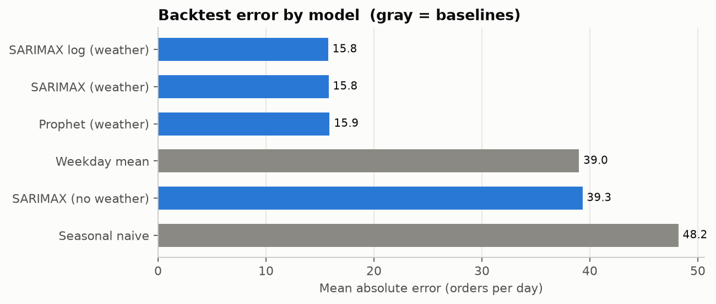
P1 · Time-Series Order-Volume Forecasting
P1 · T04, T05, T06
SARIMAX + Prophet rolling-origin backtest — does weather knowledge help?
Method & Setup (T04, T05)
SERIES PROPERTIES:
Stationary (ADF p < 0.001, KPSS p >= 0.10)
Strong weekly pattern (Fri-Sun peaks)
No detectable yearly trend
MODELS TESTED:
Seasonal Naive (same weekday 1 week earlier)
Weekday Mean baseline
SARIMAX (no weather / with weather regressors / log)
Prophet (with festival flags)
BACKTEST DESIGN:
131 rolling-origin folds — 7-day forecast horizons
First 180 days training, walk-forward validation
Weather given as observed (oracle upper bound)
Results & Business Interpretation (T06)
BEST MODEL: SARIMAX with Weather Regressors
MAE: 15.8 orders/day (MAPE: 10.1%)
Weekday-mean baseline: MAE = 39.0
Seasonal naive: MAE = 48.2
WEATHER KNOWLEDGE EFFECT:
Adding weather (incl. rain x weekend) lowers SARIMAX
error by 23.5 orders/day (-60%), 95% CI 21.5-25.5
Rain/dry error: 15.4 vs 15.9 once weather is known
OPERATIONAL PLANNING BUFFER:
Add 25 orders (17%) above forecast to cover 90% of days
Use 27 orders buffer on rainy days, 24 on dry days
Forecast is within 0.2 MAE of theoretical best possible
Weather-Driven Food Order Patterns · Coimbatore · BA Capstone 2026
Slide 4 / 14

Slide 5
P2 · Menu Catalog & Weather-Driven Order Generator
P2 · T07, T08, T09, T10
Real Chinthamani menu · survey-backed weather combos · validated against real orders
Menu Architecture (T07)
80 items:
70 real Hotel Chinthamani dishes (Swiggy, Aug-Sep 2026)
Meals, soups, biryani, Chinese, starters, breads
10 snacks & drinks named in the survey
Chai, Coffee, Samosa, Pakora, Bajji, Vada,
Ice Cream, Cold Coffee, Lime Juice, Buttermilk
prices: median of Coimbatore outlet listings
ORDERS:
Food orders = resampled real Swiggy baskets
Snack/drink share by weather (survey):
hot 54% · rainy 35% · normal 18%
HOURS (real Swiggy profile, 11:00-23:00):
Lunch 74% · Evening snacks 10% · Dinner 17%
Planted Item Associations & Ground Truth (T09, T10)
PLANTED ASSOCIATION RULES (Ground Truth for ARM):
Strengths = survey frequency score / 4 (Q12-Q16)
RAINY DAY COMBOS:
Chai -> Pakora P(rain)=0.30 vs P(dry)=0.22
Chai -> Samosa P(rain)=0.32 vs P(dry)=0.25
Coffee -> Vada P(rain)=0.31 vs P(dry)=0.27
HOT DAY COMBO:
Ice Cream -> Cold Coffee hot 0.31 · normal 0.28 · rain 0.23
ALL-WEATHER PAIR (survey shows no weather effect):
Any Biryani -> Buttermilk 0.30 in all weather
VALIDATION (docs/validation.md): all 5 pairs recovered
by association rules at the planted strength.
Weather-Driven Food Order Patterns · Coimbatore · BA Capstone 2026
Slide 5 / 14

Slide 6
P3 · Data Cleaning, Feature Engineering & ARM Preparation
P3 · T13, T14, T15, T16, T17
Weather-orders merge · lag features · rain flags · monsoon phases · FP-Growth setup
Preprocessing & Feature Engineering
DATA CLEANING (T13):
Joined orders.csv to weather.csv on date (1,097 rows)
Parsed date/timestamp types; checked for gaps & nulls
No duplicates found; no IQR outliers warranting removal
Log of every transformation step recorded
FEATURE ENGINEERING (T14):
Lag-1, Lag-7 order counts (no leakage — past only)
7-day rolling mean of past orders
Rain flag (>=2.5mm) + heavy rain flag (>=15mm)
Rain bins: none / trace / moderate / heavy
Temperature bands: cool / warm / hot / extreme
Weekend flag (Fri-Sat-Sun) + festival flag
Rain x weekend interaction (rain lifts weekdays,
lowers weekends)
Monsoon phase: SW Monsoon (Jun-Sep), NE Monsoon (Oct-Dec)
FEATURE SELECTION (T15):
Correlation matrix + Variance Inflation Factor (VIF)
All VIF < 4; PCA not required
ARM Preparation & Initial Results (T16, T17)
ARM STATUS (T16, T17 — OPEN):
Preparation and FP-Growth are not yet complete
No implementation PR or results are available
REVIEW 2 OWNERSHIP:
P3: T16 data prep + T17 FP-Growth implementation
P2: T11 rainy/dry evaluation + T12 threshold sensitivity
Weather-Driven Food Order Patterns · Coimbatore · BA Capstone 2026
Slide 6 / 14

Slide 7
P4 · Exploratory Data Analysis — Overview & Method
P4 · T19, T20
1,097 days · 182,696 transactions · 80 menu items · Coimbatore weather
Five analytical dimensions explored in this EDA:
01
Distribution Analysis
Daily order volumes, basket sizes, order values across the full 3-year sample
02
Temporal Patterns
Weekday-of-week demand profiles and hourly meal slot clustering
03
Rain vs. Dry Comparison
Rain effect by day type, significance testing, intensity gradient
04
Item & Category Substitution
Weather-driven menu preference shifts — hot comfort vs cold refresh substitution
05
Correlation Heatmap
Multi-variable Pearson correlation between weather features and order metrics
Weather-Driven Food Order Patterns · Coimbatore · BA Capstone 2026
Slide 7 / 14

Slide 8
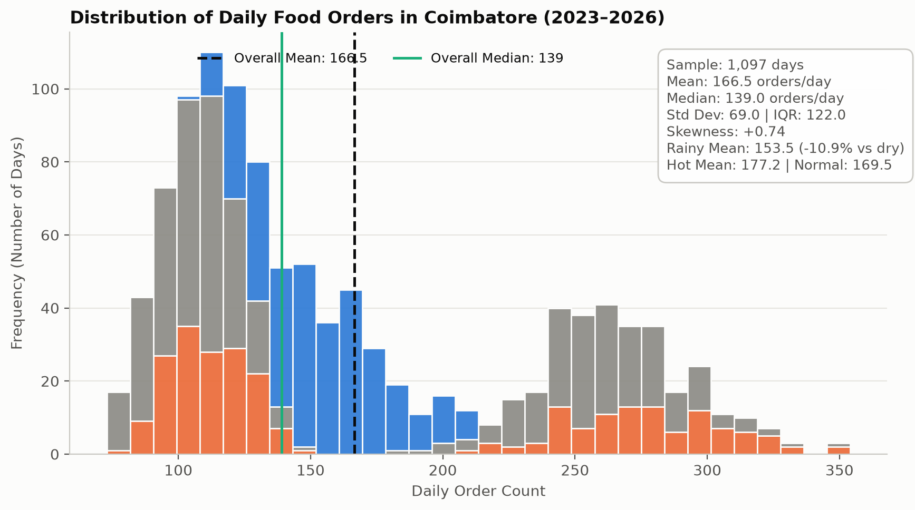
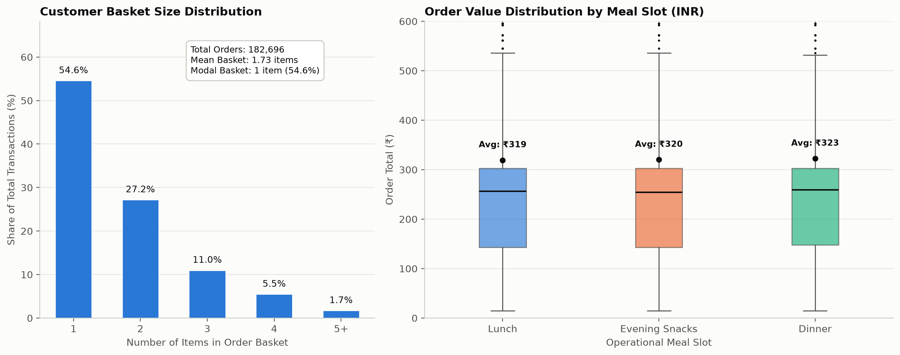
P4 · Daily Order Distributions: Volume, Baskets & Spend
P4 · T19 — Fig 01, 02
Two-humped demand (weekday vs weekend) · single-item orders dominate · Rs.255 median order
• Mean: 166.5 orders/day | Median: 139 | StdDev: 69.0 | IQR: 122 | weekday hump ~110-170, weekend hump ~220-300
• Rainy days: 153.5 orders/day with a narrow spread (SD 24 vs 80 on dry days) — rain flattens the week
• Modal basket: 1 item (54.6%, real Swiggy: 65%) | Mean basket: 1.73 items | Avg spend: Rs.320
Weather-Driven Food Order Patterns · Coimbatore · BA Capstone 2026
Slide 8 / 14

Slide 9
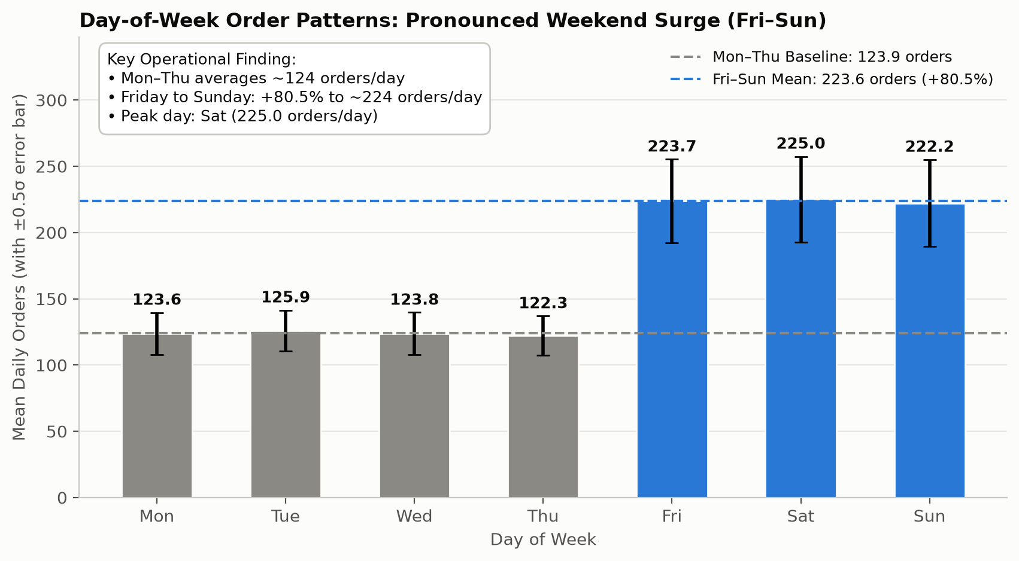
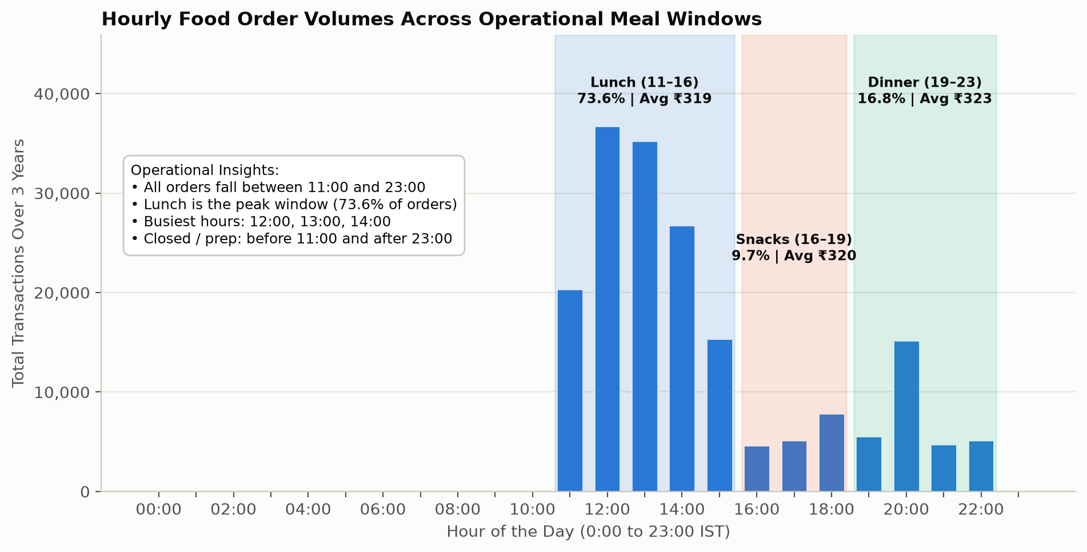
P4 · Temporal Demand Patterns: Weekday & Hourly
P4 · T19 — Fig 03, 04
~+80% weekend surge on dry days · lunch carries 74% of orders
• Mon-Thu: ~124 orders/day · Fri-Sun: ~224 orders/day (+80%) — weekend size taken from real Swiggy orders (x2.47)
• Lunch (11:00-16:00) carries 73.6% of orders, peaking at 12:00-13:00. Dinner 16.8% (spike at 20:00). Evening snacks 9.7%.
• All orders between 11:00 and 23:00 (real trading hours) — before 11:00 and 15:00-16:00 are prep windows.
Weather-Driven Food Order Patterns · Coimbatore · BA Capstone 2026
Slide 9 / 14

Slide 10
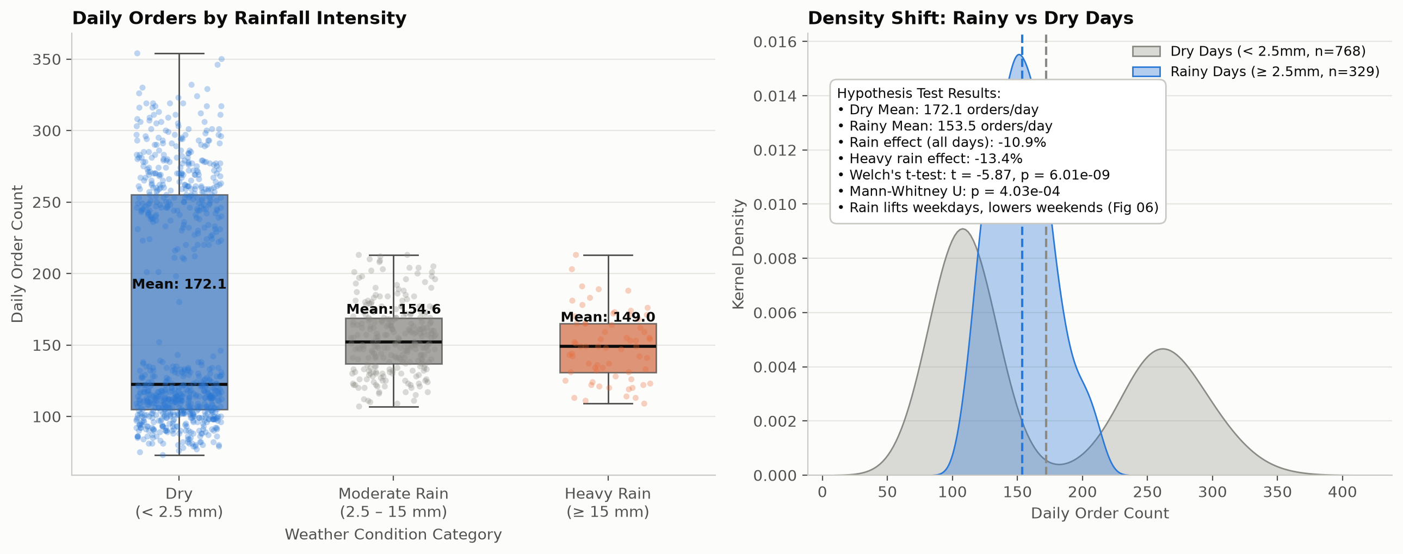
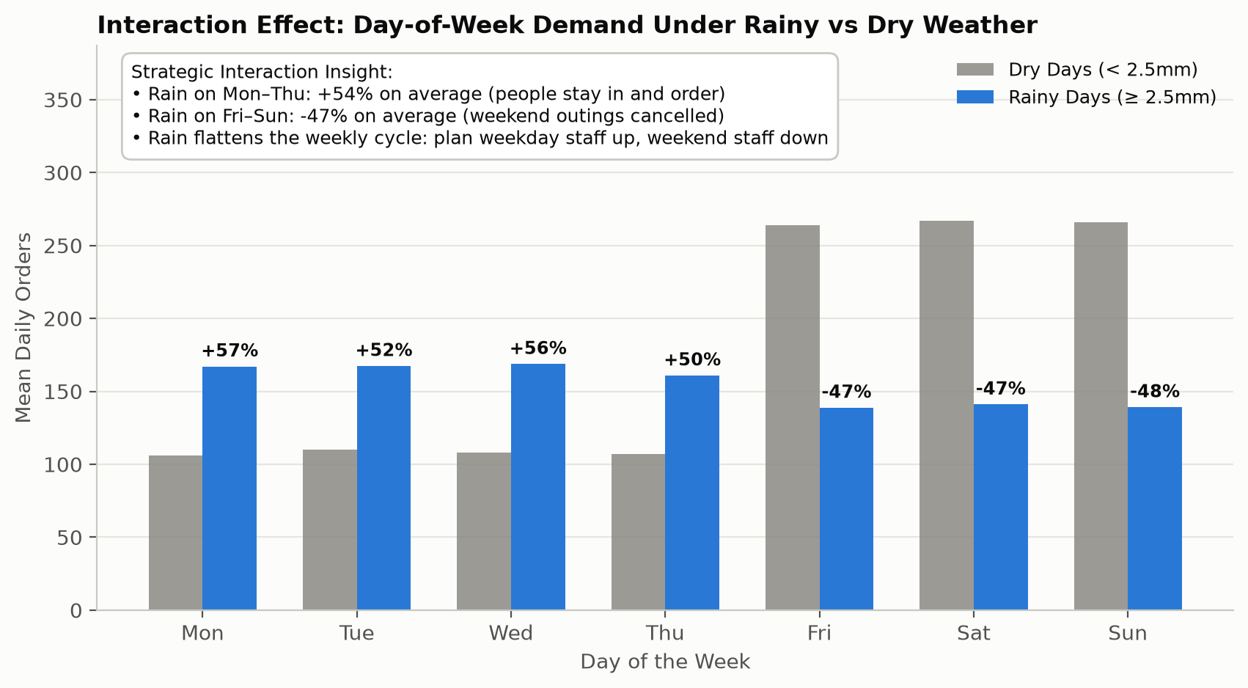
P4 · Rain Lifts Weekdays +54% but Cuts Weekends -47%
P4 · T19 — Fig 05, 06
Pooled: rainy 153.5 vs dry 172.1/day (-10.9%, p = 6×10⁻⁹) hides two opposite effects
• Mon-Thu: rain lifts orders 107.9 -> 165.9 (+54%) — people stay in and order (real Swiggy: x1.56).
• Fri-Sun: rain cuts orders 265.5 -> 139.6 (-47%) — weekend outings cancelled (real Swiggy: x0.54; survey agrees).
• Pooled test: Welch t = -5.87, p = 6.0×10⁻⁹; Mann-Whitney p = 4.0×10⁻⁴. Models need a rain x weekend term.
Weather-Driven Food Order Patterns · Coimbatore · BA Capstone 2026
Slide 10 / 14

Slide 11
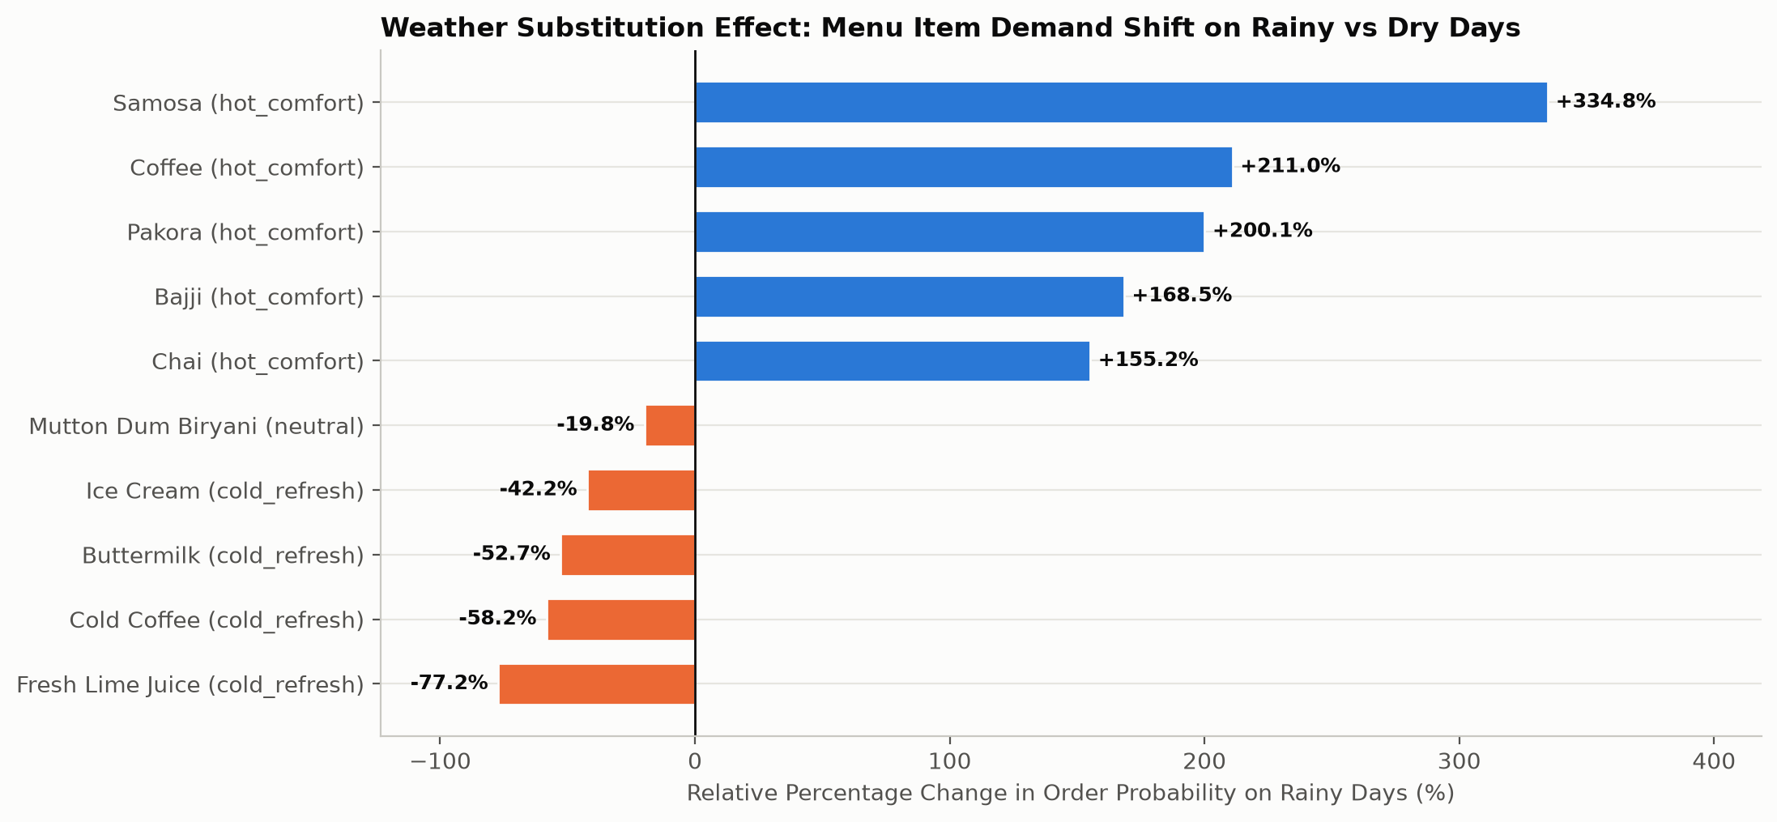
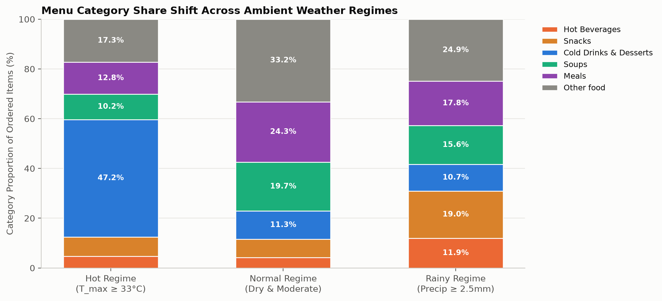
P4 · Monsoon Menu Effect: Hot Comfort vs Cold Refresh Substitution
P4 · T19 — Fig 07, 08
Samosa +335% · Pakora +200% · Chai +155% on rainy days vs Lime Juice -77% · Ice Cream -42%
• Rainy days: Samosa, Coffee, Pakora, Bajji, Chai triple their share of items — the snacks the survey names for rain (Q9).
• Hot days: cold drinks & ice cream reach 47% of items (vs ~11% otherwise) — survey Q10: ice cream, lime juice, cold coffee.
• Soups rise on rainy days (15.6% vs 10.2% hot), matching the real Swiggy soup tilt. Restaurant food baskets stay real.
Weather-Driven Food Order Patterns · Coimbatore · BA Capstone 2026
Slide 11 / 14

Slide 12
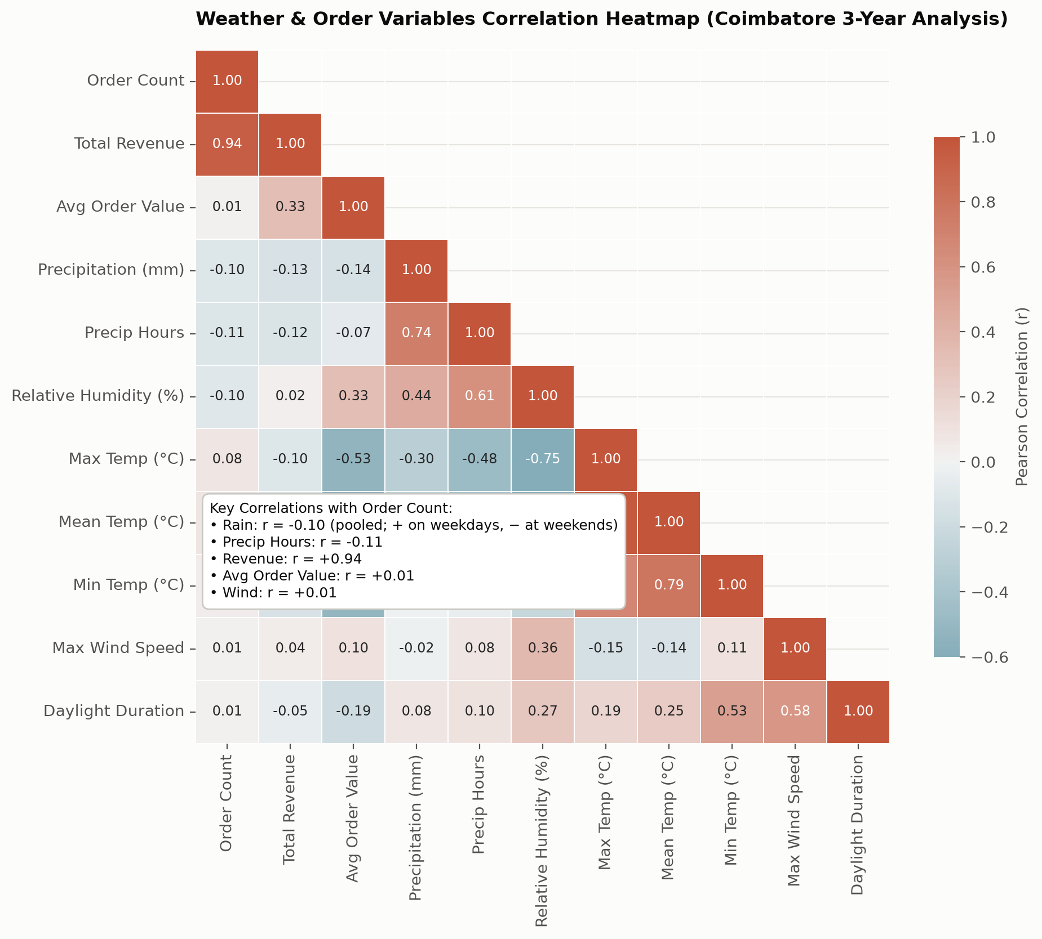
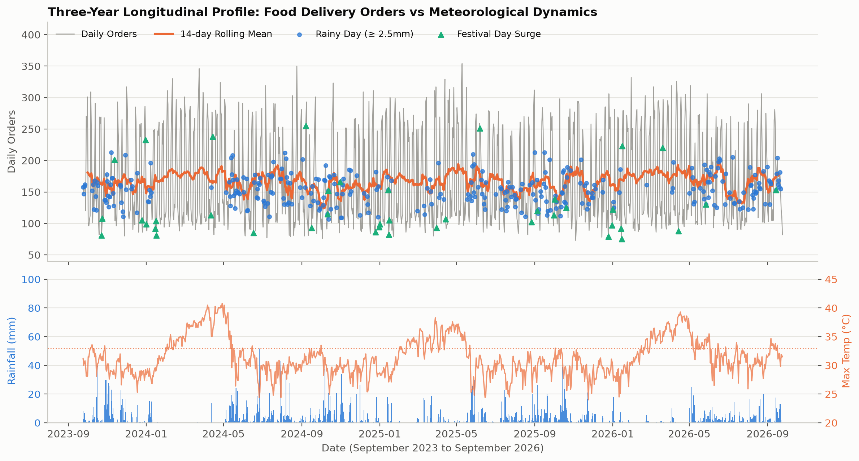
P4 · Weather-Orders Correlation Heatmap & Three-Year Timeline
P4 · T19 — Fig 09, 10
Pooled rain r≈-0.10 hides the weekday/weekend split · Revenue r=+0.94 · Wind r≈0.00
• Pooled correlation of rain with orders is weak (r=-0.10) because the weekday lift and the weekend drop cancel out.
• A correlation matrix cannot show an interaction — Fig 06 and models with rain x weekend can. Revenue tracks orders (r=+0.94).
• Wind speed and daylight duration are operationally irrelevant (r approx 0.01).
Weather-Driven Food Order Patterns · Coimbatore · BA Capstone 2026
Slide 12 / 14

Slide 13
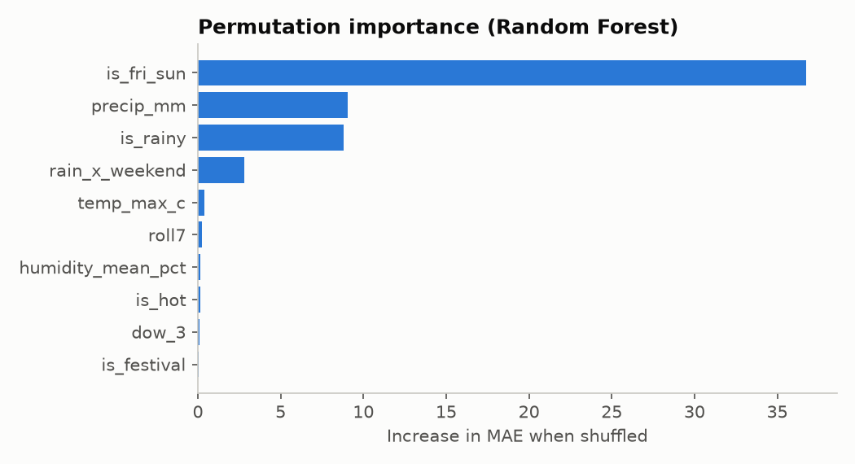
P5 · Predictive Modeling: Ridge, Random Forest, XGBoost
P5 · T25, T26
56-day hold-out test · MAE/RMSE/R² comparison · Feature importance & SHAP
Model Design (T25)
OBJECTIVE: Predict daily order volume
from weather + calendar + lag features
FEATURE SET:
Lagged orders: lag1, lag7, roll7
Weather: rain flag, heavy_rain, is_hot,
precip_mm, temp_max_c, humidity_mean_pct
Calendar: dow (0-6), is_weekend, is_festival
Interaction: rain x weekend
Monsoon phase: SW / NE / other
TIME-BASED SPLIT:
Training: first 1,034 feature-ready days
Test: last 56 days (8 weeks held out)
No data leakage — lag features use past only
TUNING: TimeSeriesSplit cross-validation
Hyperparameters tuned on training window only
Evaluation & First Business Findings (T26)
MODEL PERFORMANCE (56-day test set):
Model MAE RMSE R2 MAPE
Seasonal Naive 58.2 71.4 -0.56 36.1%
Ridge 14.9 18.6 +0.89 8.7%
Random Forest 14.6 18.3 +0.90 8.6% BEST MAE
XGBoost 14.7 18.1 +0.90 8.8%
KEY FINDINGS (T26):
Weather inputs cut MAE by 60-64% in every model
Importance: Fri–Sun, precipitation, rain flag, rain x weekend
RMSE 18.3 is at the noise floor (~19.9): no room left to tune
90% of days within ±28 orders (16% of volume)
Weather-Driven Food Order Patterns · Coimbatore · BA Capstone 2026
Slide 13 / 14

Slide 14
Review 1 · Summary of Key Findings & Review 2 Roadmap
ALL MEMBERS
What we found · What we recommend · What comes next in Review 2
Consolidated Key Findings (R1)
FINDING 1 — RAIN WORKS DIFFERENTLY BY DAY TYPE
Rainy weekdays +54%, rainy weekends -47% (real Swiggy evidence)
Rain flattens the weekly cycle; pooled, rainy days are 10.9% lower
FINDING 2 — WEEKEND IS THE BIGGEST CALENDAR DRIVER
~124 orders/day Mon–Thu vs ~224 Fri–Sun on dry days (+80%)
FINDING 3 — MENU SUBSTITUTION IS DRAMATIC
Rain triples samosa, pakora, chai shares; heat: cold drinks 47%
Combos: chai+samosa/pakora (rain), ice cream+cold coffee (heat)
FINDING 4 — WEATHER MAKES FORECASTS ~60% MORE ACCURATE
Best MAE 14.6/day (R2=0.90) vs naive 58.2; weather: -60% error
SARIMAX forecast: weather lowers error by 23.5 orders/day (-60%)
DATA: generator validated vs Swiggy + survey (25/26 checks)
Review 2 Roadmap & Open Questions
REVIEW 2 WORK AHEAD:
P2: ARM evaluation (T11) + threshold sensitivity (T12)
Compare rainy vs dry rules; test support/confidence settings
P3: ARM preparation + FP-Growth (T16, T17)
Transaction encoding, itemsets and association rules
P1: Time-Series Forecasting — SARIMAX + Prophet
Rolling-origin backtest, 131 folds (T05, T06)
P5: Monsoon Lift Timeline
14-day rolling lift of weather-linked combos (T27)
P4: Interactive Dashboard (Streamlit)
Forecast view + ARM explorer + monsoon chart (T22, T23, T24)
ALL: Final Notebook Integration (T29)
Final report, combined insights (T18, T28, T29)
GITHUB: All code in one repo — no external data used
Weather-Driven Food Order Patterns · Coimbatore · BA Capstone 2026
Slide 14 / 14

