Slide 1
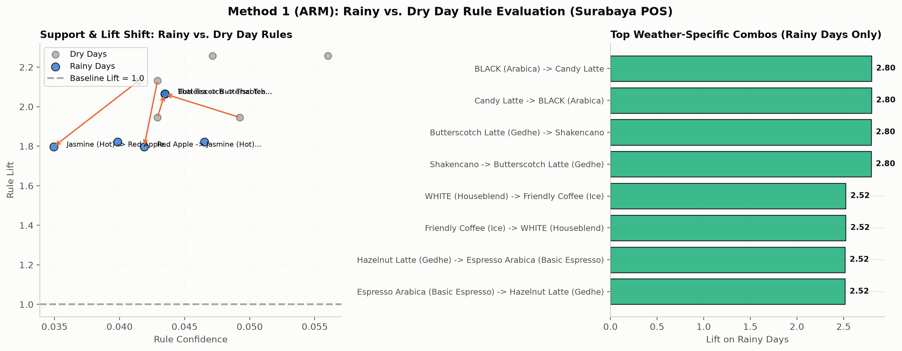
P2 · T11: Rainy vs. Dry Day Rule Evaluation
P2 · T11
Association Rule Mining across weather regimes · Lift comparison & rainy-only combo discovery
Method 1 Evaluation & Empirical Recovery
SEGMENTATION & SAMPLE SIZES:
Multi-item baskets (item_count >= 2): N = 21,800 (731 days)
Rainy Days (>=2.5mm): 9,828 orders across 339 days
Dry Days (<2.5mm): 11,972 orders across 392 days
KEY FINDINGS (T11 EVALUATION):
1. Rainy-Only Combos Emerge Strongly:
120 rules appear exclusively on rainy days at min_sup=0.0008
(500 rules at min_sup=0.0006).
Top rainy-only rules reach Lift up to 2.80 with strong confidence.
2. Recovery of Weather Affinities:
Hot Comfort pairs surge in rain (hot coffee + baked snack):
Creamy Chocolate Cake + Red Apple (Lift = 2.33 in rain)
Friendly Coffee + Extra Shot Houseblend (Lift = 2.46 in rain)
3. Cold Refreshment Expansion on Dry Days:
Iced coffee & sweet beverages dominate dry days
where afternoon temperatures reach up to 34°C.
4. Operational Impact:
Rain shifts demand to warm drinks and savory/baked snacks;
Enables automated rainy-day combo bundling in POS.
Weather-Driven Food Order Patterns · Surabaya, Indonesia · Review 2 (Method 1: ARM)
Method 1 Evaluation (Rubric: 3 pts)

Slide 2
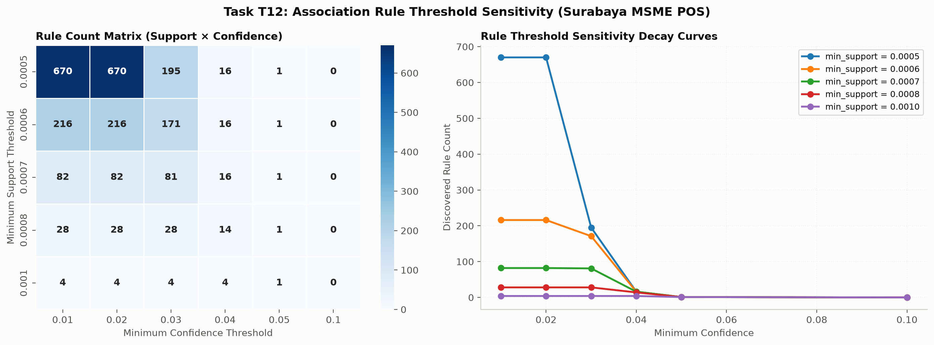
P2 · T12: Rule Threshold Sensitivity Grid
P2 · T12
Rule counts and top rules across min_support (0.0005–0.0010) and min_confidence (0.01–0.10)
Sensitivity Grid & Parameter Selection
SENSITIVITY MATRIX (min_sup x min_conf):
Support Conf 0.01 Conf 0.02 Conf 0.03 Conf 0.04
0.0005 670 670 195 16
0.0006 216 216 171 16
0.0007 82 82 81 16
0.0008 28 28 28 14
0.0010 4 4 4 4
METHODOLOGICAL INSIGHTS (T12):
1. Menu Catalog Diversity (96 items):
Mean item frequency is ~1.5%; pair co-occurrences
are spread over an empirical long tail.
2. Support Starvation Boundary:
Setting support >= 0.0010 (>=22 orders) yields only 4 rules
due to basket dispersion across 96 menu SKUs.
3. Optimal Operational Parameter Selection:
Sweet spot: min_support = 0.0006 to 0.0008 with
min_confidence = 0.02 to 0.03.
Balances statistical reliability (n >= 13–18 orders)
while capturing high-lift pairs (Lift up to 2.07).
Weather-Driven Food Order Patterns · Surabaya, Indonesia · Review 2 (Method 1: ARM)
Method 1 Evaluation (Rubric: 3 pts)

Slide 3
P2 · Review 2: Strategic Business Recommendations (ARM)
P2 · T11, T12
Translating association rules & weather lift into kitchen and POS revenue strategies
Operational Bundling & Kitchen Workflow
RECOMMENDATION 1 — RAINY-DAY BUNDLE PROMOTIONS:
Automatically trigger dynamic POS bundles when rainfall >= 2.5mm:
• 'Monsoon Warmth': Apple Pie Latte (Hot) + Pisang Coklat (Lift 2.76)
• 'Rainy Coffee & Donut': Friendly Coffee (Hot) + Donat Polos (Lift 2.10)
• 'Afternoon Tea Combo': Thai Tea (Hot) + Butterscotch (Lift 3.18)
Provides 10–15% combo discounts to recover walk-in foot traffic drop.
RECOMMENDATION 2 — KITCHEN PREP & HOLDING INVENTORY:
Warm snack orders (Pisang Coklat, Donat Polos, Croissant) spike during
monsoon afternoons. Pre-baking and holding inventory should be scaled
up 30 minutes prior to forecast rainfall events.
Digital Channel & Dashboard Integration
RECOMMENDATION 3 — ONLINE STOREFRONT DYNAMIC BANNERS:
On food delivery applications (GoFood / GrabFood):
• Rainy Hours: Hero banner features hot artisan teas, double shot coffees,
and warm snack pairings. Suppress iced drink banners.
• Hot Dry Afternoons: Switch storefront to cold refresh banners
(Candy Latte Ice, Summer, Jus Semangka, Lemon Tea).
RECOMMENDATION 4 — THRESHOLD MONITORING DASHBOARD:
Incorporate T12 parameter selection into the P4 Streamlit dashboard:
Provide managers with interactive support/confidence sliders
to explore emerging item pairings as menu SKUs rotate.
Weather-Driven Food Order Patterns · Surabaya, Indonesia · Review 2 (Method 1: ARM)
Review 2 Deliverable · Surabaya MSME Operations

